Slide 1
Disruptive Effects of Cloud Computing Will Continue
James Hughes
Huawei Technology

Slide 2
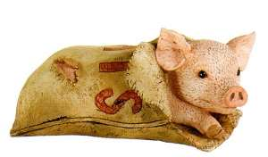
Cloud Computing Promise
Paradigm Shift or a pig in a poke?
Can we save real money?
http://thechamberlainfiles.wordpress.com/2012/03/26/
dont-elect-a-pig-in-a-poke-guest-post-by-cllr-michael-wilkes/

Slide 3
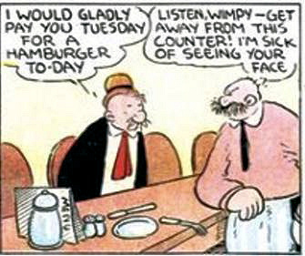
Cloud Computing Paradigm
Is virtualization the answer?
Will massive outlays provide promised rewards?
http://www.comicsreporter.com/index.php/
index/the_greatest_comic_character_of_all_time/

Slide 4
Economies of scale
http://www.jboats.com/intro.htm
http://www.worldslargestship.com/TripleE/

Slide 5
Netflix
Spent one year “reinventing” their application
Elastic compute Cloud
Elastic Block Storage
Simple Queuing Service
SimpleDB
Simple Storage Service
Elastic Load Balancing
Elastic MapReduce
Necessary for:
- Reliability
- Achieve benefit of scale
Result:
- Ability to compete
more effectively

Slide 6
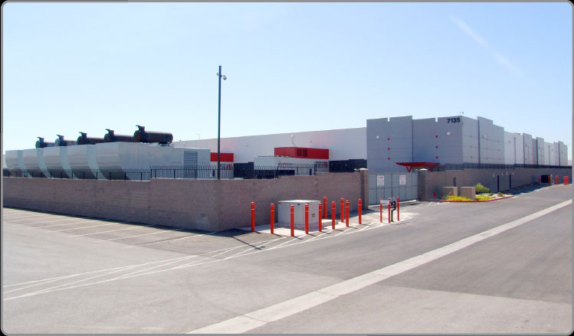
Security?
Common complaint
Cloud Providers have significantly more security
Better tools
better facilities
Better training
Better auditing
http://www.switchnap.com/pages/all-things-switch/tier-elite/security.php

Slide 7
What are the new Paradigms
Example: Storage
Why buy storage
Hire administrators
Deal with the “issues”
Backup, Archive, Logs, Content, Files, Reports Records could be in the cloud

Slide 8
What is next?
Application version++ will be in the cloud
Significantly reduced IT resources
IT efficiency will be a strategic requirement
Broadcasting?
There’s an app for that!

Slide 9
Who is Huawei
Huawei sells storage systems to public clouds
Huawei sells storage systems to customers that want private cloud scale storage

