Slide 1

4.16.2012
Cloud as a Flexible & Collaborative Tool for Creators
Cloud Computing Conference - NAB 2012
Jean-Luc Chatelain
Vice President, Office of Strategy and Technology

Slide 2

Cloud | The New Black
The Cloud is “cloudy”
Apparent & intuitive benefits
Vendor “cloud buzz”
Not all the experts agree
Should your business
be in the cloud?
“What is it [cloud]? It's complete gibberish. It's insane.”
– Larry Ellison, Oracle CEO
“Common, Location independent, Online, Utility, on Demand.”
– Joe Weinman, Cloudonomics

Slide 3

Cloud | The Good
Federated resources
Flex your needs as function of workload,
when in lumpy business
Avoid large CapEx that remains unused in downtime
Focus on creative process not on IT
Enable follow the sun creative process
for distributed teams
Lower TCO
No Limits
No Worries

Slide 4
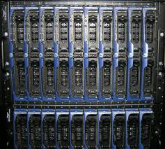
Cloud | Compute
No need for expensive workstations or licenses
Easy access to unlimited processing for intensive applications (Rendering, Transcoding, …)
Flexible amount of compute as requirements vary depending on type of creator and tools
Access to CPUs & GPUs

Slide 5

Cloud | Storage
Large file sizes
Unlimited capacity
Redundancy, fail-safe
Distributed, global
Local ingest and download
Collaborative
“Its not really the cost of computing,
it is the cost of delivering the results of your computing”
- Alistair Croll

Slide 6
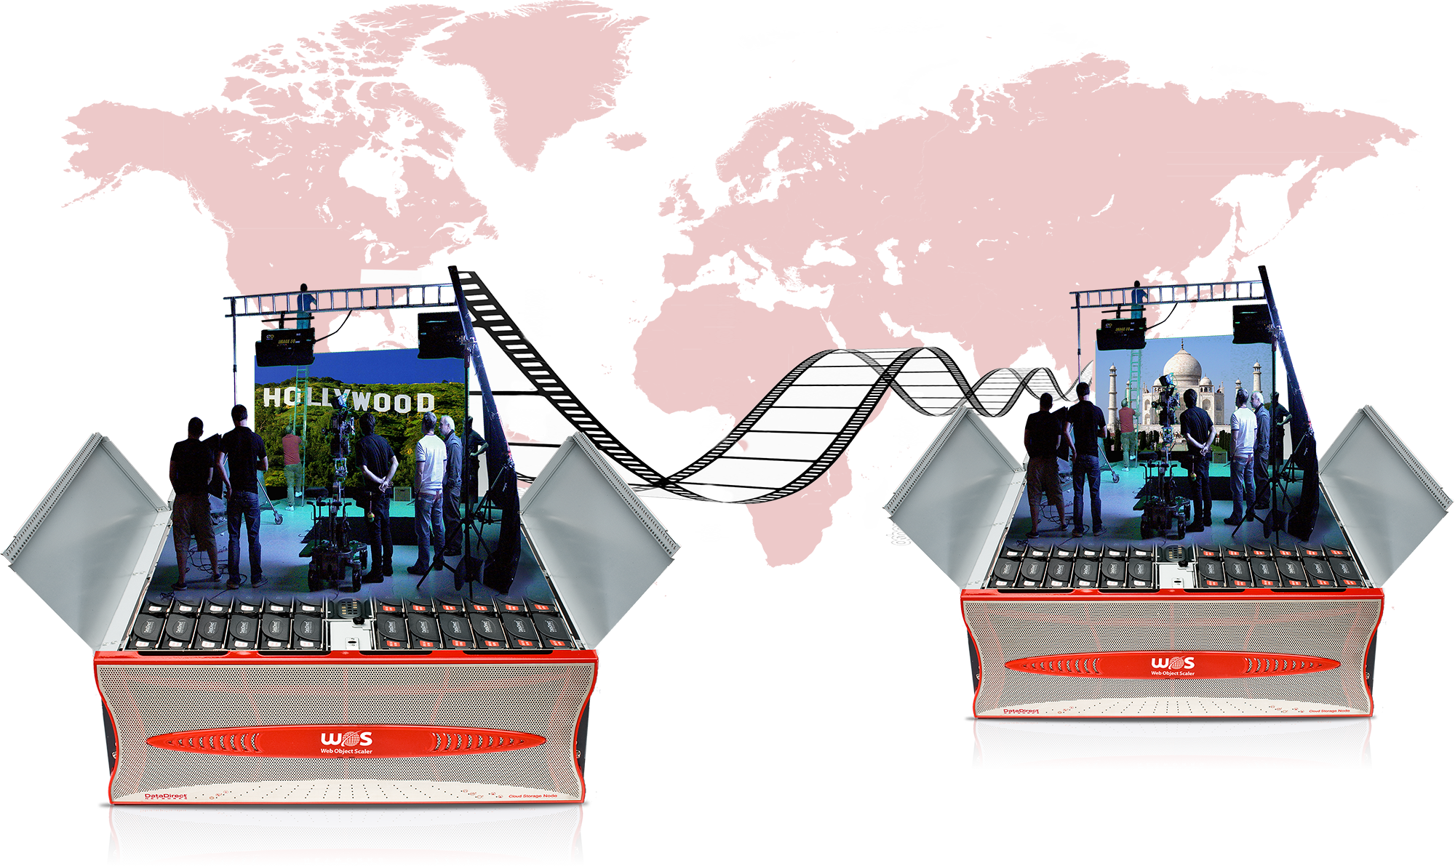
Cloud | Expanding on Collaboration
What does it mean for creative teams?
Increased interaction, availability, & creativity
Follow-the-sun
production
Shrinking world,
Globalization

Slide 7

Cloud | The Bad
Legal Concerns
SLAs, guarantees
Security
Last mile access…a powerful cloud is useless to the end user with a small pipe

Slide 8

Cloud | The Ugly
Implementation
Trust
Consumption
Scale
Interactivity

Slide 9
Cloud | Stakeholder Needs
Business
Creative
IT

Slide 10
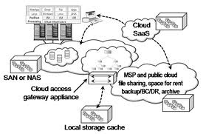
Cloud | Implementation
Metadata management
Resilience
Performance
Geo distribution
Easily & efficiently scaling, eventually to hyperscale

Slide 11
Cloud | Scale
A movie is not one object but millions of files - needs to scale to billions of files
Same footage is broadcast again & again by stations all over the world
More capabilities = more storage
Larger file sizes
2K, 4K… 5K, 8K
SD, HD… 3D, Ultra HD
24fps… 48fps, 60fps

Slide 12
Cloud | Keeping the Creativity Flowing
Agile & intuitive
Creative people are "special"
Productivity that still "feels creative"
Efficiency vs. creativity
1 frame can make or break the whole workflow or project
Many editors & animators know what a RAID array is…
Should they?
Should they?

Slide 13

The Future of the Creative Cloud
New storage technologies
Private Clouds
Community Clouds
A new business model for creators

Slide 14
Cloud | Is not about technology
It is about . . .
Taking an overnight 12hr rendering process & making it real-time
Results delivered 1 week earlier at no additional cost
Finding a forgotten back-up copy that saves the project
More optimized file formats in the same amount of time
Collaboration across great distances that can still ignite wonderful sparks of creativity
Working deeply in technology, yet feeling like an artist or a journalist or a broadcaster

Slide 15


Cloud | Should we be in it?
“IFR flight depends upon flying by
reference to instruments only” - FAA
Should your business
be in the cloud?
We absolutely can operate in the cloud,
as long as we have the right instruments.

Slide 16
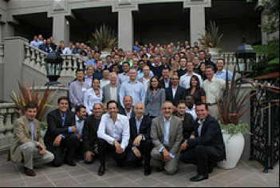
A Word from Our Sponsor

Slide 17
DDN | The Global Big Data Leader
We deliver highly scalable & highly efficient storage solution
Specializing in the most content intensive environments
Over 600 Media and Entertainment customers
Cloud storage experts in scale and performance
Leaders storage workflow optimization for over 10 years
Learn more at booth #SL 6611

Slide 18
Thank You Q & A

