Slide 1
How the cloud is transforming
production as we know it
Notes:
Mark Davis
William Morris Agency
Founder, Fresh Baked Studios
CEO, Scenios
Jeff Wurtz
Producer, director, editor
Inside The Actor’s Studio
5 Emmys for editing
Chief Evangelist, Scenios

Slide 2
Mark Davis
William Morris Endeavor
Fresh Baked Studios
CEO, Scenios

Slide 3
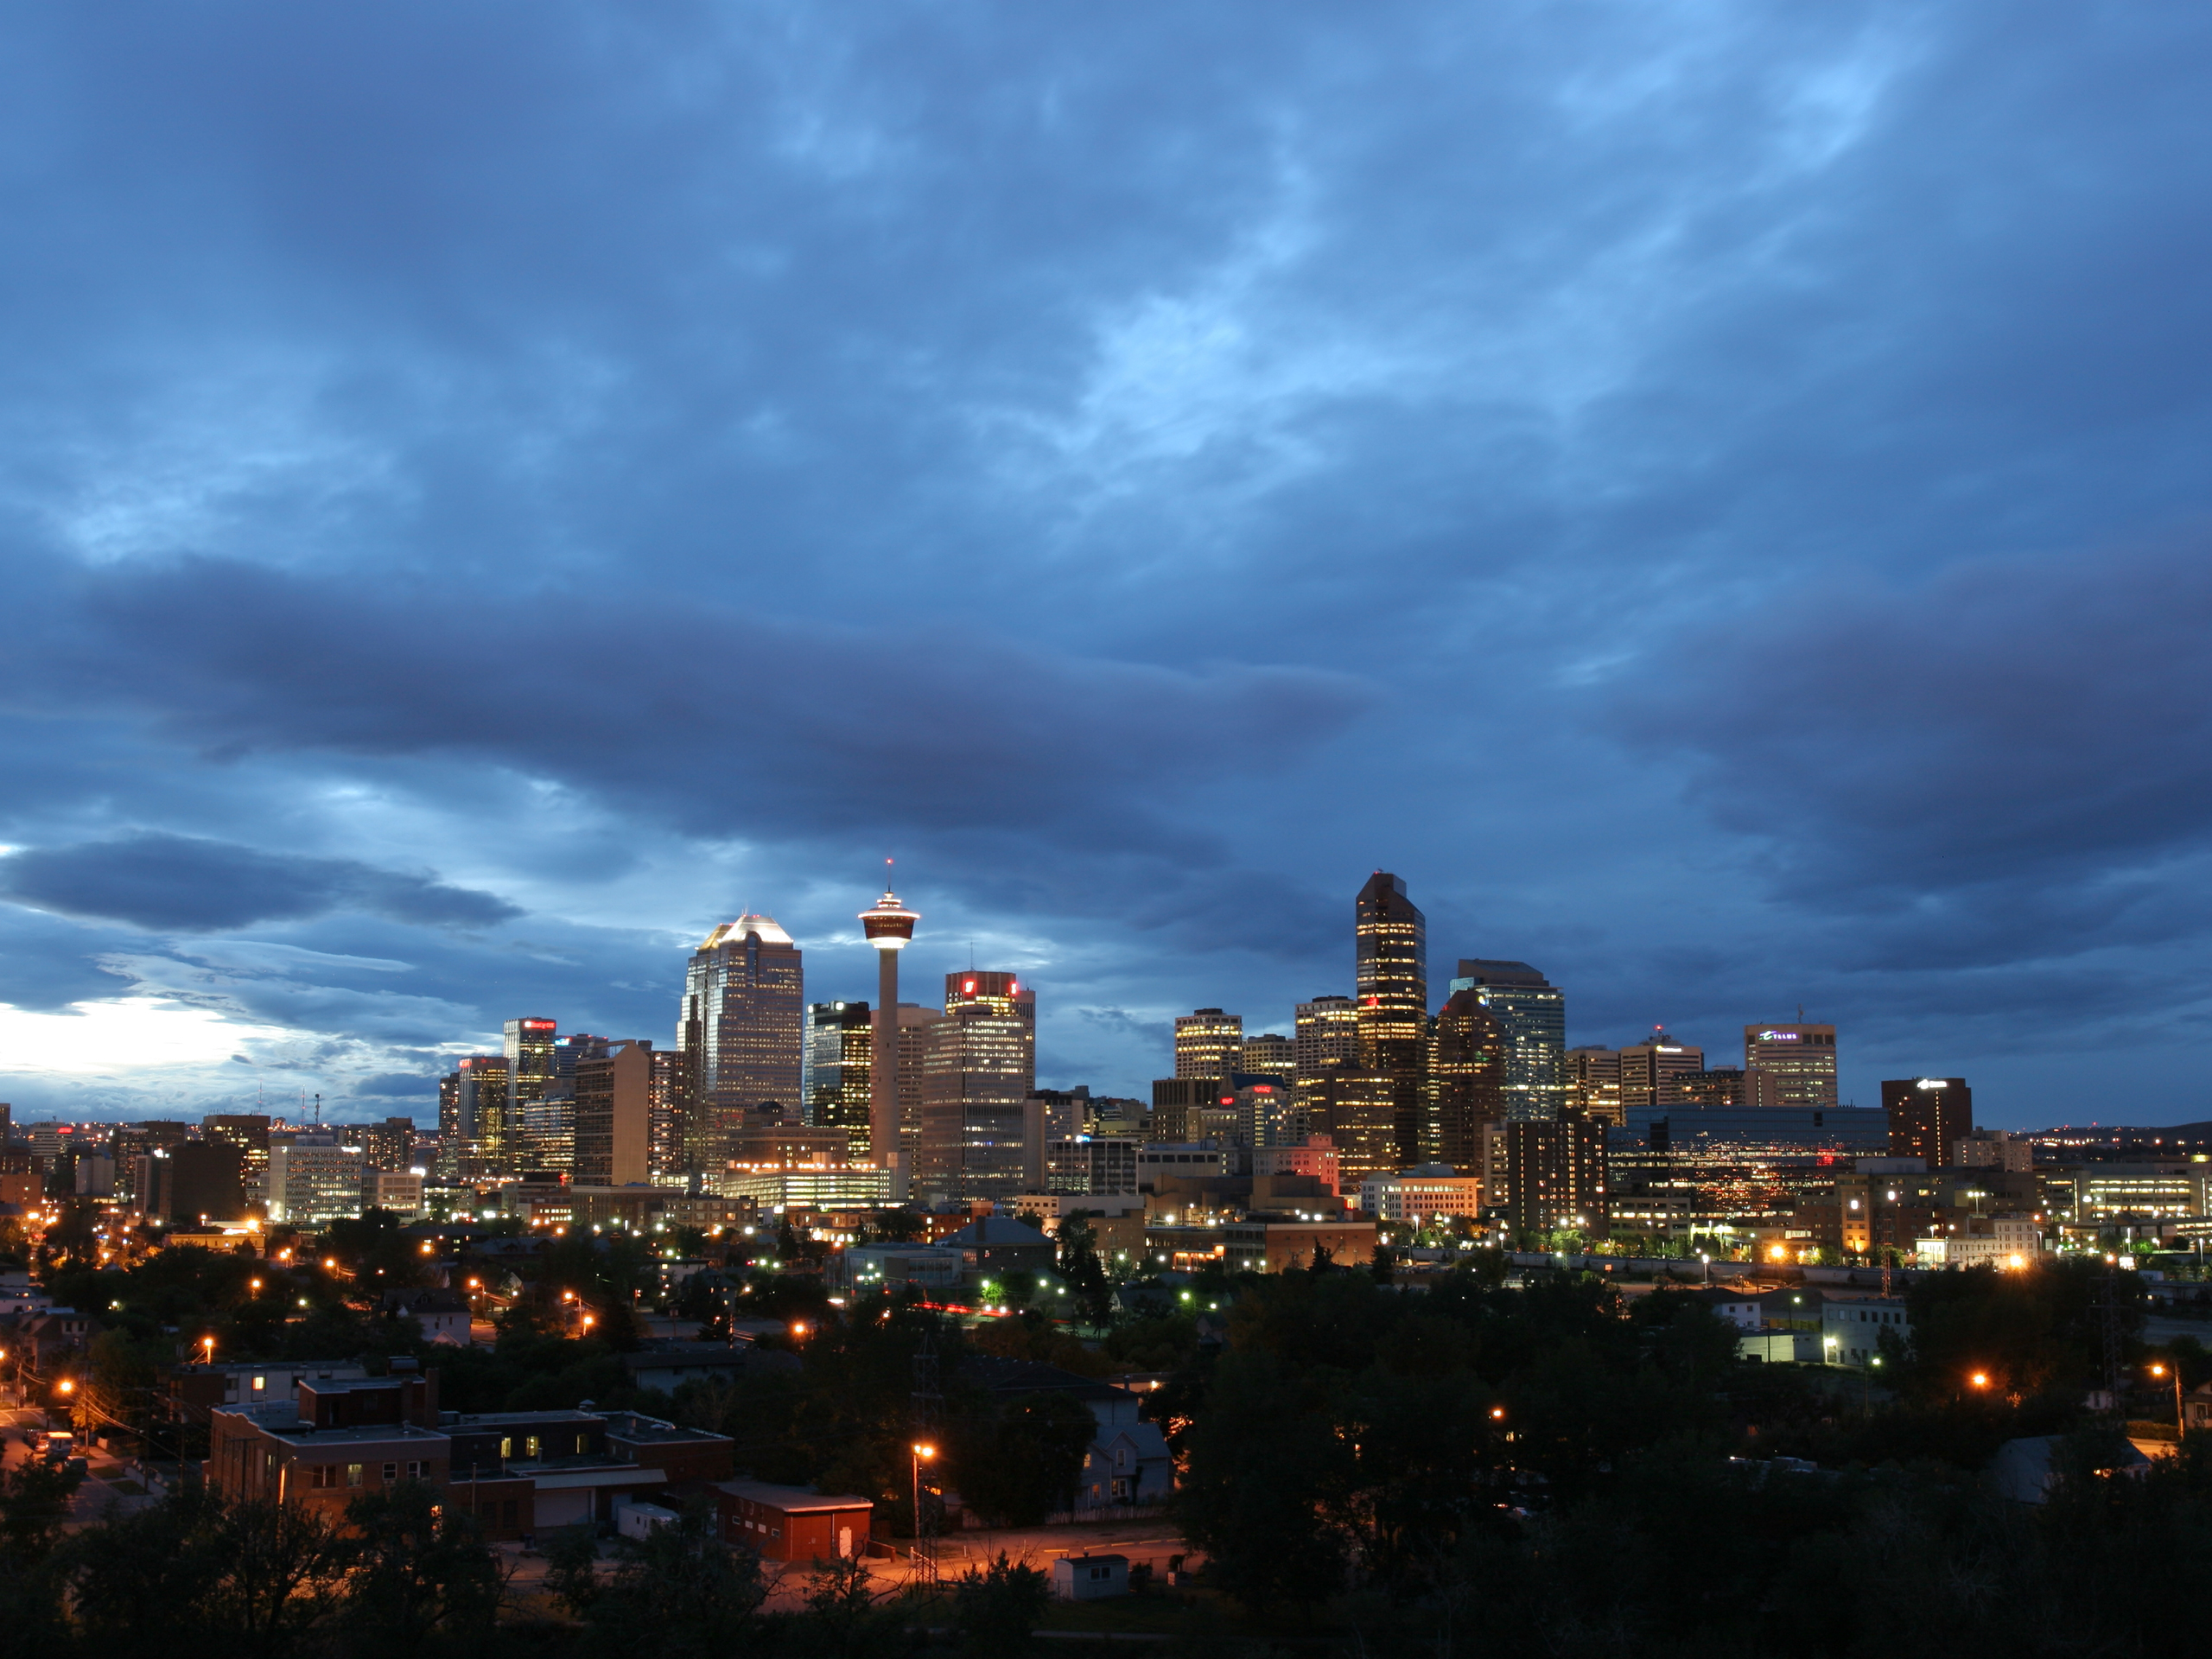
What is the cloud?

Slide 5
The use of web services to perform the functions that were traditionally done with software installed on an individual computer, or on a server

Slide 6
A new generation of Internet-based computing, where applications are provided to computers and other devices on-demand, like electricity.

Slide 7
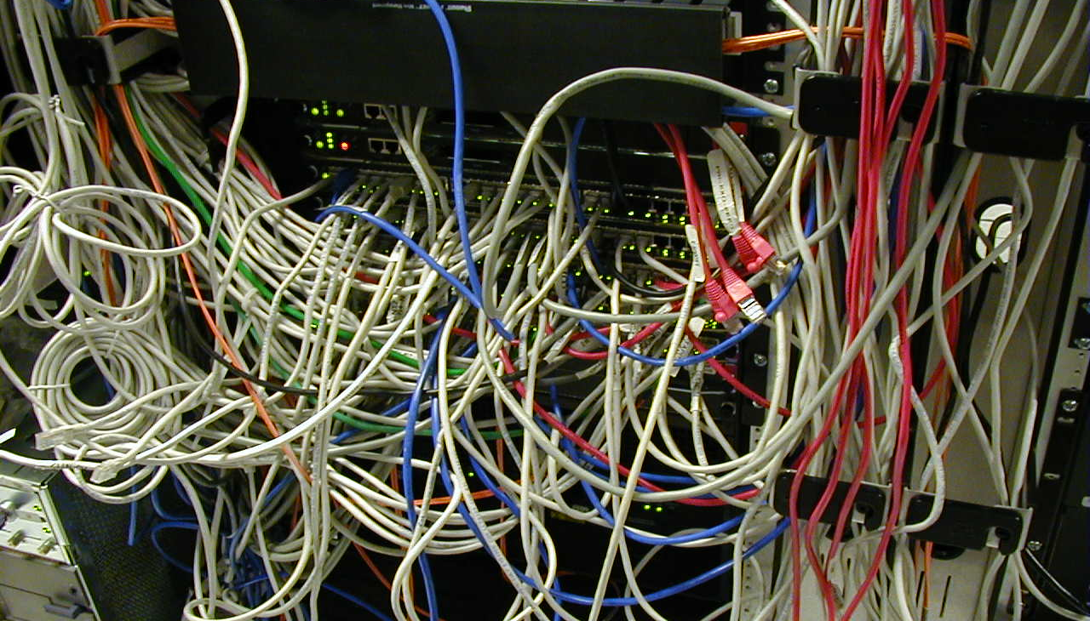
Notes:
The old way…servers, lots of old hardward and sofrware

Slide 8
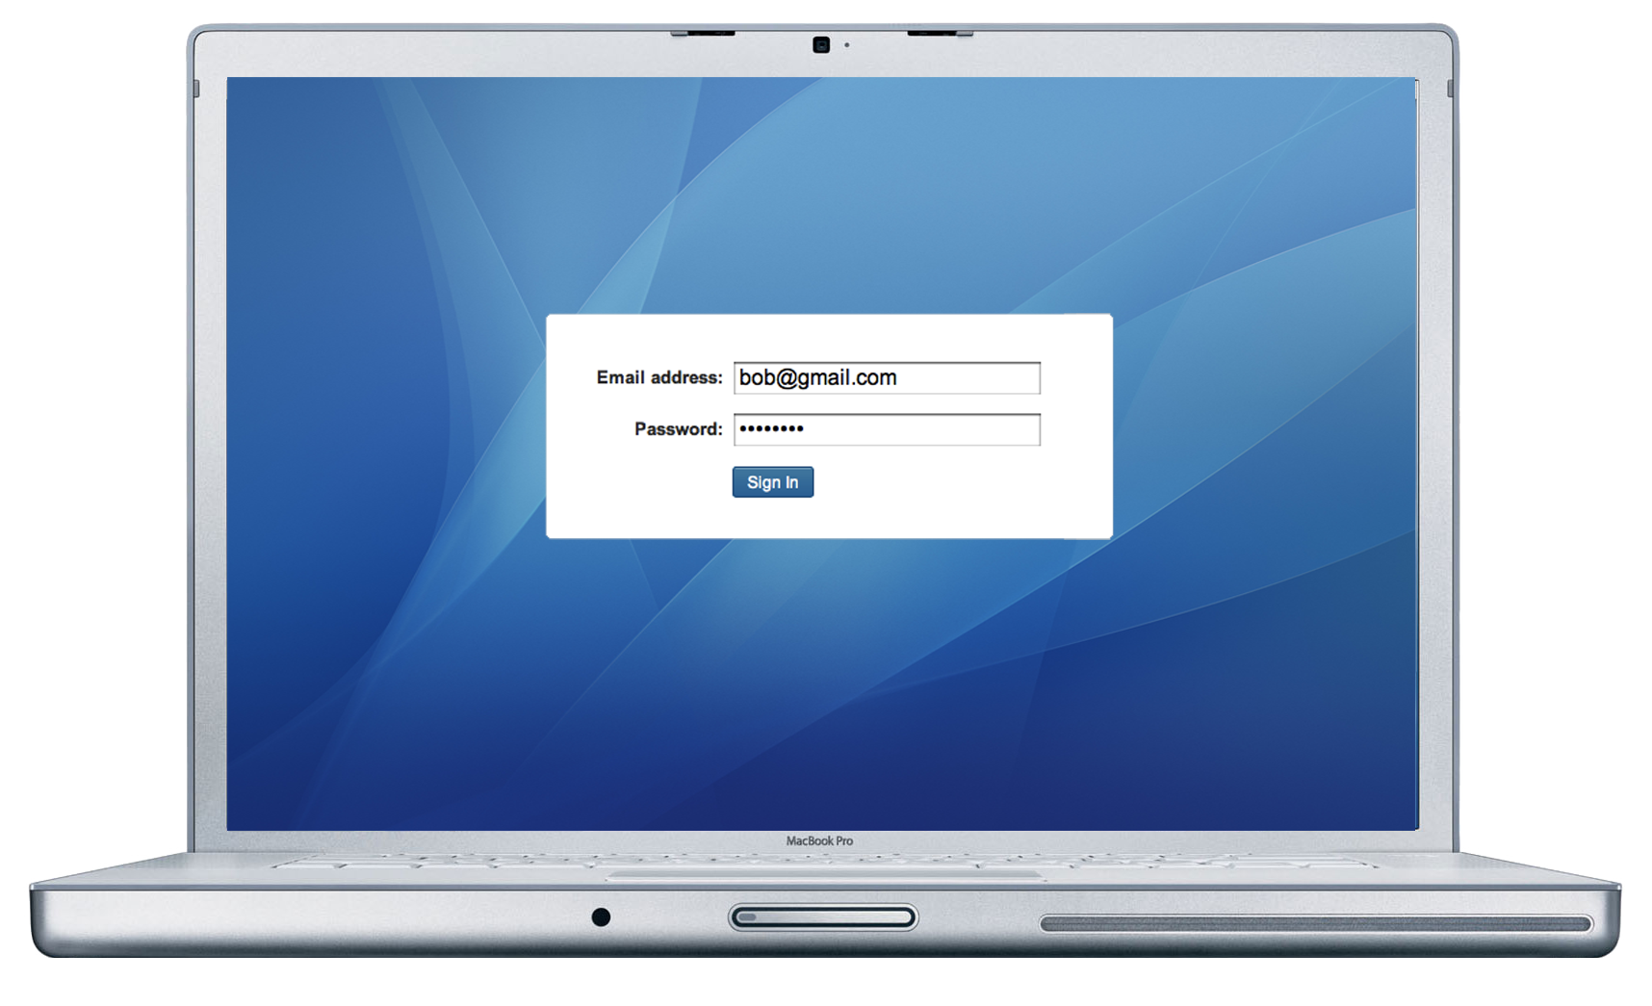
Notes:
New way (2009+): go to a cloud provider and buy software as a service

Slide 9
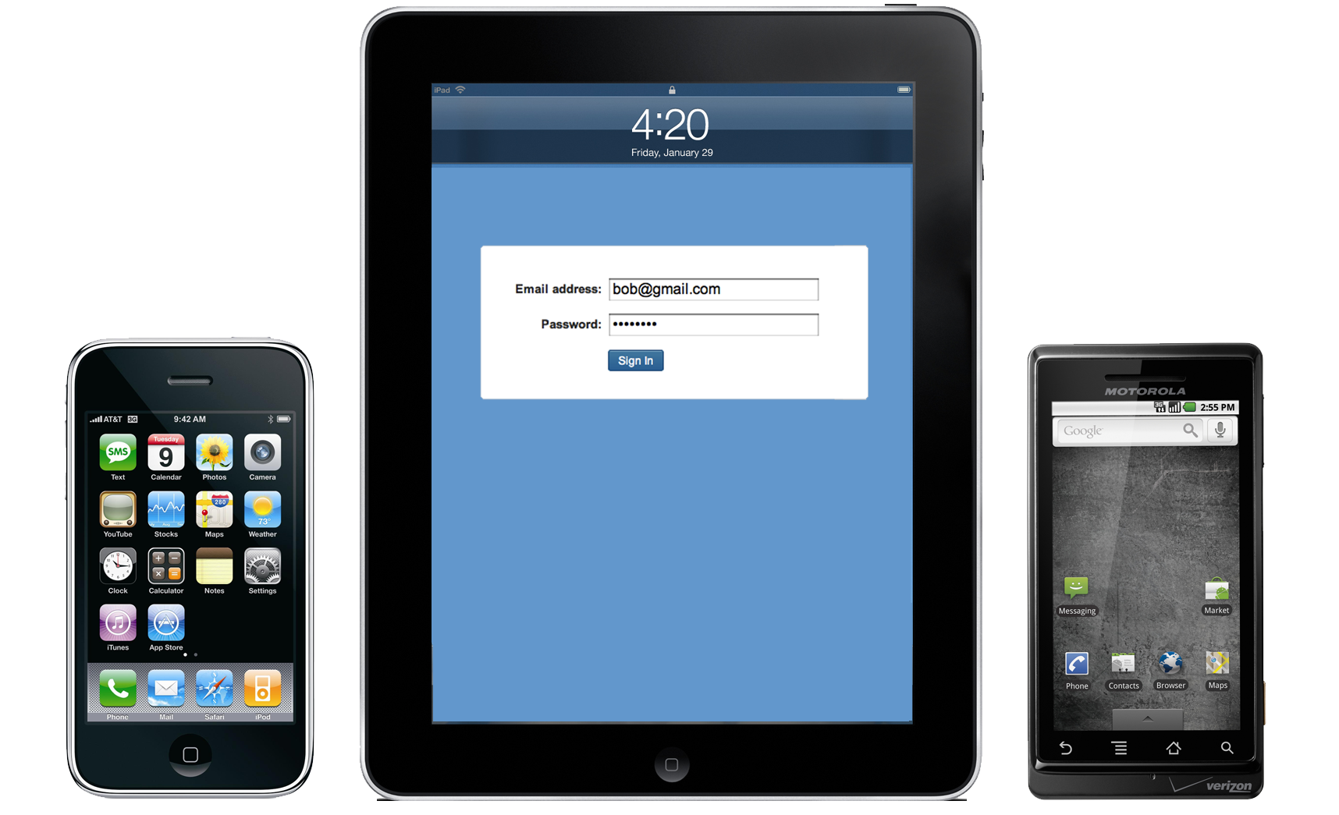

Slide 10
Big deal?

Slide 11
2010
$20 B
2014
$55 B
Notes:
Worldwide revenue from public IT cloud services exceeded $16 billion in 2009 and is forecast to reach $55.5 billion in 2014, representing a compound annual growth rate (CAGR) of 27.4%, a newly published International Data Corporation (IDC) document finds. This rapid growth rate is over five times the projected rate of growth for traditional IT products (5%). This research further illustrates that public IT cloud services are crossing the chasm with modest revenue, but very fast growth.
Corporate cloud computing is expected to grow rapidly, by more than 25 percent a year, to $55.5 billion by 2014, IDC estimates.

Slide 12
Fastest growing industries
 |  | Revenue (billions) | Annual growth rate
 |  | 2010 | 2011-2014
1 | Cloud computing | 20 | 25.0%
2 | Voice over IP | 12 | 17.4%
3 | Wind power | 3 | 11.2%
4 | E-commerce | 95 | 9.4%
5 | Environmental consulting | 18 | 9.4%
6 | Biotech | 86 | 9.6%
7 | Video games | 38 | 8.3%
8 | Solar power | 1 | 7.9%
9 | Insurance claims adjusters | 57 | 7.7%
10 | Correctional facilities | 34 | 7.5%
Source: IDC, Ibis
Notes:
Worldwide revenue from public IT cloud services exceeded $16 billion in 2009 and is forecast to reach $55.5 billion in 2014, representing a compound annual growth rate (CAGR) of 27.4%, a newly published International Data Corporation (IDC) document finds. This rapid growth rate is over five times the projected rate of growth for traditional IT products (5%). This research further illustrates that public IT cloud services are crossing the chasm with modest revenue, but very fast growth.
Corporate cloud computing is expected to grow rapidly, by more than 25 percent a year, to $55.5 billion by 2014, IDC estimates.

Slide 13
Fastest growing industries
 |  | Revenue (billions) | Annual growth rate
 |  | 2010 | 2011-2014
1 | Cloud computing | 20 | 25.0%
2 | Voice over IP | 12 | 17.4%
3 | Wind power | 3 | 11.2%
4 | E-commerce | 95 | 9.4%
5 | Environmental consulting | 18 | 9.4%
6 | Biotech | 86 | 9.6%
7 | Video games | 38 | 8.3%
8 | Solar power | 1 | 7.9%
9 | Insurance claims adjusters | 57 | 7.7%
10 | Correctional facilities | 34 | 7.5%
Source: IDC, Ibis
Notes:
Worldwide revenue from public IT cloud services exceeded $16 billion in 2009 and is forecast to reach $55.5 billion in 2014, representing a compound annual growth rate (CAGR) of 27.4%, a newly published International Data Corporation (IDC) document finds. This rapid growth rate is over five times the projected rate of growth for traditional IT products (5%). This research further illustrates that public IT cloud services are crossing the chasm with modest revenue, but very fast growth.
Corporate cloud computing is expected to grow rapidly, by more than 25 percent a year, to $55.5 billion by 2014, IDC estimates.

Slide 14
Why is the cloud
happening now?
Notes:
The economy has people looking at things they’ve never looked at before (do I really need
To spend money, or should I reduce cost wherever possible)
Reduce risk via SLA’s (before if it went down it’s my cost; now with SLA’s the risk is
Moved to the provider)
High volumes from providers means economies of scale (e.g. microsoft buys computers
One semitruck = 2000 computers with 4-5 processors each, scale drives cost down)..but with technologies today all of us with an internet connection can benefit from these economies of scale
There are now big data centers in (name cities) and what’s going to happen is these will absorb the IT departments from many companies…plus they have best practices built right in (how to back it up, make sure it’s up all the time)

Slide 15
Why is the cloud
happening now?
Virtualization
Notes:
The economy has people looking at things they’ve never looked at before (do I really need
To spend money, or should I reduce cost wherever possible)
Reduce risk via SLA’s (before if it went down it’s my cost; now with SLA’s the risk is
Moved to the provider)
High volumes from providers means economies of scale (e.g. microsoft buys computers
One semitruck = 2000 computers with 4-5 processors each, scale drives cost down)..but with technologies today all of us with an internet connection can benefit from these economies of scale
There are now big data centers in (name cities) and what’s going to happen is these will absorb the IT departments from many companies…plus they have best practices built right in (how to back it up, make sure it’s up all the time)

Slide 17
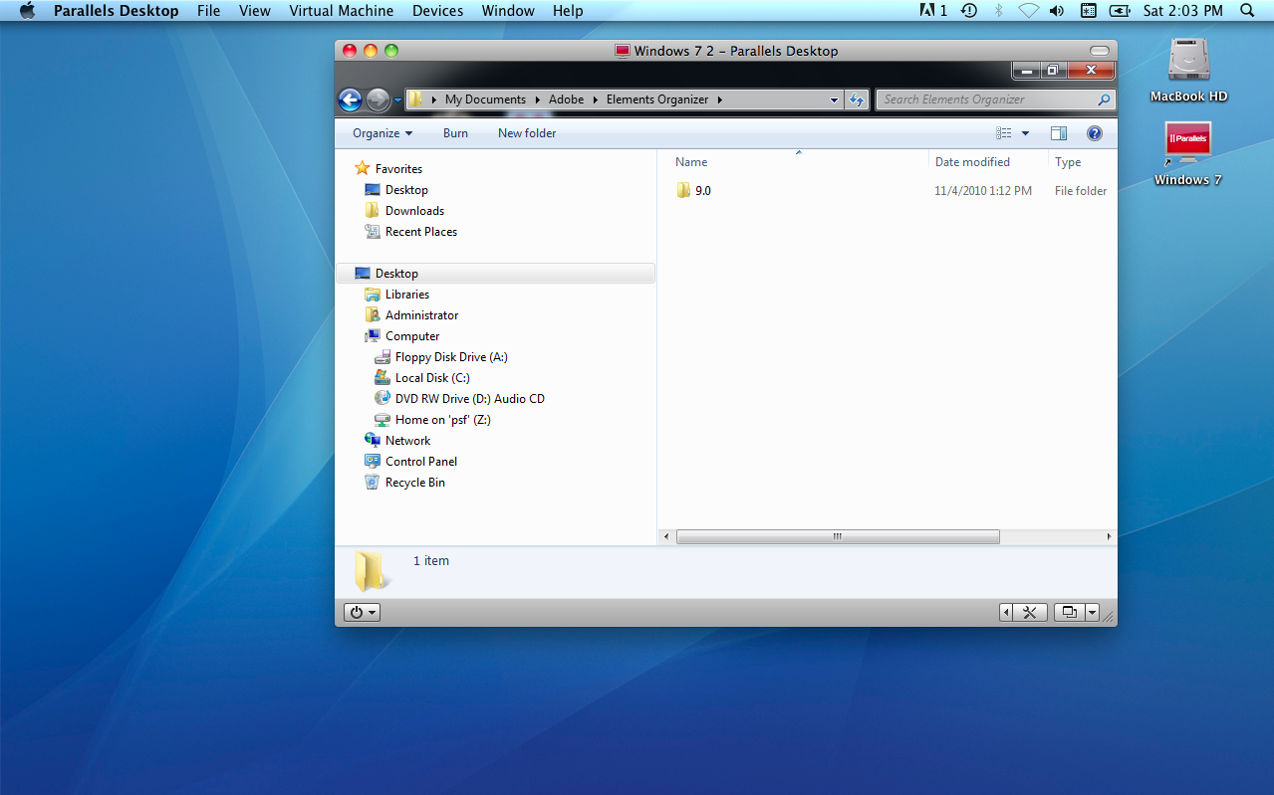

Slide 18
Why is the cloud
happening now?
Virtualization
Broadband
Optimum Online Ultra 101 Mbps down / 15 up
150 down / 35 up
Notes:
The economy has people looking at things they’ve never looked at before (do I really need
To spend money, or should I reduce cost wherever possible)
Reduce risk via SLA’s (before if it went down it’s my cost; now with SLA’s the risk is
Moved to the provider)
High volumes from providers means economies of scale (e.g. microsoft buys computers
One semitruck = 2000 computers with 4-5 processors each, scale drives cost down)..but with technologies today all of us with an internet connection can benefit from these economies of scale
There are now big data centers in (name cities) and what’s going to happen is these will absorb the IT departments from many companies…plus they have best practices built right in (how to back it up, make sure it’s up all the time)

Slide 19
Virtualization
Broadband
150 down / 35 up
1 GB
4 min
10 GB
40 min
30 GB
114 min
Notes:
The economy has people looking at things they’ve never looked at before (do I really need
To spend money, or should I reduce cost wherever possible)
Reduce risk via SLA’s (before if it went down it’s my cost; now with SLA’s the risk is
Moved to the provider)
High volumes from providers means economies of scale (e.g. microsoft buys computers
One semitruck = 2000 computers with 4-5 processors each, scale drives cost down)..but with technologies today all of us with an internet connection can benefit from these economies of scale
There are now big data centers in (name cities) and what’s going to happen is these will absorb the IT departments from many companies…plus they have best practices built right in (how to back it up, make sure it’s up all the time)

Slide 20
Why is the cloud
happening now?
The economy
Virtualization
Broadband
Cheaper
Faster
Pay as you go = no contract
Variable cost
Notes:
The economy has people looking at things they’ve never looked at before (do I really need
CHEAPER
High volumes from providers means economies of scale (e.g. microsoft buys computers
One semitruck = 2000 computers with 4-5 processors each, scale drives cost down)..but with technologies today all of us with an internet connection can benefit from these economies of scale
FASTER
Fast to deploy…easy and cheap experimentation
PAY AS YOU GO
No conract
LESS RISK
To spend money, or should I reduce cost wherever possible)
----
It’s these three factors…virtualization, broadband and the economy – that is really driving the huge growth of this market
Who are the players: apps vs infrastructure (amazon and rackspace each have about 49% market share)

Slide 21
Film and TV production in the cloud

Slide 22
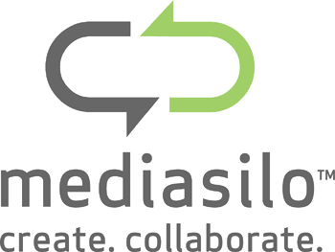
Shared Calendar
File Sharing
Production Elements
Video Collaboration
Email
Production management
Notes:
What are the options for cloud computing in our industry?

Slide 23
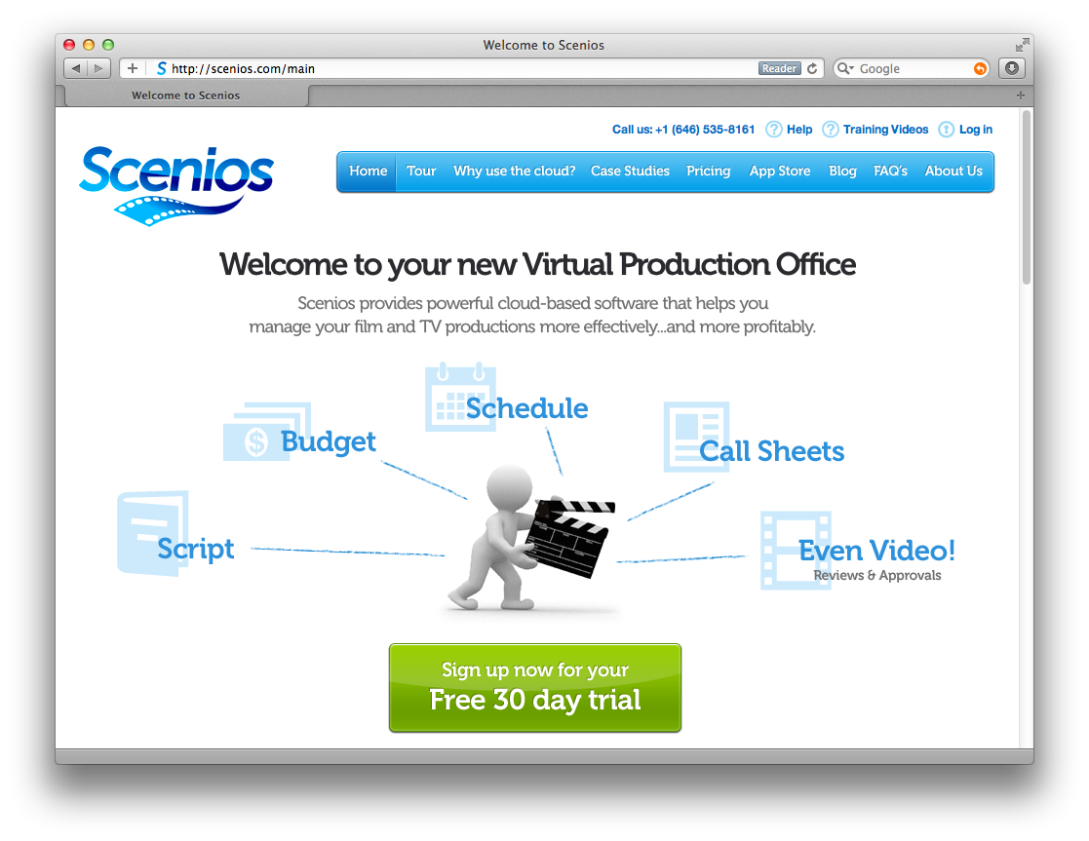
Notes:
Mark gives 15 minute demo

Slide 24
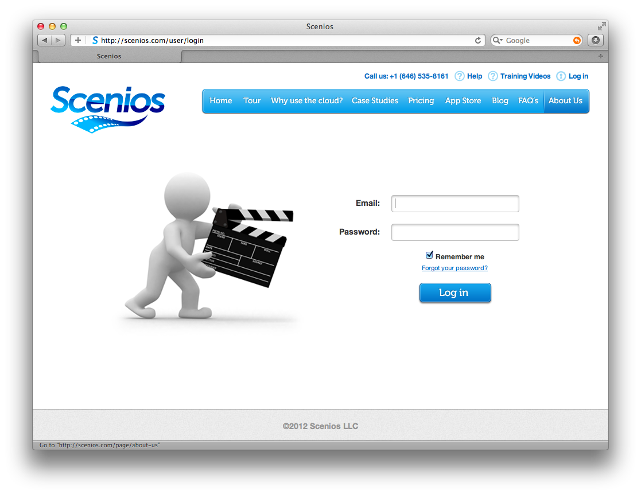
Notes:
Mark gives 15 minute demo

Slide 25
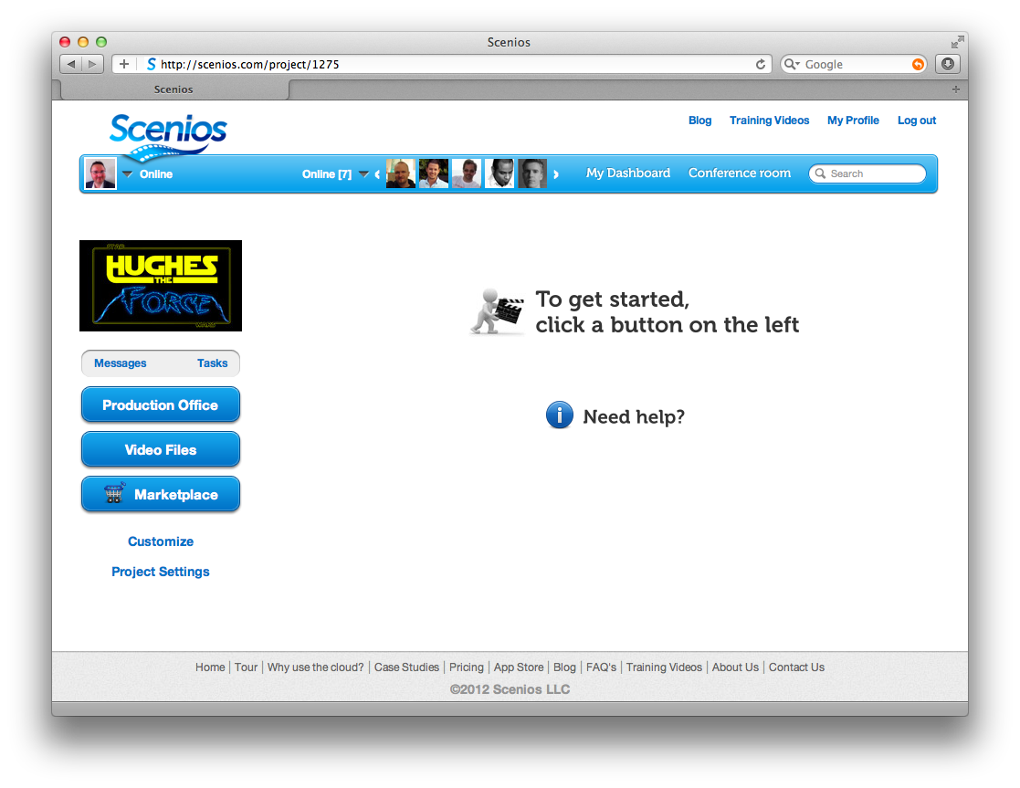
Notes:
Mark gives 15 minute demo

Slide 26
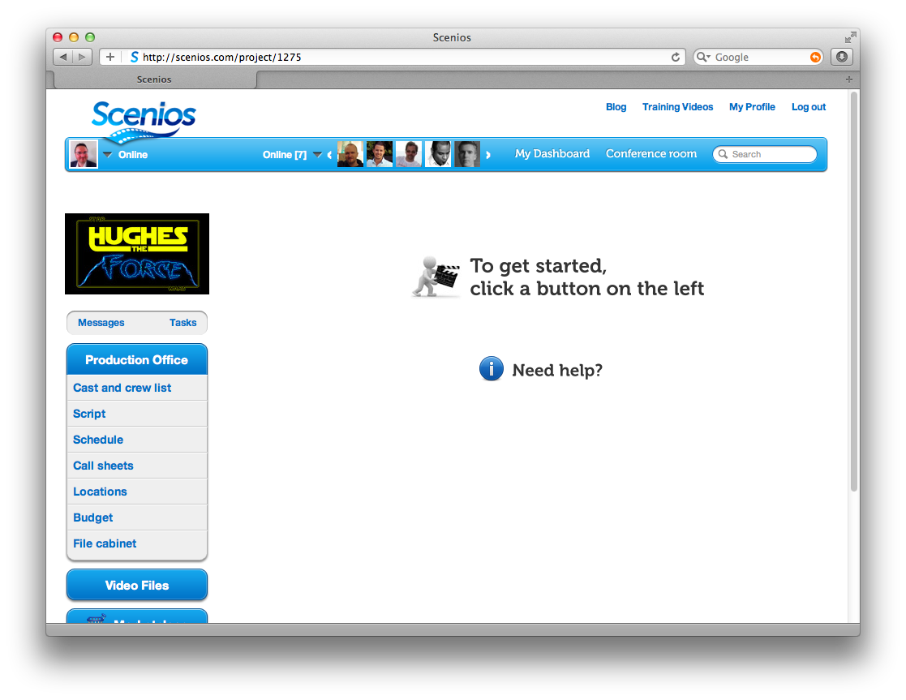
Notes:
Mark gives 15 minute demo

Slide 27
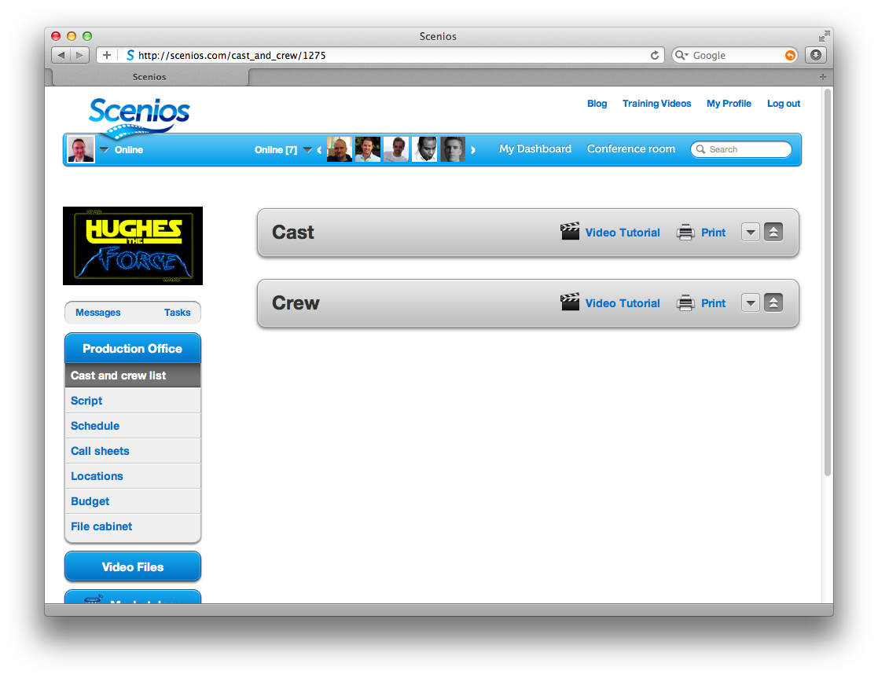
Notes:
Mark gives 15 minute demo

Slide 28
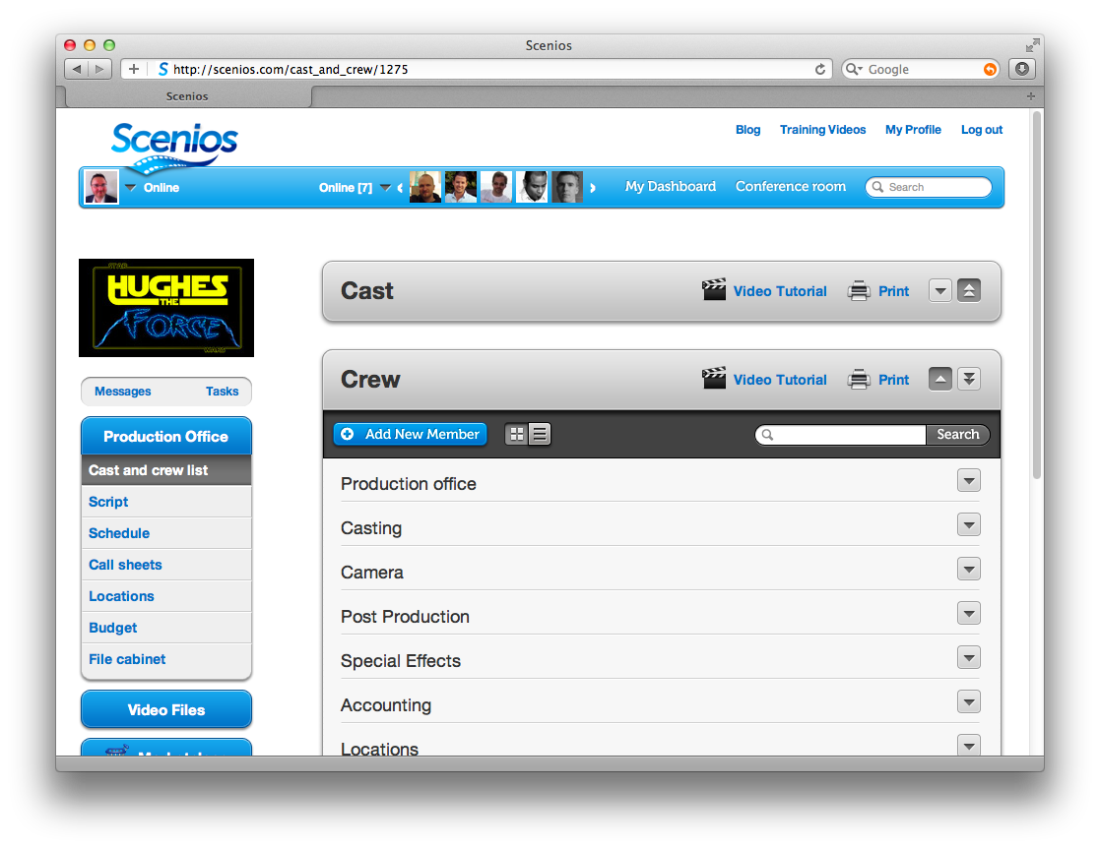
Notes:
Mark gives 15 minute demo

Slide 29
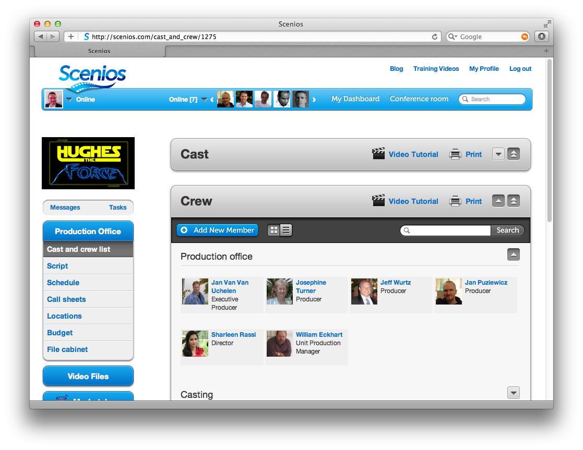
Notes:
Mark gives 15 minute demo

Slide 30
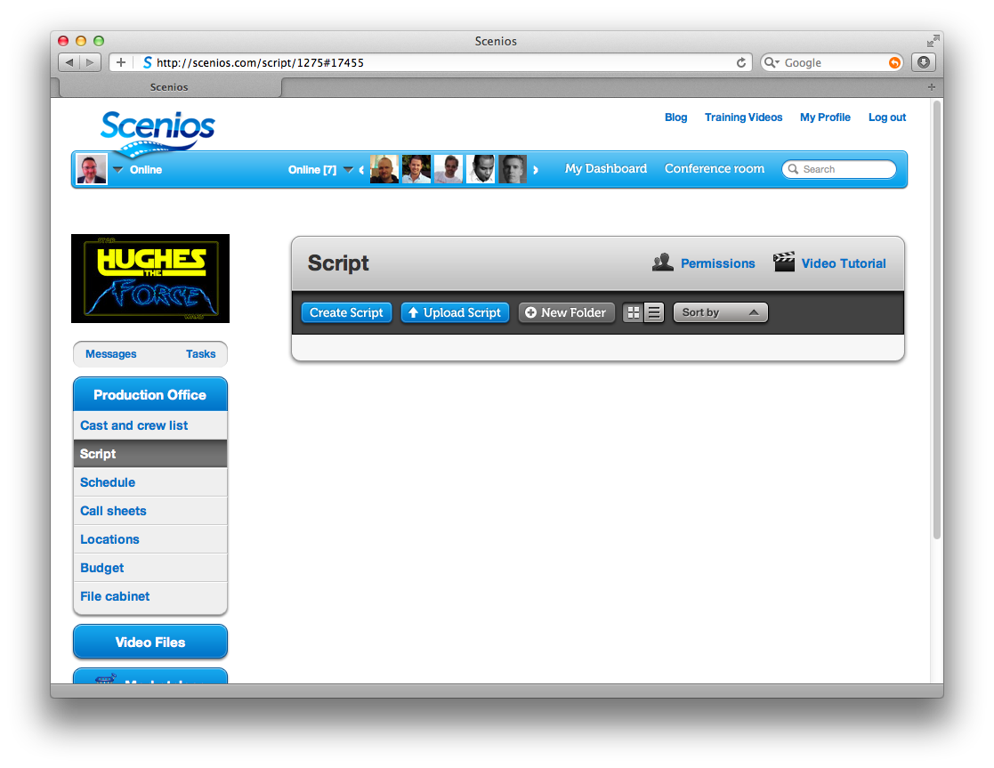
Notes:
Mark gives 15 minute demo

Slide 31
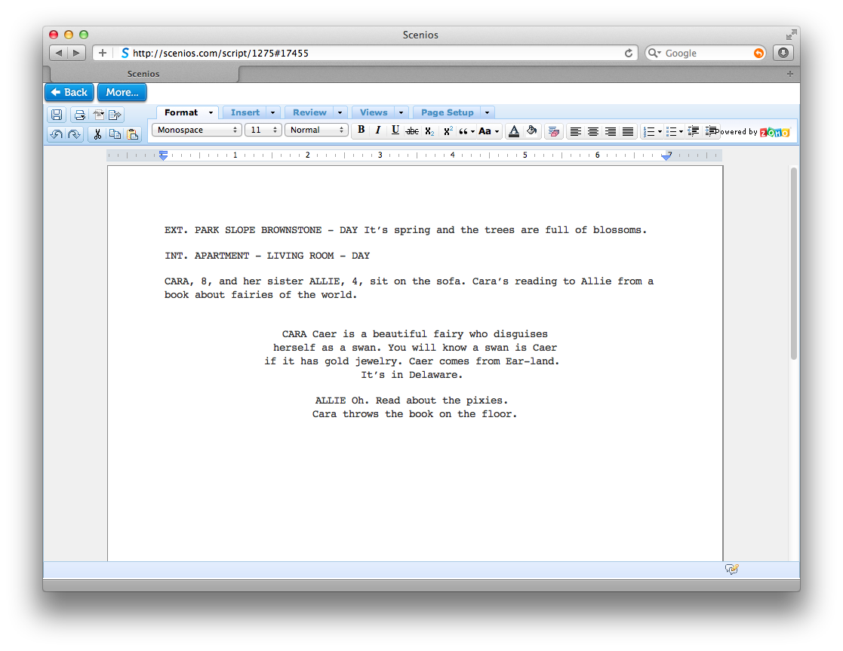
Notes:
Mark gives 15 minute demo

Slide 32
Notes:
Mark gives 15 minute demo

Slide 33
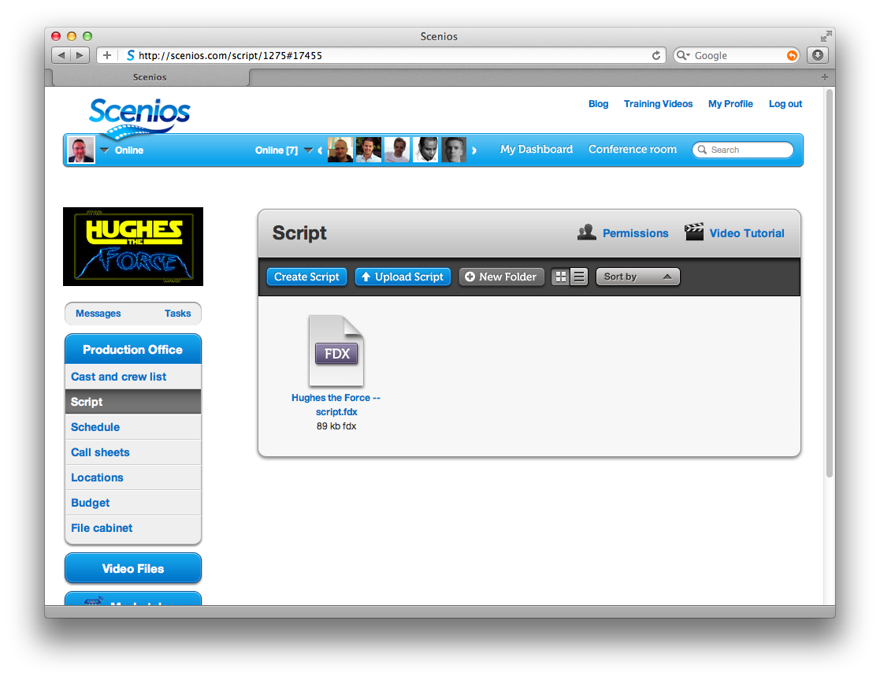
Notes:
Mark gives 15 minute demo

Slide 34
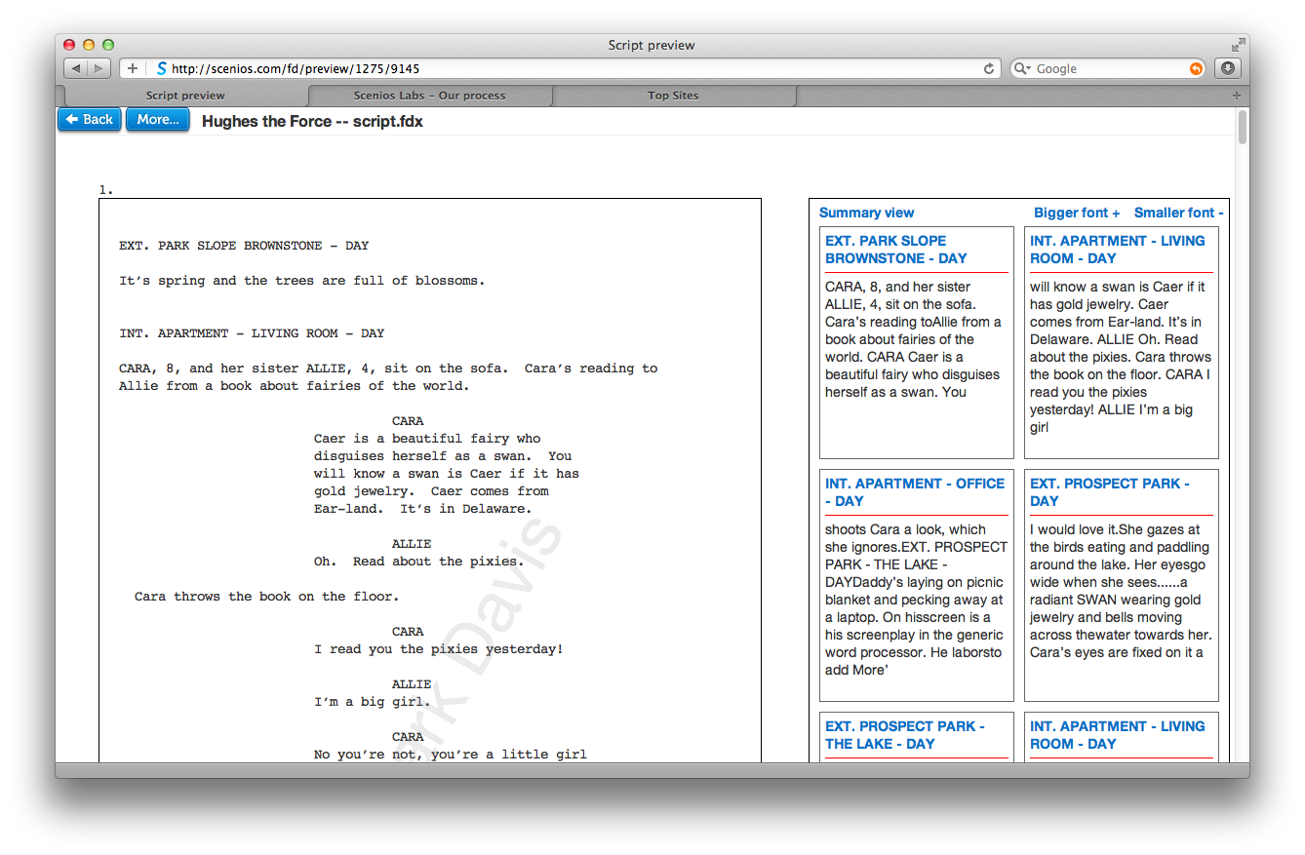
Notes:
Mark gives 15 minute demo

Slide 35
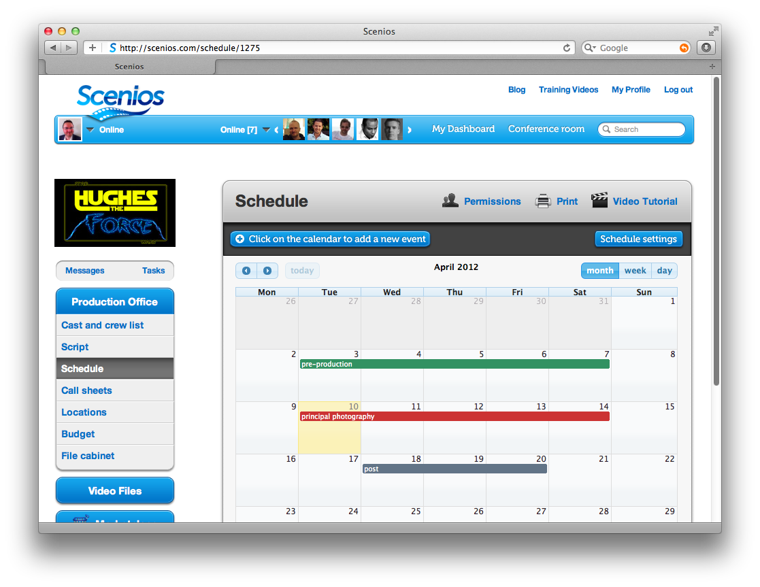
Notes:
Mark gives 15 minute demo

Slide 36
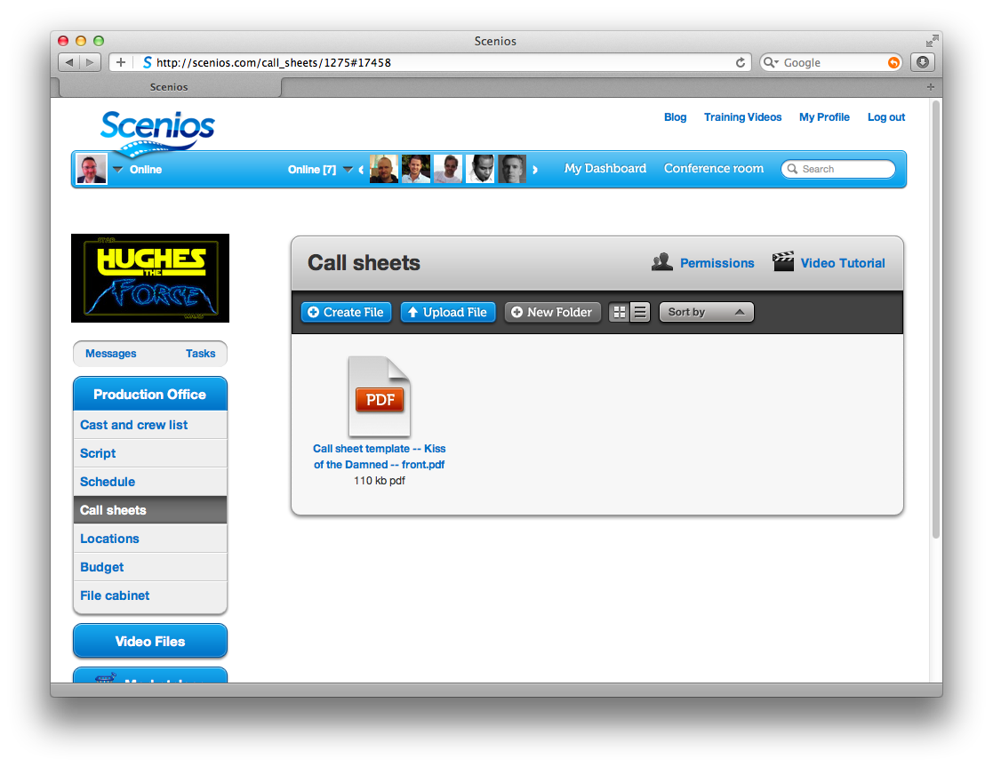
Notes:
Mark gives 15 minute demo

Slide 37
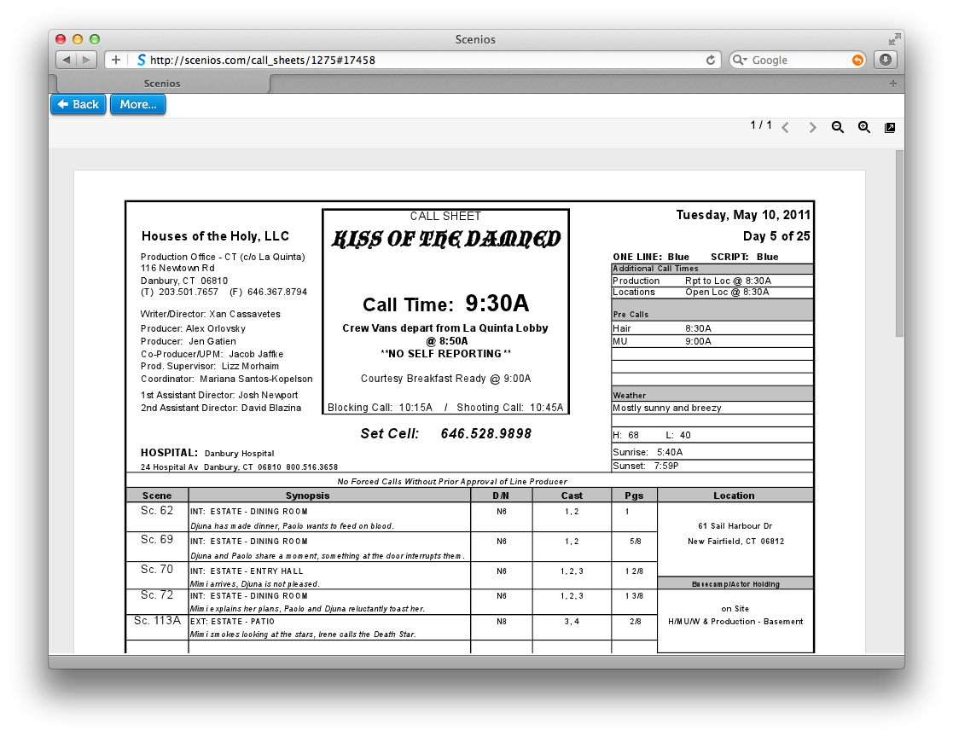
Notes:
Mark gives 15 minute demo

Slide 38
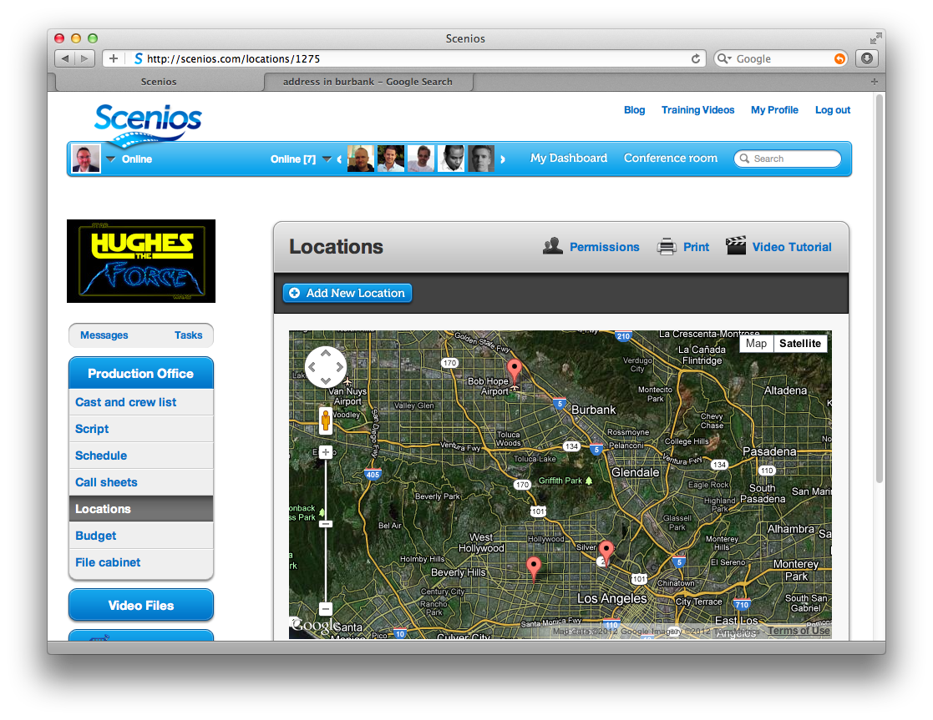
Notes:
Mark gives 15 minute demo

Slide 39
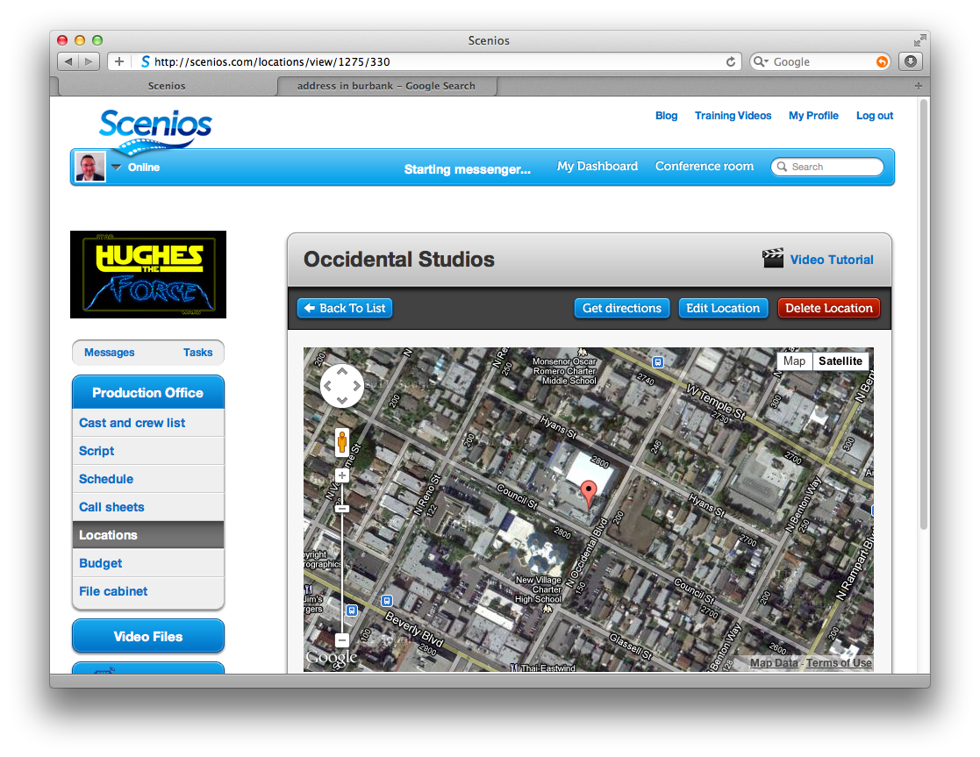
Notes:
Mark gives 15 minute demo

Slide 40
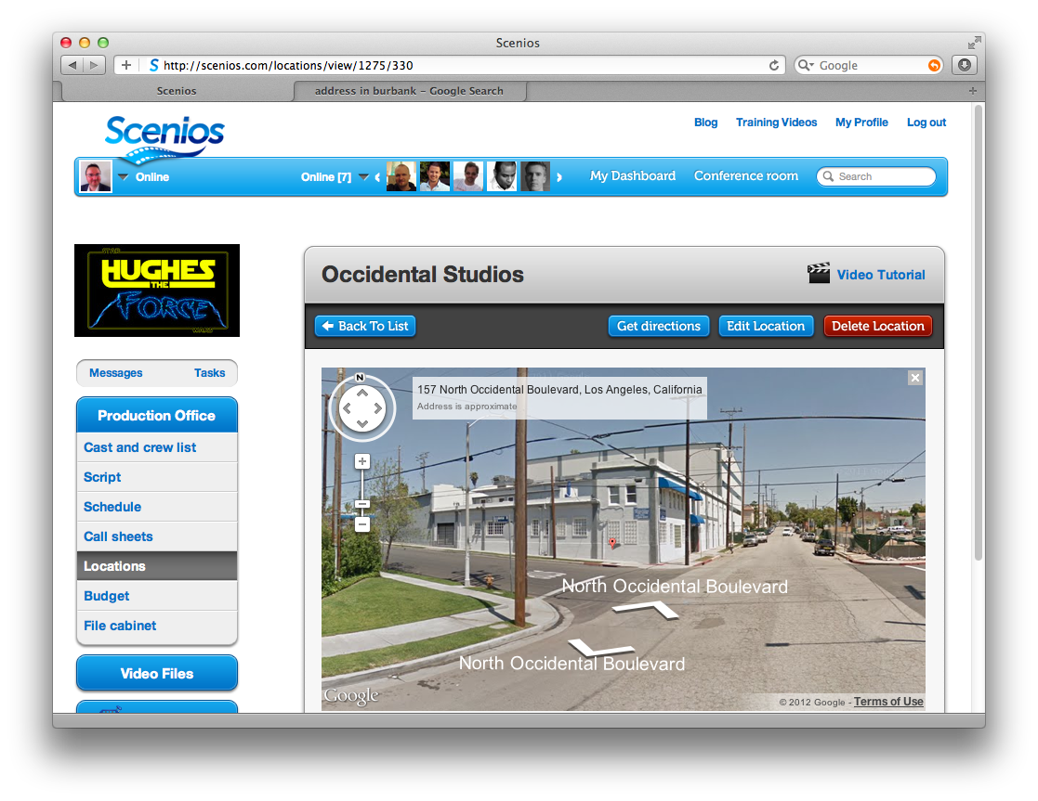
Notes:
Mark gives 15 minute demo

Slide 41
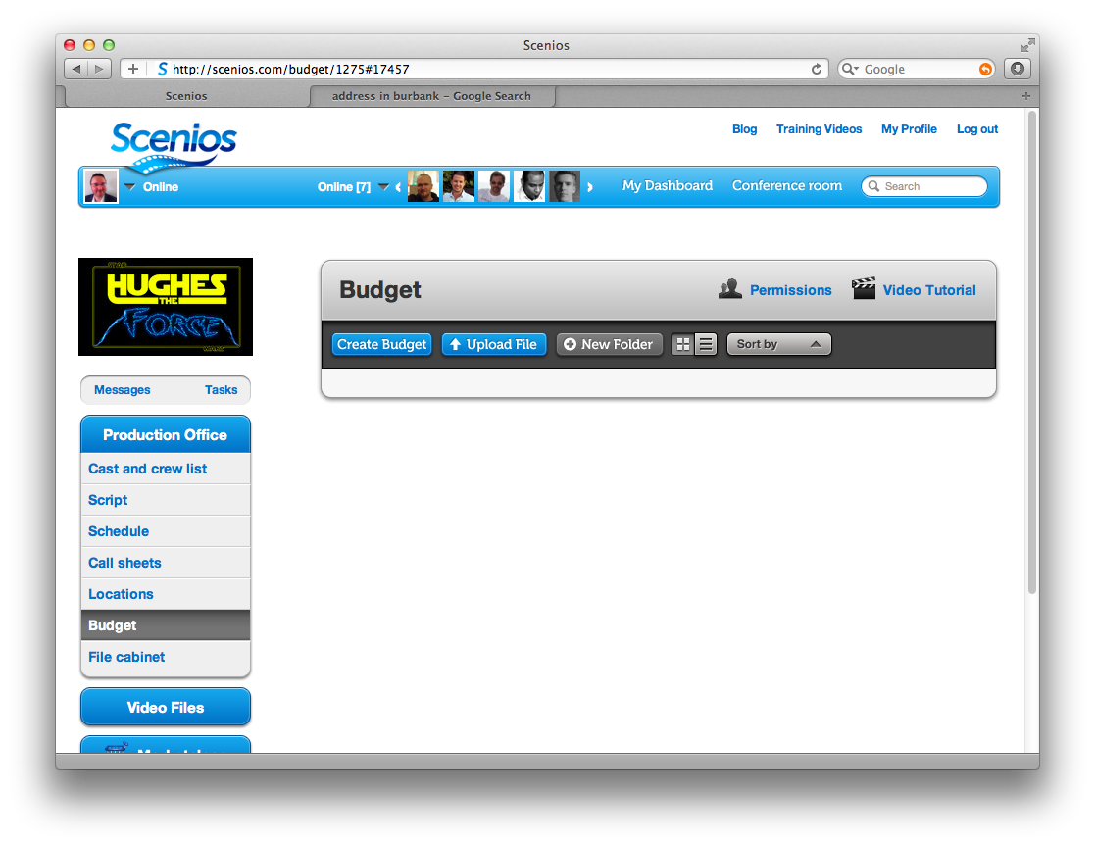
Notes:
Mark gives 15 minute demo

Slide 42
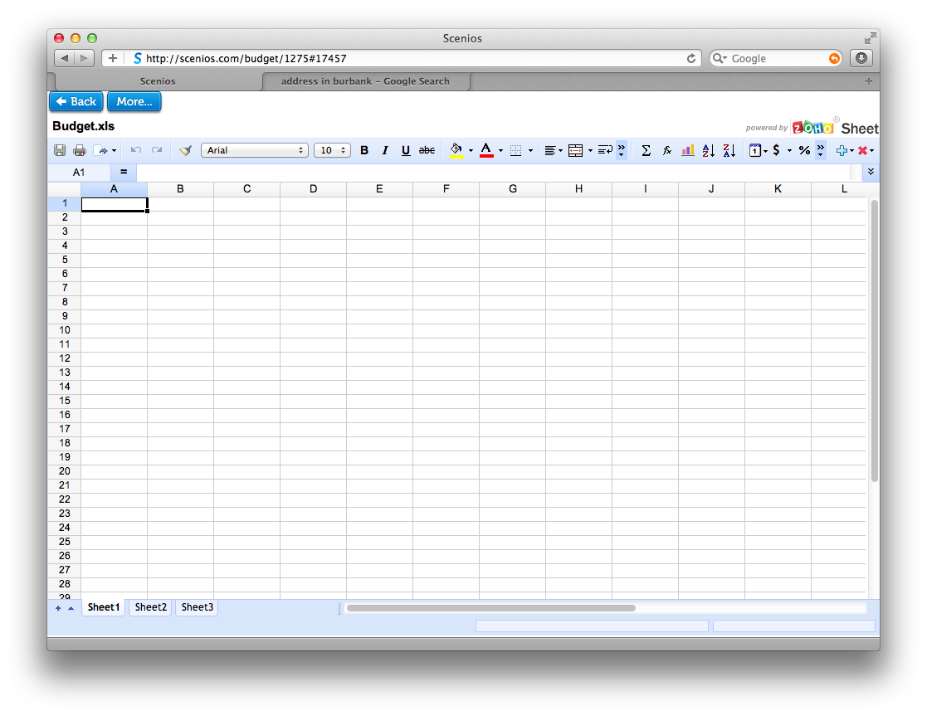
Notes:
Mark gives 15 minute demo

Slide 43
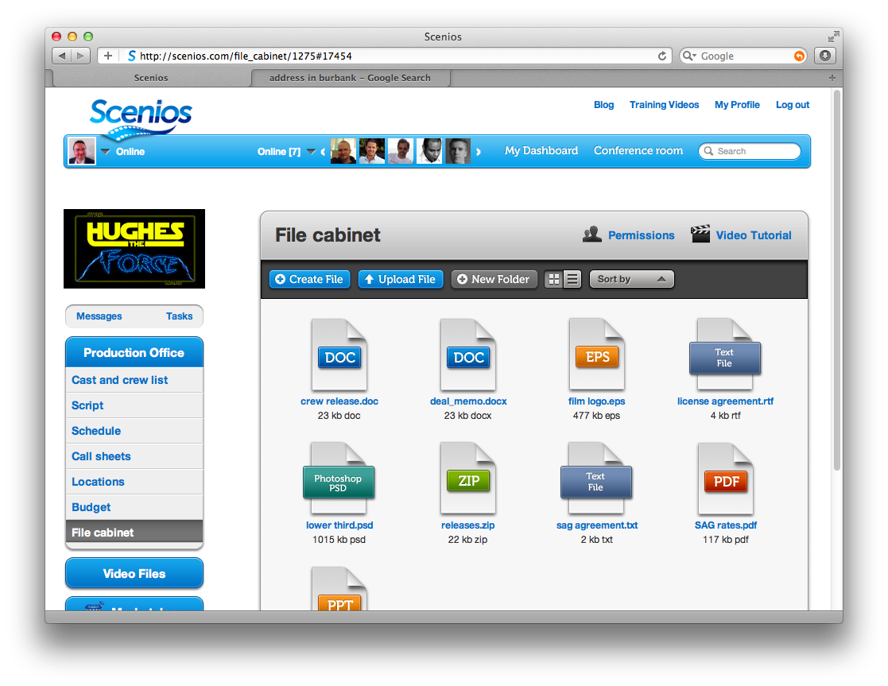
Notes:
Mark gives 15 minute demo

Slide 44
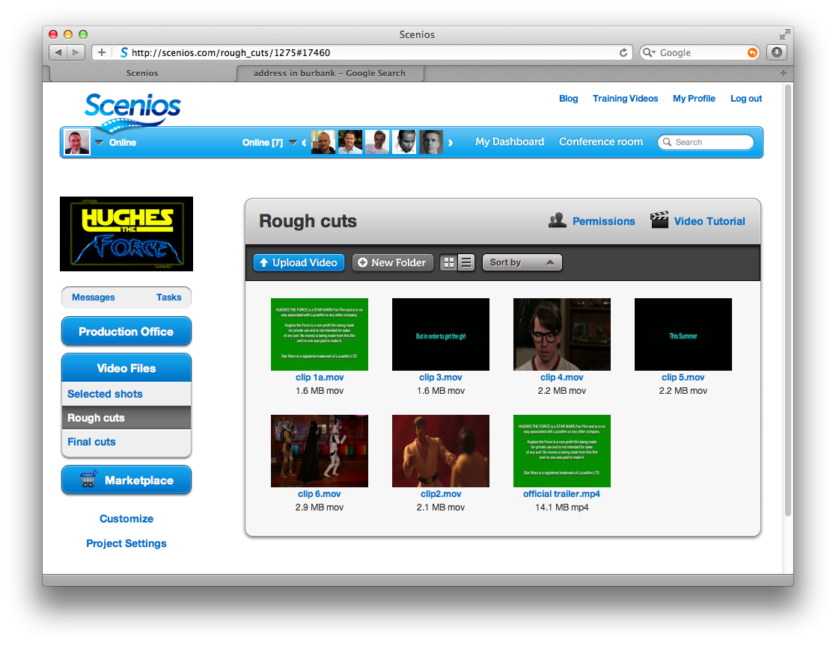
Notes:
Mark gives 15 minute demo

Slide 45
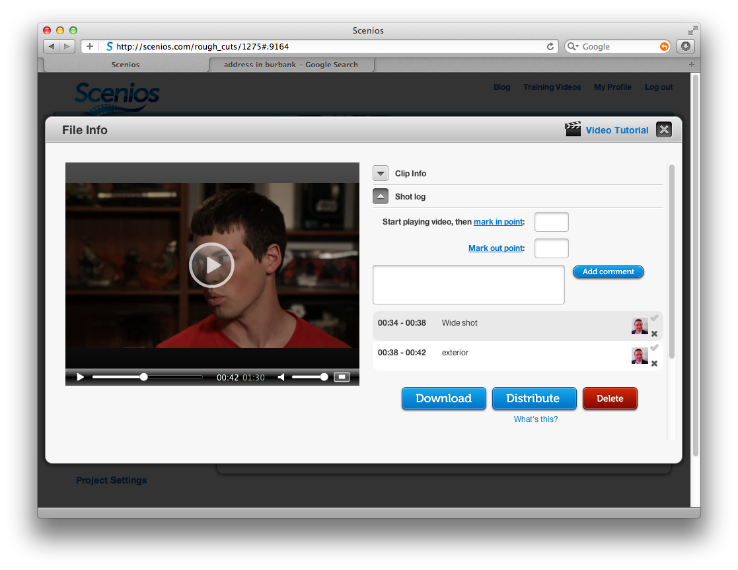
Notes:
Mark gives 15 minute demo

Slide 46
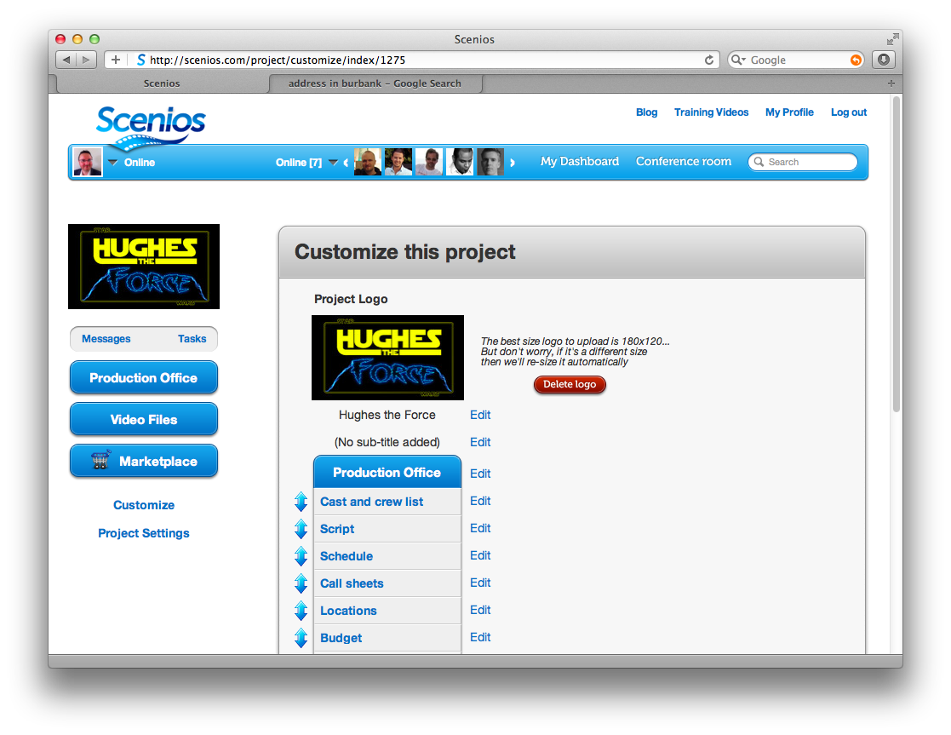
Notes:
Mark gives 15 minute demo

Slide 47
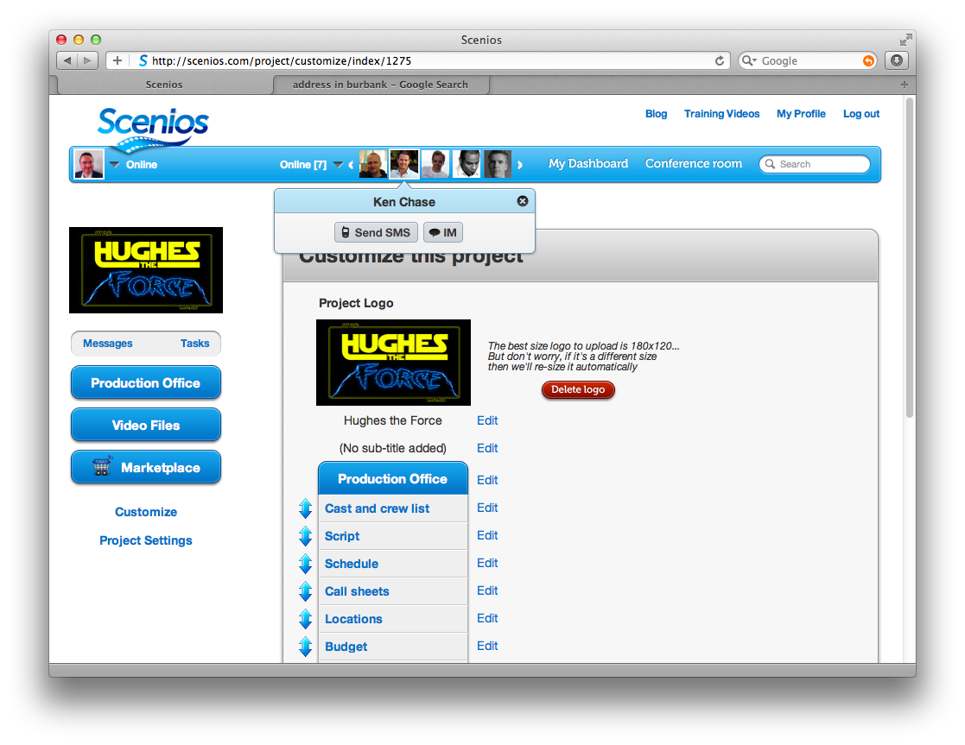
Notes:
Mark gives 15 minute demo

Slide 48
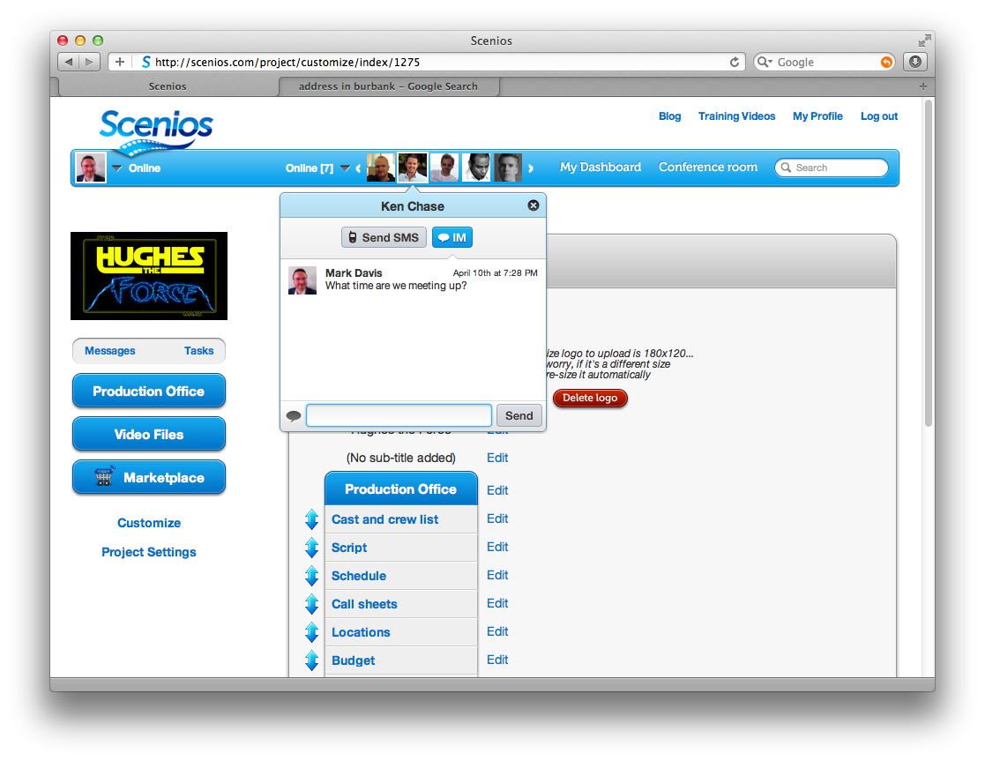
Notes:
Mark gives 15 minute demo

Slide 49
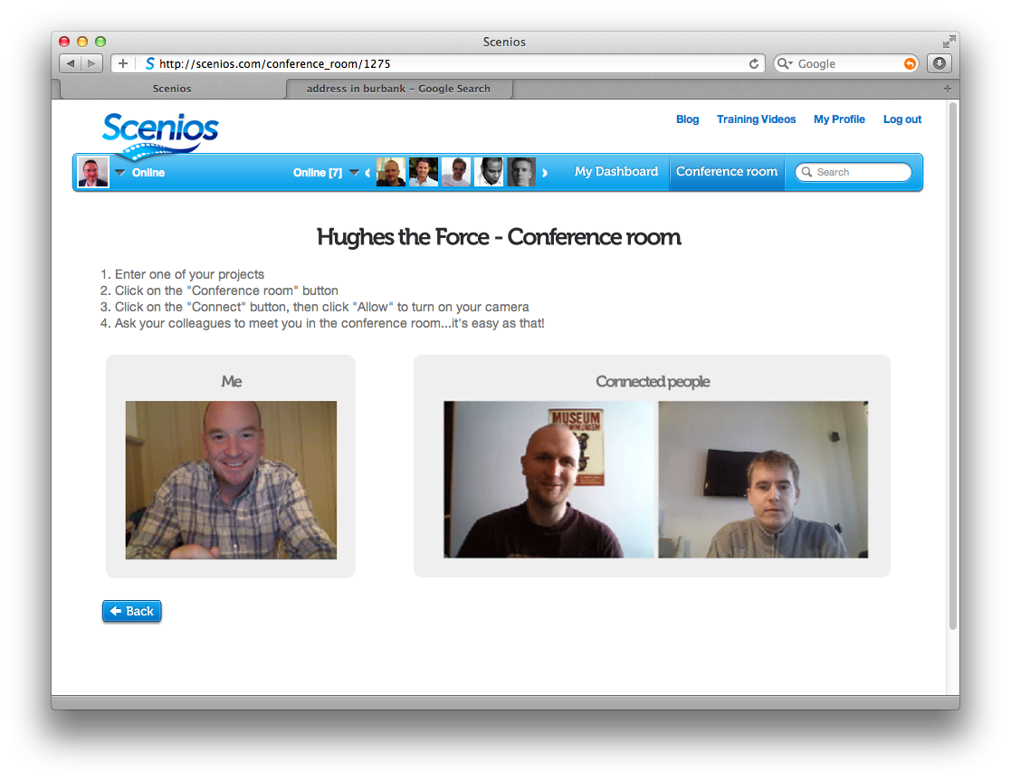
Notes:
Mark gives 15 minute demo

Slide 50
Notes:
Mark gives 15 minute demo

Slide 51
By giving producers their next edge
Manage better
Spend less
Work more quickly
Work in real time
Go green
Sell better
Experiment
Notes:
A lot of producers saw the benefit of transitioning to tapeless..not all!...now moving that tapeless workflow into the cloud is the next logical step
SPEND LESS
Rent software, don't buy expensive hardware and software
No contracts to sign
EXPERIMENT
The cost of experimentation is very low in the cloud. This is making it easy for companies to test drive new concepts without making a large up-front commitment. If it sticks, the transition into a fully-fledged application is smooth.
SELL BETTER
Sell projects while they are still in development
Sell films after they’re done (due diligence room)
GO GREEN
Show scenios on ipad…are you used to carrying around inch-thick production bibles, that are out of date before they’re even printed. Throw those in the trash…or recycle bin…because now your production bible is on your ipad, in real time

Slide 52
Cloud-based workflows
Film
Video
Non-linear
Tapeless and HD workflows
Only recently possible
Is transforming production as we know it
Notes:
The evolution of film and TV production

Slide 53
What’s coming?
The cloud becomes standard
Hybrid online/offline cloud apps
Notes:
Big question: is it safe?
Let me give you an analogy to try and answer this question

Slide 54
How the cloud is transforming
production as we know it
Notes:
So that, is how we believe the cloud will transform production as we know it
You have just seen how a TV show was able to completely transition itself to a cloud based workflow, and the resulting benefits
This demonstrates the true power of bringing production into the cloud
this has only just become possible!
We’ve just shown how a major show transformed itself
Unique moment in time…only recently possible
This will be seen in TV, film and commercials
It’s already starting to happen
Cloud based workflows are a big deal…
get out there and try it for yourself!

Slide 55
Additional slides

Slide 56
Is it safe?
Notes:
Big question: is it safe?
Let me give you an analogy to try and answer this question

Slide 57
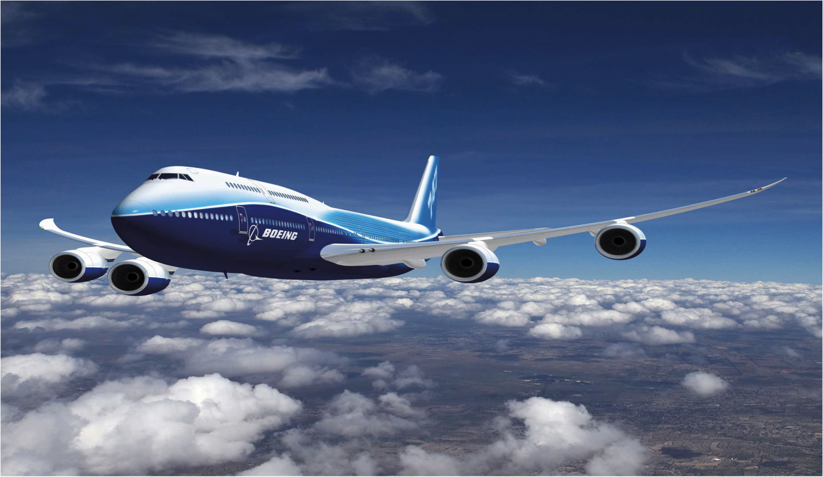
Fatalities per
1M hours flown
4
20
Notes:
LESS RISK
Reduce risk via SLA’s (before if it went down it’s my cost; now with SLA’s the risk is Moved to the provider)

Slide 58
Cost
$
$
Notes:
LESS RISK
Reduce risk via SLA’s (before if it went down it’s my cost; now with SLA’s the risk is Moved to the provider)

Slide 59
Know the risks
Make an informed decision
Protect yourself
Notes:
LESS RISK
Reduce risk via SLA’s (before if it went down it’s my cost; now with SLA’s the risk is Moved to the provider)

Slide 60
What to know before you get started
Know where your data will live
Know the risks…make sure your software runs on Amazon or Rackspace, and has offsite backups
Look for 99.999% guaranteed uptime
Don’t dive in headfirst…experimenting is free
Notes:
Big question: is it safe?
Let me give you an analogy to try and answer this question

