Slide 1
NAB 2012
Cloud Computing Conference
New Levels of Media Performance Data Enabled by Cloud Computing -- and Impact on Other Sectors
Scott Brown, GM US and VP Strategic Technology Partnerships

Slide 2


Octoshape
Broadband TV Distribution Solutions
Through the cloud Octoshape is bringing TV Economics, Quality and Scale to Over The Top Video

Slide 3
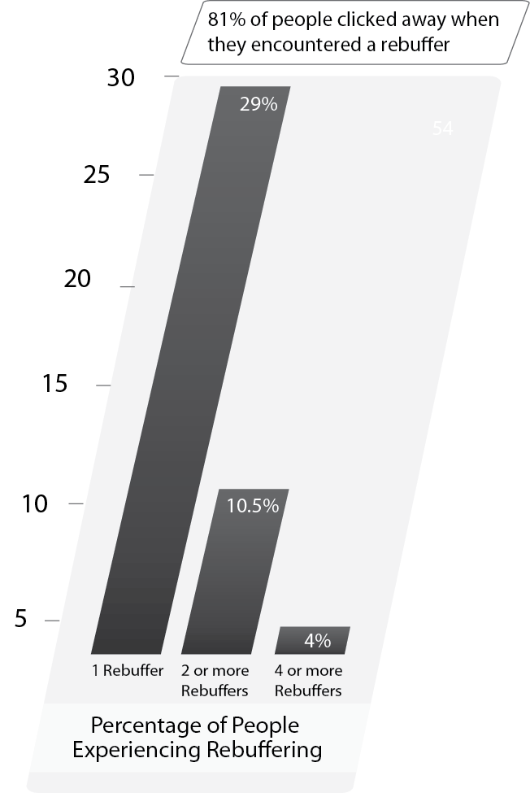
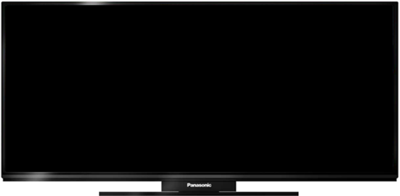



Factors Contributing To New Performance Data
Big Screen viewing experience requires higher encoding bitrates
Using traditional technologies, higher bitrates increases buffer events and disconnects
Traditional technologies use ‘Adaptive Bitrates’ to lower quality to overcome contention on internet connectivity
Octoshape solution provides a Consistent and High Quality viewing Experience
Patented UDP based transport protocol with resilient coding scheme and forward error correction
Eliminates buffer and provides instant-start up of High Quality Video
Coupled with Industry Unique pricing & licensing models leads to profitable and sustainable business

Slide 4
Performance / Marketing Data
Video delivery over the top through the cloud enables very accurate statistics for marketers, and new dimensions of data to consider
Traditional Metrics
New Media Metrics
Sampling and Statistical Extrapolation
Which Channels
View Duration
City, State, Region
Exact Unique User Data
View Duration
City, State, Region
Video Quality
Buffering
Startup Time
Ad View Duration
Multi Angle / Stream Path Flow
Platform (PC, Device, Connected TV)

Slide 5



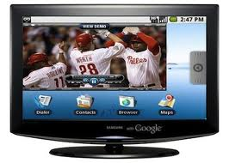
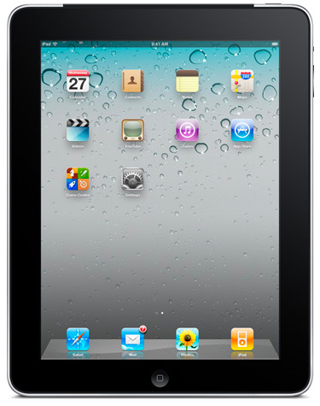
Cloudmass enables Octoshape to dynamically aggregate multiple clouds to create large pools of video delivery capacity

Slide 6
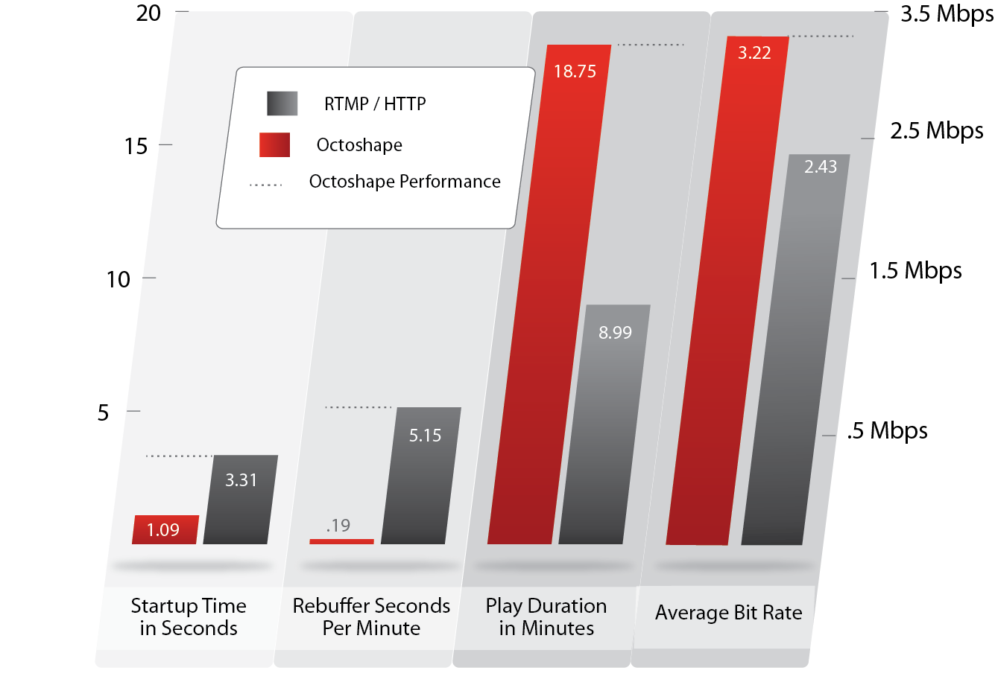
Performance / Marketing Data
Video delivery over the top through the cloud enables very accurate statistics for marketers, and new dimensions of data to consider

Slide 7

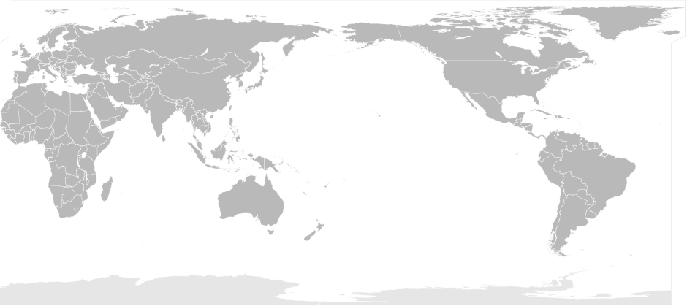



Flat Fee Linear Broadband TV

Slide 8
Summary
For Internet delivery out of the cloud, a new dimension of metrics will drive value to subscribers and marketers
Metrics like quality, buffering, and duration of view will effect the value of the content
Octoshape is providing the highest quality metrics in the space from the cloud
Octoshape is bringing the traditional economics, quality and scale of TV to the Internet

Slide 9
Summary
Thank you!
White Papers:
They don’t make a CDN this big
http://bit.ly/octosolution
http://bit.ly/cloudmass

