Slide 1
4/8/2013
Cloud-Based Multimedia Storage
Seeing the bright spots in the clouds
Dave Fellinger
Chief Scientist, Strategy & Technology

Slide 2
Industry Trends
Most clouds still on file-based origin solutions
Moving slowly toward object storage
Large files being chucked into very small files
Less regional and more worldwide
Still require integration with legacy systems and workflows
Customer demands for performance increasing

Slide 3
To cloud, or not to cloud?
?
What steps in the workflow are moving to the cloud?

Slide 4
Notable Trend - Insourcing
Zynga CTO talks up Z Cloud 2.0, shift away from Amazon
“In early 2011, 80 percent of our [daily average users] were on Amazon, 20 percent on Z Cloud. By the end of the year that number flipped,” said Zynga’s CTO of infrastructure engineering Allan Leinwand… eventually, Zynga "realized we could actually do it on our own and we could scale it in a way that worked better for our business."
Announcing the Netflix Open Connect Network
Around the world, people are enjoying nearly a billion hours per month of movies and TV shows from Netflix. We’ve been delivering these petabytes of data exclusively through commercial content delivery networks.
Now, in addition to these general-purpose commercial CDNs, we are enabling ISPs to get Netflix video data from Open Connect, a single-purpose Netflix content delivery network we’ve established. The world’s other major Internet video provider, YouTube, has long had its own content delivery network. Given our size and growth, it now makes economic sense for Netflix to have one as well. We’ll continue to work with our commercial CDN partners for the next few years, but eventually most of our data will be served by Open Connect.

Slide 5
More trends
Continued reduction in HDD pricing
Improvement in networking and internet connectivity
Virtuous cycle of assets on demand and long tail content popularity
Connected devices, multi screen solutions and increased consumption
Everybody is going to the cloud…

Slide 6
How do you implement?
Build
Buy
Rent
VS
VS
Hybrid
Public
Private

Slide 7
Business vs. Consumer Clouds
Similarities
Capacity
Scale
Performance
Access options
Differences
Access patterns
Concurrency
Multi-tenancy
SLAs
Legacy Protocols
Security
Redundancy

Slide 8
How it will play out
Winners
Service providers
At scale infrastructure manufacturers
Cloud technology
Solution integrators
Online distribution
Outsourced content creators
Big data analytics
Losers
Legacy archiving solutions
Legacy distribution technology and channels
Legacy audience measurement
Local storage devices
Regional content creators
Big Media

Slide 9
A Word from Our Sponsor

Slide 10
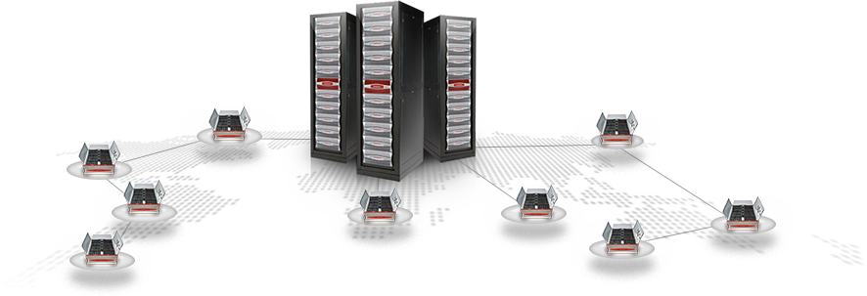
Why DDN?
Broad portfolio for Media, Entertainment, & Cloud
Seamless production to cloud integration
Simple to deploy, manage, & maintain
Scale from small to hyper-scale
Legacy access options for easy migration and workflow integration
High performance
Worldwide Support and Professional Services
Lowest TCO
Extremely efficient data placement

Slide 11
The Global Big Data Leader
We deliver highly scalable & highly efficient storage solutions
Specializing in the most content intensive environments
Over 600 Media and Entertainment customers
Cloud storage experts in scale and performance
Leaders in storage workflow optimization for over 14 years
Learn more at booth #SL 6610

