Slide 1
Content Delivery from the Cloud
Chris Rittler
Deluxe Digital Distribution
April 8, 2013

Slide 2
It Used To Be Easy …
HDTV
Processing & Distribution
SDTV
A few content providers

Slide 3
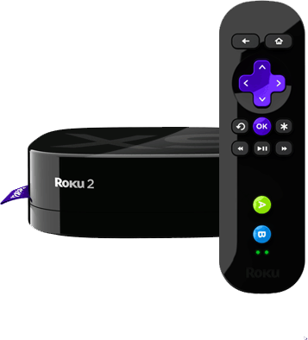
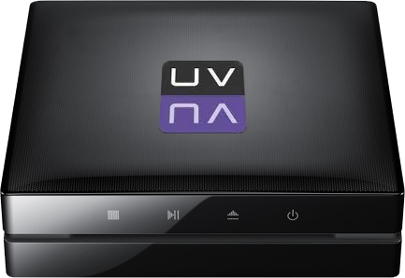
The World Today
iOS
Routing
Roku
DRM
Quality Control
Packaging
Playstation 3
HDTV
Encryption
Transcoding
Bandwidth
Transport
Eider
Storage
Xbox
ADI
VPN
Workflow
License Survey
Android
SDTV
Aspera
TMS
PC/MAC
CDN
Ultraviolet
4K
8K
WMV

Slide 4
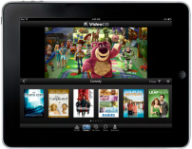
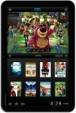
Multiscreen Solution Architecture
Workflow
Services
Retail Systems
Apps
All Studios
All Content
Ingest
DRM
Server
DRM Licenses
CE
Encoders
Retailer System
Metadata
Store
Front
Admin
STBs
Content Processing
CMS
Reporting
Merchandising
SDKs
Recommendations
PC/Mac
DRM
Encryption
Discovery
Social
iOS
Content, and Metadata
Media Library
Reporting
Entitlement
Origin
CDN 1
CDN 2
AV Feed
Android

Slide 5
Cloud Solutions
Retail Systems
Apps
Workflow
Services

Slide 6
Strategic Options
Full Service Cloud
“Half Cloud”
Blend of in-house and cloud
Build In-House

Slide 7
Key Cloud Economics
Scale
Re-Use
Virtualization
Know How

Slide 8
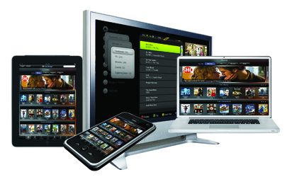
Deluxe OnDemand™
VOD Catalog As A Service:
Multiscreen Ready
Studio-Quality Outputs
Cloud-based Service
Multiscreen Ready Video Catalog
Highest Quality Video Outputs
Simplified Operations; Reduced Cost
Easy Integration
Time-to-Market in Days not Months

Slide 9
Conclusion
Consumers want easy access to deep catalogs of high quality content on their device of choice
Many technical and economic challenges to becoming a popular distributor of multi-screen content
Cloud services and third party services are growing in capability and popularity to address challenges

Slide 10
Thank you!
Chris Rittler
Senior Vice President, Sales & Business Development
chris.rittler@bydeluxe.com
www.bydeluxe.com/d3

