Slide 1
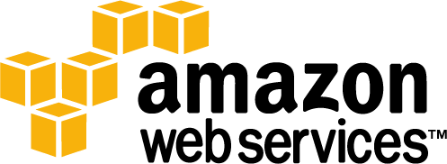
Industry Update on Cloud Adoption
Mark W. Ramberg
Amazon Web Services
Global Digital Media Business Strategy
Notes:
Good morning and welcome to the Cloud Computing Conference at NAB
I’d like to start by saying “thank you” for your time today and also thank the DCIA (Distributed Computing Industry Association) for asking me to speak
In my role at Amazon Web Services I’m responsible for the Global Digital Media Business Strategy
That translates to 3 things:
Working with media industry companies like studios, broadcasters, and publishers
Working with the ecosystem of partners to enable their media solutions on the AWS platform
Driving AWS internal strategy for how we engage with the media industry and what services we should offer

Slide 2
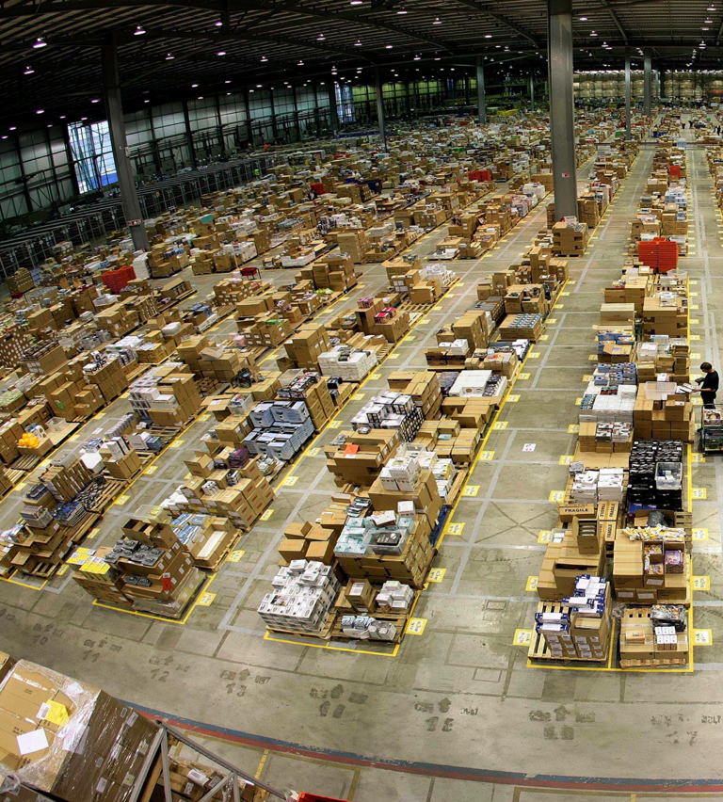
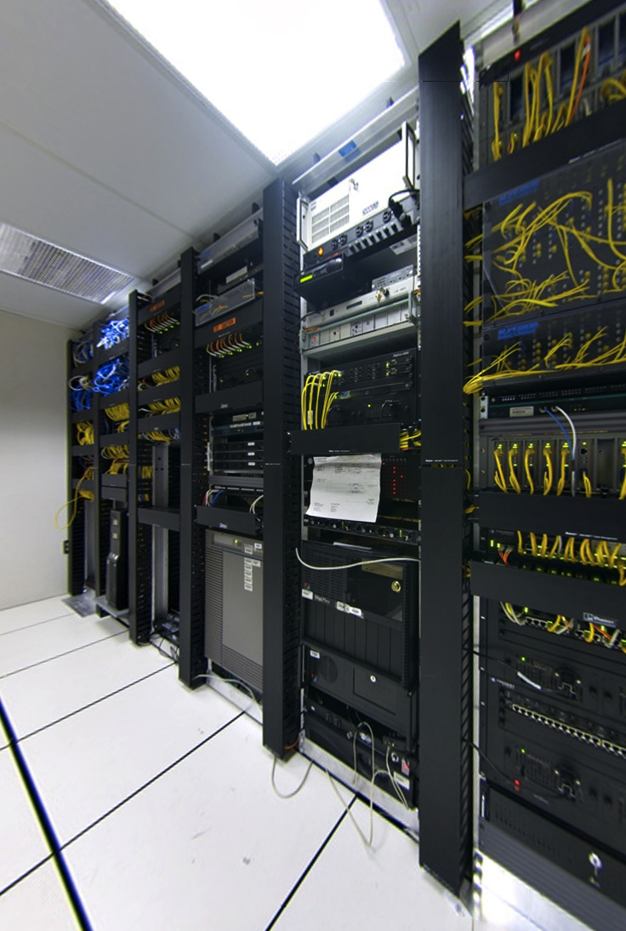
About Amazon Web Services
How did Amazon…
?
Deep experience in building and operating global web scale systems
…get into cloud computing?
Notes:
We are often asked the question: how did Amazon get into cloud computing? Amazon is really good at providing an immense selection of products, and of shipping those products to customers efficiently. But behind that online capability lies years of experience in providing technical services to the business that ensures our online stores are secure, fast, always available and capable of meeting huge seasonal demand.
Over ten years ago, the technical teams supporting Amazon’s retail businesses were moving from providing software and hardware capabilities to a service orientated approach - that is packaging things in an easy to consume way so that deployments by parts of the business were easier, faster and more scalable. As Amazon opened up it's internal services to third party sellers, and we published simple web services such as our catalog search, it became apparent very quickly that developers were hungry for more, and that Amazon had developed significant technical know-how that could be packaged for others to use. We asked ourselves 'what if we could package everything we do and offer it to others over the web?'. 'What if other businesses could leverage the scale and reach of Amazon.com?'

Slide 3
AWS global footprint
Region
Availability Zone
Edge Locations
London(2)
Seattle
South Bend
New York (2)
Amsterdam
Newark
Dublin
Stockholm
Palo Alto
Tokyo
San Jose
Frankfurt(2)
Paris(2)
Ashburn(2)
Milan
Osaka
Los Angeles (2)
Jacksonville
Dallas(2)
Hong Kong
St.Louis
Miami
Singapore(2)
Sao Paulo
Sydney
Notes:
So here is a map of our infrastructure. The AWS infrastructure is global, with multiple regions around the globe from which services are available. This means you have control over things like where you applications run, where you data is stored, and where best to serve your customers from.
Each AWS region is also split into Availability Zones, making highly available applications possible from within a region.
And the whole footprint is supported by the many edge locations of our content delivery network; places from which content can be served to your customers for the fastest possible response times.
The AWS infrastructure enables you to meet your needs related to security, scalability, and high-availability
For example, if you are a Hollywood studio, or one of the partners who works with their content, you’re going to need to worry about things like the MPAA Content Security Best Practices. AWS alignment with the MPAA Content Security Best Practices was reviewed last fall and covers most AWS services as well as content types ranging from pre-theatrical raw master through distribution formats.
Optional if time:
Why are customers adopting cloud computing?
Variable expense - Replace capital expenditure with variable expense
Economies of scale - Lower variable expense than companies can achieve themselves
Elastic capacity - No need to guess capacity requirements and over-provision
Speed and agility - Infrastructure in minutes not weeks
Focus on business - Not undifferentiated heavy IT lifting
Global Reach - Go global in minutes and reach a global audience

Slide 4
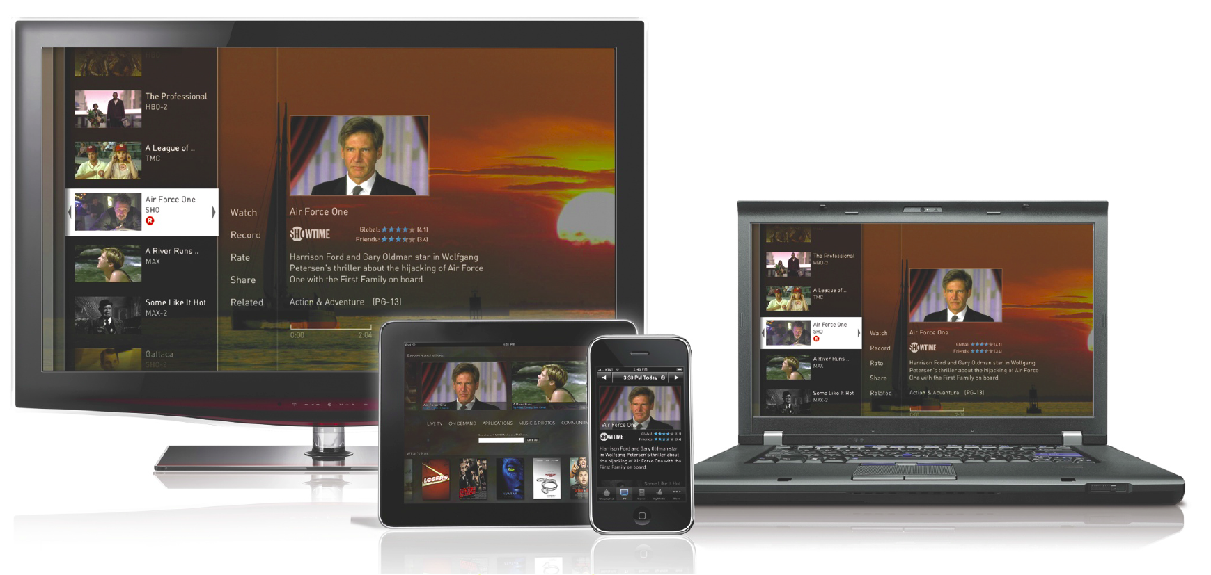
Many Options for Media Consumers…
More content choices
More devices to consume media
Many ways to get the content to devices
New experiences
Notes:
This is an exciting time for consumers of media with many options
More content choices for consumers: traditional network content, premium/excusive content (HBO, etc.), more coverage of live events (20+ simultaneous Olympic feeds in HD), UGC, and so on.
More devices to consume media: Traditional STBs, smart TVs, game consoles, PCs, tablets, smartphones…
Many ways to get the content to devices: Broadcast, cable, satellite, OTT, TV Everywhere…
New experiences: Second screen, social networking tie-ins, in-app purchasing…

Slide 5
…Means More Monetization Opportunities, Right?
Notes:
All of this theoretically adds up to many more monetization opportunities for the media industry
But how do you capitalize on the opportunity?

Slide 6
Main Theme
We continually hear the refrain of “Content anytime, anywhere, any device”, but rarely do we hear anyone talk about what it takes to make that happen
Notes:
We often hear the refrain of “Content anytime, anywhere, on any device”, but rarely do we hear anyone talk about what it takes to make that happen so today I’m going to talk about some of the things you’ll need to consider and how the cloud is being adopted to address these use cases

Slide 7
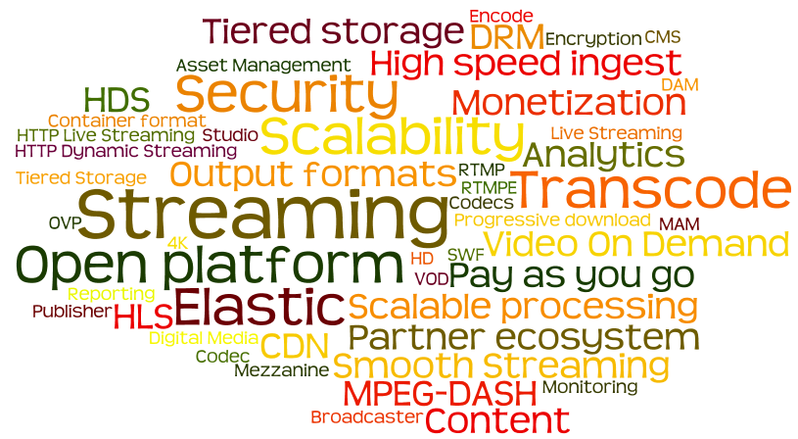
Turns Out There is Massive Complexity
Notes:
…but with all of those consumer options comes a lot of complexity.

Slide 8
…But How Do You Enable These?
More content choices
More devices to consume media
Many ways to get the content to devices
New experiences
Notes:
Going back to our list, how do you deal with all of that complexity? Let’s dig into each of the these…
There is an exponential growth in content meaning more content and larger content such as HD, 3D, 4K and so on.
For that you need scalable, tiered storage for current catalog, back catalog, and archive. You need ways to manage across those tiers to promote and demote content in order to take advantage of monetization opportunities.
[optional example] LTO/DLT tape used for archive traditionally has long retrieval times (use example of famous actor in the news – how do you quickly retrieve and offer content while the story is still relevant).
Don’t make this a sales pitch, but mention that Amazon Glacier cloud based archive storage provides much better SLAs and is disruptively inexpensive.
But while cloud storage may make a lot of sense, how do you get that content into the cloud quickly and cost effectively? For many of the big media customers their libraries would literally take months to transfer over the internet
There are software solutions like Aspera and Signiant which can greatly speed up your transfer times, but you may also want to ship physical hard drives or have direct fiber connectivity at convenient peering points

Slide 9
Key Trend #1
Trend: More content and larger content formats leads to ever increasing storage requirements
Implication: Managing storage is expensive and complex; the cloud shifts CapEx to OpEx, freeing resources
Notes:
Key Trend: More content and larger content formats leads to ever increasing storage requirements.
Now while that probably isn’t a surprise to anyone, the implication is that managing storage is expensive and complex; the cloud shifts capital expenditures to operating expenses, thereby freeing resources
But let’s talk about what happens after you’ve decided to move to cloud based storage
First, large content libraries are traditionally slow and costly to move, so once content owners select a cloud platform to store their content, it will probably live there for a long time. This means that ingest/storage is likely the first and biggest decision that media companies will make in selecting a cloud provider.
You need to look at what you have to do with the content. If you need to still ship it around then you’ve lost - you should place it into a service that is surrounded by all the technology you need to transform the content into a monetizable asset. This is the concept of content gravity.
From that we will see that decisions around storage requirements will drive the ecosystem – 3rd party solution providers will flock to the platform where the content lives so they can participate in the value chain. The partner ecosystem is a critical consideration in selecting a cloud provider.
Over time this will lead to content access instead of content transfer, thereby creating a network effect and collapsing cost structures, which leads to higher margins

Slide 10
…But How Do You Enable These?
More content choices
More devices to consume media
Many ways to get the content to devices
New experiences
Notes:
With all of the devices you end up with a massive # of distribution formats
Stat: Last year, in 2012, global shipments of smartphones increased 46% to 722M, tablets increased 78% to 128M, while PCs declined 4%
With all of the output formats, you need to think about storage considerations for those in addition to the storage of the source/mezzanine files
To create all of the various output files, you need to think about processing at scale…when you talk about using the cloud for media you’re generally not talking about a single video for a marketing website – instead you’re talking about massive libraries of content which require automated workflows to manage significant processing resources
For example, let’s look at Netflix.
For each source piece of content they have, they are transcoding each into more than 120 different output formats optimized for all of the devices they want to reach
When they need to support a new device, they spin up between 4000 and 6000 virtual compute instances on AWS, transcode their entire library in a matter of days, then release all of that compute power without ever having to buy or rack a single server.

Slide 11
Key Trend #2
Trend: Requirements for processing media at scale will continue to increase Implication: Strategic use of the cloud was a competitive advantage; now it is a core competency
Notes:
Key Trend: Requirements for processing media at scale will continue to increase
Implication: Strategic use of the cloud used to be a competitive advantage; but now it is a core competency
Business decisions are no longer constrained by infrastructure availability
It used to be the case that media companies were constrained by their physical infrastructure – they would plan release schedules based on solving business problems in a linear or serial manner dependent upon the time that it would take to process the content with the available hardware they had in their data centers. With a massively scalable elastic compute cloud you can make a business decision to provision the right amount of capacity for your business needs. Increased use of elastic compute power enables business agility…

Slide 12
…But How Do You Enable These?
More content choices
More devices to consume media
Many ways to get the content to devices
New experiences
Notes:
Once you get the content transferred and stored in the cloud, transcoded, etc. you’re going to want to distribute it. Consumers won’t tolerate slow start up times or buffering. Add to that the fact that media content delivery has gone from primarily being managed content, across managed networks (cable, satellite, etc.), to managed devices (STBs) to a model where it is managed AND unmanaged content, across managed AND unmanaged networks, to managed AND unmanaged devices
Now that it’s all moving to IP based delivery, there are scale issues.
Stat: I heard a statistic recently that said that if only 10% of the content delivered via cable were delivered online it would saturate the internet currently (due to lack of multicast), so you need to find ways to scale. So how do you scale your delivery?
One way is through origin scaling
In the past to get any kind of scale distribution it meant standing up a massive fleet of origin streaming servers. You’d have a huge capital outlay to build for peak capacity by buying, racking, and maintaining data centers full of hardware, which probably isn’t your core competency anyway. And on top of the hardware costs and operational issues, you’d have to buy traditional perpetual software licenses.
That investment would go underutilized most of the time, especially if you are doing events whether that is church on Sundays or the Olympics every couple of years.
Now with the cloud you can easily and elastically scale your resources to meet your demand, then scale it down when demand decreases. Not only can you stand up as many servers as you need on demand, but you only pay for what you use. This also extends to the software layers where you can pay for things like Adobe Media Server or Wowza Streaming Server in a pay-as-you-go model by the hour instead of paying thousands of dollars for the traditional perpetual license.
CDN
And to extend that idea even further, newer HTTP based streaming protocols mean that you can scale your distribution through Content Delivery Networks (CDNs) instead of having to build out a fleet of origin servers.
The CDN not only reduces load on the origin, but it provides a better user experience by caching content closer to end users around the world.

Slide 13
Key Trend #3
Trend: Consumers expectations of “Content anytime, anywhere, any device” will be the norm
Implication: Media companies are utilizing the global nature of the cloud to reach audiences
Notes:
Key Trend: Consumers expectations of “Content anytime, anywhere, any device” will be the norm
Implication: Media companies are utilizing the global nature of the cloud to reach audiences
Consumers are rapidly coming to expect that they can get their content across a range of devices and delivery mechanisms. The media companies that provide that will be positioned to capitalize, while the ones that don’t will risk losing audiences.
Consumers expect a seamless transition of content viewing as they move from living room to mobile, and so on.
Adapting content delivery to the network/bandwidth availability will be critical in retaining the viewer’s attention

Slide 14
…But How Do You Enable These?
More content choices
More devices to consume media
Many ways to get the content to devices
New experiences
Notes:
And what about the experience your consumers are getting?
Second screen, social media, gaming, in-app purchasing, etc.
Stat: 85% of smartphone users reported second screen-linked behavior at least once a month, over 60% reported doing it on a weekly basis, and 39% did so daily [Source: Business Insider]
Let’s look at the iPad…it was launched in early 2010, kicking off the tablet revolution – that’s only 3 years ago. This shows the dramatic speed of adoption. [to illustrate, ask the audience to hold up their tablets if they have one]
Those experiences require publishers to do a lot behind the scenes
You need monitoring of your infrastructure, real-time stream health, analytics/reporting, and metadata aggregation from a variety of sources. And when doing that at scale it’s a much bigger issue that often requires big data solutions running on scalable cloud infrastructure.

Slide 15
Key Trend #4
Trend: Consumers’ attention will get pulled in many directions
Implication: Media companies are finding new and innovative ways to engage and monetize
Notes:
Key Trend: We are seeing consumers’ attention getting pulled in many directions
Implication: Media companies are finding new and innovative ways to engage and monetize
Vying for the attention of audiences will require media companies to find ways to remove friction to accessing primary and secondary content and keep the audience engaged
What about things like content discovery? How do you make it easy for consumers to easily find the content? With massive amounts of content and metadata, it’s no longer sufficient to simply have a program guide. Just as the internet went through an evolution from site directories to search engines, media content discovery will see a similar evolution. Consumers are looking for personalized recommendations.
One of the challenges will be making this a great consumer experience across devices, content sources, etc.
In order to provide those you’ll need to do some heavy duty big data processing based on large databases of information about the content, the consumers, and so on.

Slide 16
Summary

Slide 17
Key Points
Complexity of “Content anytime, anywhere, any device” requires you to think very differently
The cloud is viable and a reality today and if you’re not thinking about it you should be
Strategic use of the cloud used to be a competitive advantage, but is now a core competency
The cloud enables you to spend more time growing and less time worrying about the logistics of growth
Notes:
Additional end user options for consuming media in a “content anytime, anywhere, any device” way necessitates a scalable infrastructure to deal with all of the complexity
The cloud is viable and a reality today and if you’re not thinking about it you should be
Strategic use of the cloud used to be a competitive advantage, but is now a core competency
The cloud enables you to spend more time growing and less time worrying about the logistics of growth. Focus on your business, not undifferentiated heavy IT lifting

Slide 18
What’s Next?
Pick up an AWS swag bag in the back of the room
Visit our Booth located in the South Hall (SL10405)
Redeem coupon for $100 in AWS credits
Register to win a Kindle Fire or Amazon Gift Card
Learn about AWS and partner solutions
Talk to AWS Solution Architects
Office hours 11am-12pm and demos 3pm-4pm daily
Cocktail party in the AWS booth Monday evening 4-6pm
Notes:
Need Jarrod to work on this slide

Slide 19
aws.amazon.com
AWS Booth is Located in the
South Hall Lower #SL10405

