Slide 1




Cloud Reliability and Security
Shekhar Gupta
Director, Consulting & PLM
Motorola Mobility

Slide 2
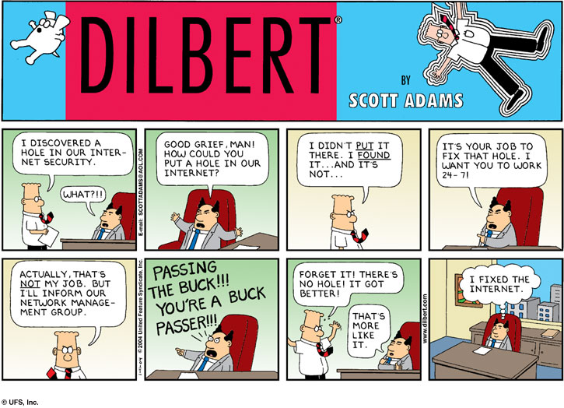

Slide 3

CONSUMERS WANT ACCESS TO RELEVANT CONTENT REGARDLESS OF TIME, PLACE, DEVICE OR NETWORK

Slide 4

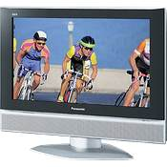


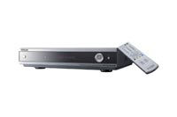






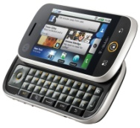
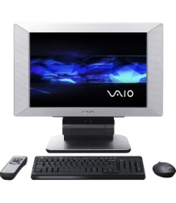
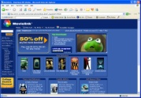


The operator challenge: content anywhere, anytime, from any channel
Content Owners
Operators
Consumers
Internet

Slide 5
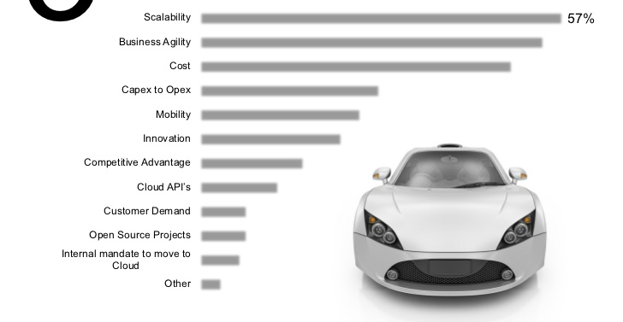
3
Big Cloud Drivers
Notes:
5

Slide 6
Cloud-based consumer and business products, services and solutions are delivered and consumed in real-time over the Internet
Shared, standard service – built for a public market, not a single customer
Solution-packaged – a “turnkey” offering that integrates required resources
Self-service – admin, provisioning; may require some “on-boarding” support
Elastic scaling – dynamic and fine-grained
Use-based pricing – supported by service metering
Accessible via the Internet/IP – ubiquitous, authorized network access
Standard UI technologies – browsers, RIA clients and underlying technologies
Published service interface/API – e.g., web services, APIs
Key
Attributes
Public – open to a largely unrestricted universe of potential users; designed for a market, not a single enterprise
Private – designed for, and access restricted to, a single enterprise (or extended enterprise); an internal shared resource, not a commercial offering; IT Org is the “vendor” of the shared/std service to its users
Deployment
Models*
*[Note: large gray zones exist between these two broad categories]

Slide 7
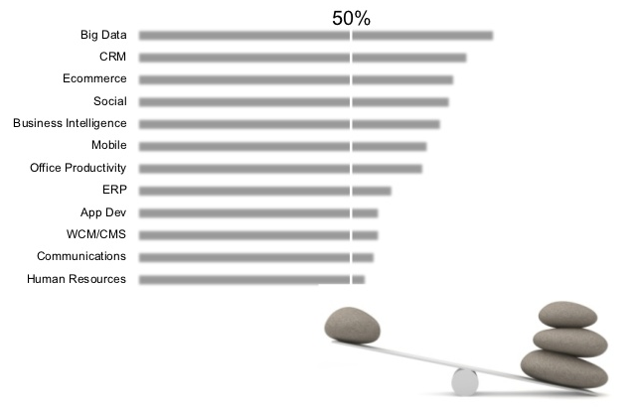
Cloud Disruption
More than 50% believe most categories will be disrupted
Notes:
7

Slide 8
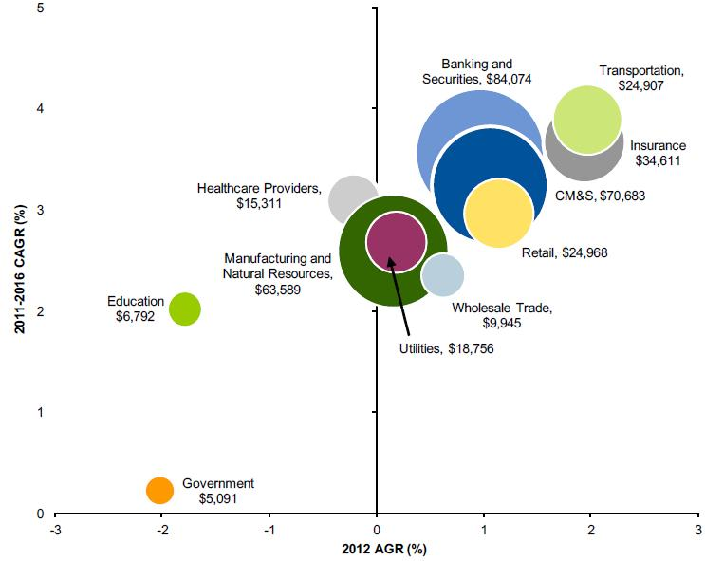
The Cloud Isn’t Just for IT
Growth Opportunities by Vertical Industry Market, 2011–2016 (Millions of Dollars)
Note: Bubble size measures the expected difference between the 2016 and the 2011 market sizes in millions of U.S. dollars
Source: Gartner November 2012
Notes:
8

Slide 9
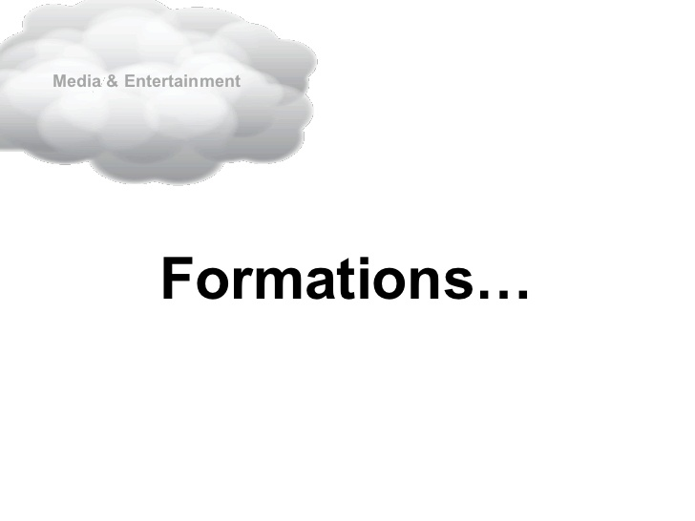
Cloud formation
Notes:
9

Slide 10
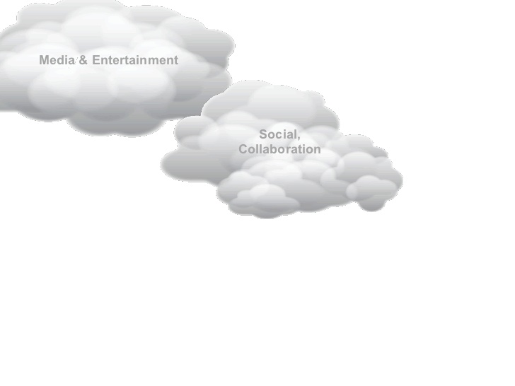
Cloud Formation
Notes:
10

Slide 11
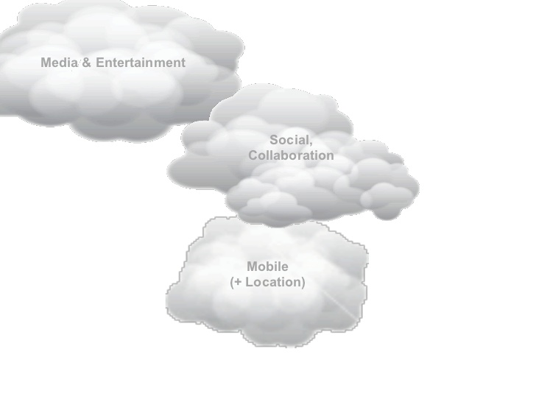
Cloud formation
Notes:
11

Slide 12
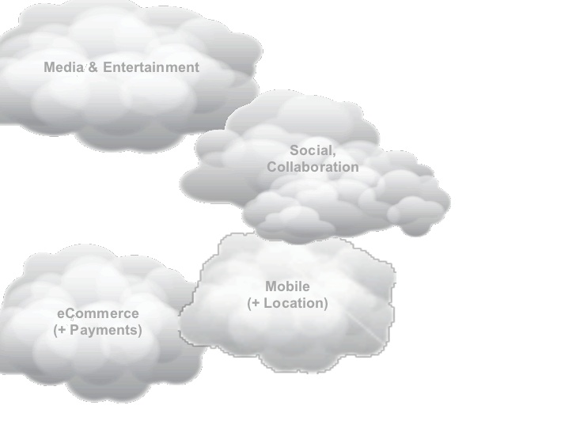
Cloud formation
Notes:
12

Slide 13
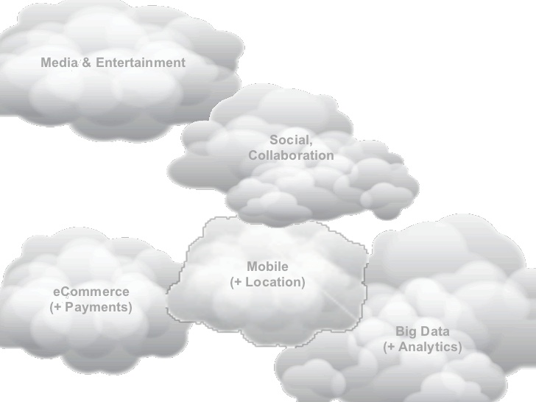
Cloud formation
Notes:
13

Slide 14
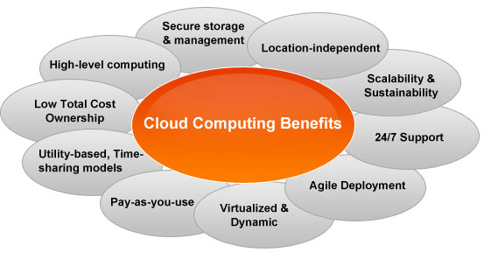
Benefits
Notes:
14

Slide 15
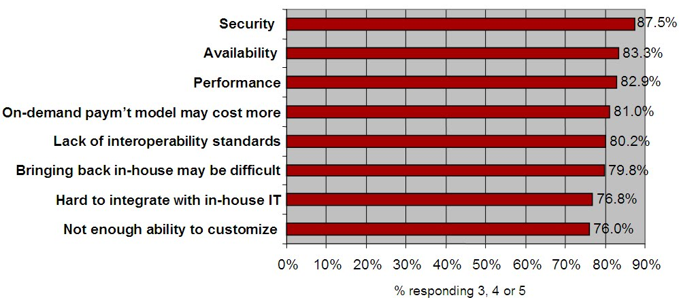
Perceived Challenges
Q: Rate the challenges/issues of the “cloud”/on-demand model
(Scale: 1 = Not at all concerned 5 = Very concerned)
Source: IDC Enterprise Panel, 3Q09, n = 263
Notes:
15

Slide 16
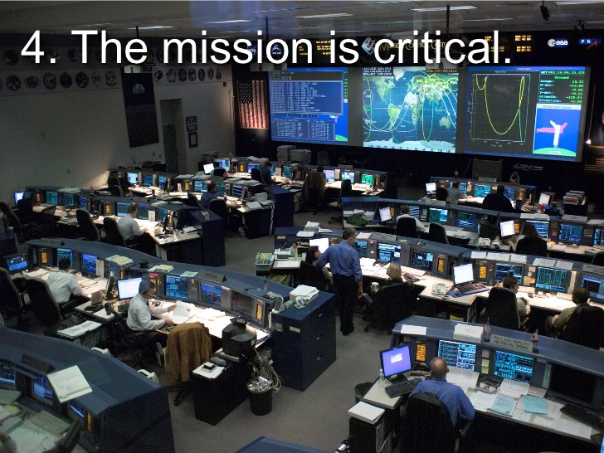
The Mission is Critical
Notes:
16

Slide 17

Addressing the Challenges

Slide 18
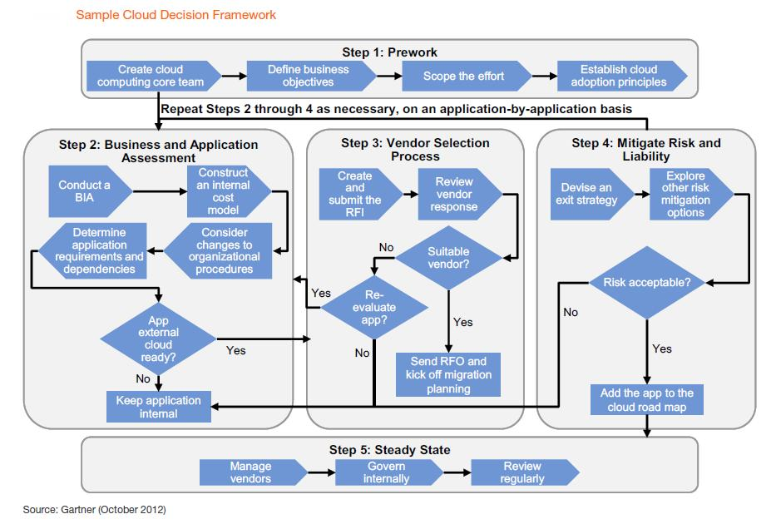
Creating Cloud
Notes:
18

Slide 19
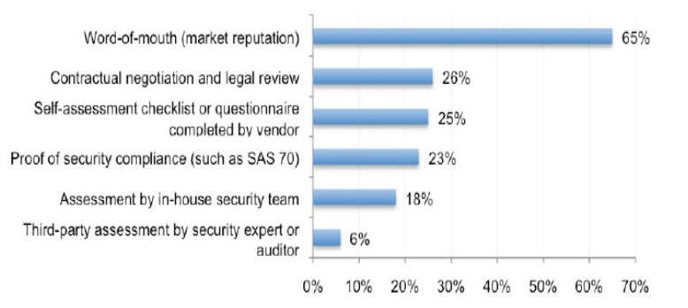
Selecting a Vendor
Cloud Computing Vendors Review “Process”
Notes:
19

Slide 20
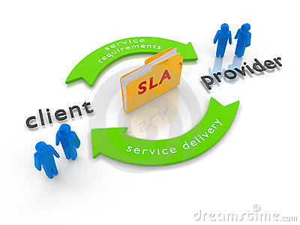
SLA

Slide 21
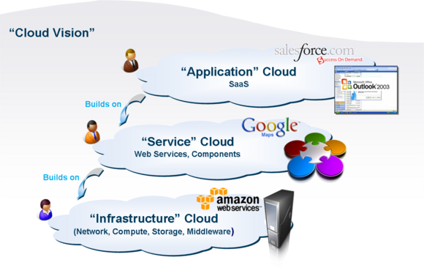
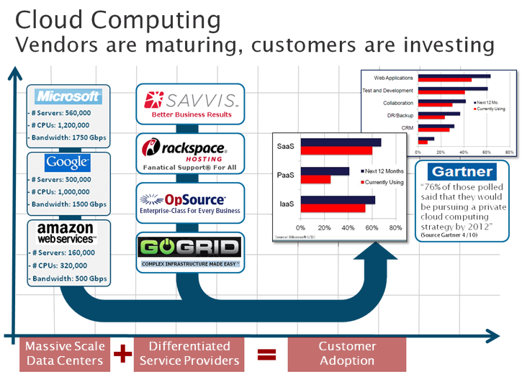
Maturing Technology
Notes:
21

Slide 22
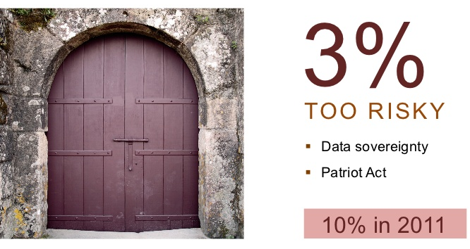
Progress
Notes:
22

Slide 23
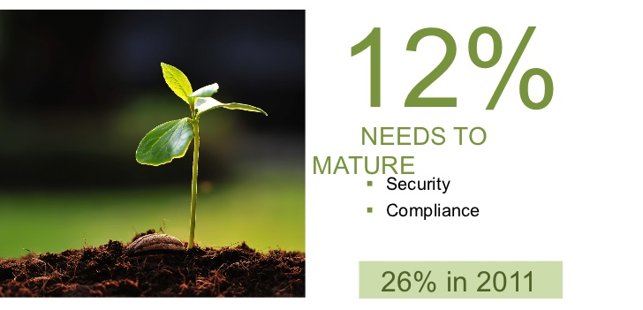
Progress
Notes:
23

Slide 24

Progress
Notes:
24

Slide 25
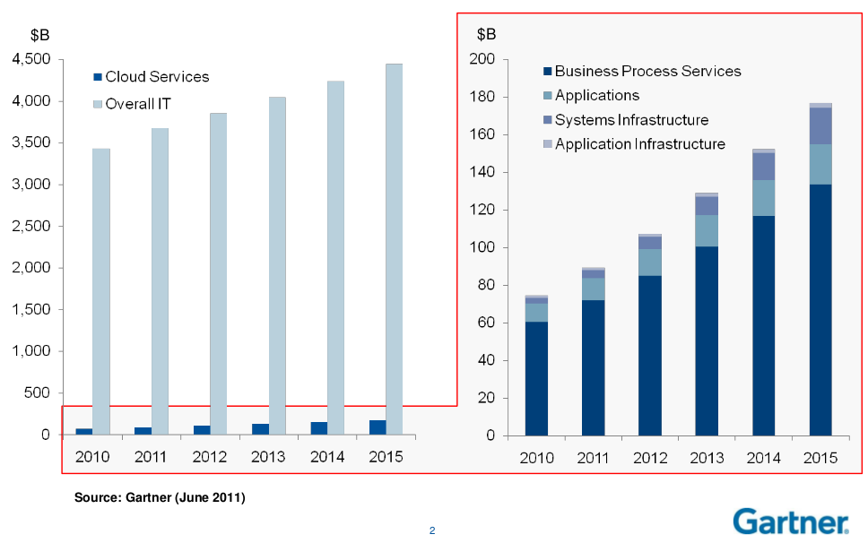
Forecast
Public Cloud Services Forecast, Worldwide, 2Q11 Update: 19% Annual Average Growth
Notes:
25

Slide 26
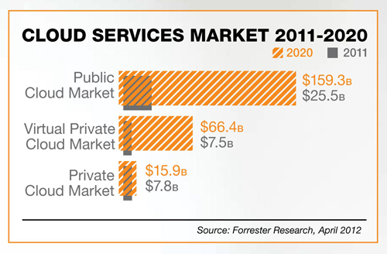
Cloud Services Market
Notes:
26

Slide 27
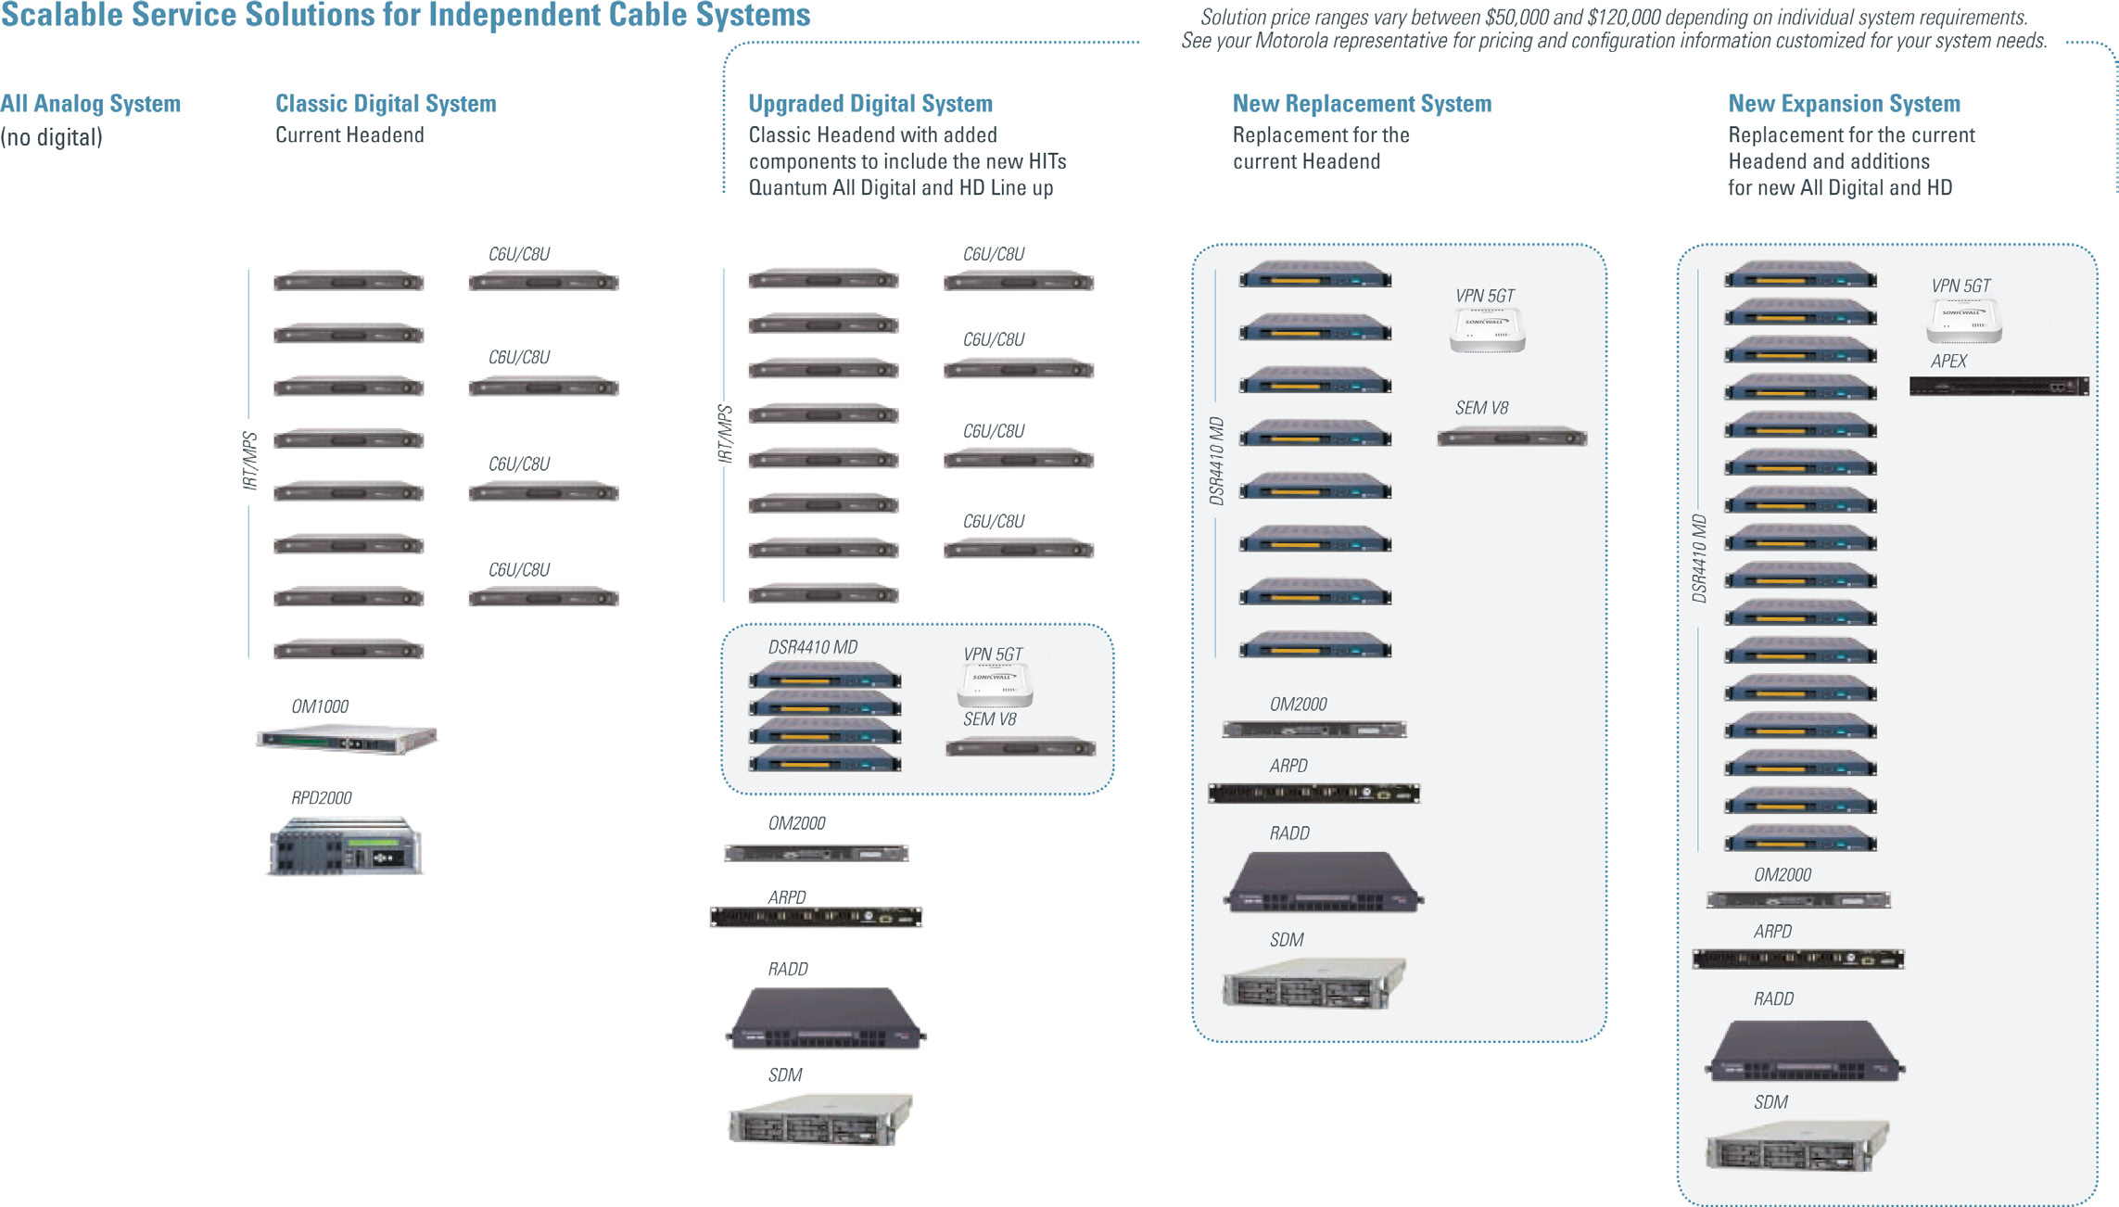
Motorola as a Leader

Slide 28


Motorola’s Cloud Based Multi-Screen Solution:
Integrated, Flexible, Open
CONTENT MANAGEMENT
DEVICE MANAGEMENT
CONTENT SECURITY
USER INTERFACE PLATFORM
Cloud
SET-TOP
ANALYTICS
SERVICE ASSURANCE
CONSUMER DEVICES
GATEWAY
CONTENT PROCESSING
CONTENT CAPTURE & DELIVERY
Home & You
Network
CONTENT DELIVERY NETWORK
ACCESS NETWORK

Slide 29
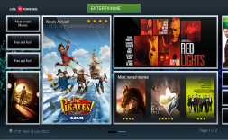





Delivering a Compelling User Experience
Leveraging HTML5 and the Cloud to increase Service Velocity
Custom GUI
Multi-Screen
Time to Market
Legacy STBs
Monetization
Efficiencies
SUBSCRIBERS EXPECT NEW SERVICES TO BE INTRODUCED AT THE PACE OF THE INTERNET

Slide 30
Q and A
Notes:
30

