Slide 1
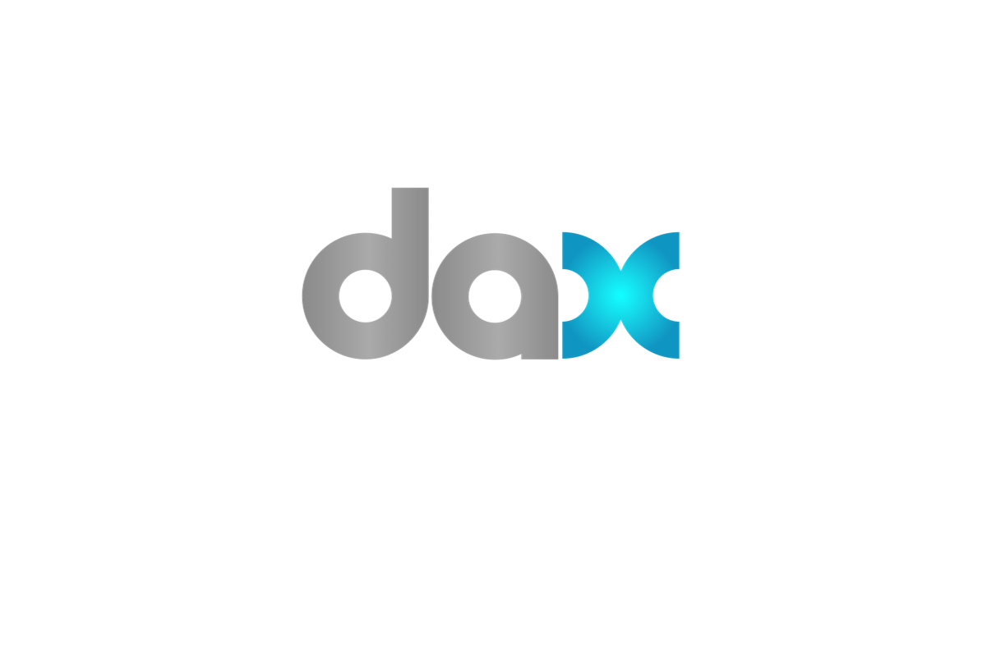
Suite 432 @ Renaissance Hotel adjacent to south hall info@daxcloud.com
310.895.9550
@DAXPLATFORM
Notes:
Hi Everyone

Slide 2
Catalysts in Technology Adoption in Media Production
Bandwidth & 4g
Ipad
Self education
Simplicity
Notes:
I been asked to speak today on how Cloud computing is being used for distribution and collaboration logistics during the production process.
Over the past few years we have experienced amazing growth in technology adaption in the media production. There are a number of catalysts driving this, like:
Better bandwidth and 4G services available everywhere
iPad – the perfect device for media production on so many levels - iPad is such an intimate romantic experience consuming media
Self education through the proliferation of consumer technologies like itunes, Hulu, YouTube!, etc. People spend more time streaming news clips than watching TV
On top of these drivers one of the biggest catalysts is simplification. Its becoming easier and more cost effective to get digital. The availability of self-service technologies that can be consumed at a low cost.

Slide 3

I am
Patrick Macdonald-King, CEO
Formerly sample digital
Notes:
First and foremost, I would like to introduce myself – I am PMK
I am the CEO of DAX, formerly known as Sample Digital

Slide 4
Your Media Universe®
We help media reach its potential.
SaaS cloud application
Notes:
My Company is DAX. WE are here at NAB with several major announcements: 1. we are launching the 4.0 version of our platform, and 2 we are opening a Canadian office as of April 1 based in Toronto – we are also opening a Sao Paula, Brazil office mid-May.
The DAX application is a multi-tenant software as a service cloud application.
And while our name is short, the description of our services covers a lot buzz words and acrenoms relevant today at this conference track.
DAX delivers targeted production workflow and media asset management applications and services to companies that produce, distribute and license audio-visual and rich media content, AKA – digital dailies, cuts, script and do management, publicity stills and more
DAX is a highly-secure web-based environment where users can share ideas, information and content created throughout the production or campaign lifecycle, or as required for trafficking and distribution of final product.
We empower the people that make it happen. We are the dashboard or panoramic view Into one’s business media universe.

Slide 5
































Clients
Notes:
Our clients find using the DAX platform reduces production and distribution costs, simplifies collaboration logistics, and improves time to market while minimizing risk, both creatively and financially.
Almost every major production studio, television and cable network, and a lot of independent producers use DAX on a daily basis – our largest deployments in the entertainment industry are with Warner Bros, FOX, CBS, A&E Networks and Lionsgate.

Slide 6
Digital Mavericks
Managed Production Workflow and Collaboration on over 2,000 Titles
Notes:
We have been providing SaaS for over 8 years so we consider ourselves digital mavericks in the field. Our business formed really around how customers wanted to consume our services and you will see SaaS is a natural fit for media production.
We have several patents around the digital dailies process as well as trademarks on digital dailies and idailies
Managed production workflow and collaboration on over 2000 shows
(not episodes – TV series and movies)
we have worked on more unique productions than any other single company in the field over the past 3 years

Slide 7
Time to decision =
Time to market =
Time to consumption
Notes:
Why do they use us?
In the entertainment industry, The greatest impact on time to market is time to decision. We provide the stage to securely exchange ideas and information
Approve, Reject, change this, that is licensed to do that in that territory
Faster time to decision = Faster time to market = faster time to consumption
DAX is a great example of how the entertainment industry is using production workflow and collaboration in the cloud.
I am going to start off using DAX as a cloud starting reference point and expand it out to potential capabilities that exist now, on the horizon or into the future.

Slide 8

Ingest,
Metadata Tag Capture
Distribute, Transcode, Publish, Secure
Search, Edit, Clip, String, Share
Comment, Review, Approve
Notes:
So what does the industry need from the cloud for media production?
They need a secure environment to ingest, tag, and centrally manage and store media
They need the ability to search, clip content, do quick edits, create media strings or playlists with the ability to release to other stakeholders
They need automated workflows for approvals and collaboration and the ability to add notes associated to time code
They need on-demand services like transcoding, watermarking/security, DRM
And the ability to publish content to their production, distribution and licensing partners.
And they need a Dashboard to see what is happening in their media universe.

Slide 9

















Notes:
Why cloud/saas is an amazing fit for this industry
The industry made up of studios, networks, entrepreneurs, independent production companies, banks, licensees, licensors, independent distributors, creative and postproduction service providers – Even all the people that work on the shows are primarily independent contractors.
Now throw a few global production partners into the mix and boom you have complicated distribution and collaboration logistics
Cloud is the perfect fit for this vertical because there are so many players involved in the production and delivery process. It allows you to turn off and on services when you need them and have a central place to manage the exchange of content and ideas around the clock in a truly global environment.
They also need a neutral ground to share assets since competitors often partner on a project and different rights on different projects.
For instance, a show like How I Met Your Mother. In this case we have a show being produced by Fox and broadcast on CBS. Another example is House, it was produced by Universal and broadcast on Fox.
In movies, you might have Universal with domestic distribution rights and WB with international.
It all depends on the financing and distribution relationships, but it can be complicated. Nevermind the politics that goes along with it.
In addition to production workflow, there is also the management of finished content for International Servicing and Digital Distribution.
This is an industry that thrives on global accessibility of the content to maximize return on investment.
So when companies like Lionsgate or Miramax license a film or television series to an overseas partner they can log into DAX and get all the contract deliverables that go along with the licensing deal that needs to be regionalized – these could include posters, DVD wraps, advertisements, promos, billboard, trailers, etc.
In some cases it also involves digital distribution of the entire movie and/or series via the system – the only inhibitors moving DNX and Pro Res files around are end user bandwidth and cloud storage which is still pretty expensive for media that is not frequently used or high in demand.
So we can expand this diagram out to Hotel Chains, Airlines, DVD replication facilities and more, but I only have so much time and only so much room on my slide so we will stick with production workflow as our example.
But you can start to see very quickly how the reach on cloud based technologies can grow and reach.
Can you imagine doing all this without the internet?? Hard to believe this is still an emerging market.

Slide 10







Notes:
So lets scale this down to a smaller sub set of the media ecosystem. We have a couple of studios, broadcasters, production companies and production sets.
Where is the use of the cloud going in production and collaboration? Lets get down to some specifics and use cases:
USE CASES:
The producers and directors want to control release of content like dailies to studios and television networks.
A Creative Exec wants to string a bunch of takes together for presentation to other stakeholders; or wants to create a clip of content to share with another user or do a rough assembly of a scene.
The ability to collaborate by adding notes and comments associated to time code – ability to make public and private comments and bookmark videos.
Watermarking a some cuts for offline viewing, etc.
Production and studio personnel expect these services to be available for on-demand via self service instead of outsourcing them to expensive media service providers or having to wait days for the job to be turned around (hey this was just 3-4 years ago – honestly).
These services, not just from DAX, are more accessible and attainable everywhere around the internet.
The market used to be served by big brick and mortar media services / post houses – they used to be the center of the ecosystem, but now its more distributed. We are not just talking about cloud media services, but also post in general. Let me give you a few examples:
Think about how much the Dailies process has changed in the past few years. We have gone from processing film in labs to near or on set solutions like MTI and Colorfront where color, audit video sync, editorial file creation, etc. is all now being done on the edge as opposed to the old brick and mortar hub. And there is no reason not to believe that these services which have gotten decentralized will become centralized once again. The cloud enables us to do this.
How long will it be until we have 7G wireless and a transmitter from the camera tap is simultaneously transmitting content into the cloud?
Just think of it, media capture and transmission complete with metadata delivered in almost real time. Say it aint so right, the director would never agree to it, its against union rules, etc. All totally untrue as long as the checks and balances are in place to ensure only the right people see what they are supposed to – in fact the director would love it as the assistant editors would already be pairing down selects from some remote location. If they could have everything all queued up at the end of each day ready to review – its basically the same as what is going today except they can work with any talent because editorial does not have to be onset.
Now lets keep thinking about this – if connectivity could transmit from set editorial quality media along with metadata and timecode – why not edit in the cloud? Why do we need the media in our local environment and why do we have to build out expensive editorial suites on set or at some remote production office – why do we have to pay for storage and hardware and software – why cant we just pay for what we use? Why cant we scale on demand? Everyone is working with proxies anyways – why not in the cloud – all you really need is bandwidth.
So think about it, we are cutting faster, composers, VFX, title sequences, etc. can all be done faster. Approvals can be instantaneous and almost real time.
How much faster does marketing and publicity start building campaigns. The can provide instant, secure access to creative agencies and trailer houses who can start cutting trailers, commercials, promo and sizzler reels in realtime without ever having complete access the content in their local environments.
How about alternative forms of creating media? For instance, Hawaii 5.0 did a show where users could login via second screen or web and vote. How far are we away from being able to do this in real time? Change the script or plot on the fly – with real time user involvement and influence.
This is just around the corner and creatives want it and demand it. They want unique or enhanced forms of programming and customer interaction.
8 years ago there were so many obstacles to be successful in the cloud (most of them personnel) – today the biggest problem is we can develop enough stuff fast enough.
Different topic but similar example: My client services department often gets calls from people screening content on plane via Wifi – 18 months ago it didn’t exist, now its unacceptable if it doesn’t work.

Slide 11





Notes:
OK cool lets look beyond production workflow – we are cloud enabled and producing content in the cloud – amazing stuff – BUT it doesn’t stop here. This is just a small sub-section of this industry (ie. Some shows in Television production) – what about the rest of the ecosystem?
So lets take a step back and reset the table and look at this from an enterprise perspective.
The area of example, DAX, is based on 2 workflows: production and/or content creation (case study I gave you) and content distribution for international servicing. Lets take a look at this from an enterprise perspective.
So you have DAX as a cloud based solution critical to the success content creation
You might have a solution for archiving and metadata,
you might have a media vault located on another providers cloud or you might have your own media located in several different locations (tech, deluxe, Cinram),
you have distribution channels like Hulu and iTunes, you might want to tie in advertising agencies and marketers into the mix, and so on and so on –
Pretty soon you have a combination of service providers and service consumers that create a massive media ecosystem and to you this all looks like this

Slide 12


Slide 13


Notes:
As cloud technologies advance and usage increases the cloud will become the super highway of business the dot bomb set out to accomplish 10 years ago.
The cloud though is about openness and integration. These systems need to figure out where the handoffs occur and who is the best of breed at parts of the ecosystem.
The alternative is to create another closed system not connected to the cloud service providers supporting on your own infrastructure. And folks this is a dead end street. Building it yourself will not save you money – it will put you on an island
The Cloud is an enabler!! It allows you to get your feet wet – not your head – and scale costs as you consume the services.
Its about scaling costs and paying for only what you use – its about Monthly expense vs. Capital outlay
At the end of the day as cloud providers become more connected and integrated the automated digital supply chain becomes a reality.

Slide 14
Key Take Aways:
Find Your Secret Sauce
Dashboards
Open APIs and Interoperability
(the cloud should be like Lego)
Notes:
So what do I want to leave you with? Our Vision on how all this has to come together:
To cloud vendors, stick with your core competencies and do it well – integration and partnerships will expand your business.
To studios and networks, Build useful Dashboards – instead of building systems studios and networks should be building dashboards or hire great company’s to provide them portals as the connective tissue between their disparate cloud systems.
They should force service providers to integrate. They need to choose vendors with an open vision willing to collaborate and work alongside potential fringe competitors.
The key to the cloud being what is can be is interoperability – OPEN API’s are an absolute must for extendibility and scalability of systems. Closed architectures do not promote the value of the cloud or its capabilities. We need LEGO
No single solution provider will own this – it needs to be a combination of partnerships, and open technologies. There will be your backend utilitarian type of providers (a la Amazon), there will be front end providers (a la DAX) and then there will be service providers who offer more targeted services like storage, transcoding, security, distribution, digital packaging, etc.

Slide 15

CEO Shameless Plug
We are launching the 4.0 version of the DAX Platform here at NAB.
Its really awesome.
We have a suite at Renaissance - #123
310.895.9550 or nab@daxcloud.com if you want to see it
Notes:
I would now like to hand the floor over to my collegues on the panel whom I’m sure will have some great insight.
Thank you very much for your time – once again my name is Patrick Macdonald-King, and my company is DAX
We have a suite at the Renaissance where we are demonstrating our new platform DAX 4.0
If you would like to see it – email and call us and we will get together
Thanks.

