Slide 1
“Cloud” is not a noun.

Slide 3
The Problem
People are more empowered with technology when they go home than when they come to work.
If you tear down walls, people will build palaces.

Slide 5
The Stakes
Ideas are most powerful when unbounded.
Never forget why we are here: translating amazing ideas into amazing content.

Slide 6
The Fix!
Lie detector
Geiger counter
Generator
Radiation suit
Telegraph
Pulley
Water pump
Battery charger
Telescope
Sewing machine
Pool table
Hot air balloon
Golf clubs
Xylophone
Roulette wheel

Slide 7
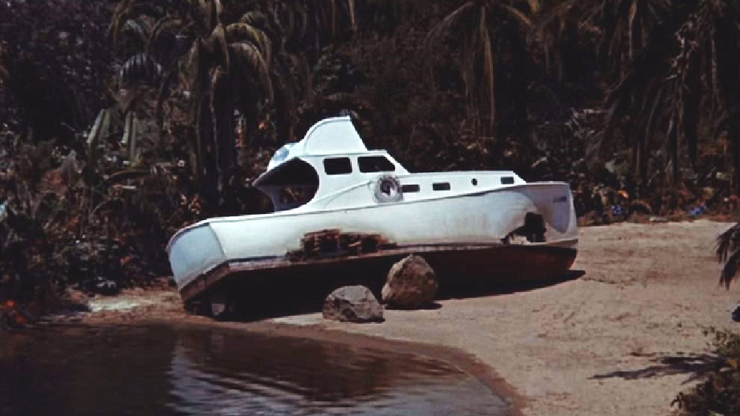

Slide 8
The Fix, Fixed
‘Cloud’ is not a noun. It’s not a thing. It’s a how. It’s a way to deliver a service. It’s a way to consume data. It’s a way to do almost anything.
Don’t build a cloud. Do everything cloudly.

Slide 10
Data Freedom
Open systems aren’t open if you can’t get at your data.
You spend your whole day destroying silos. Don’t pay someone to build more of them.

Slide 11
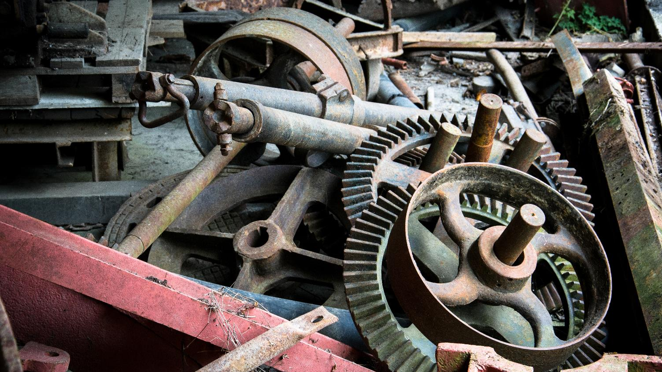

Slide 12
Interoperability
Systems have to work together – no one thing will ever do it all.
Choose solutions that fit together to do what you need.

