Slide 1
NAB
Turning Massive Data Sets Into Critical Intel
Randy Kreiser
Senior Technical Advisor
DataDirect Networks Federal

Slide 2
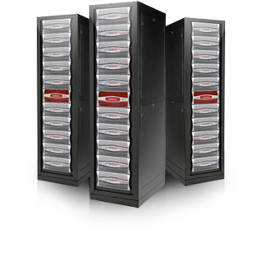
DDN | We Accelerate Information Insight
DDN provides a competitive advantage by maximizing your datacenter investment while mitigating growth challenges over your discovery process.
Established: 1998
Main Office: Sunnyvale, California, USA
Employees: 600+ Worldwide
Worldwide Presence: 16 Countries
Installed Base: 1,000+ End Customers; 50+ Countries
Go To Market: Global Partners, Resellers, Direct
World-Renowned & Award-Winning

Slide 3
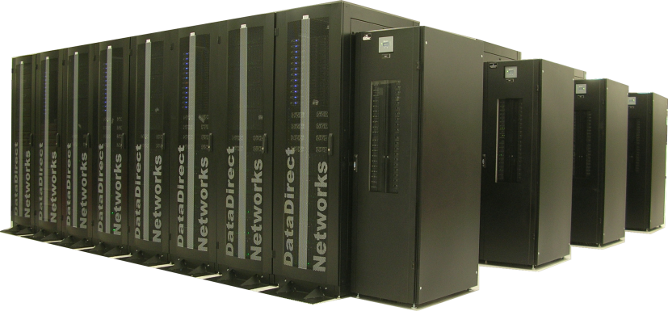
Powering Supercomputers
DDN Provides more storage to the Top 500 than all other storage companies combined
Extreme Storage Powering:
8 of the World’s Top 10 Systems
80 of the Top 100 Systems
Commercial | Government | Academic
340GB/s Powering the World’s #1 HPC System at Oak Ridge Nat’l Lab
Sample Customers

Slide 4
A Legacy in Video Content Management
600+
Powering Hollywood and Media Generation Worldwide
DDN has delivered solutions to over 600 of the world's largest media organizations.

Slide 5
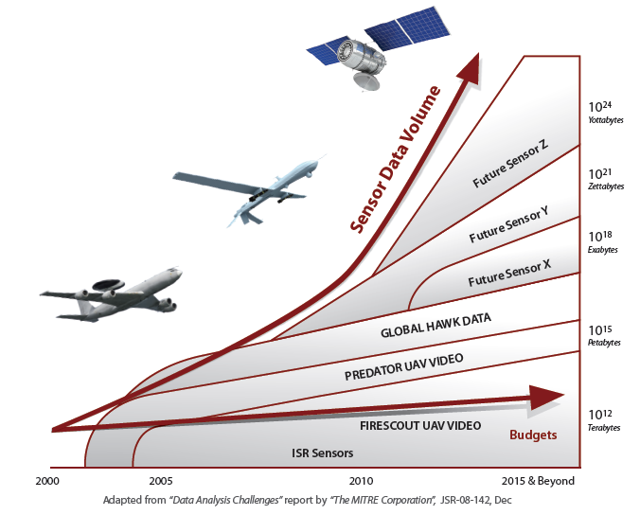
The Large Object Challenge - Volume
Exponential² Growth in Intelligence Data
Increasingly higher resolution sensors on more and more platforms
Satellites
Unmanned Aerial Vehicles (UAVs)
Manned Aircraft
Future Sensors
The DoD is creating 24 years of video every year if watched continuously
Notes:
The ARGUS-IS system, for example uses 368 five MegaPixel detectors capable of generating more than 260 Giga bits per second of raw data

Slide 6
Object Storage – The Fusion of Speed and Capacity
Traditional storage can’t solve this problem
5-12 disk operations per file read
Multiple levels of translation and communication
Metadata lookups and directory travelling
Extent list fetches
RAID & block operations
Object Storage is perfect to solve this problem
None of the constructs of traditional systems
Single-Disk-Operation Reads, Dual-Operation Writes
Reduced latency from SATA Disks since seeks are minimized
Millions of file/ops per second with much fewer disks
256 Billion objects on a single namespace

Slide 7
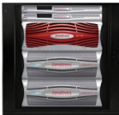
Automated, Cloud-Based Collaboration One Global Namespace
Clustered NAS
Storage
Appliances
Clustered NAS
Clustered NAS
Cloud Ready - Tiering ready with file system tiering to a public or private WOS cloud - share and disseminate information globally
Collaboration Ready - Eliminate organizational storage silos while automating data distribution & collaboration
Archive Ready - Backup files safely to a public or private WOS cloud for disaster recovery

Slide 8
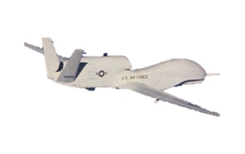
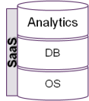
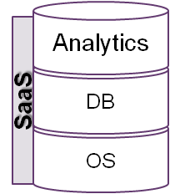
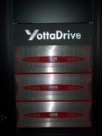
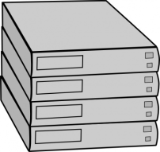
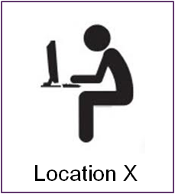
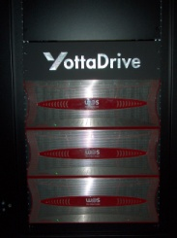
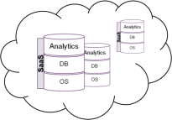
YottaDrive: Interface to the Cloud - ISR Scenario
Machine to Machine processing
MetaData
10011010001010101
MetaData
1001101000101010
Request
MetaData
Tip
10011010001010101100101
MetaData
10011010001010101100101
MetaData
Query
10011010001010101100101
Objects Stay Local
Imagery can be pushed to multiple clouds support different missions or different organizations
Only the objects that are needed are transmitted over the network to the analyst
An external source provides a tip and the image is pushed to the analysts
Run algorithms that create insight in the cloud
Run algorithms that create context locally

Slide 9
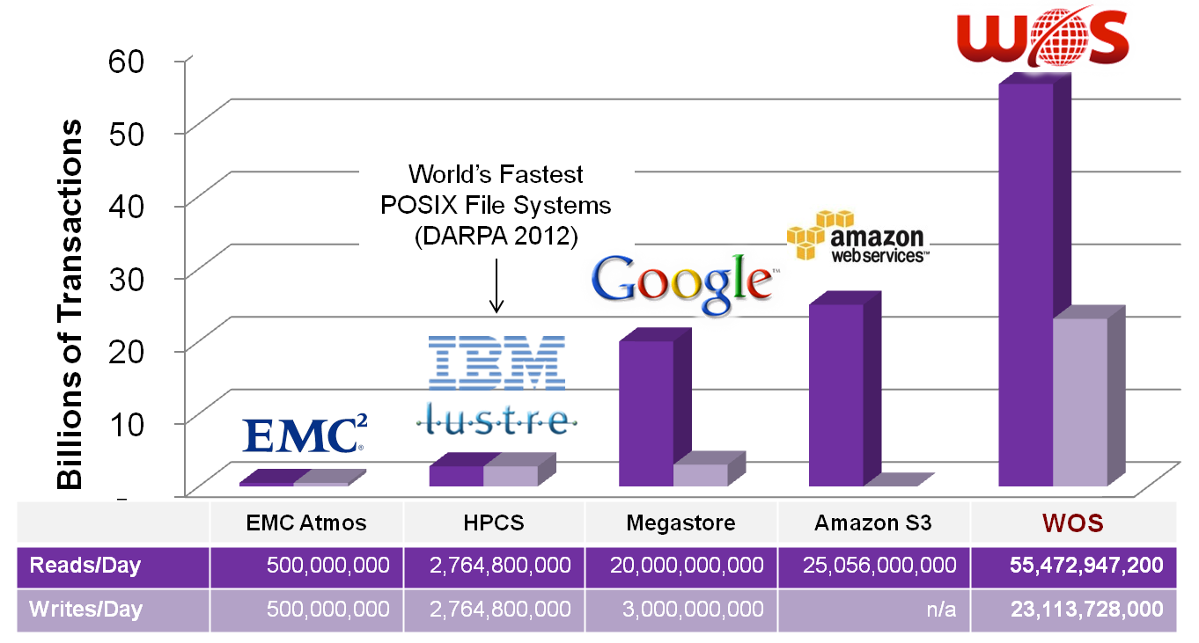
HyperScale Requires a Different Scale
8am to 5pm technologies
Enterprise
5pm to 8am technologies
HyperScale
Large Social Media Property
Customer X
Amazon: http://aws.typepad.com/aws/2011/07/amazon-s3-more-than-449-billion-objects.html
EMC: http://reg.cx/1P1E
HPCS: http://www.spscicomp.org/ScicomP13/Presentations/IBM/GPFSGunda.pdf
Megastore: http://highscalability.com/blog/2011/1/11/google-megastore-3-billion-writes-and-20-billion-read-transa.html
© 2012 YottaStor, LLC. Proprietary and confidential; Do not duplicate or distribute.

Slide 10
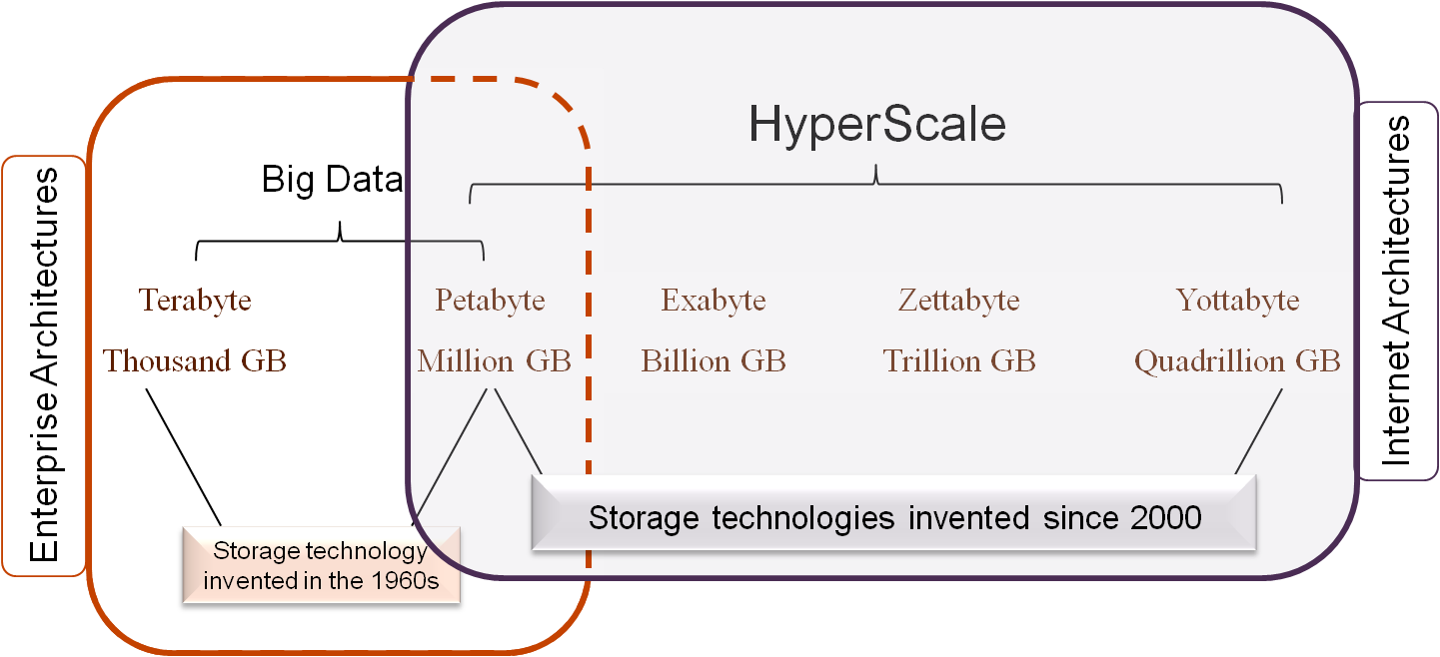
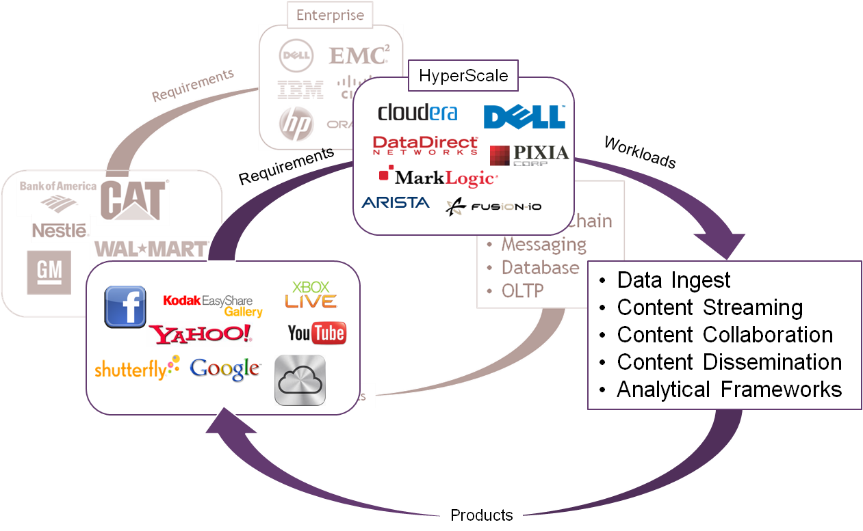
Emergence of HyperScale COTS Technologies

Slide 11
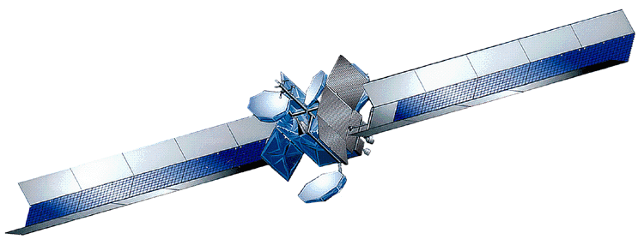
Object Storage for Improved Collaboration
DHS
USCG
NORAD
Law Enforcement
Law Enforcement
DHS
Intel
TSA
Industry
DoD
Other
Agencies
NORAD
USCG
Policy enabled subscribers
Industry
TSA
Global Name Space
Meta Data
DATA
Meta Data
DATA
Meta Data
DATA
Intel
DoD
Point to Point Data sharing
Complex
Expensive
Network Centric Data sharing
Highly efficient
Secure
No File System Complexity

Slide 12
Summary
Superior density per rack
Dramatically lower cost per GB
Acquisition
Management
Different scale of performance management and distributing large/small objects
Reduces Energy Consumption By 50% eliminating unnecessary storage enclosures, switches, fans and power supplies

