Slide 1
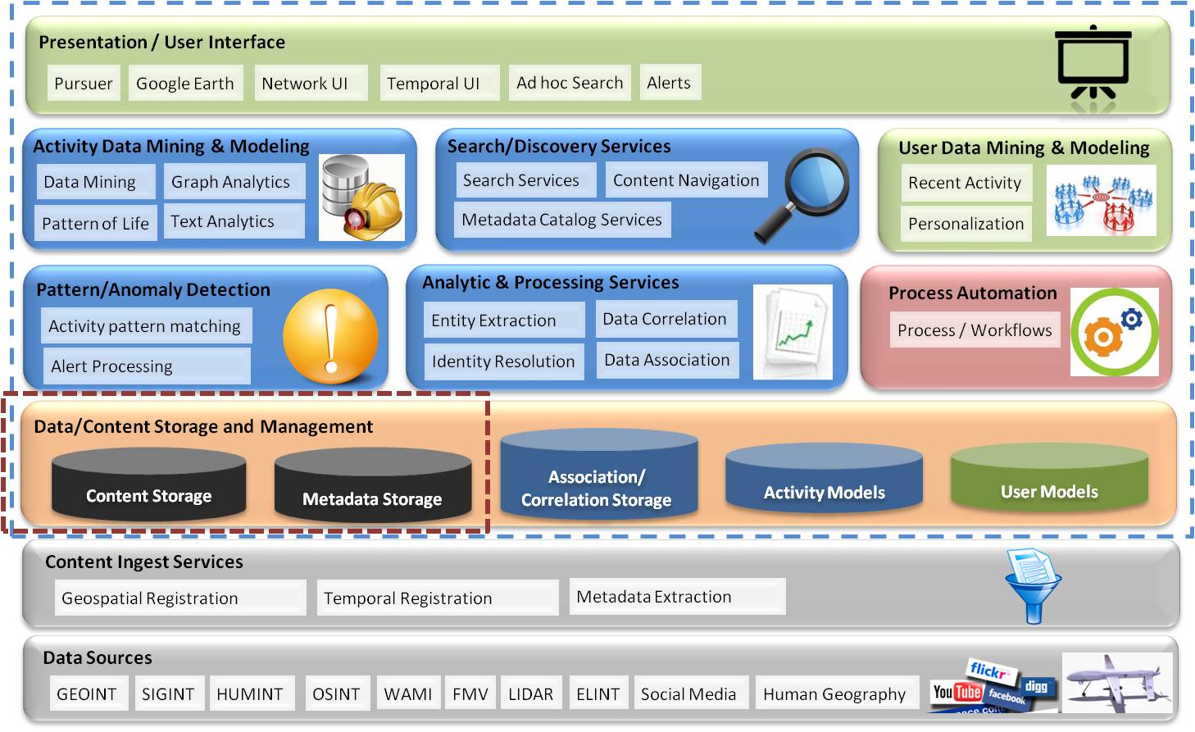
Agenda
Motion Imagery Challenges
Overview of our Cloud Activities
-Big Data
-Large Data
Implementation
Lessons Learned
Summary

Slide 2
Motion Imagery = Large Data = Big Data
The Motion Imagery LARGE DATA Problem
…100tb of MI per day
…size of data is beyond the ability of commonly used software tools to capture, manage, and process the data
… GigaPixel Images 1-10 fps per sensor is = 1500 1080P video feeds 24 x 7
…I/O and within a tolerable elapsed time
…Current NGA archive holds > 30M minutes of video
…Billions of metadata transactions
Between 2001 and 2015 we will see a 70,000% increase in the areas under surveillance – all captured in motion video intelligence – yielding yottobytes of video data”
- The Economist, Feb 27, 2010

Slide 3
Harris Cloud-Past-Present-Future
Phase 1:Motion Imagery Enterprise
Phase 2: Motion Imagery Cloud
Phase 3: Distributed Motion Imagery Cloud
Phase 4: OpenFlow
Enabled Network’s
Enterprise Workflow Orchestration & Management
Carrier Grade Cloud Central Management
Video Recording
OpenStack or Cloudera
Regional Data Center
AF
Video Processing
Hadoop/Accumulo VM
Focused
Engineering Team to Convert
Applications
Continued
Expansion Of
Workflows
Supported
Leverage
Open Flow
Services
Network
NGA
WAMI Ingest
E_Puppet VM
Telestration
Splunk VM
Regional Data Center
DISA
Media Management
CEPH Dist. Storage
Navy
Transcoding
Enterprise VM’s
Regional Data Center
Army
T&M
Enterprise Trust
On Demand Streaming
Multi-Tenant-Mgr
Regional Data Center
Trusted Security
Virtualized Enterprise
Virtualized Cloud
Intercloud
Carrier Cloud
Cloud based application development must mature as we progress toward Carrier Grade Clouds

Slide 4
Lessons Learned
Large Data Vs Big Data, ingesting, scaling and moving the data is hard
100tb of data a day is a I/O limited, you just can’t move it all electronically
Must ingest once and use many ( even virtual environments struggle to scale)
Hadoop was not engineered for processing motion imagery
Processing billions of big data records in near real-time today
GPU Clouds will be needed to process Large Data
Todays cloud implementations are really multi-tenant not elastic distributed scalable cloud’s
Applications needs to both scale down rapidly as well as scale up, which is a new requirement.
Latency is a huge concern in a distributed cloud
VMs need to be optimized for motion imagery applications.
Hardware Systems should be designed to scale without having to bring systems down
CPU, GPU, Memory, Storage and Networking resources must be dynamically allocated
Data center resources must be engineered to match application environment in the LAN and across the WAN

Slide 5
Where Are We Going From Here
Carrier Clouds Will Emerge
Where the convergence of cloud computing, wide area networks (WANs), local area networks (LANs), and carrier-class networks provide predictable response times and secure data transport through dynamic and coordinated management and allocation of cloud computing and network resources.
Enable rapid deployment of applications, services, and data.
Meet the traffic demands of large-scale virtual workload mobility and federated services and applications
Isolate traffic to provide secure multi-tenancy (vertical management)

