Slide 1



UEFA 2012
Aspera Plays Soccer

Slide 2
PRESENTER AND AGENDA
PRESENTER
Andrea Di Muzio
Sr. Solutions Architect
dimuzio@asperasoft.com
AGENDA
  Industry Trends and Challenges
  Aspera Solution
  UEFA Case Study
  Q & A

Slide 3
Aspera’s mission
Creating next-generation transport technologies
that move the world’s digital assets at maximum speed,
regardless of file size, transfer distance and network conditions.

Slide 4
Trends
Big Data Explosion
  90% of data today file-based or unstructured
  Mix of file sizes—but larger and larger files the norm
Diversity of IP Networks—Media, Bandwidth Rates, and Conditions
  Variable bandwidth rates (slow to super-fast)
  Bandwidth rates increasing—costs decreasing
  Network media remains diverse (terrestrial, satellite, wireless)
  Conditions vary—all networks prone to degradation over distance
Global Workflows—moving Big Data over WANs
  Teams are geographically dispersed
  Over distance, network conditions degrade
  Contemporary TCP acceleration solutions not designed for big data transfer and replication
Cloud Computing Grows Up
  Amazon Web Services (AWS) S3 cloud storage – 2010: 262 billion objects, 2012: 1.3 trillion objects
  More choices: Microsoft Azure, OpenStack, HP Cloud
  No longer a niche – Netflix (transcoding), MTV (global video distribution), BGI (genomic sequencing)

Slide 5
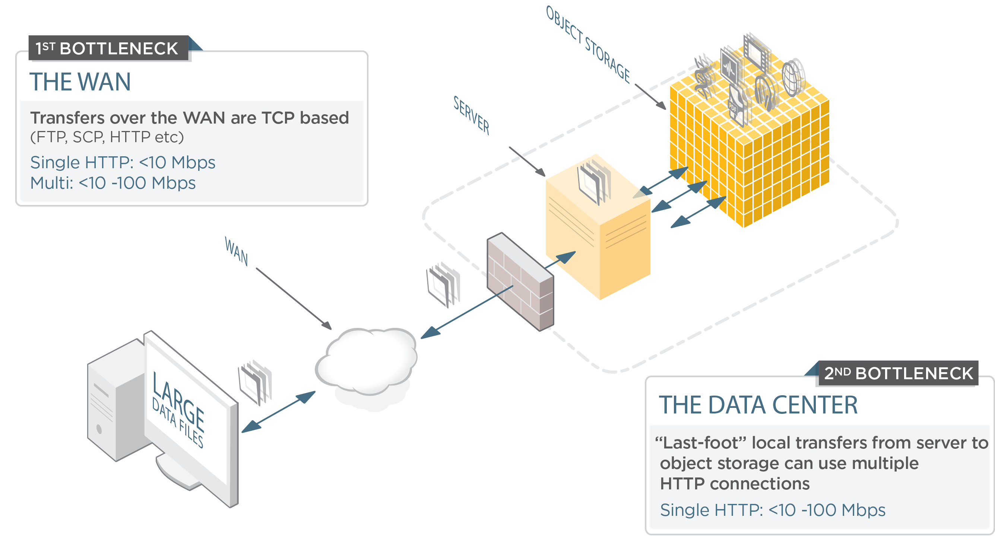
Big data cloud storage challenge

Slide 6
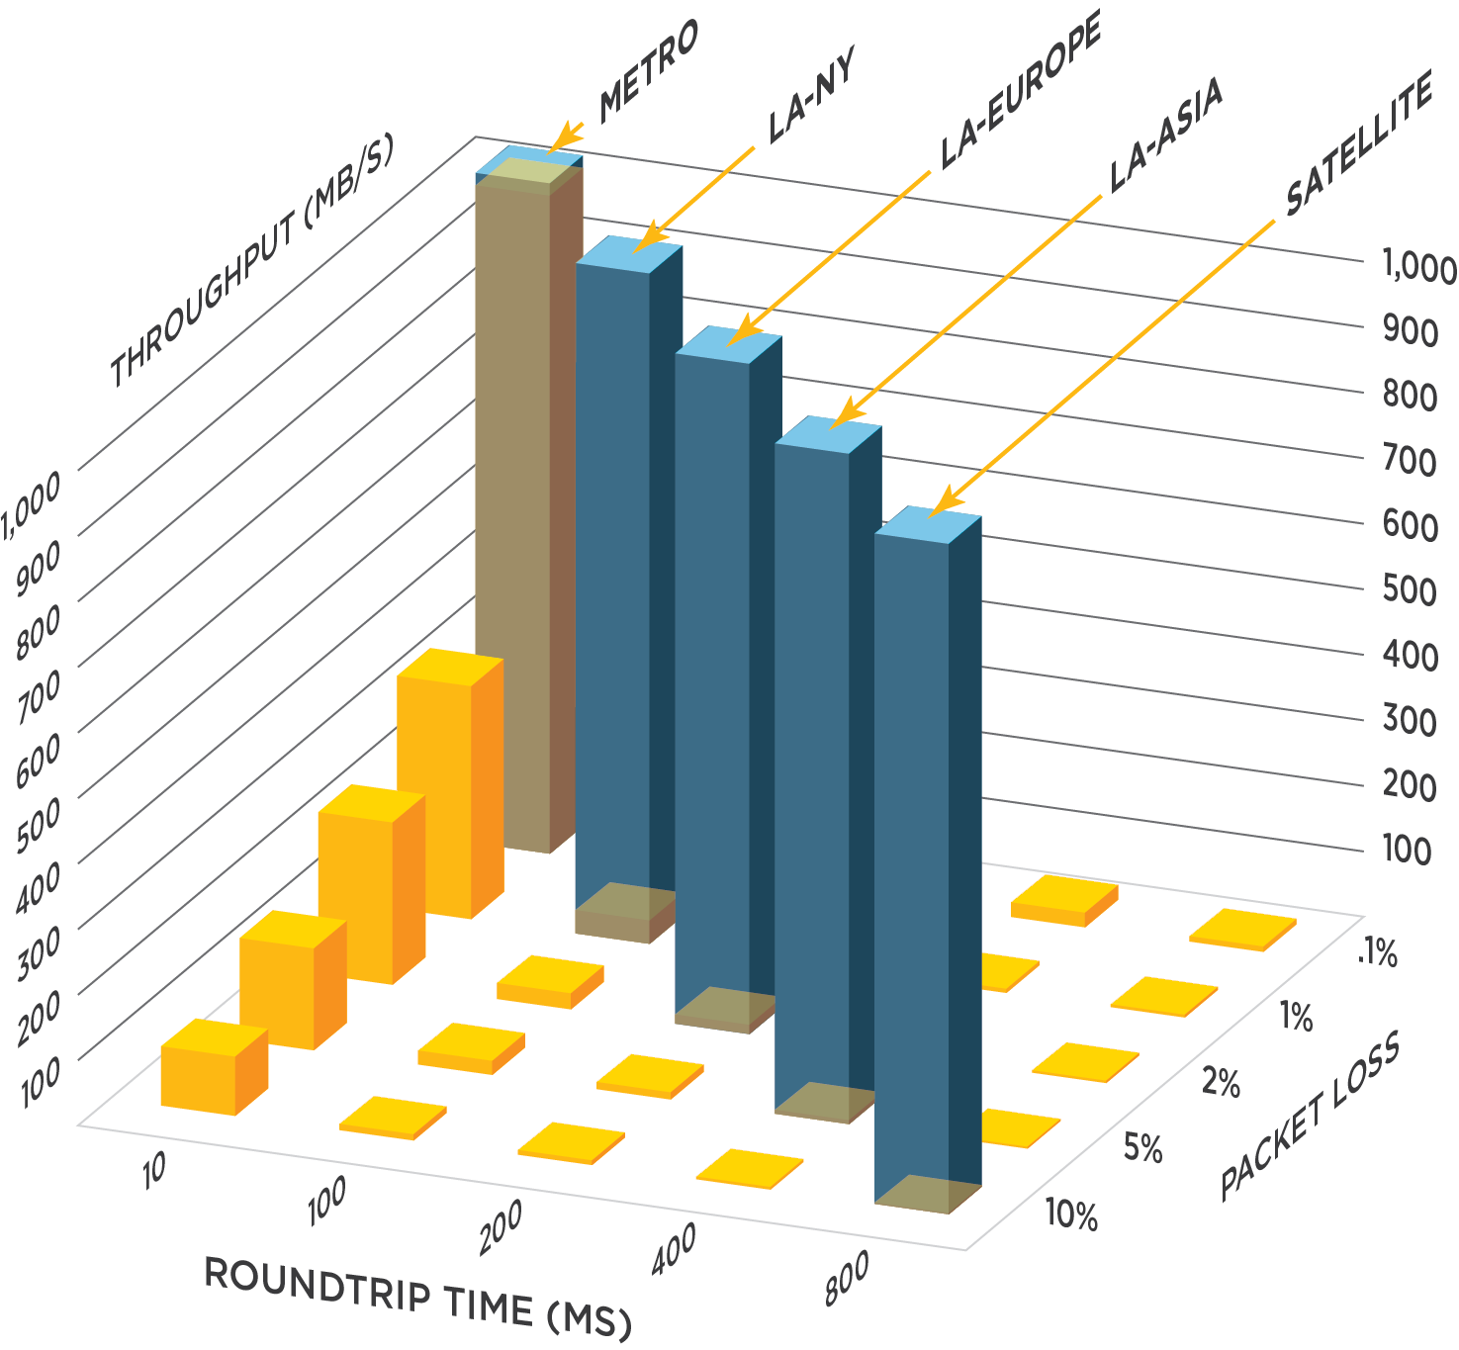
fasP™: high-performance transport
Maximum transfer speed
  Optimal end-to-end throughput efficiency
  Transfer performance scales with bandwidth independent of transfer distance and resilient to packet loss
Congestion Avoidance and Policy Control
  Automatic, full utilization of available bandwidth
  On-the-fly prioritization and bandwidth allocation
Uncompromising security and reliability
  Secure, user/endpoint authentication
  AES-128 cryptography in transit and at-rest
Low Overhead
  Less than 0.1% overhead on 30% packet loss
  High performance with large files or large sets of small files
Resulting in
  Transfers up to thousands of times faster than FTP
  Precise and predictable transfer times
  Extreme scalability (concurrency and throughput)

Slide 7
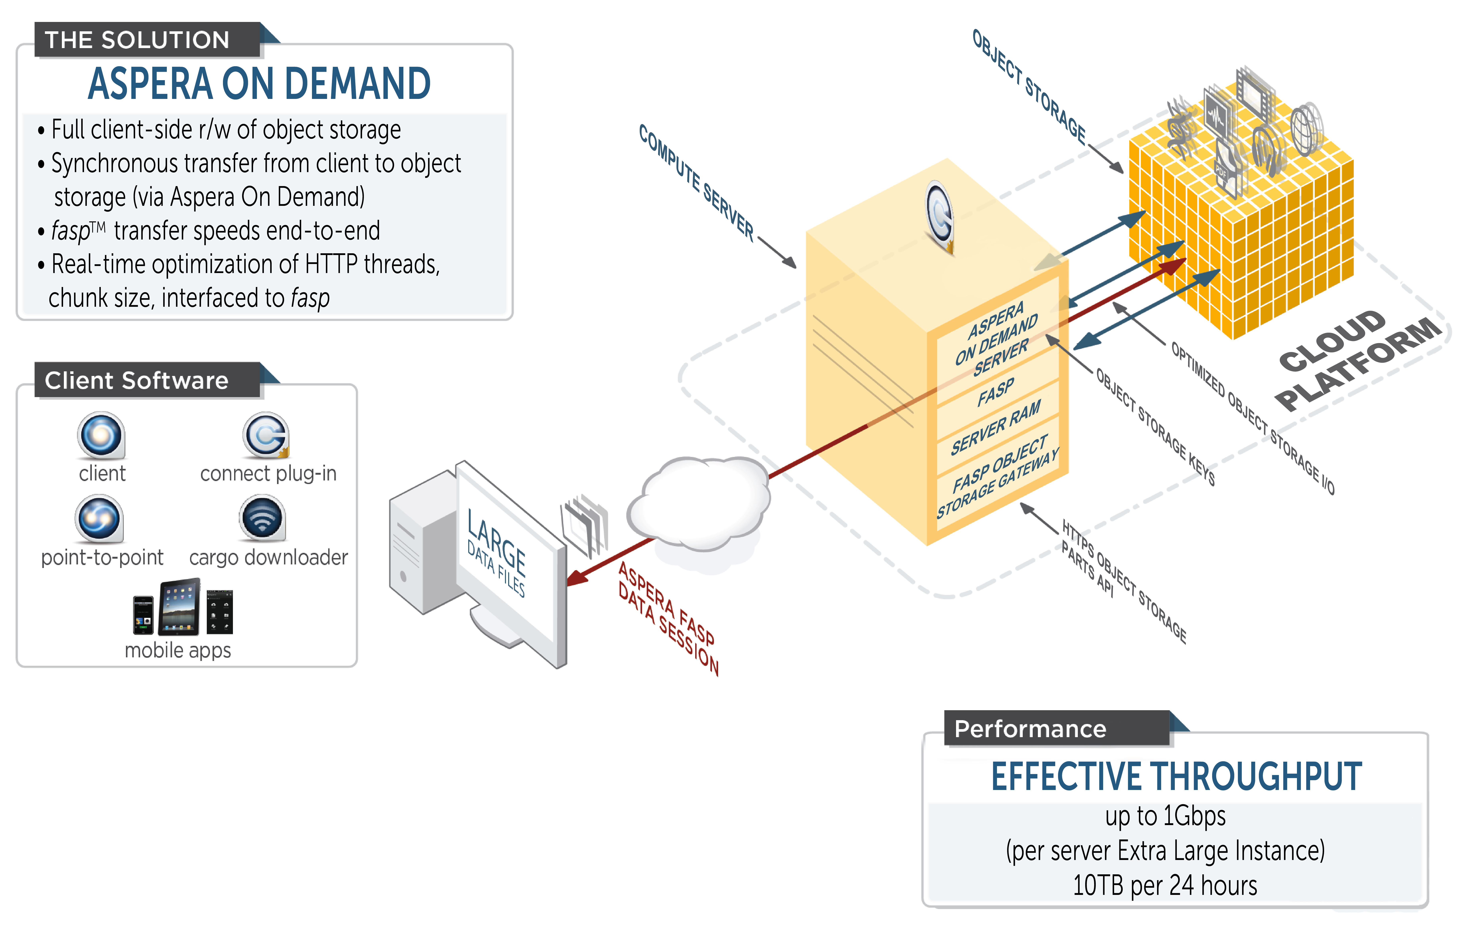



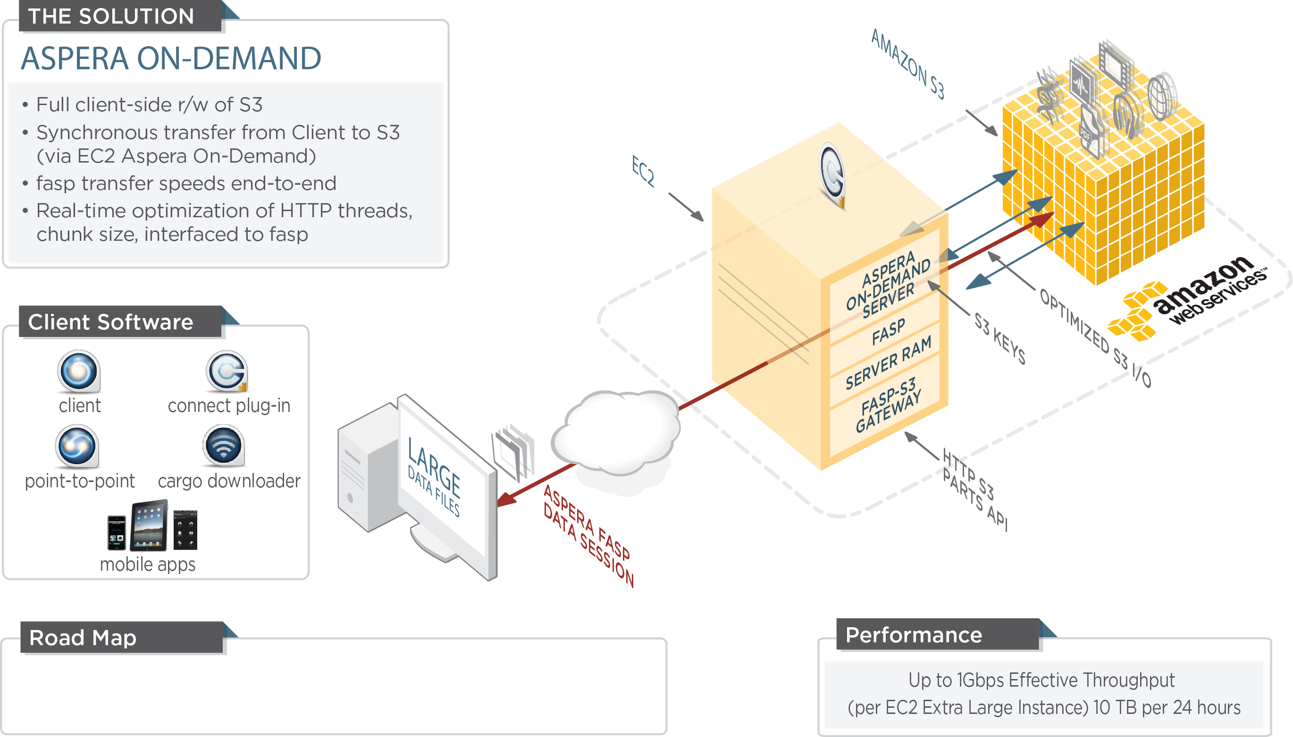





Aspera On Demand HIGH SPEED DATA INGEST
With Direct-to-CLOUD
Cloud

Slide 8

Euro 2012 final tournament: some numbers
1 month of operations
8 cities
31 matches
16 national teams
The 3rd most important sport event in Europe

Slide 9





UEFA Technology partners

Slide 10
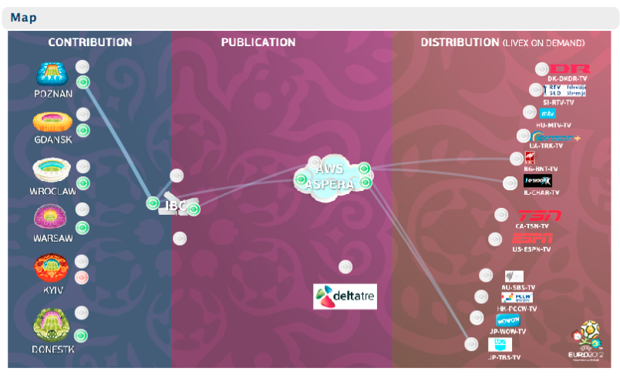


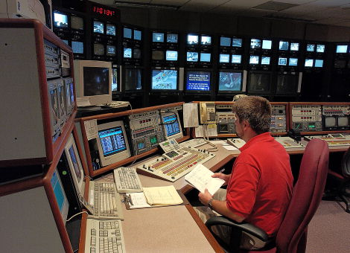
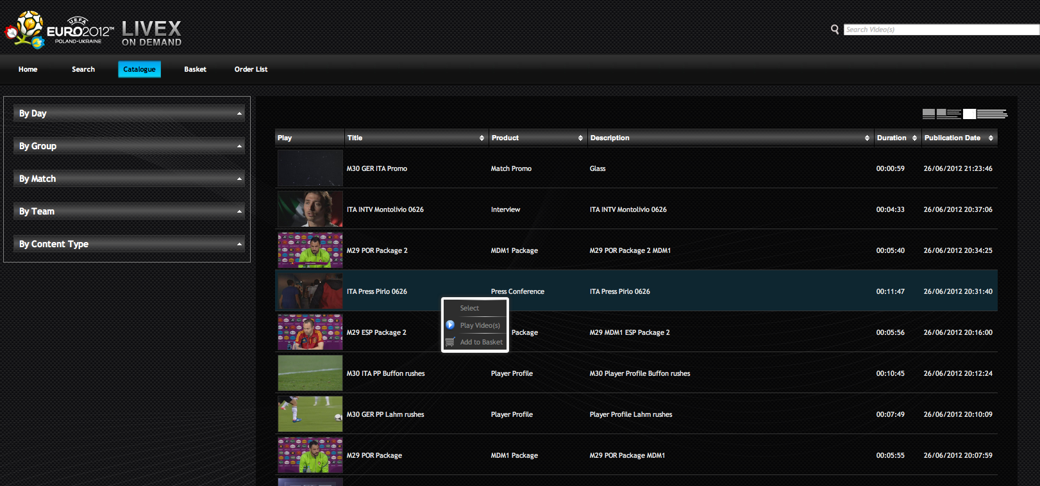
UEFA Livex service

Slide 11
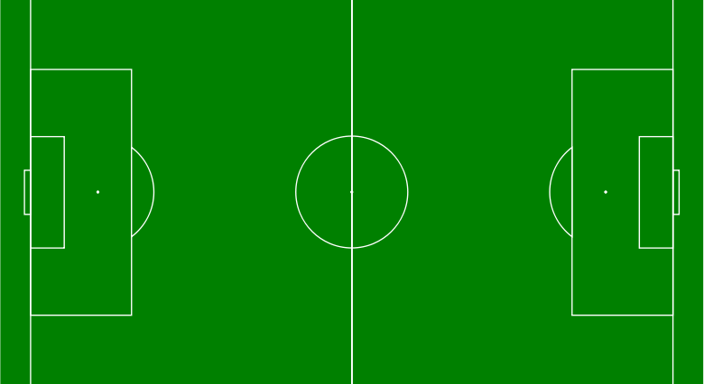





UEFA Euro 2012 – The Aspera team
Console
Cargo
P2P
Defense
Midfield
Contribution
Publication
Distribution
Attack
Cargo
P2P
Enterprise
Server
Aspera Server
On Demand
Faspex
On Demand
P2P
Cargo
Orchestrator

Slide 12
UEFA Livex service
Cargo
P2P
Console
Cargo
P2P
Enterprise
Server
Aspera Server
On Demand
Faspex
On Demand
Orchestrator
P2P
Cargo

Slide 13
Publication: FAME

Slide 14
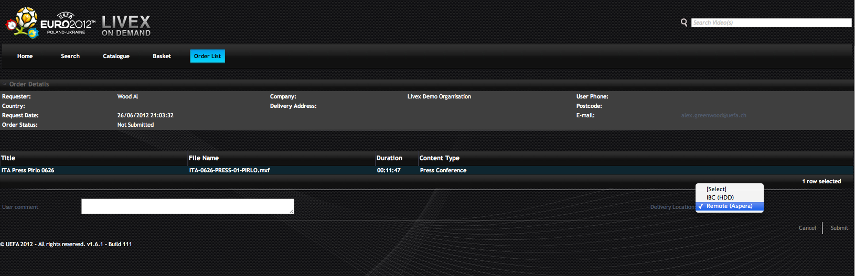
FAME: delivery

Slide 15
UEFA: some numbers
Some statistics on one month of operations
Contributed > 1000 clips. Transferred 7.2 TB from venues to EVS SAN
Published 1703 video clips, 1185 audio tracks. Transferred 5TB to the cloud
Executed ~10K workflows via Orchestrator
Ordered 3070 clips. Distributed 13.9 TB via Faspex on demand and Cargo

Slide 16
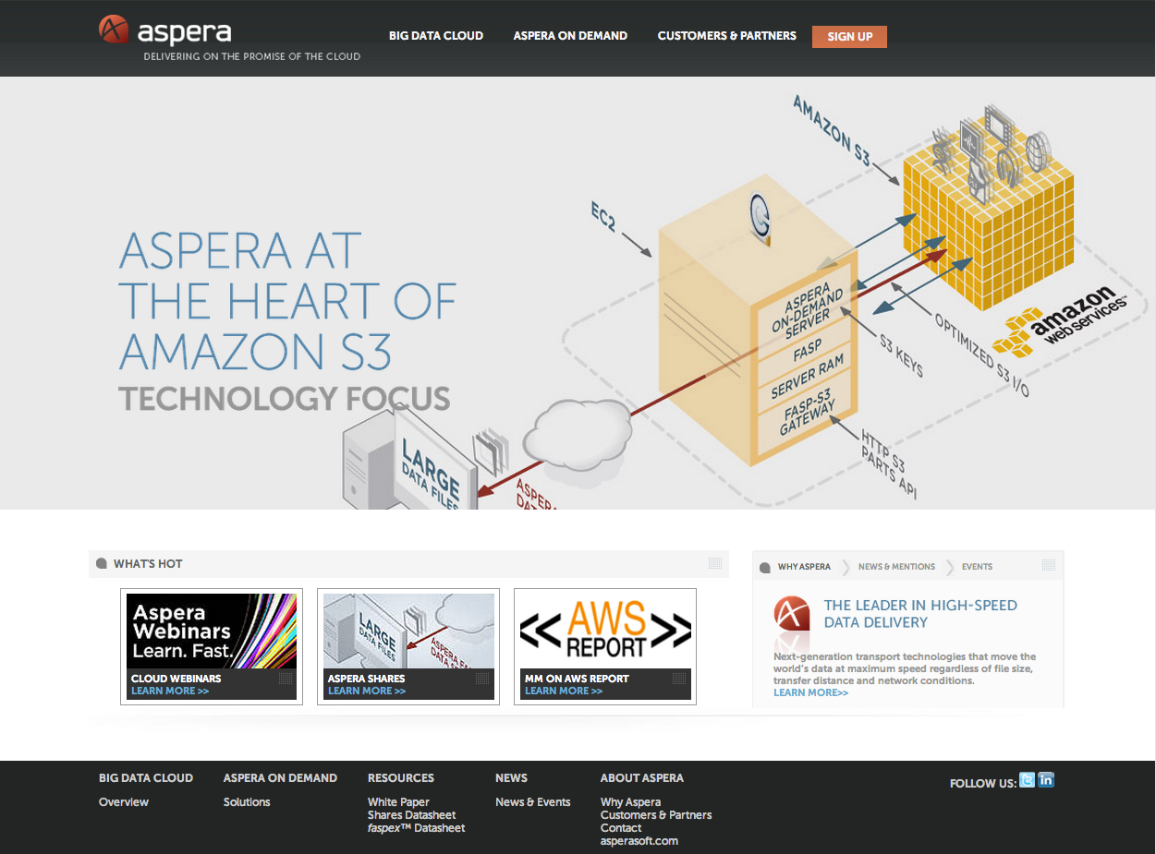
LEARN MORE AT Cloud.asperasoft.com

Slide 17
THANK YOU FOR JOINING!
Andrea Di Muzio
Aspera Sr. Solutions Architect
For more information on any Aspera product, please contact:
sales@asperasoft.com

Slide 18
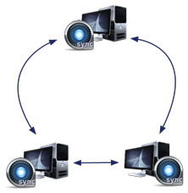

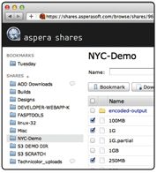
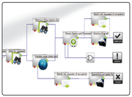


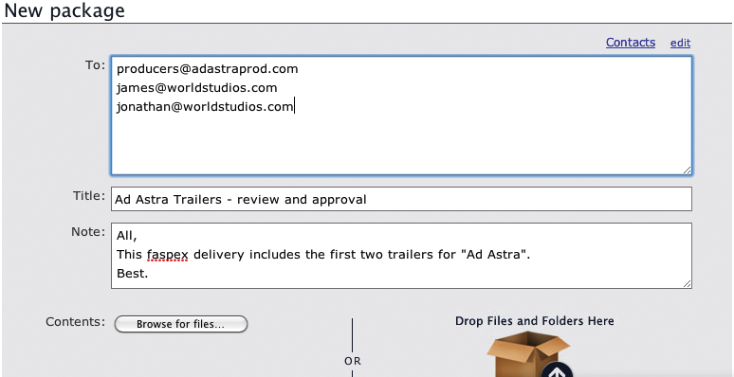
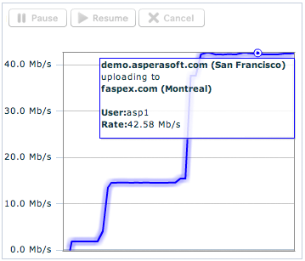






Aspera product portfolio
TRANSFER CLIENTS
WEB APPLICATIONS
MANAGEMENT & AUTOMATION
SYNCHRONIZATION
High-speed transfers
for web, desktop and mobile
File sharing, collaboration and exchange applications
Transfer management, monitoring and automation
Scalable, multi-directional, multi-node synchronization
TRANSFER SERVERS
High-speed file transfer servers for on premise, private, public, and hybrid cloud deployments
FASP™ TRANSPORT
Innovative, patented, highly efficient bulk data transport technology, unique and core to all Aspera products

Slide 19











CUSTOMER EXAMPLE: CLOUD-BASED ENCODING
Ultimate Fighting Championship® (UFC®) is the world’s leading promoter of mixed martial arts (MMA), with programming broadcast to half a billion homes throughout 150 countries.
Challenge: Transferring high-resolution video content from venue to host site in the cloud for scale-out transcoding
HTTP – multipart
fasp
2
3
Aspera Connect browser plug-in
Connect Server running on EC2
Parallel Transcoding
14 EC2 instances: 3 min
1
4
Herndon, VA
THE SOLUTION
Video Broadcast Capture
High-speed upload of content directly into AWS S3
Transfer completion triggers parallel transcoding in the cloud and device-specific videos are saved to S3
Using AWS CloudFront, content is delivered to viewers’ devices
`

Slide 20




Demo at Aspera Stand K09: END-TO-END WORKFLOW
Ingest, Transfer, Distribute and Archive globally, in minutes
THE SOLUTION
AUTOMATE
Content is transferred and ingested to an on-premise Aspera server
Aspera high-speed transfer Direct-to-S3 with Aspera On Demand
Multiple parallel transcoding jobs, with output stored back to S3
Faspex packages are created, sent and downloaded by the customer
Media files are archived to Azure BLOB or AWS S3 / Glacier
Entire process is MINUTES, works GLOBALLY, and is SECURE
Aspera
Console
Aspera
Orchestrator
DMZ
Media Customer
BLOB
3
Transcoding Service
4
5
Media Company
Faspex
On Demand
Aspera Node
1
S3
Glacier
Aspera Node
2
Ingest
Transform
Distribute
Archive

