Slide 1
The transition from live to file –
How it’s changing video transmission networks?
Keith Goldberg, VP, Transmission Operations, Fox Networks
Ryan Korte, Principal Network Architect, Level 3 Communications
© 2013 Level 3 Communications, LLC. All Rights Reserved. Level 3, Level 3 Communications, the Level 3 Logo and Vyvx are either registered service marks or service marks of Level 3 Communications, LLC and/or one of its Affiliates in the United States and/or other countries. Level 3 services are provided by wholly owned subsidiaries of Level 3 Communications, Inc. Any other service names, product names, company names or logos included herein are the trademarks or service marks of their respective owners.

Slide 2
Keith Goldberg
VP, Transmission Operations
Fox Networks

Slide 3
Affiliate Distribution Portal - Objective
Developed specifically to enable affiliate promo reel content distribution via the Internet from Fox Broadcasting to Affiliates
Design goals
  Ease of use
  Improved flexibility in delivering promo reel content over current approach
  Improved communication from Fox Broadcasting to Affiliates regarding promo reel content
  More timely content availability
Ability to distribute new content immediately upon approval
Allows promo reel clips to be downloaded whenever desired by Affiliate
Enhanced metadata tagging for content identification by region
File transfer acceleration software built-in
  Speeds file delivery to Affiliates with constrained internet bandwidth
Email notification when new content is available
  Email system can also notify when content is being retired
  Enhanced Reporting

Slide 4
High-Level Portal Workflow
Promos uploaded to portal via Portal Website (Only need an Internet connection)
(2) Promos held in portal until approved for release
(4) Promos available for Affiliate download
(6) Promos downloaded to Affiliate via existing
Internet connection
Staging
Released
Content
RELEASE
Download
(5) Affiliate views promos via Portal Website on the Internet
(3) Approval for promo release via Portal Website
Content Users
Content Creators

Slide 5
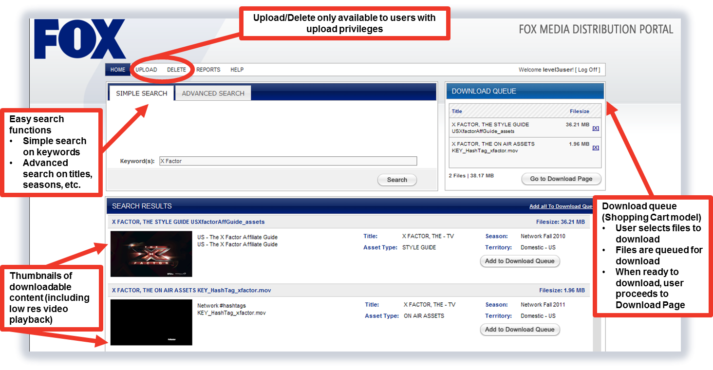
Fox Media Distribution Portal –
Basis for Promo Portal

Slide 6
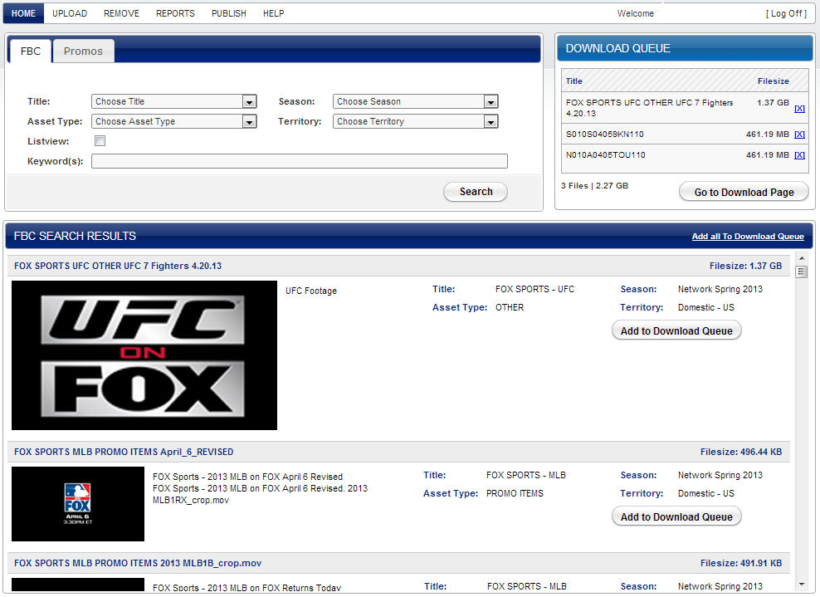
Smaller frame
Showing the download queue and larger version of the graphic

Slide 7
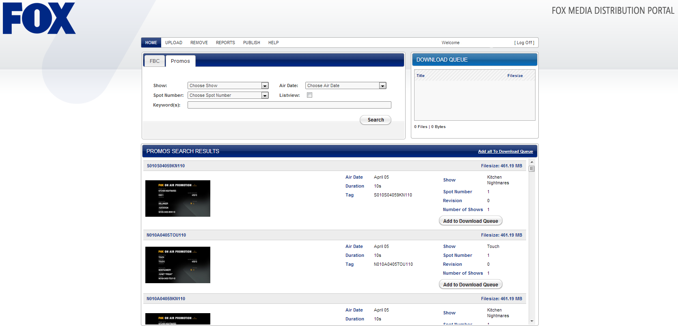
Full screen version showing Fox logo in top left corner

Slide 8
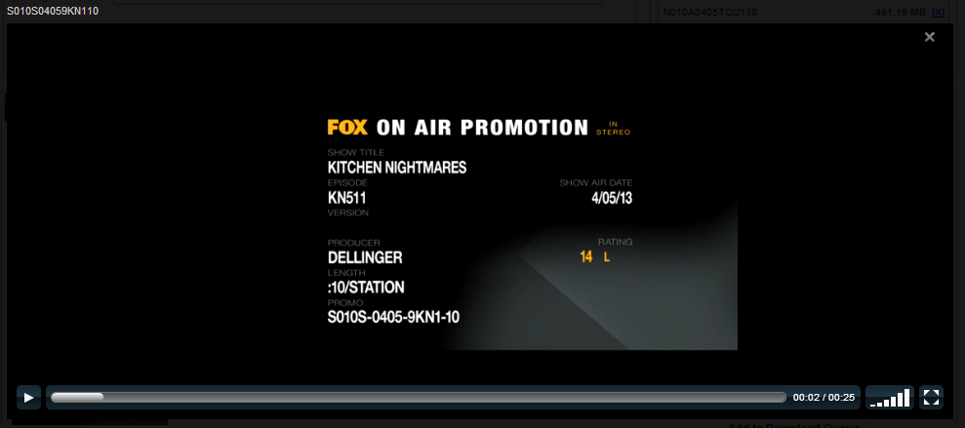
Play-out of low resolution version

Slide 9
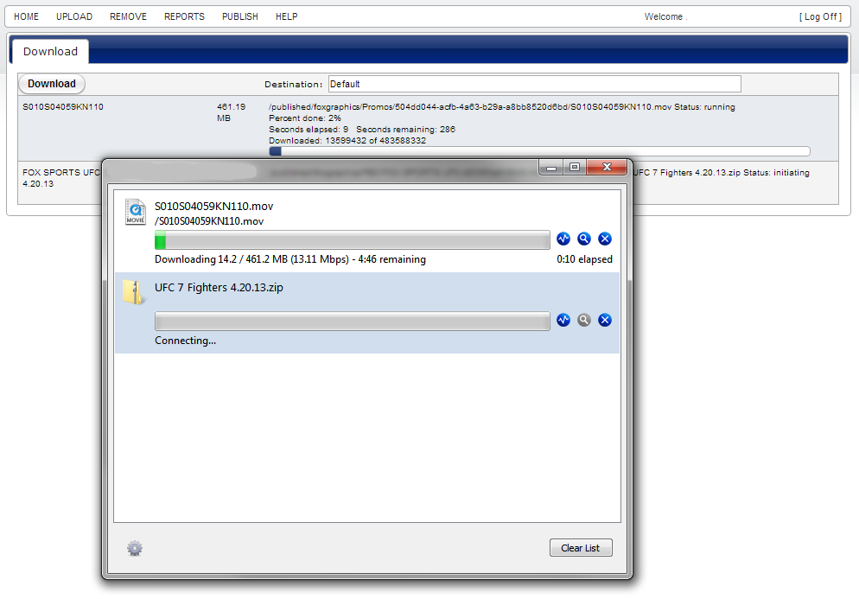
Smaller frame
Showing the download management with file acceleration

Slide 10
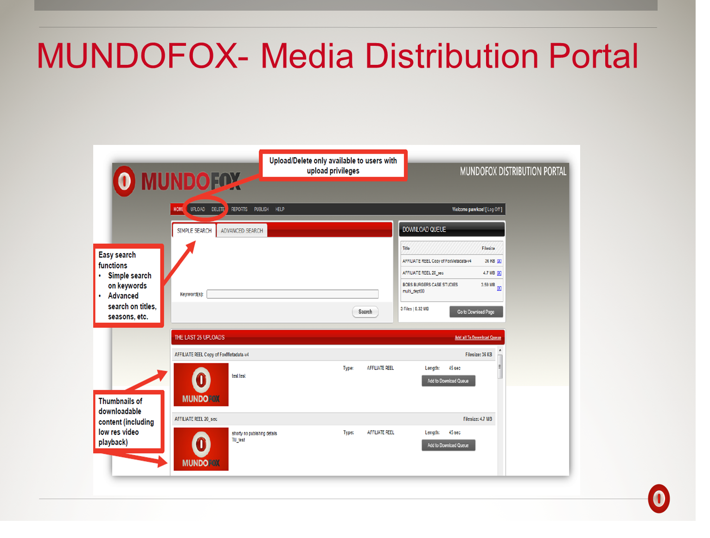

Slide 11
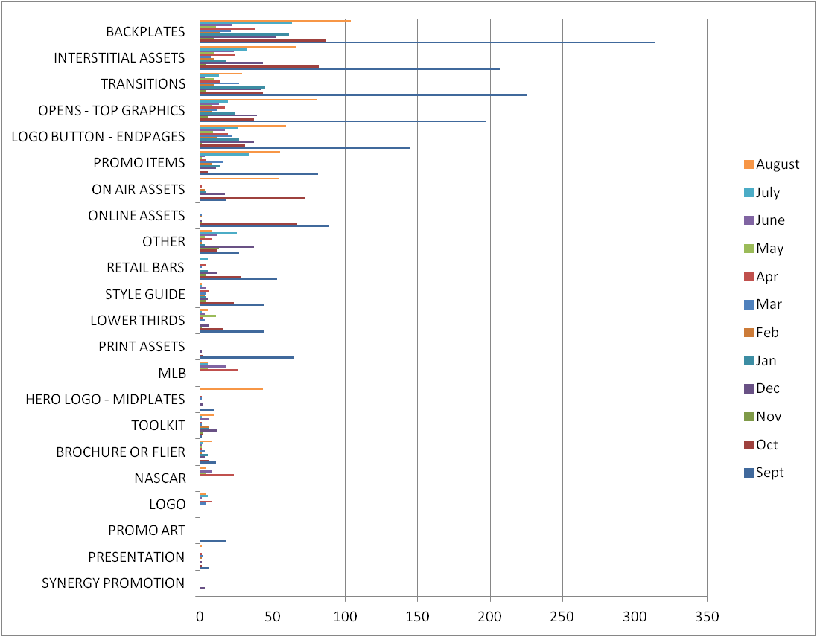
Asset Type Popularity Graph
Note: Data from Nov. 12 – Dec. 11 is not reported here.

Slide 12
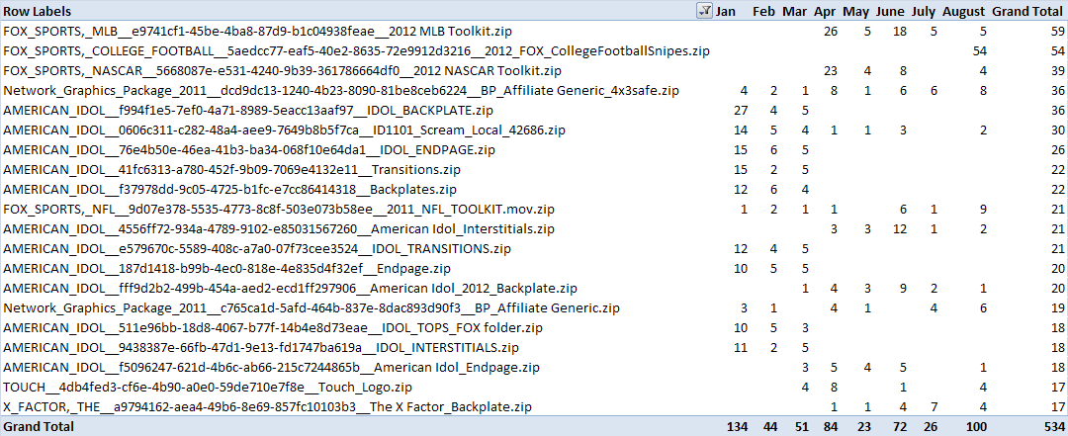
Top 20 Individual Assets in 2012

Slide 13
Ryan Korte
Principal Network Architect, Level 3 Communications

Slide 14
What’s changing?
Dynamic for service providers is changing – why?
  Changes in
    Workflow
    Technology
    Economics and the Economy
    Globalization
    New Distribution platforms = new formats
    Collaborative nature of content creation
Controlled closed environments -> open multi-network environments
Is that so different from before? Maybe not….
  Access loops were from multiple carriers
  Many video services used 3rd party hubs and mixture of terrestrial and satellite

Slide 15
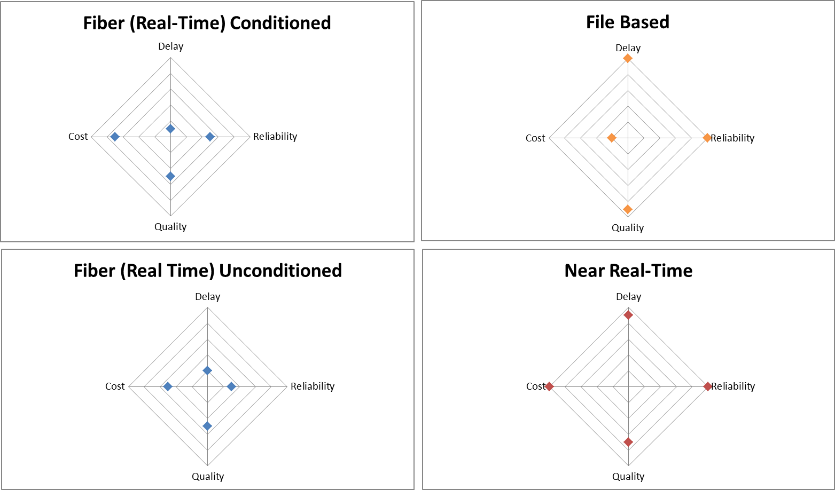
Service Network Characteristics

Slide 16
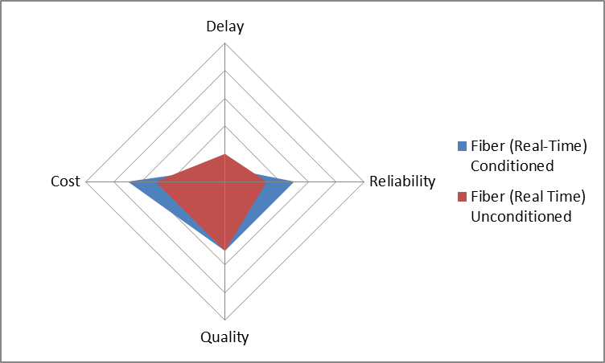
Real-Time Conditioned and Unconditioned

Slide 17
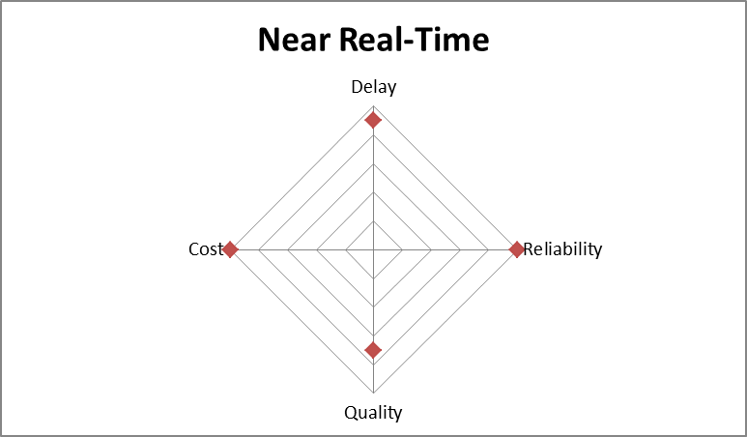
What is Near Real-Time?
Input/ Output is still a video signal as compared with File transmission
Dual paths
Hitless (latency differential is key) Diversity must be maintained
Packet Retransmission (roundtrip latency is key)
FEC (depending on amount)
Increases in delay and bandwidth can equal a higher quality and more reliable transmission

Slide 18
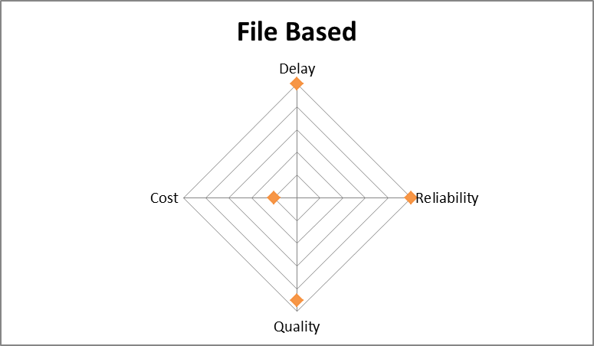
File Based Transmission
File Transmission Service
  Portals for single customers
  Collaboration environments for many customers
  Delivery Receipts
  File checksums
  Multiple Formats
  Transcoding coupled with the delivery
  Quality – initial file defines the limits
  Thumbnail capabilities
  Access controls
  Network latency less relevant
  Multiple paths can exist eliminating points of failure

Slide 19
Conclusion
Access links needs to be able to support any of the service types
  Video loops, SONET loops, Ethernet Access
Providers should focus more on the end to end service characteristics not just the network characteristics
  As an industry we are fairly good at this, but need to continue our work in all areas
The application of which service characteristic best fit should determine which service to use
The underlying network needs to be matched to the desired cost targets

Slide 20
THANK YOU!

