Slide 1
Changes in Cloud Computing
Notes:
Mark Davis
William Morris Agency
Founder, Fresh Baked Studios
CEO, Scenios
Jeff Wurtz
Producer, director, editor
Inside The Actor’s Studio
5 Emmys for editing
Chief Evangelist, Scenios

Slide 2
Do you feel like you understand
what the cloud is?
44%
Source: Wakefield Research
Notes:
Recent study by ovum research

Slide 3
Do you think that stormy weather can interfere with cloud computing?
51%
Source: Wakefield Research
Notes:
Recent study by ovum research

Slide 4
Are you currently using any
cloud-based production tools?
23%
Source: Ovum Research
Notes:
Recent study by ovum research

Slide 5
Are you considering using any
cloud-based production tools?
75%
Source: Ovum Research
Notes:
Recent study by ovum research

Slide 6
So what is the cloud, anyway?

Slide 8
A place where you store stuff online,
and collaborate with other people.

Slide 9
Data center

Slide 10
Why all the hype?
Notes:
http://www.eweek.com/cloud/cloud-adoption-ahead-of-schedule-to-reach-500-million-in-2012-ihs/

Slide 11
500M
This year
150M
Last year
Notes:
http://www.eweek.com/cloud/cloud-adoption-ahead-of-schedule-to-reach-500-million-in-2012-ihs/

Slide 12
$100B
2016
$40B
2012
Notes:
http://www.eweek.com/cloud/cloud-adoption-ahead-of-schedule-to-reach-500-million-in-2012-ihs/

Slide 13
Cloud
computing
Biotech
Video games
Solar power
Notes:
http://www.eweek.com/cloud/cloud-adoption-ahead-of-schedule-to-reach-500-million-in-2012-ihs/

Slide 14
That’s why there’s
so much hype
Notes:
http://www.eweek.com/cloud/cloud-adoption-ahead-of-schedule-to-reach-500-million-in-2012-ihs/

Slide 15
Who’s sick of hearing all the
hype about the cloud?
What does this mean for me?
Notes:
Recent study by ovum research

Slide 16
Connecting the Dots
Notes:
Mark Davis
William Morris Agency
Founder, Fresh Baked Studios
CEO, Scenios
Jeff Wurtz
Producer, director, editor
Inside The Actor’s Studio
5 Emmys for editing
Chief Evangelist, Scenios

Slide 17
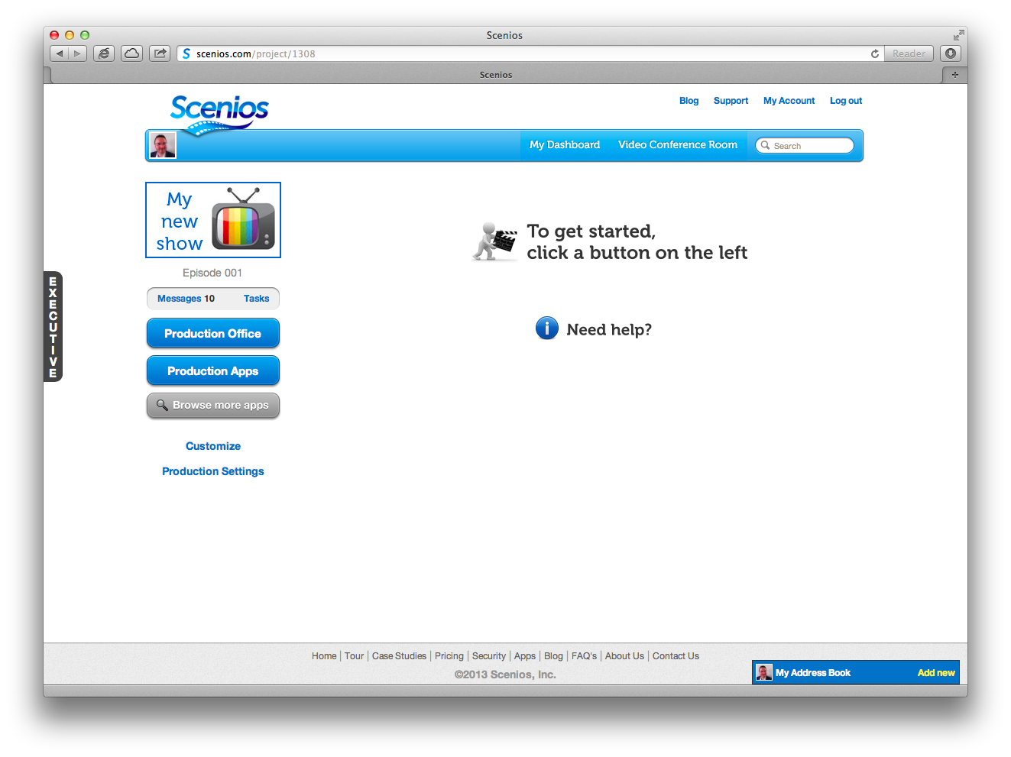

Slide 18
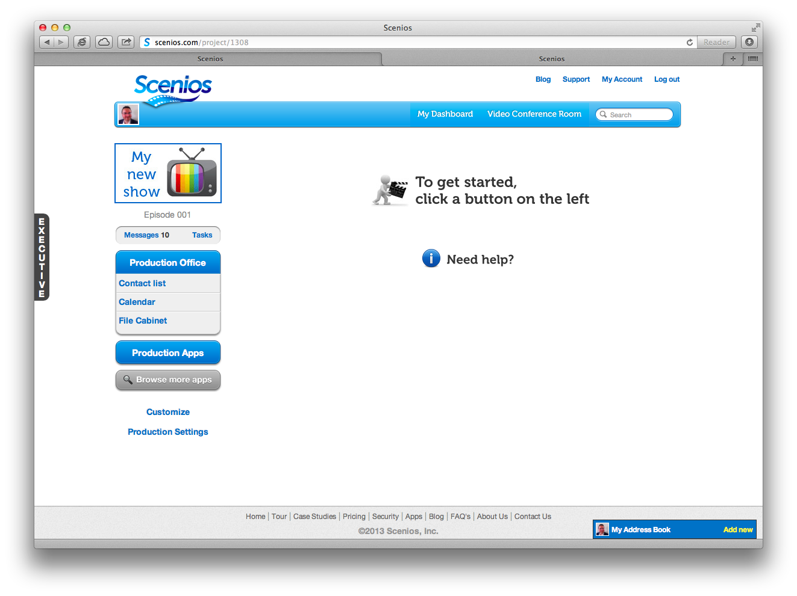

Slide 19
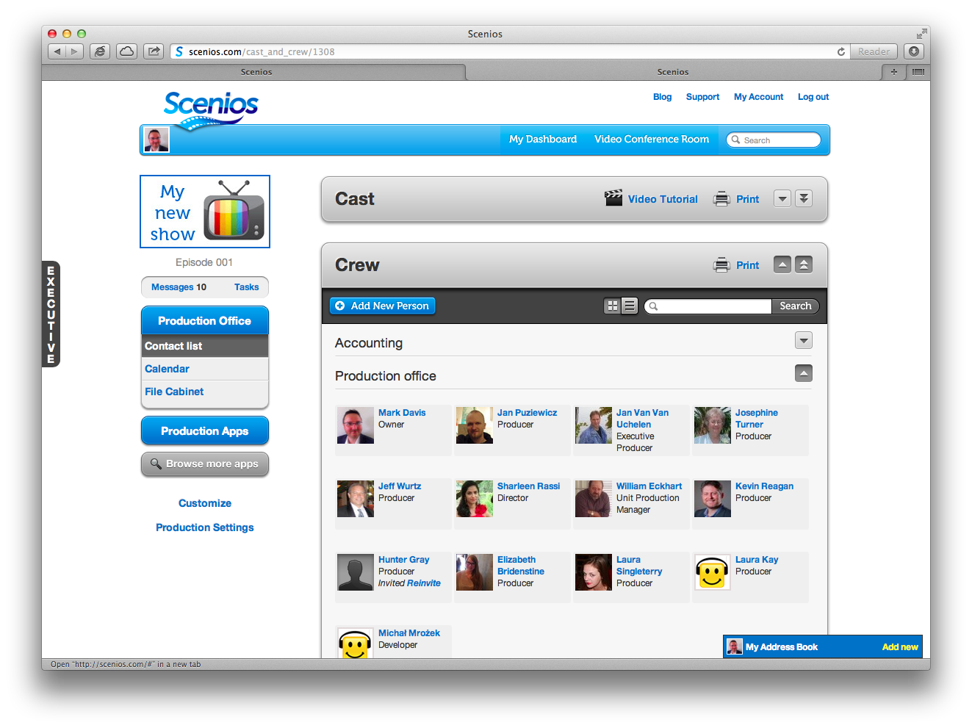

Slide 20
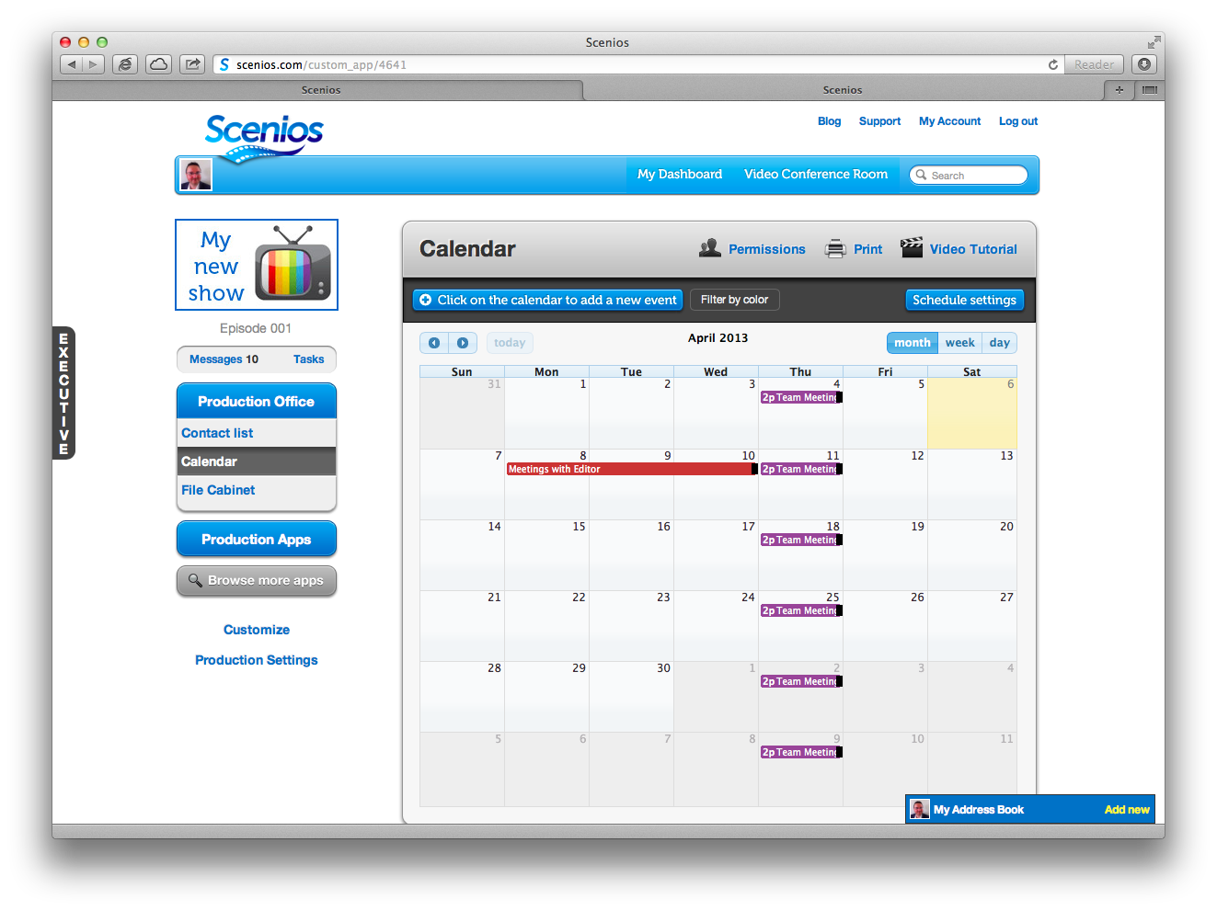

Slide 21
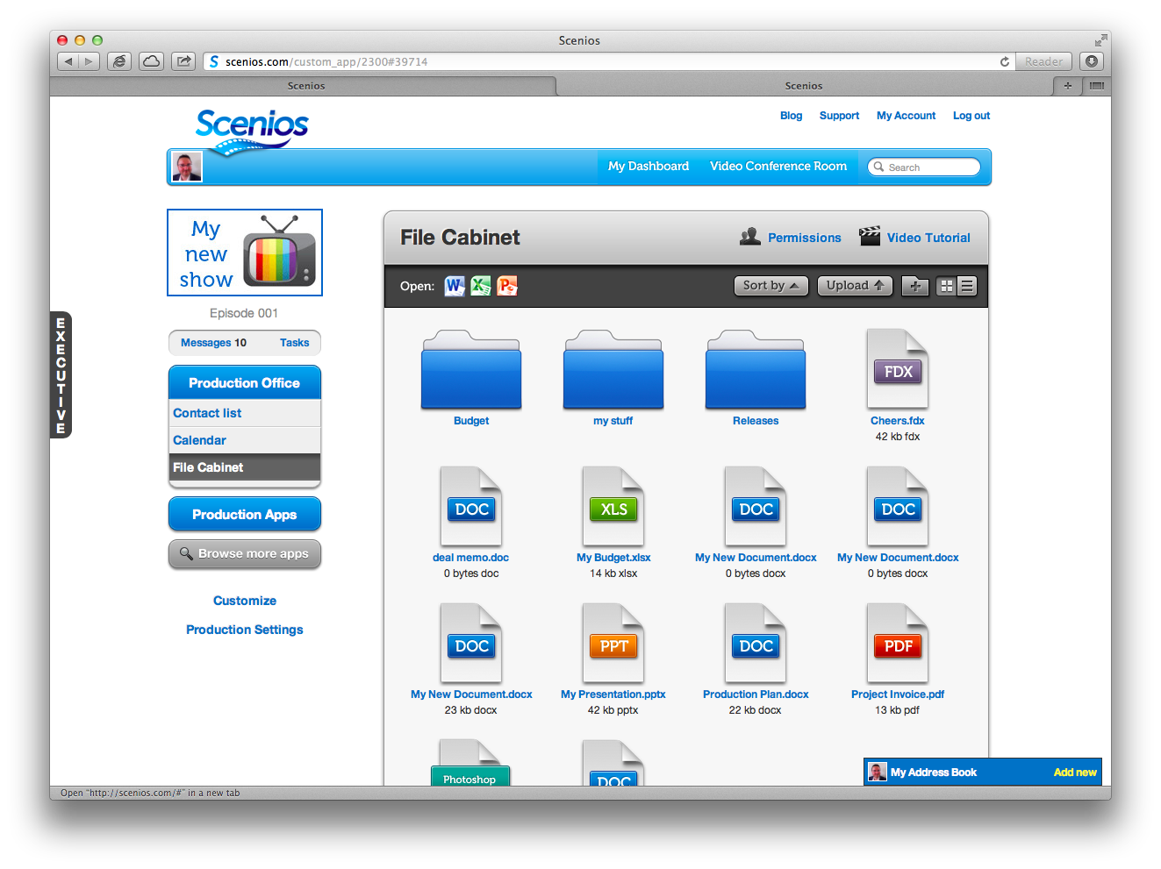

Slide 23
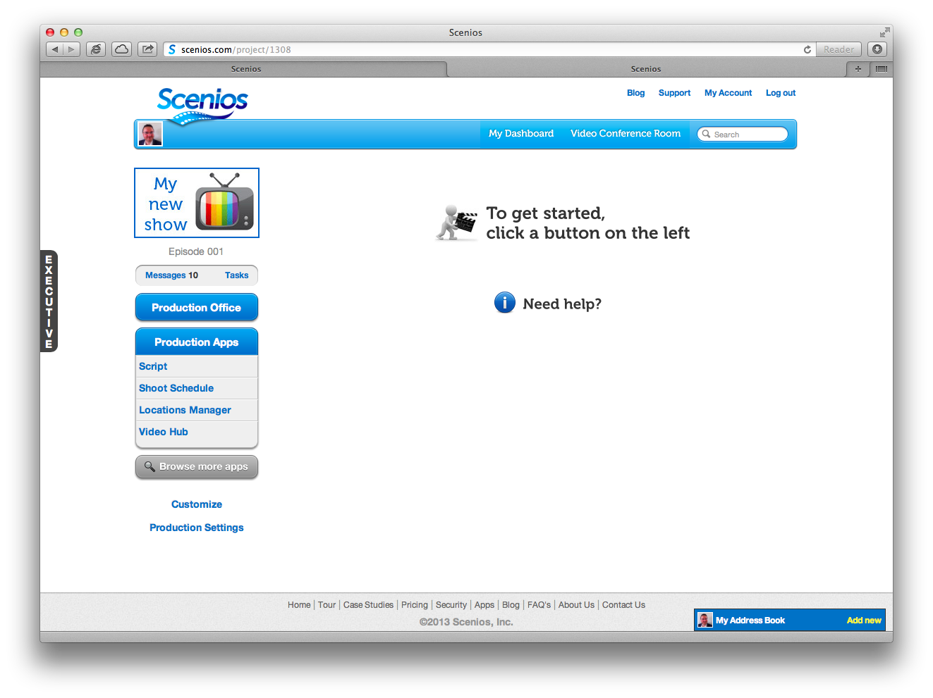

Slide 24
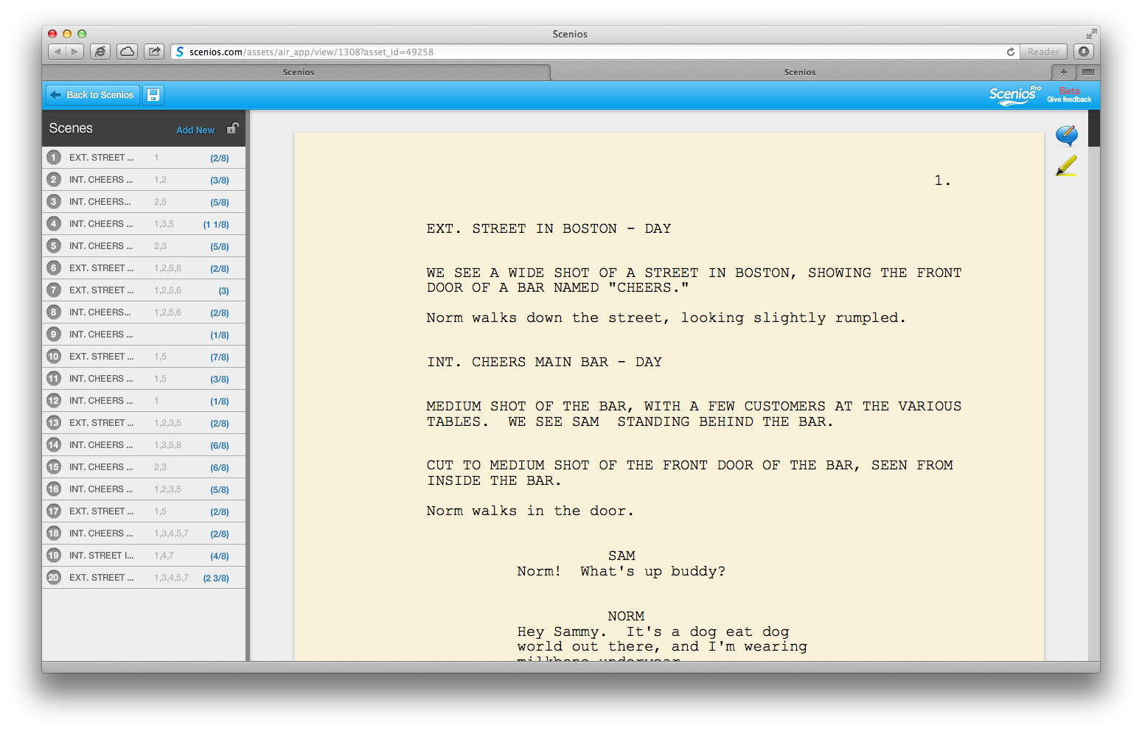

Slide 25
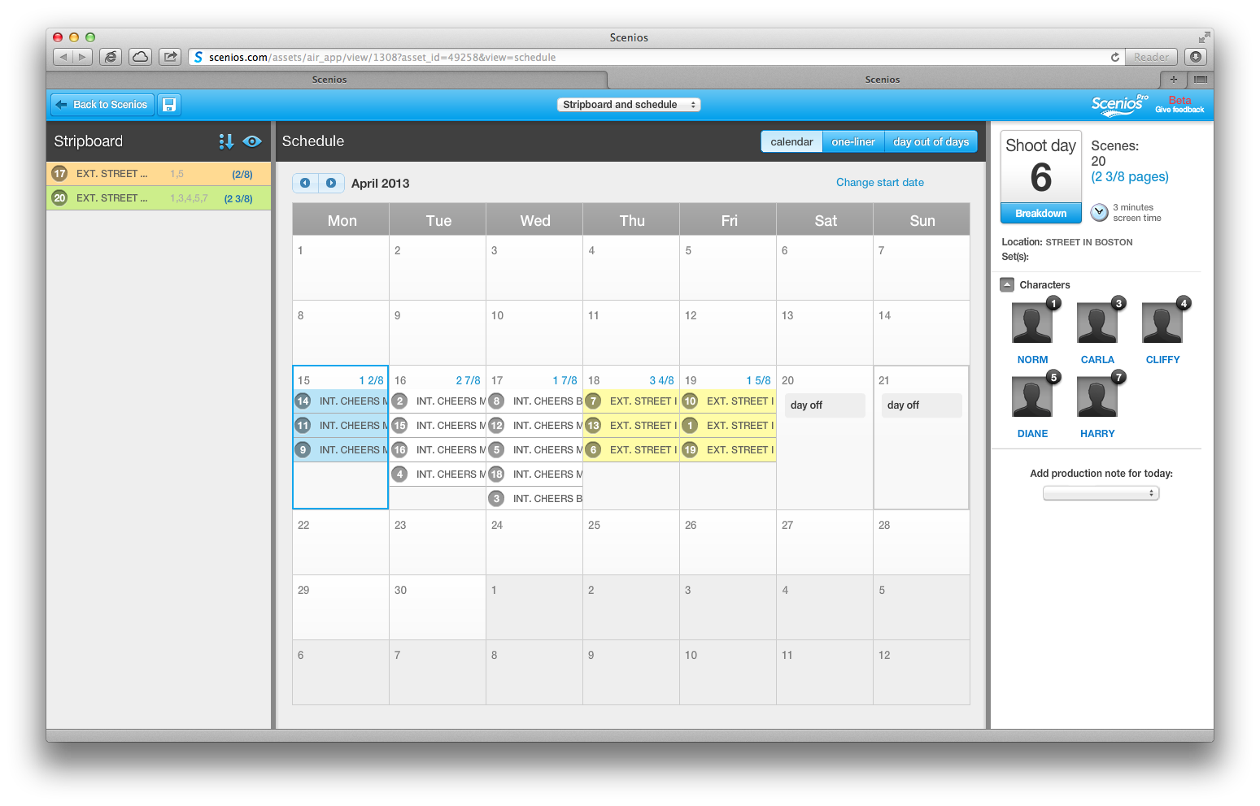

Slide 26
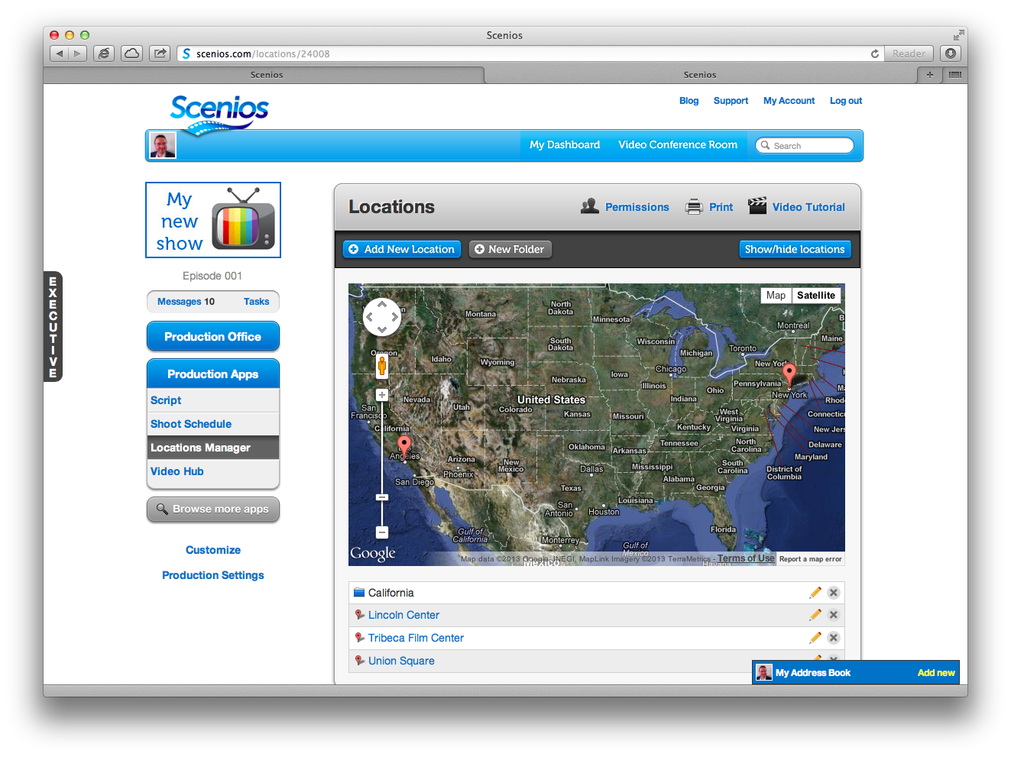

Slide 27
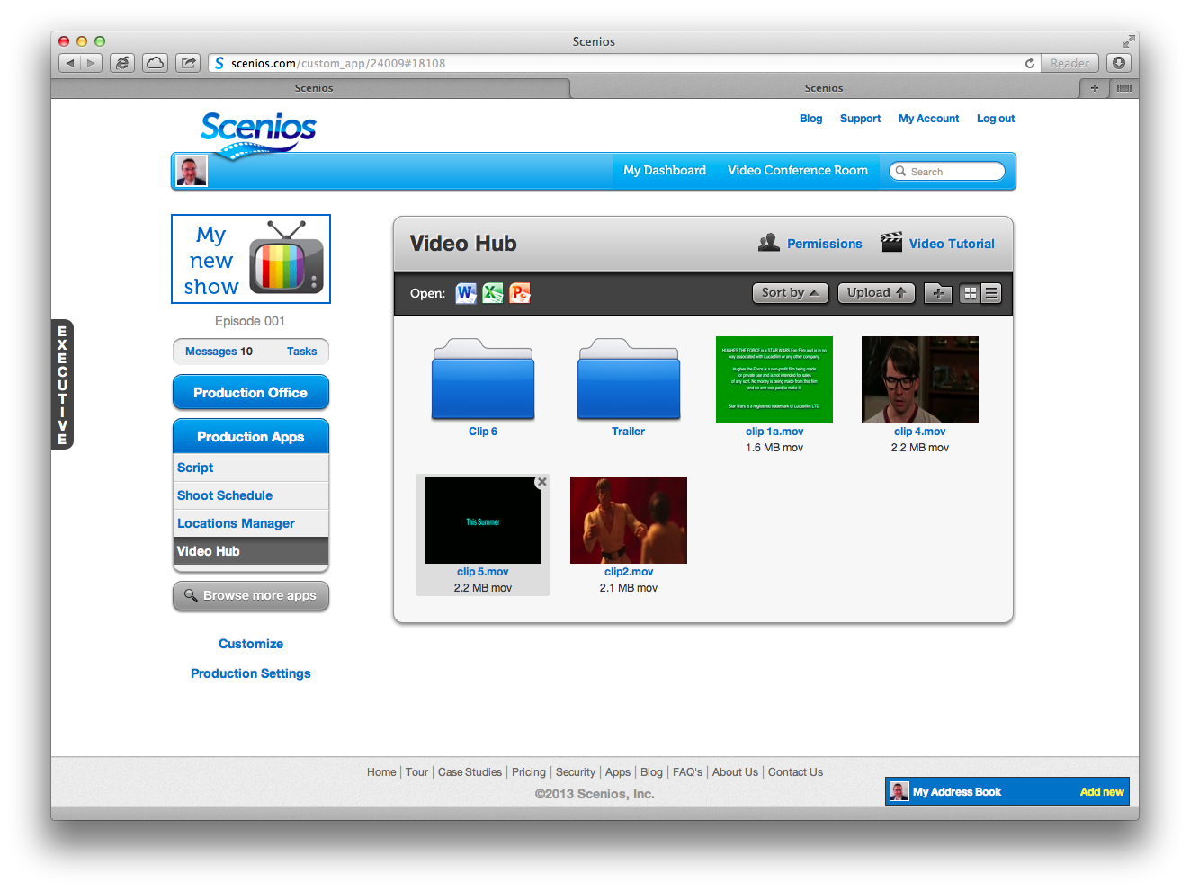

Slide 28
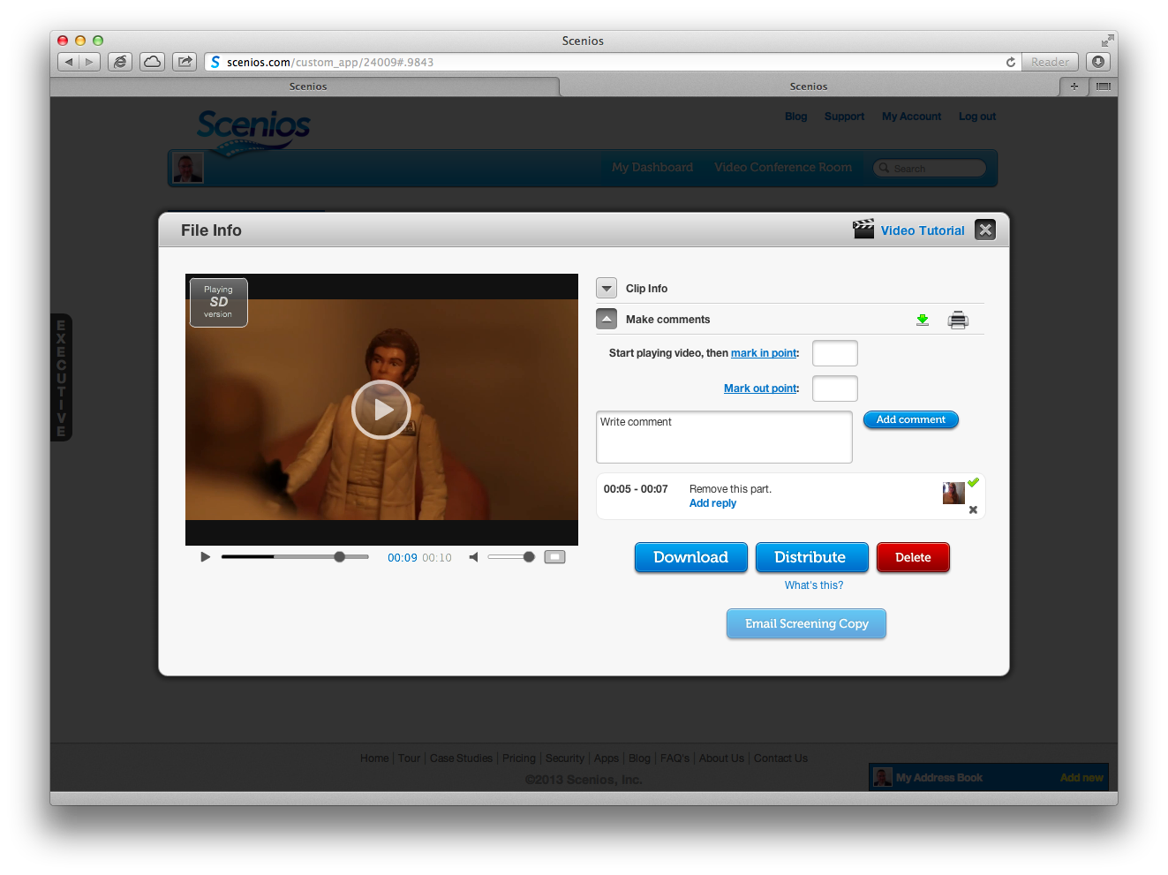

Slide 29
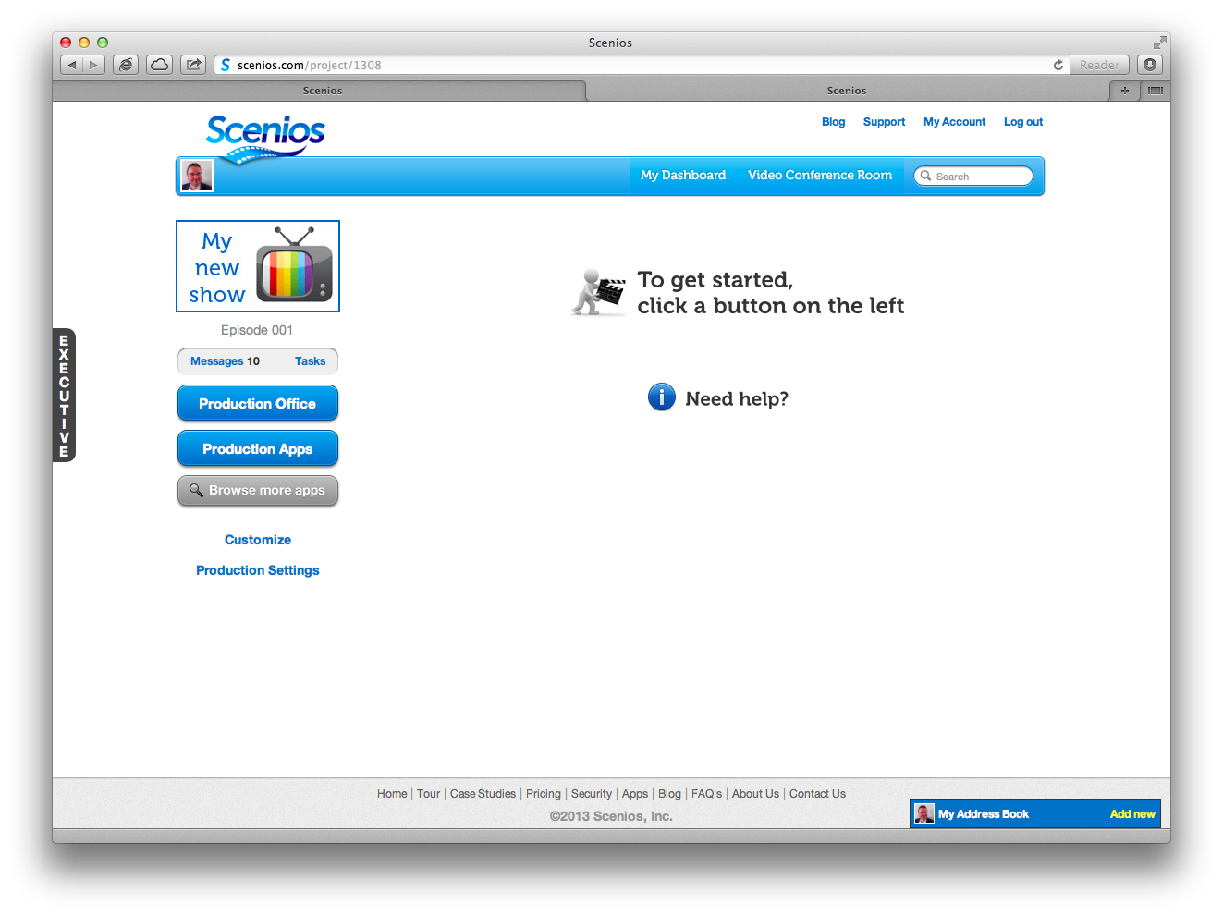

Slide 30
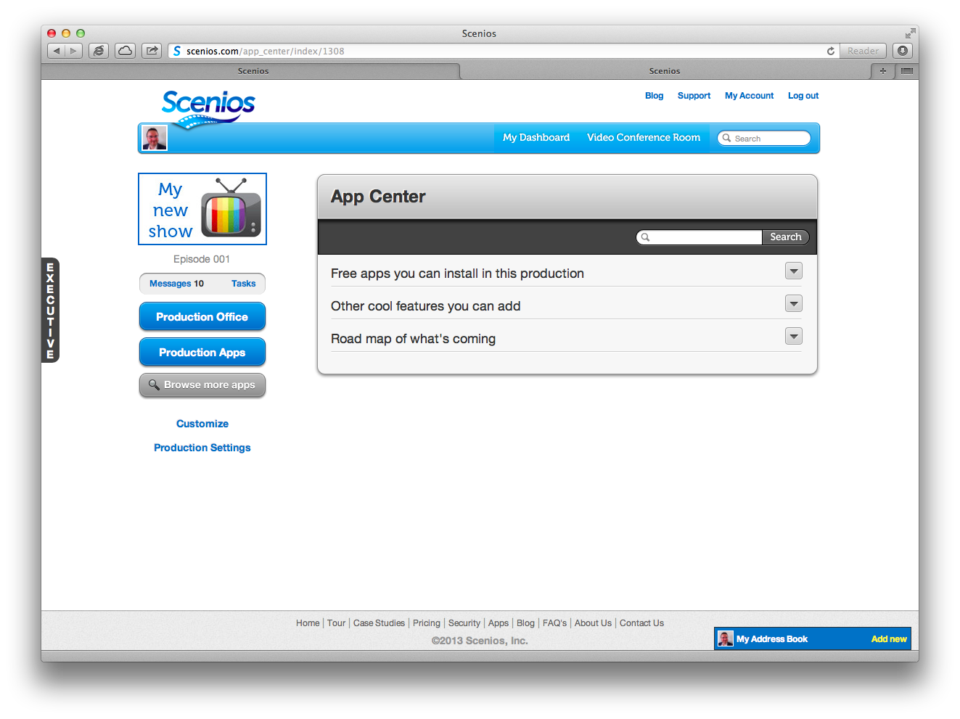

Slide 31
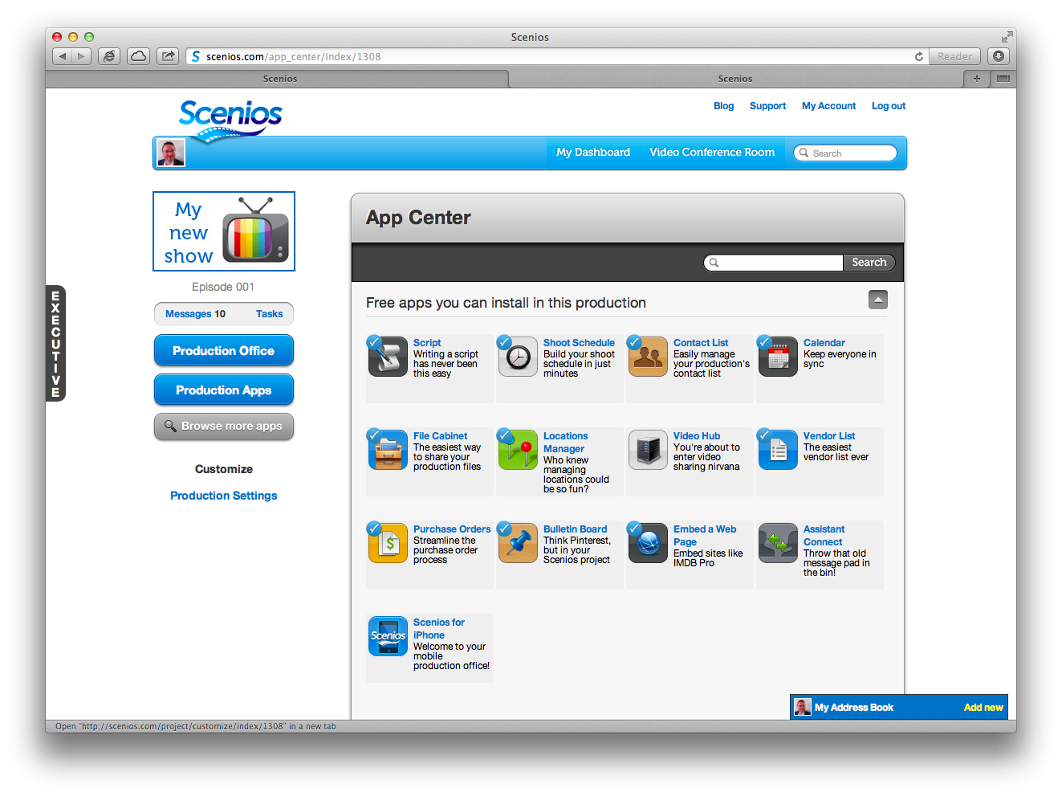

Slide 32
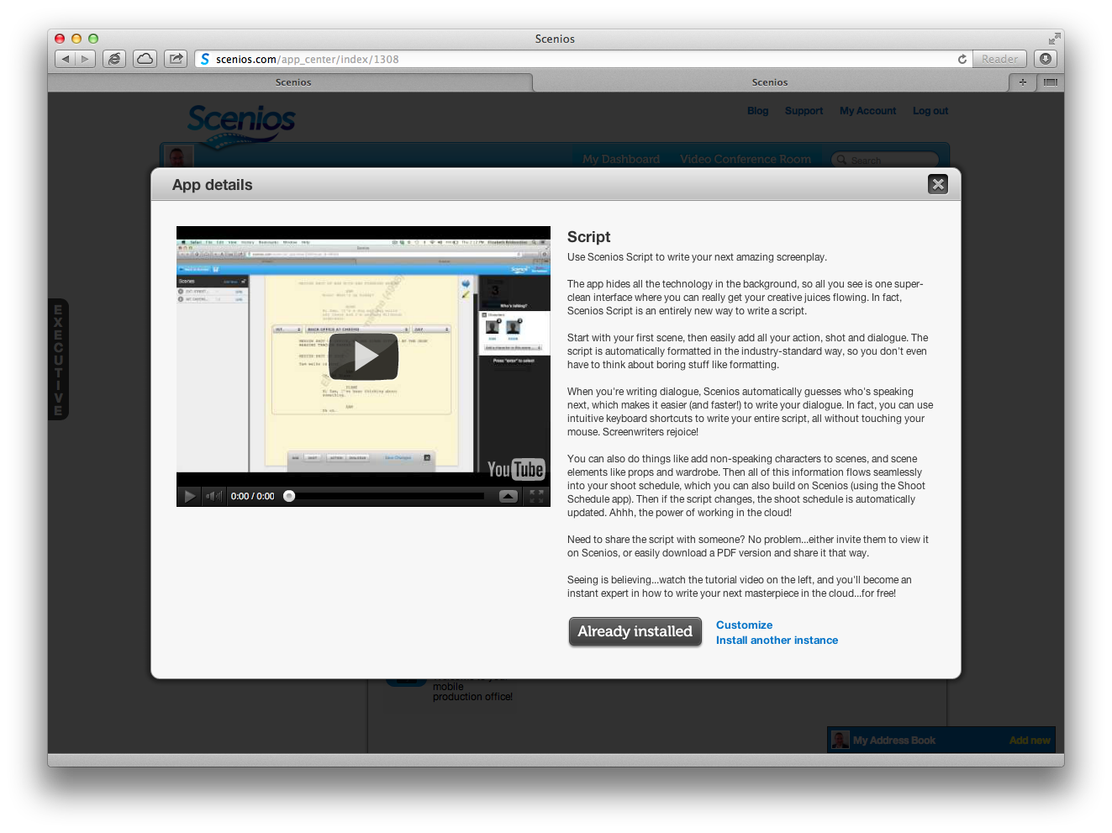

Slide 33
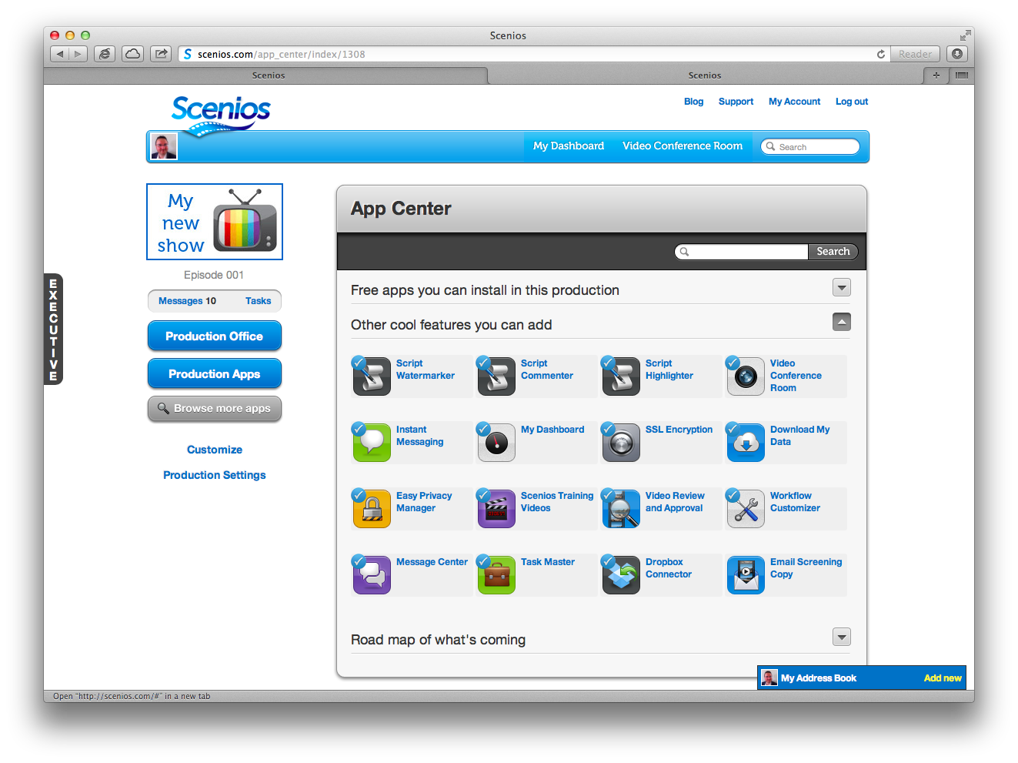

Slide 34
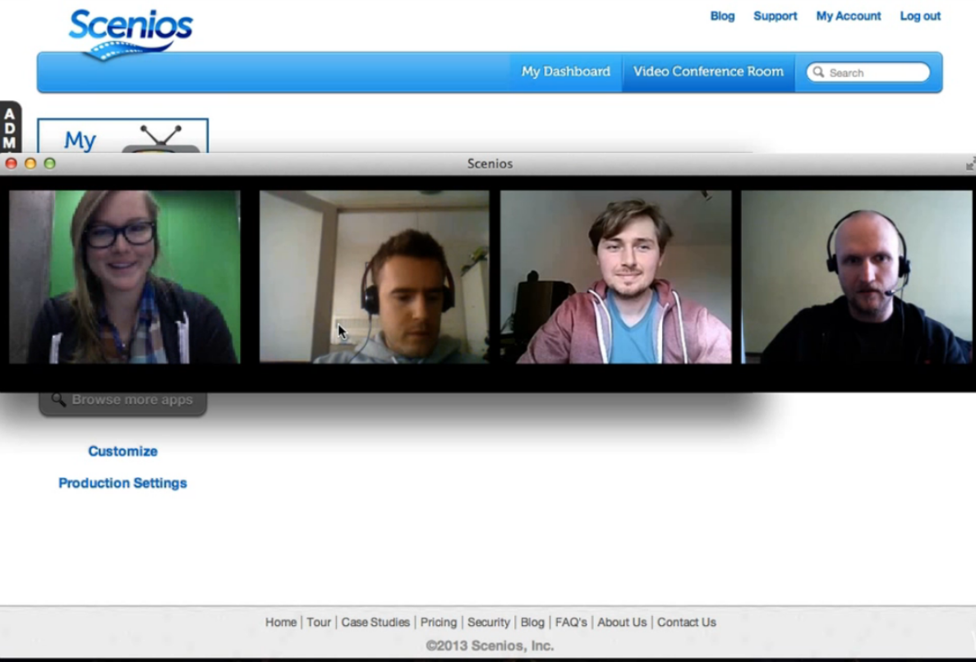

Slide 35
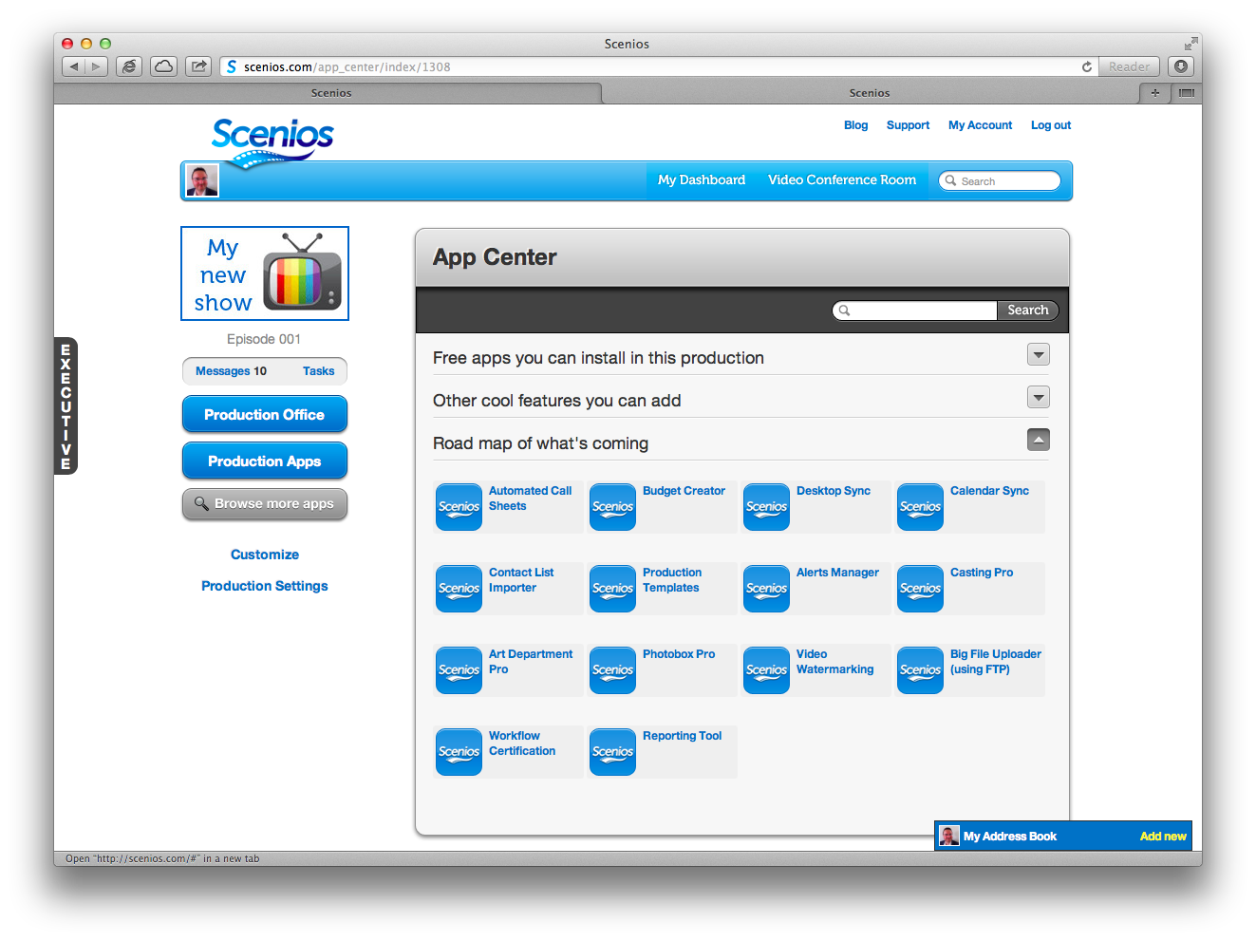

Slide 36
Changes in Cloud Computing:
Connecting the Dots
Notes:
Mark Davis
William Morris Agency
Founder, Fresh Baked Studios
CEO, Scenios
Jeff Wurtz
Producer, director, editor
Inside The Actor’s Studio
5 Emmys for editing
Chief Evangelist, Scenios

