Slide 1
Private Cloud Pragmatic Predictions
Chris Haddad
VP Technology Evangelism, WSO2
@cobiacomm on Twitter
http://blog.cobia.net/cobiacomm
Notes:
Private Clouds
(15 minutes)
Private Cloud: Adoption Stories and Pragmatic Predictions
Organizations are re-tooling infrastructure, development, and operations to deploy applications into private clouds. As organizations embrace DevOps practices and Cloud initiatives, they are challenged by legacy architecture, up-front investment requirements, and missing team skills. In this investment track keynote presentation, Chris Haddad will describe how early private cloud adopters are successfully adapting their IT business models, vendor-provided infrastructure, and practices to gain Cloud benefits. Chris will outline:
Emergent market trends and technology disruption
An accelerating IT business model evolution
How Cloud is shifting market leadership and IT value
Keynote Speaker : Chris Haddad. WSO2
5 minutes – Overview of How “Private Clouds” Should Be Defined: What They Are and Aren’t
5 minutes – Examples (Good and Bad) of How They’re Being Implemented in the Industry
5 minutes – How WSO2 Is a Successful Case Study in This Space
Suggested topic coverage:
Where is the cloud computing industry heading and how does WSO2 fit into the picture?
What are the key market trends that you see emerging as cloud computing continues to be adopted?
Where will cloud technologies and/or businesses be in one year, three years, or even 5-10 years?
What mainstream companies will get involved and how will they participate?
What other industries will be impacted by the continuing evolution of cloud computing?
Who will be the winners and losers as these technologies achieve their full market potential?
And finally, what will the next generation of cloud computing companies look like?

Slide 2
A Thesis on Private Clouds
Private Clouds should not exist
Focus on pragmatic cloud composition and shifting topologies
Plan to de-commission most (if not all) private Cloud infrastructure
Success is when you establish agile collaboration and adaptable business execution

Slide 3
Traditional Private Cloud View
Sharing: My organization
Location: Inside my firewall
Responsibility: IT owns the Cloud
Traditional Focus
Legacy infrastructure refurbished and virtualized
Legacy processes re-used and improved
Retain app architecture and app development status quo
Internal IT agility and delivery gating factor
Internal IT in control

Slide 4
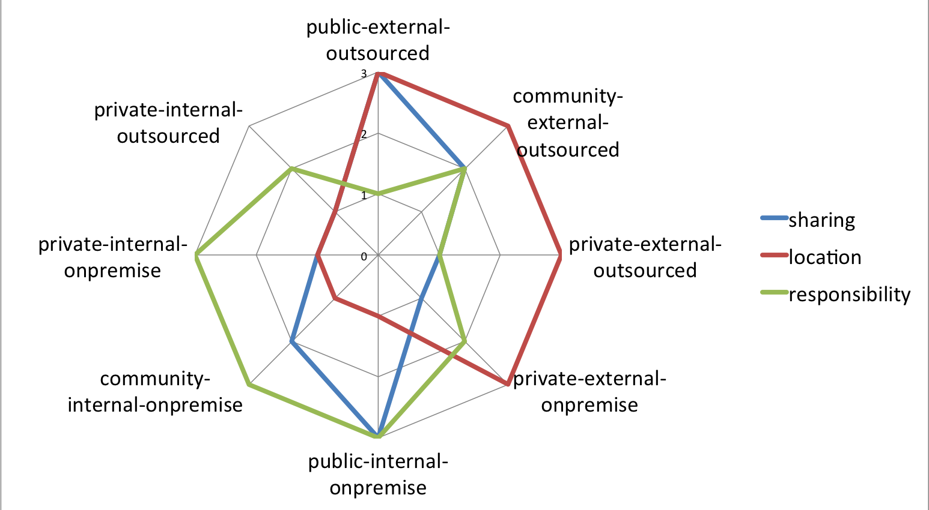
Cloud Dimensions
Real world business is multi-faceted
Notes:
Simply stating public or private does not address multiple options

Slide 5
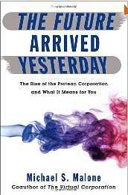
Private Cloud Future Must Fit Within Reality
Sharing: Protean organization
Location: Everywhere
Responsibility (local IT)
IT defines Cloud policies
IT populates service catalogue
IT integrates Cloud services
Responsibility (core business)
Sign up and use services
Configure information flows, notifications, and dashboards
Notes:
Protean Organizations
http://www.amazon.com/The-Future-Arrived-Yesterday-Corporation/dp/0307406903

Slide 6
Building a Private Cloud
IT as a Business offering services
Who can you serve?
What are your service offerings?
How may the services be personalized and composed?
How quickly can customers place an order and receive delivery?
Notes:
5 minutes – Overview of How “Private Clouds” Should Be Defined: What They Are and Aren’t
What are the key market trends that you see emerging as cloud computing continues to be adopted?
Infrastructure as a Service
Image builder
Instance monitoring
Provisioning
Resizing
Application Platform Services
SaaS
multi-tenancy
personalization
Where will cloud technologies and/or businesses be in one year, three years, or even 5-10 years?
Cloud Technologies
Silos in the cloud -> shared infrastructure services
Automated governance
Provisioning plans
DevOps
? Reliable distributed design
Business Adoption
Portfolio migration
Portfolio re-factoring

Slide 7
Private Cloud Trends
Radical IT Culture Shift
IT infrastructure supports all locations
Collaboration beyond single team
Democratize IT
On-demand self-service workspace provisioning
Lower adoption barriers
Business users as app hackers
Decrease time to market
API Building blocks
Pre-composed services

Slide 8
Stories from the Field
Agile collaboration and adaptable business execution
Focus on cloud composition, tenant collaboration, and shifting topologies
Notes:
5 minutes – Examples (Good and Bad) of How They’re Being Implemented in the Industry
Where is the cloud computing industry heading and how does WSO2 fit into the picture?
DevOps
Provisioning
On-demand self service [ portfolio store and click-access]
Reducing cost, increasing performance
What mainstream companies will get involved and how will they participate?
All companies getting involved – at different layers

Slide 9
Stories from the field
MY set of Cloud services
Every service is multi-tenant
Personalization trumps location
Sharable and re-usable business services
Adaptive workspaces
Ad-hoc collaboration
Policy based governance and compliance

Slide 10
Defining Success
IT Service Metrics
Capacity limits
Lead times
Scope of service sharing and re-use
Cost per IT service
Business Metrics
Cost, time, and effort required to
Enter a new market
Establish a new distribution channel
Create a new product offering
Engage a new customer or partner
Notes:
5 minutes – How WSO2 Is a Successful Case Study in This Space
What other industries will be impacted by the continuing evolution of cloud computing?
Customer relationship management
Maintenance, repair, and operations
Sales and marketing
Logistics
Supply chain management
Who will be the winners and losers as these technologies achieve their full market potential?
Cloud Native
And finally, what will the next generation of cloud computing companies look like?
Cloud Native
Focused on ease of use, reducing adoption barriers.

Slide 11
Defining Success
Cloud Natives will be the winners
Ease of use
Rapid provisioning
Low adoption barriers
Ubiquitous access

Slide 12
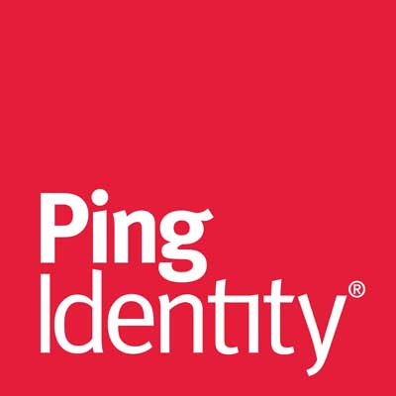
Innovative IT Arms Dealers
Extend team participation and increase engagement
Provide a governed, policy-compliant collaboration environment

