Slide 1
Keynote: The Latest Trends
in Cloud Computing Solutions for the Audio/Video (A/V) Ecosystem
Bill Kallman, CEO Scayl
Email Without Limits

Slide 2
Key Trends
Content
Anywhere
Content Protection
Privacy
Quality
Sources: Under30CEO, March 7, 2012
Scayl internal industry analysis.
Copyright 2012 Scayl

Slide 3
Video booms by 2015
4K
Video min online per seconds
Video users up from 1B
Advanced video traffic 3D and HDTV increase 14X
Cisco 2011
Copyright 2012 Scayl

Slide 4
“Video-on-demand, IP-TV, P2P and Internet video will account for 90% of all consumer IP traffic in 2012”
Cisco
“Next wave is Quality
Video and Audio”
Mary Meeker
Morgan Stanley 2011
Copyright 2012 Scayl

Slide 5
Cloud Usage Models
services
services
Private services
Public services
Hybrid
Copyright 2012 Scayl

Slide 6
Cloud Architectures
services
services
Centralized
Federated
Distributed
Copyright 2012 Scayl

Slide 7
Architecture Benefits
Copyright 2012 Scayl

Slide 8
Low Cost | High Quality Distribution
Hybrid clouds with both centralized and distributed services that interoperate can provide benefits of speed, unlimited files capacities, privacy and security at low cost.
Copyright 2012 Scayl

Slide 9
Distributed Cloud
A/V Applications
4K
Direct Delivery of:
• Secure
• Monetizable
Content:
• Premium (eg 3D films)
• User Generated
Copyright 2012 Scayl

Slide 10
File Delivery Future
Today:
Video streams
DVDs mailed out rental/kiosk
Tomorrow:
Secure electronic file delivery
Copyright 2012 Scayl

Slide 11
Today’s Limits
Limited, Poorly Socialized
5 – 300 Mb Attachment limits, Slow, Unreliable
Weak Security
Slow, Loss of IP Ownership
– 12-20 min for 200 Mb upload
Slow & Expensive

Slide 12
Email Dominant
E-mail
Social networking
3.1B
Active
Mailboxes
International Center
for Integrative Systems 2011.
85%
62%
Daily email message traffic = 4X
ALL Facebook & Twitter updates +
Google, Yahoo & Bing searches +
All Internet page views!
Ipsos 2012
Copyright 2012 Scayl

Slide 13
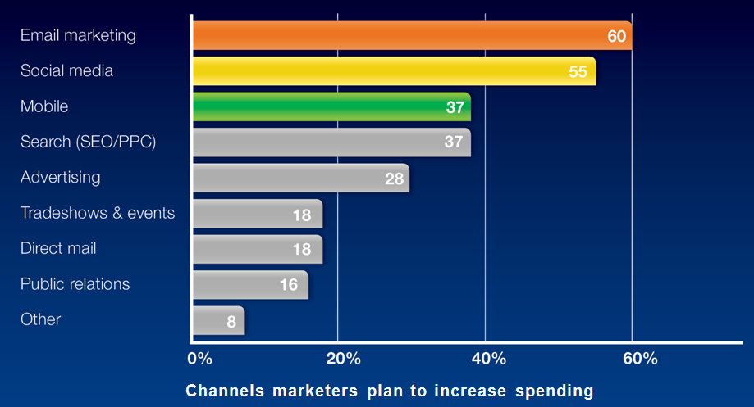
Email is the Top Money Maker
Channels marketers plan to increase spending
2012 Marketing trends survey, StrongMail/Zoomerang, Dec 2011
Copyright 2012 Scayl

Slide 14
Scayl Email Without Limits
1. Speed & Ease Of Use
2. Privacy and Security
3. High Quality Media – Low Cost
Email Without Limits
Copyright 2012 Scayl

Slide 15
1. Speed & Ease of Use
What if
Hybridizing the cloud could reinvent the world’s oldest killer app?
Copyright 2012 Scayl

Slide 16
How much Faster?
10X
200X
LAN Settings
2X
10X
Centralized Cloud
VS.
On initial distribution
@ LAN speed

Slide 17
2. Privacy and Security
“How will you deliver auditable high quality media
at a low cost?
Software based
File centric
Already accepted by mainstream studios
Copyright 2012 Scayl

Slide 18
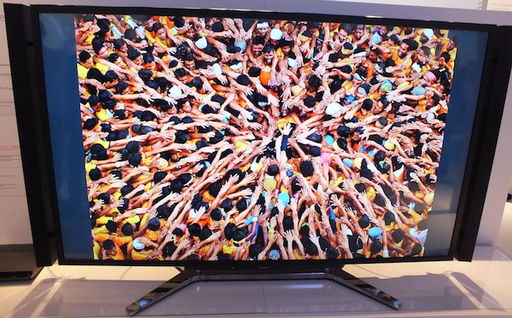
3. High Quality– Low Cost
How do you globally distribute a 3D/HD movie or Video Ad easily, quickly and securely at lowest cost?

Slide 19
Example Delivery
Scayl Delivers Films as big as 28.5 GB
Wonder Women! wins best documentary

Slide 20
Scayl - “Sweet Spot”
Scayl:
0.01 – 50 GB in 1 Min – 10 Hrs. ($0.01 – 0.5/GB)
Cost ($/GB)
10.0
Upload Boxes:
<0.025 – 0.5 GB in 1 Min - 2 Hrs. ($0.1 – 1 /GB)
Fedex/DHL:
0.025 – 1,000 GB in 15 Hrs. – 5 Days ($30 – 100/GB)
1.0
email:
<0.01 – 0.3 GB in < 1 – 10 Min
.1
.01
0
1
10
.1
100
1,000 (15 hrs)
1.0
Delivery Time (min)
File Size (GB)
10
100
1,000

Slide 21
Secure Paid Delivery
Commercial Distribution - Paid service
Consumer-
Selected
Content Push
Shared Ad Revenue
Paid Delivery
White Label Licenses
Consumers
– Free App, Ads & Pay
Per View Content

Slide 22
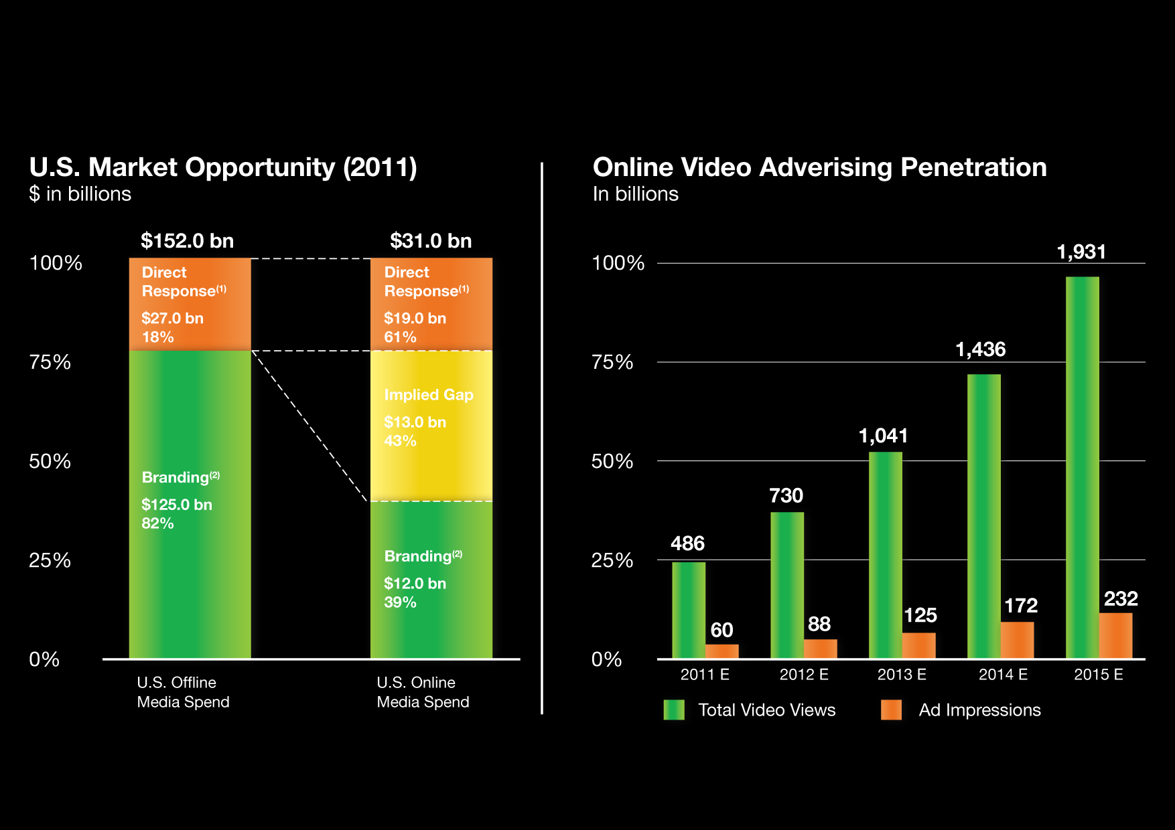
$13 B Video Ad Opportunity
Source: IAB, comscore, Blackstone 2011

Slide 23
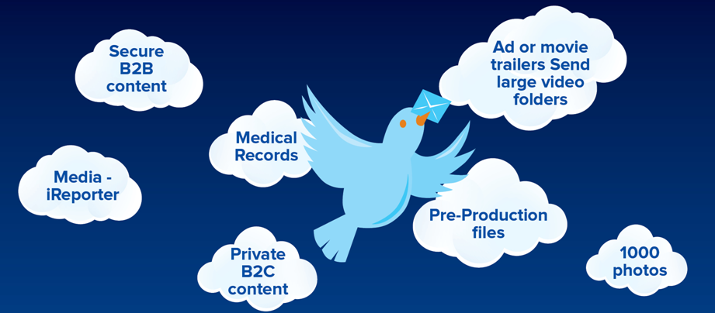
Quality Cost
Copyright 2012 Scayl

Slide 24
Conclusion
New services will unify clouds
Focus on quality/speed/cost
Toward distributed cloud services
Toward personal clouds
Copyright 2012 Scayl

Slide 25
Thank You! Please join us!
Email Without Limits
Live Demo at
Our Booth
Try Scayl
www.scayl.com

