Slide 1
Cloud Computing’s Effects on Media and Telecom Industries
Geng Lin, Ph. D. CTO, Networking Business, Dell, Inc.
Geng_Lin@dell.com

Slide 2
Agenda
Media industry in transition
Telcos and Cloud
Cloud-based content life cycle
Impact to the global network infrastructure
Dell solutions for media, telecom and entertainment industries
Conclusions

Slide 3
Media industry in transition
Technology and market forces are impacting the landscape of content industry around the world, requiring the transformation of the industry business models
Digitalization of premium media content
Cloud-based business model… simplification of content industry value chain
Global Internet as a platform for both content delivery and content creation
New and disruptive technologies – social networking, behavior targeting, intelligent analytics
Industry pressures
Proliferation of end devices and apps drives new content consumption model
Integration of media content into business process to improve business performance

Slide 4
Media industry in transition
It Disrupts Today’s Entertainment Content Value Chain
Video
Film
Sound
Data
Sound
Voice
TV, Film, Music, Print …
Digitalization
Television
Cinema/Film
Radio
Print
Music
Telephony
$
$
$
$
$
$
$
Global Internet
Cloud Model
Acquire,
Create
Produce
Edit
Encode
Index
Publish
Transcode
Integrate
Storage
Distribute
Asset Management
Analytics
Personalization,
User interaction
Content Life Cycle

Slide 5
Media industry in transition
It Creates New Category of Content: The Emergence of Business-Class Media Content
Content value
Premium
Entertainment Content
Business-Class Media Content
User Generated Content
Content volume

Slide 6
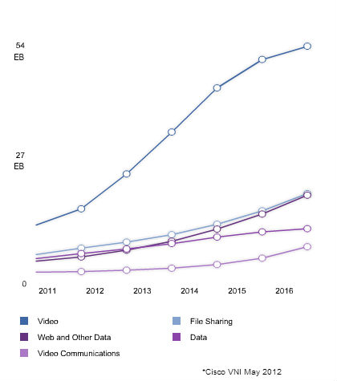
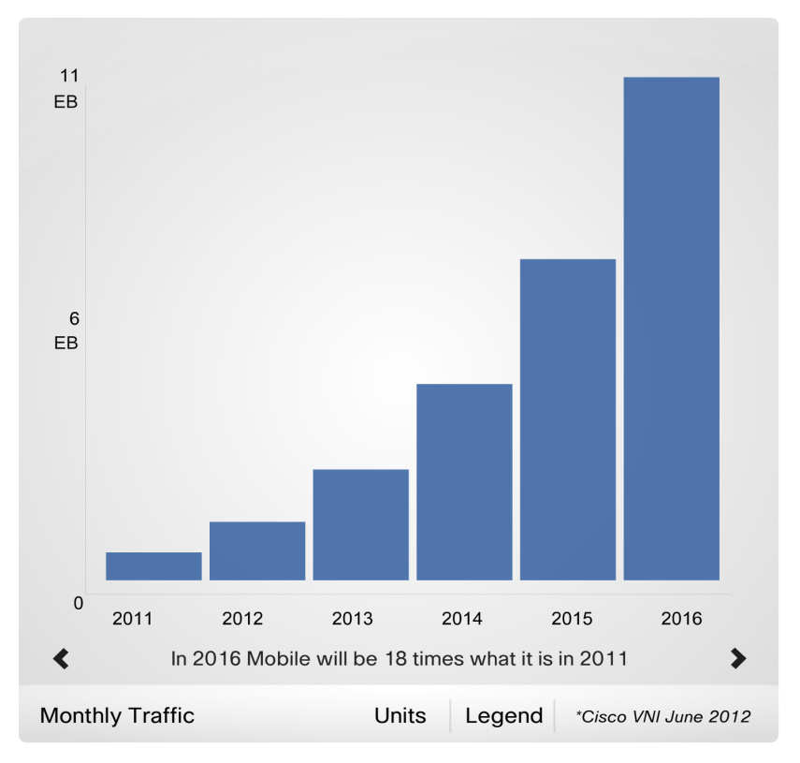
Content in the cloud
Media Content and Cloud have Great Impact on Global Network Infrastructure
Internet video exceeds half of global Internet traffic by year-end 2011 and will reach 55% in 2016.
Internet-Video-to-TV traffic will increase 6-fold between 2011 and 2016
Consumer IP VOD traffic will grow 3-fold from 2011 to 2016, and reach the equivalent of 4 billion DVDs per month
Mobile video traffic will grow 25-fold from 2011 to 2016, a compound annual growth rate of 90%.
Video will be 70% of global mobile data traffic in 2016, compared to 55% in global Internet overall

Slide 7
Telecom and Cloud
Cloud Services are the Ultimate Destination for Telecom Service Providers
Distribute
Distribute
Distributed Data Centers (Virtual Resources)
Business Services
Consumer
Services
Content and Applications
Distribute
Distribute
On-Demand, At Scale, Multitenant
Public cloud market: $43B+ addressable market by 2015, 25% CAGR

Slide 8
Content in the cloud
Cloud-based media solution and its extension to adjacent industries
Additional vertical/horizontal-specific platform capabilities
Digital marketing
New media & entertainment
Education / Training
End-point devices
HW / SW for video capture, editing, and collaboration
TV, PC, tablets, and mobile phones
HW / SW for creation, editing, and collaboration of education content
Content aggregation/ storage
Hosted cloud solutions
Cloud-hosted data-center HW, SW and network equipment
Content transcription/ tagging
Intelligent HW / SW tools for content tagging, transcription
User search cookie analytics tools for search engine opt.
Tools to normalize tags / metadata across media
Content interactivity/ activation
Tools to embed links in content for advanced interactivity
Content transcoding/ distribution
Automated media content formatting / conversion tools
Tools to transcode content to mobile device form factors
Performance tracking
Analytic tools to track media downloads / traffic
Performance tracking and integration with sales measurement
Tools to normalize tags / metadata across media
Performance tracking and integration with backend systems
SOURCE: McKinsey study, Aug. 2010

Slide 9
Content in the cloud
Adjacent Industries with Strong Affinity to Media Content
Digital Marketing
Education
Healthcare
Public Safety

Slide 10
Content in the cloud
Dell has a Strong Solution Portfolio for Telecom, Media and Entertainment Industries
Industry Focus
Service Providers (Telecommunications, Cable, Network, Internet , Content, Cloud, Satellite, Media, Entertainment, Broadcasting, Hosting, and Gaming)
Subject Matter Focus
Customer Intimacy, Operational Excellence, Cost Optimization, Product Leadership & Innovation, Video, Cloud computing, Mobility, Data Management, Business Analytics, Content Management
Industry Solution Priorities
Content Management
Data Management & Archiving
Business Intelligence/Analytics
Customer intimacy solutions
Digital Asset Management
Video Storage, Transcoding and Delivery Platform
Mobility
Consulting
Mobile payments
Advertising
Device management
Application development
Next Generation IT
Cloud services (sell to and through)
App modernization for cloud execution
Converged infrastructure
Cloud based Remote DVR
Retail innovation
Horizontal Solutions
Cloud-based Solutions, Modular DC services, Purpose built HW, Application dev/support/mod

Slide 11
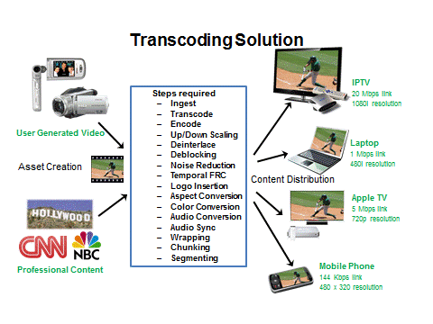
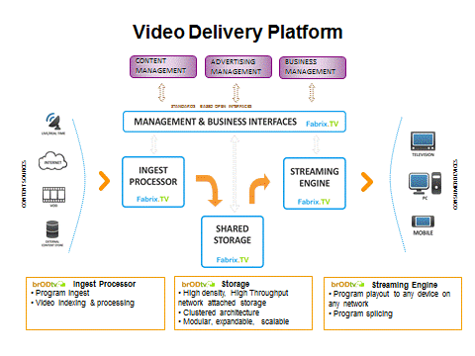
Dell Telco Media & Entertainment Solutions
Content Management
Dell Content Management Solutions
Video Transcoding solutions
VOD
Video storage
Dell Backup & Archiving solutions for email and files
Unstructured Data Governance and optimization
Structured Data Archiving Solutions
Digital Asset Management
Customer Pain
Insert
Insert
Insert

Slide 12
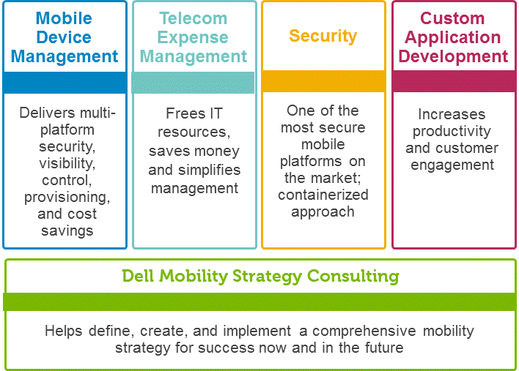
Dell Telco Media & Entertainment Solutions
Mobility
Dell Solutions
Telecom Expense Management
ProConsult for enterprise mobility
Dell Customer / Application Development solutions
Dell Mobile Application Platform
Mobile Applications Development
Secure email/calendar/PIM
Mobile Device Management (MDM)
Common Use Cases
Insert
Insert
Insert
12

Slide 13
Dell Telco Media & Entertainment Solutions
Next Gen IT
Dell Next Gen IT Solutions
Cloud Based Solutions
Modular Data Center Solutions
Structured Data Archiving Solutions
Virtualization POD
Retail Stores IT in a box
Dell Application Development / Application Management
13

Slide 14
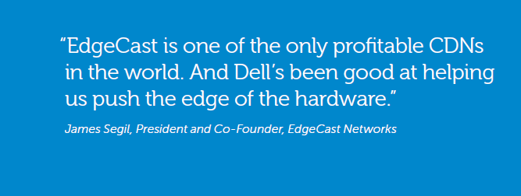
Case Study
Content Delivery Network
Business need
For its own global content delivery network (CDN) and for the white-labeled CDNs it builds for telecom operators, EdgeCast needed a strategic technology partner to gain a competitive edge in the fast-growing content delivery network (CDN) sector.
Solution
Joint content delivery network solutions with integrated Dell platforms and EdgeCast software .
14

Slide 15
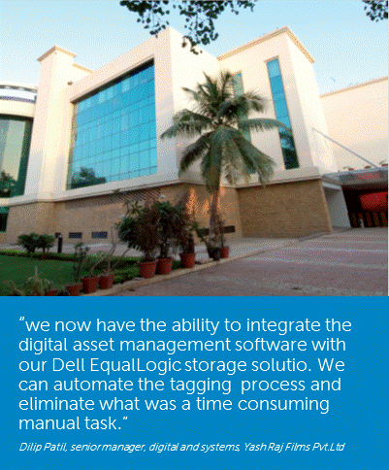
Case Study
Digital Asset Management
Business need
Yash Raj Films (YRF) Studios needed a single, scalable solution to store their catalogue film footage in a digital format that would guarantee availability of content and specific footage when required by various business touch points.
Solution
The studio deployed an archival
solution using Dell storage array to ensure instant access to the studio’s entire film content in various digital formats.
15

Slide 16
Media and Cloud Computing
Long Term Opportunities, Challenges, and Industry Impact
Cloud computing represents a paradigm shift to the media and entertainment content industry
Opportunities and impact
Cloud has the potential to disrupt the entire content value chain and existing business ecosystem
Cloud has the potential to create new forms of media content and expand the total content markets
Cloud has the potential to integrate media content into other vertical industries (non entertainment industry)
Challenges
Business model transformation
Legal/legislation framework required
New ecosystem needed… content producer, distributor, technology providers, consumption model, investment community

Slide 17
Thank You
Geng Lin, Ph. D. CTO, Networking Business, Dell, Inc.
Geng_Lin@dell.com

