Slide 1


Cloud Security
Julian Lovelock
VP, Product Marketing, HID Global

Slide 2
Which part are we talking about?
Enterprise BYOD strategy
Cloud Security
Don’t loose it
Don’t get it stolen
Cloud access from mobile devices
Secure
operations
Close back doors
User Access management for the cloud
Secure
infrastructure
Enterprise Identity
Management
This part

Slide 3

Things to think about
Avoid more user account silos.
Secure access over the internet.

Slide 4



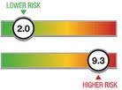
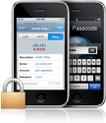

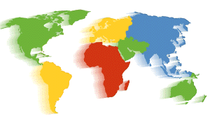

What’s needed?
A Layered Approach with Versatile Authentication
Risk Based Authentication
Determine Risk
Layer 3 | Pattern-based intelligence OOB Verification KBA
Layer 2 | End-point Authentication Device identification and Profiling Proxy Detection Geo-location and velocity check
Layer 1 | User Authentication (Multifactor) Something you know (passwords) Something you have (token or tokenless) Something you are (biometrics, Behaviormetrics)
Authenticate Device
Authenticate to the Cloud
Authenticate from anywhere, anytime
Authenticate user
An ASSA ABLOY Group brand
PROPRIETARY INFORMATION. © 2011 HID Global Corporation. All rights reserved.
Notes:
Layered approach
User authentication + End-point authentication
To ensure security you add on versatile authentication
OOB verification + KBA

Slide 5
User Access Management for the cloud
Options
Open Access
Accessible on the public internet. Username / password, per cloud application.

Slide 6
User Access Management for the cloud
Options
Open Access
Behind the VPN
Remote users must first authenticate to the VPN, then enter username & password.

Slide 7
User Access Management for the cloud
Options
Open Access
Behind the VPN
Federated Identity Mngment
User authenticates to central portal, through which he/she gains access to multiple cloud / internal applications

Slide 8
User Access Management for the cloud
Options
Open Access
Behind the VPN
Federated Identity mngmt
Native strong auth
Strong authentication to the individual cloud software application

Slide 9
User Access Management for the cloud Selection criteria
 | External threats
Open Access
Behind the VPN
Federated Identity mngmt
Native strong auth
Protection against attacks lauched over the internet, such as APTs, ad hoc hacking attempts and ex-employees

Slide 10
User Access Management for the cloud Selection criteria
 | External threats | Internal Threats
Open Access
Behind the VPN
Federated Identity provider
Native strong auth
Protection against fraud from internal employees

Slide 11
User Access Management for the cloud Selection criteria
 | External threats | Internal Threats | BYOD
Open Access
Behind the VPN
Federated Identity mngmt
Native strong auth
Suitability to access from personal mobile devices

Slide 12
User Access Management for the cloud Selection criteria
 | External threats | Internal Threats | BYOD | User Convenience
Open Access
Behind the VPN
Federated Identity mngmt
Native strong auth
Ease of access for legitimate users

Slide 13
User Access Management for the cloud Selection criteria
 | External threats | Internal Threats | BYOD | User Convenience | Audit & Compliance
Open Access
Behind the VPN
Federated Identity mngmt
Native strong auth
Retention of a centralized record of user access across different applications. Application of access policy

Slide 14


 | External threats | Internal Threats | BYOD | User Convenience | Audit & Compliance
Open Access
Behind the VPN
Federated Identity mngmt
Native strong auth
-
Notes:
Accelerate cloud app rollout
Reduce admin costs with unified strong auth
Easier for users, reduce help desk calls
Reduce deployment, training costs

Slide 15
 | External threats | Internal Threats | BYOD | User Convenience | Audit & Compliance
Open Access
Behind the VPN
Federated Identity mngmt
Native strong auth
-
-
Notes:
Accelerate cloud app rollout
Reduce admin costs with unified strong auth
Easier for users, reduce help desk calls
Reduce deployment, training costs

Slide 16
 | External threats | Internal Threats | BYOD | User Convenience | Audit & Compliance
Open Access
Behind the VPN
Federated Identity mngmt
Native strong auth
-
-
Notes:
Accelerate cloud app rollout
Reduce admin costs with unified strong auth
Easier for users, reduce help desk calls
Reduce deployment, training costs

Slide 17
 | External threats | Internal Threats | BYOD | User Convenience | Audit & Compliance
Open Access
Behind the VPN
Federated Identity mngmt
Native strong auth
-
-
Notes:
Accelerate cloud app rollout
Reduce admin costs with unified strong auth
Easier for users, reduce help desk calls
Reduce deployment, training costs

Slide 18
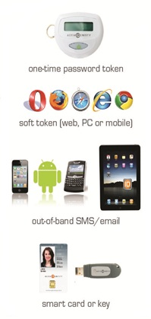


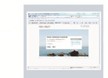
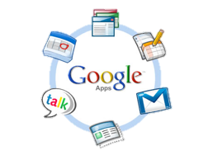



Federated Identity Management Solution
IdP Product (e.g. 4TRESS)
Manage user credentials
Authenticate users
Apply policy
Assert Identity to service provider
Authentication for VPN & internal applications

Slide 19
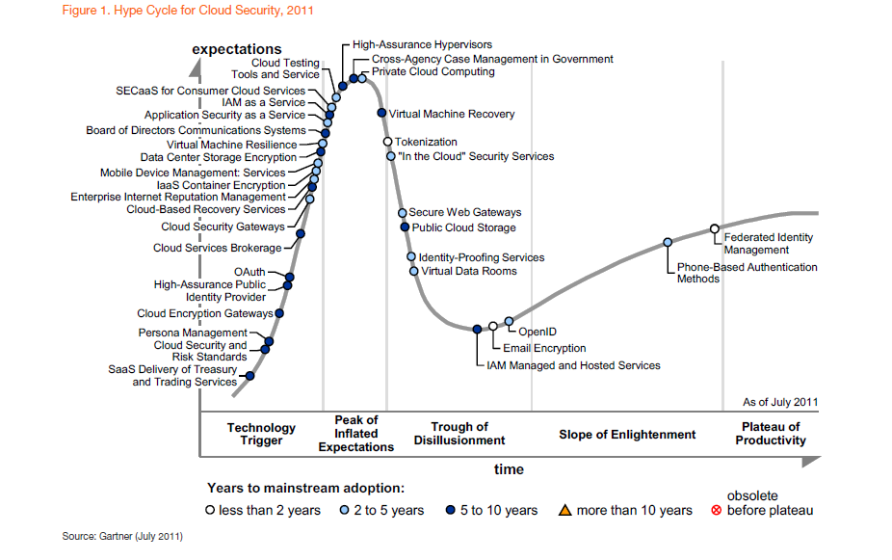

Slide 20
Thank You
Questions

