Slide 1

VC & M&A Activity in Cloud Computing Space
Ketan Patel
New Venture Partners LLC

Slide 2
State of IPO Market

Slide 3
Healthy public comps
Source: William Blair; Cloud Insights
Sept, 2012
Notes:
Eloqua: $106M IPO. Traded up 21% on first day
Workday IPO: 72% pop on first day
ExactTarget firled S1 for $100M follow-on

Slide 4
Source: DB 2012 Technology IPO market update, Oct 24, 2012

Slide 5
Source: DB 2012 Technology IPO market update, Oct 24, 2012

Slide 6
Q3 Venture backed IPO
  Total Volume: 10 Deals
    IT Volume: 6 Deals
  Total Value: $1.1 billion
    IT Value: $749.4 million
Q3 Venture backed M&A
  Total Volume: 96 Deals
    IT Volume: 70 Deals
  Total Value: $7.6 billion (30 announced deals)
    IT Value: $5.6 billion (18 announced deals)

Slide 7
What is driving M&A?
On Premise buys cloud
Vertical market M&A
PE Firms
15 largest tech firms holding $300B in cash for acquisitions
  Google alone acquired 79 companies @ $1.9B in 2011

Slide 8
Source: JPM Securities Q2 2012 Software Newsletter
On-prem vendors looking to add to their cloud suites
Cloud is here to stay
  Need to add management, technology to service existing customers
  Buying market-share in the cloud vs. build your own
More acquisitions by: SAP, Oracle, IBM, Dell, Adobe, HP, MSFT, etc.

Slide 9
Source: JPM Securities Q2 2012 Software Newsletter
Strategic investors and PE firms attracted by:
  Deep Domain Experience
  Less intense competition
RealPage, Ellie Mae going public
  Using public currencies for acquisitions of emerging SaaS vendors

Slide 10
Source: JPM Securities Q2 2012 Software Newsletter
Debt markets have bounced back
Software centric PE fund raises
Many transactions traditional on-prem software vendors
  Starting to see focus on SaaS vendors: Plex/Francisco Partners

Slide 11
What are they buying?
SaaS/Cloud Enabled Services
Cloud Infrastructure
Enterprise Software
Enterprise Mobile

Slide 12
SaaS/Cloud Enabled Services
  Worldwide spending on enterprise software 2012: $120.4 B (Source: Gartner)
  SaaS & Cloud based services: 16% by 2015 (Source: Gartner)
  Current spend is post-recession refresh
  Cloud effect is still to come
Enterprise Software
  Cloud Security
  Ability to provide cloud services
Enterprise Mobile
  Driven by BYOD, Consumerization business & personal digital lives
  Still early
  Current focus on security & network/application access control

Slide 13
Source: Peachtree Capital Advisors; 2012-Mid Year Software, IT, Infrastructure M&A Report

Slide 14
Source: Peachtree Capital Advisors; 2012-Mid Year Software, IT, Infrastructure M&A Report
Storage well sought out acquisition target
Enhance ability to store and retrieve data more efficiently
Companies positioning themselves to offer complete solution to big-data paradigm

Slide 15
Source: Peachtree Capital Advisors; 2012-Mid Year Software, IT, Infrastructure M&A Report

Slide 16
Source: Peachtree Capital Advisors; 2012-Mid Year Software, IT, Infrastructure M&A Report

Slide 17
Where are VCs investing?
SaaS/Cloud Enabled Services
Cloud Infrastructure
Enterprise Software
Enterprise Mobile

Slide 18
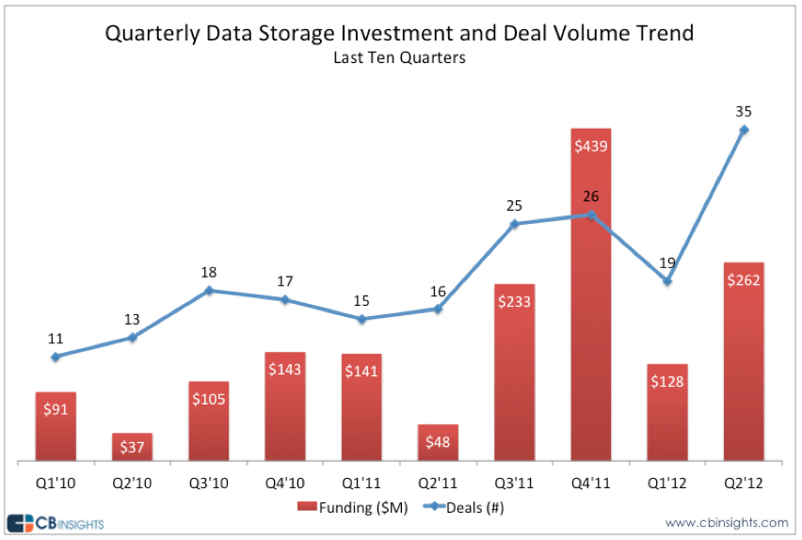
Source: Peachtree Capital Advisors; 2012-Mid Year Software, IT, Infrastructure M&A Report
Notes:
SaaS VC Investments
PWC Data: 2011, $6.9 B invested in cloud related startups; 1004 deals
Zscaler – cloud security raised $38M Series A
YottaMark – cloud based fresh-food traceability raised $24M Series D
AtTask – cloud based collaborative work management solutions raised $16M
Vital Insights – CEM solution for automotive industry raised $20M
PaaS/IaaS:
Nutanix virtualized data-center platform raised $33M series C
Magnet Systems raised $47M series B from HTC

Slide 19
Source: Peachtree Capital Advisors; 2012-Mid Year Software, IT, Infrastructure M&A Report

Slide 20
Rise of Corporate VCs
Traditionally average 6% of VC investment annually
More recently as high as 10% to 12% of VC investments
Source: Peachtree Capital Advisors; 2012-Mid Year Software, IT, Infrastructure M&A Report

Slide 21
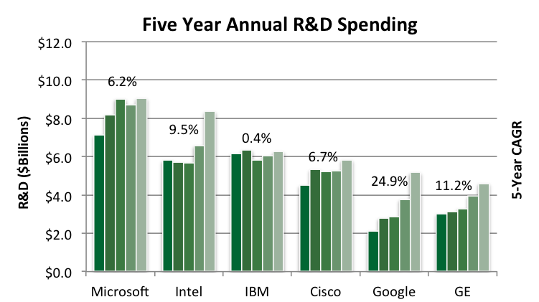
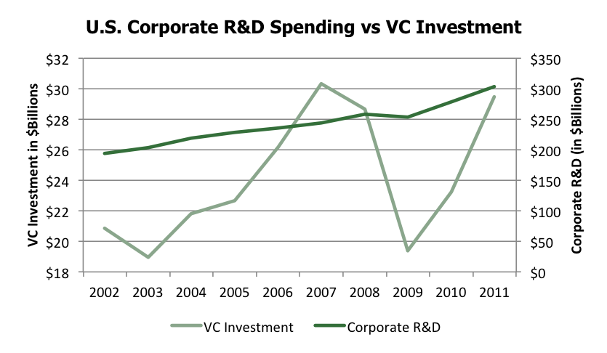
New Venture Partners LLC

Slide 22




New Venture Partners LLC Example Portfolio Companies
Investment Interests:
Cloud/Data Center Infrastructure
  Storage
  Networking technologies
SaaS/Cloud Services
Vertical Market Big-Data
Enterprise Mobile Application Infrastructure
Security
Notes:
Networking likely to get a lot of attention
SDN: Nicera exit to VmWare for $1.26B+
Brocade acquisition of Vyatta (announced on Tuesday)
Oracle’s purchase of Xsigo

Slide 23
Thank you!
Q&A

