Slide 1
Media Testing in the Cloud
Presented by:
John Schiela
President
www.PhoenixMI.com
November 8 – 9, 2012
Copyright © 2012 Phoenix Marketing International
All Rights Reserved

Slide 2
50% of Individuals Report being Very Familiar with Cloud Computing
Familiar with Cloud Computing
Cloud Computing Uses
www.PhoenixMI.com

Slide 3
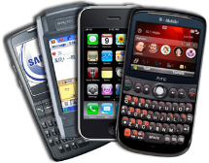
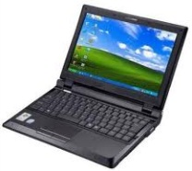
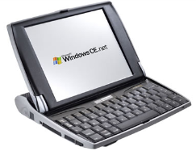
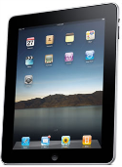
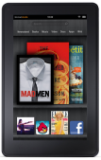
Why Test in the Cloud? 90% of Respondents Stream
Mobile Phone
2011
2012
2011
2012
Watching TV Shows
14%
21%
+7%
Mobile Phones
83%
92%
+9%
Watching Movies
16%
21%
+6%
Laptop Computers
76%
81%
Watching Short Videos
39%
43%
+4%
+5%
2011
2012
Netbook Computers
18%
21%
7%
16%
+9%
+3%
18%
31%
+13%
Tablet Computers
15%
36%
+21%
46%
47%
+1%
22%
27%
+5%
E-Readers
18%
33%
+15%
52%
27%
-25%
www.PhoenixMI.com

Slide 4
Traditional Media Testing
←
Las Vegas
←
Orlando
www.PhoenixMI.com

Slide 5
Traditional Media Testing
Seattle
←
Detroit
←
←
New York
←
←
←
Chicago
Las Vegas
←
←
Denver
Raleigh-Durham
Los Angeles
←
←
Orlando
Houston
www.PhoenixMI.com

Slide 6

The Cloud Offers Nationwide Coverage
www.PhoenixMI.com

Slide 7
Testing in the Cloud
www.PhoenixMI.com

Slide 8
Output in the Cloud
www.PhoenixMI.com

Slide 9
Analysis in the Cloud
www.PhoenixMI.com

Slide 10
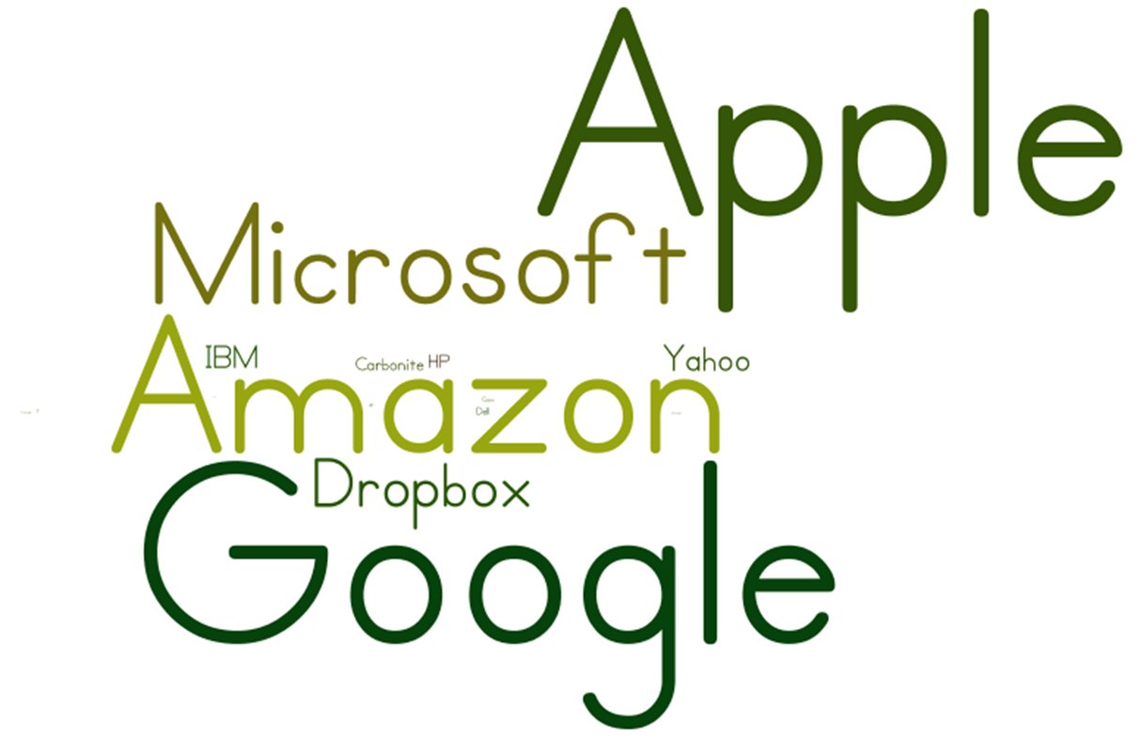
Who is positioned to win in the Cloud?
www.PhoenixMI.com

Slide 11
Thank You!
Questions?
John Schiela
President
Phoenix Converged Technology and Media
215.392.0264
John.Schiela@phoenixmi.com
www.phoenixmi.com

