Slide 1

Current impacts of cloud migration on broadband network operations and businesses
David Sterling
Partner, i₃m₃ Solutions

Slide 2


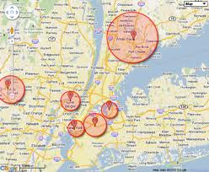
Massive explosion in cloud traffic and growth …
What does it means for network providers?
Automating processes
XaaS
Balancing demand patterns
versus
Managing security, storage…
synchronization, awareness…
monitoring and
distribution
…over 80% of cloud traffic within data centers or between them…
Sources: Cisco Analysis, 2012

Slide 3
Moving to the cloud ….
How is demand impacting network operations?
Today’s operations are
challenged with managing…
Multi-system monitoring environments
Physical versus abstraction layer
Multi-faceted premises and data
center resources
…while enterprises and SMBs are
looking to the cloud for growth…
…and customers putting more critical workloads into the cloud
Sources: Sentilla, 2012, Cisco Global Cloud Index, 2011-2016

Slide 4
Factors applying stress on broadband operators…
Mobility demand
Broadband Network Operations
OSS management complexity
4
1
Simplifying information access and usage
Aggregating, automating and scaling cloud workflows
Inconsistent customer experience
Security and performance transparency
3
2
Business Opportunities
Standardizing and integrating communications for value
Improving workflows, transparency, and “best-of-breed” operations

Slide 5
View of a future Service Provider with virtualization and cloud management characteristics
Service Provider Pyramid
Operational Emphasis
Success characteristics:
Bus Analytics, Customer Care, Order and Billing
Flexibly scale to migrate:
  Websites and browser apps
  Communications and collaboration apps
Smoothly transition to:
  Master data management
  Cloud enabled intelligence data
Quickly enable new self-service capabilities:
  Provisioning and management of mobile devices
  Security management
  Service performance
Customer Facing Cloud
Virtual network, router, routing tables, switches, bandwidth
Network Cloud
Data Center and Cloud Infrastructure
Servers, CPUs, access to applications
Source: i3m3 Solutions

Slide 6
Cloud evolution and Service Provider opportunity sets
Adoption of automation, standardization and software defined layer abstraction
Model Evolution | Enablers | Opportunity Areas
SaaS PaaS Brokerage IaaS XaaS | Service aggregation Cloud monitoring tools CSP and SI partnerships Mobility adoption | Value-added reseller of XaaS that simplifies and enhances app selection Security management Collaboration /UC Self-service marketplace
Multi-tenant Exchanges On-Net Providers | Automation and federation Development tools Agile OSS/BSS | Vertical-specific solutions with integrated communications
Massively Scalable Vertically Integrated | Low power, commodity hardware Integrated virtual and IP elements | Enterprise-grade end-to-end infrastructure and platform provider
Customer Facing Cloud
Network Cloud
Data Center & Cloud Infrastructure
Source: Cisco IBSG, i3m3 Solutions

Slide 7


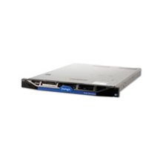


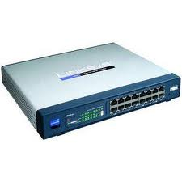


Cloud technology and IP platforms enhancing network
and IT resource performance
1
Cloud management, IMS and SOA platforms rapidly scaling workflows and reducing complexities across access, network and IT elements…
Increased agility across pooled resources
Example -- VoIP moving to the cloud
Increased resource performance
Efficiency and Flexibility
Greater Adaptiveness and Awareness
PSTN
Cloud-based VoIP
GW
WAN
IP PBX
Router
Source: Teradata, 2011
….leading to federated resource models with operational partners

Slide 8

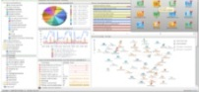


How is cloud enabling maturation of security and
performance monitoring options?
2
Enhancements in network monitoring and user analytics with cloud processes provide greater
Dynamic Operational Security Model
Implementing “best practices” such as PCI DSS 2.0, NIST SP800.53, etc.
Collaboratively providing advanced security architectures to broader customer set
Structuring architectures to ensure tenant isolation
Using DoD approved utilities and processes to perform security functions
Customer system access and configuration monitoring
Portals and dashboards
Real-time status and risk reporting
Systems management
Positioning of instances
Security hardening
Access admin/ authorization
User Control
Service Transparency
Enhancing
Source: Cloud Security Alliance

Slide 9
Cloud migration provides opportunity for more responsive
customer experience
3
Broadband providers can simplify and enhance service experience by realignment and integration of network services and content
Information access
Enhance access to network and applications with greater service transparency and better alignment
PEOPLE
Improve content effectiveness
Tighten integration of legacy and new systems and inject location, presence, and identity data
PROCESS
Enhance delivery quality
Utilize network and content aware architectures to auto-select best performance path
TECHNOLOGY
Design scalability
Create cloud-enabled models from start integrating self-service, automating activation/deactivation and aligning support layers

Slide 10
What investments can network operators prioritize to manage mobile demand for cloud resources?
4
Automation tools that enable accelerated activation and synchronization over cloud
…with further automation and intelligence needed for growth in video and social apps
Self-aware network intelligence providing resource elasticity to bursty cloud traffic
Sources: Asymco, i3m3 Solutions
Scaling at 10’s millions of transactions possible today….
…allowing mobility demand to drive cloud model growth

Slide 11











How i3m3 Solutions helps Service Providers evolve their cloud strategies…
OSS Management
Evaluation and assessment
Business case
Architectural solution
Roadmap
Implementation
i₃m₃ Solutions
Security & Performance
Broadband Network Operations and
Business
Mobility
Customer Experience

Slide 12
Thank you
Questions?
www.i3m3solutions.net
davidsterling@i3m3solutions.net

