Slide 1

Distributed Global Productions
Cloud Dailies

Slide 2
Cloud Dallies
Client access to roughs
Drives clarity of expectations
Annotaions and comments
Megauploader, libraries, collaboration
Not editing, color correcting, not glamour but infotainment

Slide 3
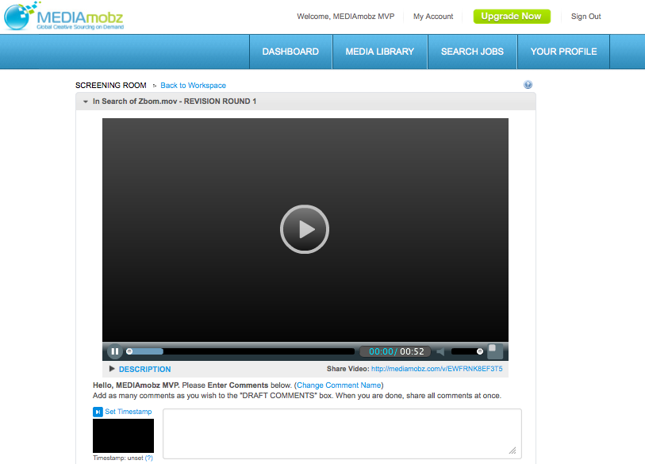

Case Studies – Business Wire

Slide 4
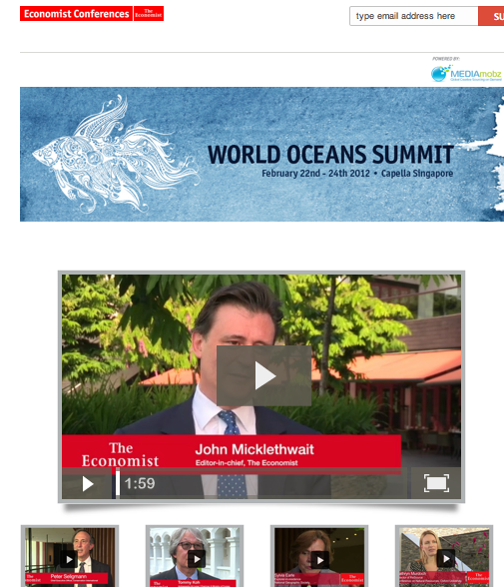
Case Studies – The Economist

Slide 5

Case Studies – World Bank

Slide 6
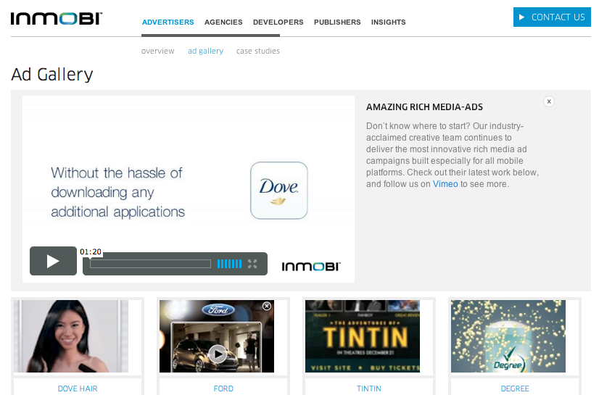
Case Studies - InMobi

Slide 7
Cloud Services Expansive
Content and collaboration barriers collapsing, new kinds of digital literacy, brands becoming media outlet
MEDIAmobz streamlines the creation and production of video and digital media
Developed the first Secure Personal Internets, software directed networks, patents
Digital near free, content IP and attribution rights a big deal
Fresh, access rights will dominate
Emerging models of publishing and monetization will shake out
Don’t lose sight of Moore’s Law

Slide 8
Digital Divide
Creativity and story telling will always have value
A bridge between media experiences will be built in the next 3-5 years
Integration of digital will drive cloud services
Content, data visualization, social will merge
Integration and provisioning of services will rule
Stories at the core

