Slide 1


Metadata in the Cloud
Stephen White
President, Gracenote

Slide 2

Metadata – noun
Data about data. In the case of Gracenote, we are focused on the relation between digital media and data in the Cloud.

Slide 3
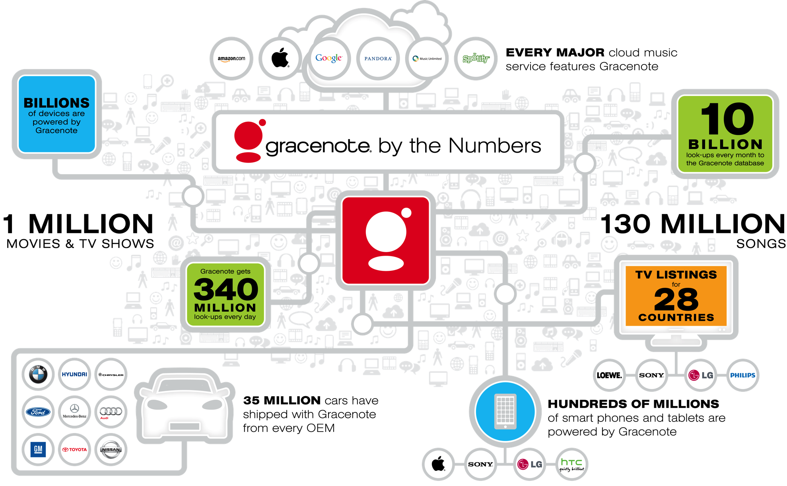

Slide 4
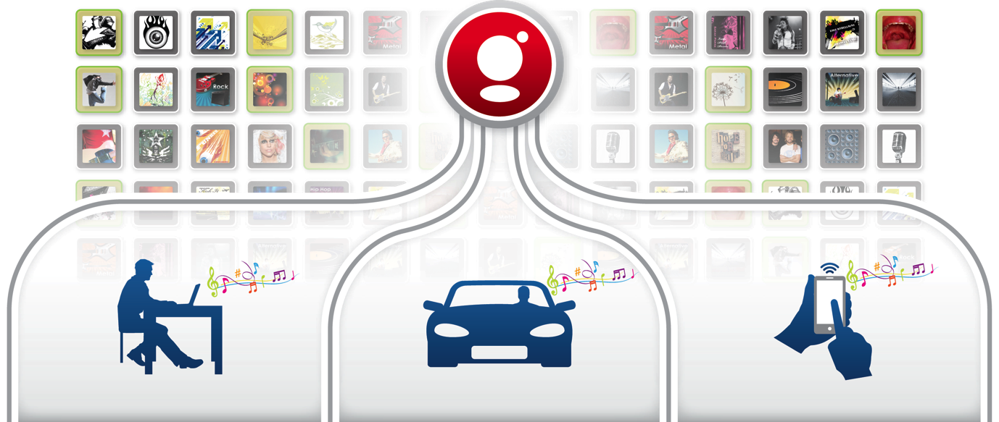
Improving Search and Discovery
Unified and structured metadata lets music fans easily connect with music through Genres, Origins, Eras, Tempos and Mood – across devices and platforms

Slide 5
Music Similarity Crosses Genres
Grindcore
Nu Metal
Heavy Metal
Strong
Black Metal
Industrial
Industrial Dance
Alternative
Punk
Noise
Indie Rock
Hardcore Industrial
Celtic Punk
Pop Punk
Classic Punk
Weak
New Wave
Emo
Alt Folk
Swing Revival
Big Band & Swing
Prog. Big Band
Strong
Jazz
Smooth Jazz
Classic Swing
Bop
Early Jazz
Celtic
Irish Celtic
World
African
Welsh Celtic
Latin
Scottish Celtic

Slide 6
Music Genres - Across Regions
ARTIST | GLOBAL | UNITED STATES | JAPAN | KOREA | TAIWAN | CHINA | EUROPE
Willie Nelson | Traditional, Classic Country, Outlaw Country | Roots, Classic Country, Outlaw Country | Pop & Folk, Country, Traditional Country | Pop/Rock, Western Folk/Country, Traditional Country | Western Pop, Country, Traditional Country | Western Pop, Country, Traditional Country | World & Traditional, U.S. Folk Blues & Country, Traditional Country
심진스님 | Traditional, Korean Traditional, Korean Traditional Song) | World, Korean, Korean Traditional Song | World Music, Korean Pop, CBM | Korean Pop & Traditional, Buddist Music, CBM | Korean/Japanese, Korean Traditional, CBM | Korean/Japanese, Korean Traditional, CBM | Other, Religious, CBM
Superfly | Rock, Japanese Rock | World, Japanese, Japanese Pop | Rock, Japanese Rock, J-Rock | Pop/Rock, Japanese Pop, J-Rock | Korean/Japanese, Japanese Pop, Japanese Rock | Korean/Japanese, Japanese Pop, Japanese Rock | World & Traditional, Asian Rock, Japanese Rock
Notes:
6

Slide 7
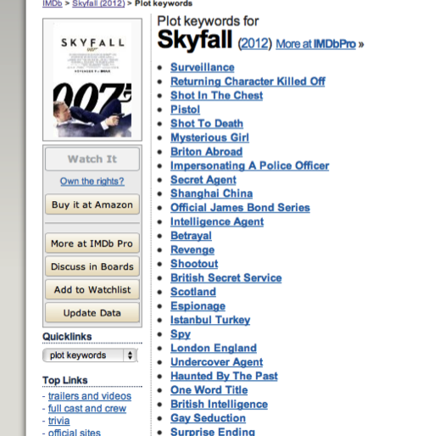
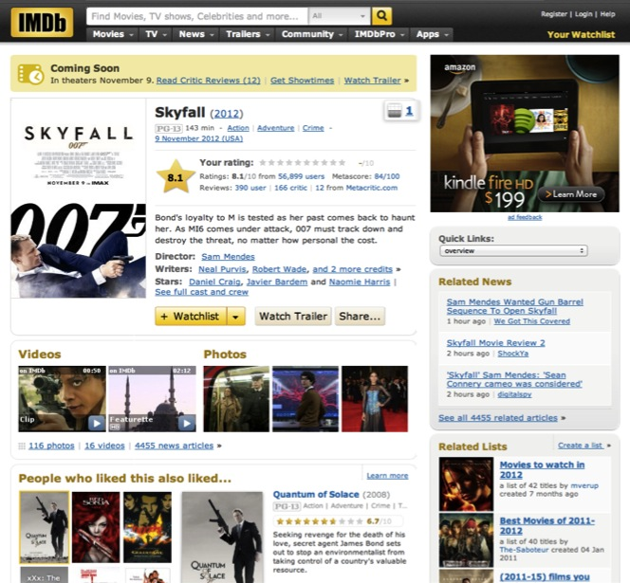
The Metadata Challenged - IMDb
IMDB is a great Web site, but from a Metadata standpoint, it faces challenges. The data is not structured well – relating items together is difficult.

Slide 8
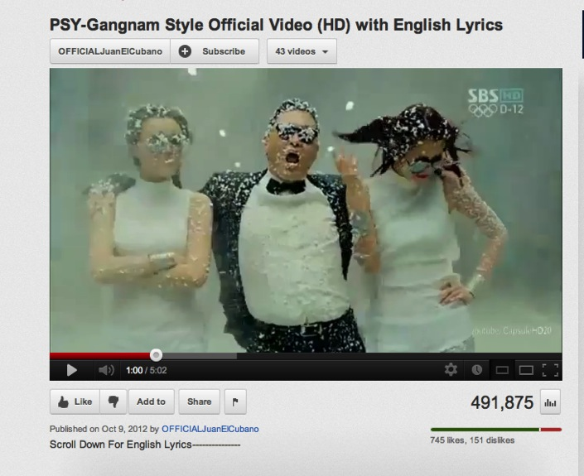
The Metadata Challenged - YouTube
World’s most popular music service
Content is totally unstructured
Search and navigation for music is cumbersome

Slide 9


Getting it Right - Rhapsody

Slide 10

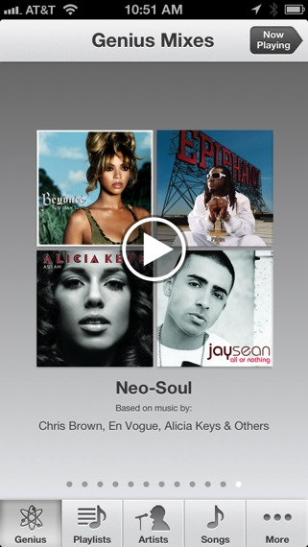
Pure Genius
Apple Genius recommendations based on related data
Consistent user experience across the world
Relating local and global content

Slide 11
Structure Matters
The earlier you think about metadata from a global perspective the better. Gracenote has done this for years, resulting in successful partnerships with leading platforms and brands.

Slide 12

Thank You

