Slide 1
The Future of Cloud Infrastructure
Cloud Scale Storage
Jean-Luc Chatelain
EVP, Strategy and Technology DataDirect Networks

Slide 2
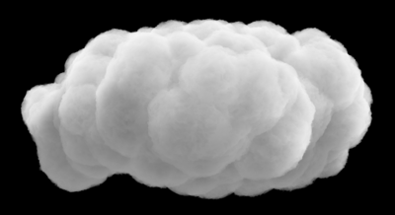
The Future of Cloud Infrastructure
Datacenter
Datacenter
Storage
&
Compute
Datacenter
Storage
&
Compute
Storage
&
Compute
Storage
&
Compute
Storage
&
Compute
Notes:
Increased compute power in mobile devices
Local device storage
Dealing with loss of connectivity
Cloud as referential storage
Recent example: Insurance

Slide 3
What We Expect Of A Cloud
Autonomous
Always On
Pay as You
Go
Everywhere
Cloud Scale Storage
Infrastructure
100% Reliable
Easy to
Use
Green
Backup
Synchronized

Slide 4
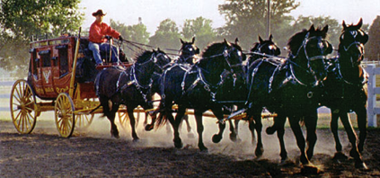
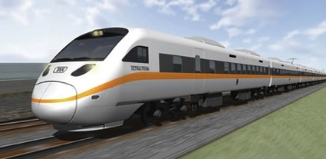
Cloud Scale Requires a Storage Paradigm Shift
File Storage
Object Storage
Vs.
Traditional File Systems Can’t Scale
Too much overhead (up to 40%)
Not designed for small I/O
Limited scalability
Management complexity
Scaling efforts balloon TCO
Designed for Web2.0+ Scalability
Virtually NO Overhead
Highly Optimized for Small I/O, SSD
Linear, Efficient Scalability
Autonomous, Self-Healing
Optimized for Data Center, CAPEX

Slide 5
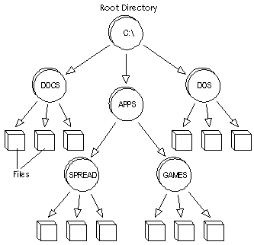
Object Storage
Object storage stores information in containers, called objects
Each object has both data, user defined & system defined metadata (a set of attributes describing the object)
File Systems
Objects
File Systems were designed to run individual computers, then limited shared concurrent access, not to store billions of files globally
Flat Namespace
Metadata
Metadata
Metadata
Data
Data
Data
Objects are stored in an infinitely large flat address space that can contain billions of files without file system complexity
Notes:
Traditional hierarchical file systems organize data into “trees” consisting
of directories, folders, subfolders and files. Files are a logical representation
of blocks of data associated with an application and are the most
familiar means of working with data. Network file system interfaces like
NFS and CIFS are well-understood, standardized methods of conveying
the logical groups of blocks from a storage repository to an application.
A problem arises, however, when a traditional file system, which has
a theoretically limited number of files it can address in a single directory
and tracks only simple metadata, runs
into massive repositories of similar files.
“File systems make less sense over
time as the amount of data grows,”
StorageMojo’s Harris said. “Architecturally,
it makes more sense for each
file to have a unique 128-bit ID and use
an Internet-like system for locating that
file; a URL points to an address and
there are files at that address, and
object-based storage interfaces are
essentially operating on the same
principle.”

Slide 6
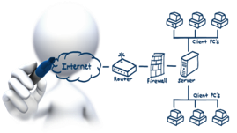
Technical Requirements
Hyper-scale
Performance
Resilience
Distribution (GEO)
Security

Slide 7
Hyper-scale
35x Growth
In 10 Years
Storing over 100PB of content¹
33x Sensor Data Growth Over Just Two Years²
Zettabytes
48fps, 3D PBs per film
Source: IDC
¹ Facebook: 2012 Form S-1 Registration Statement
² Defense Industry Daily: Too Much Information

Slide 8
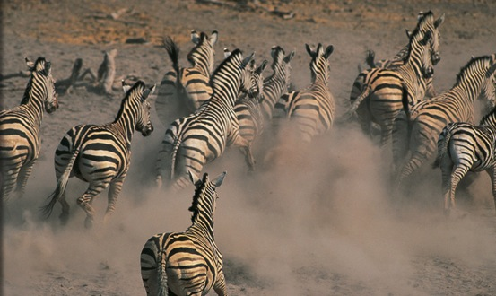
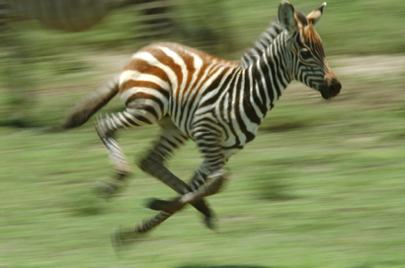
Performance
Atomic
Aggregate

Slide 9
Smart Resilience
Replication
Synchronous
Asynchronous
Erasure Coding
Distributed
Local
Self-Healing
The Cloud Becomes Your Corporate Memory.
You’d better not lose it !

Slide 10
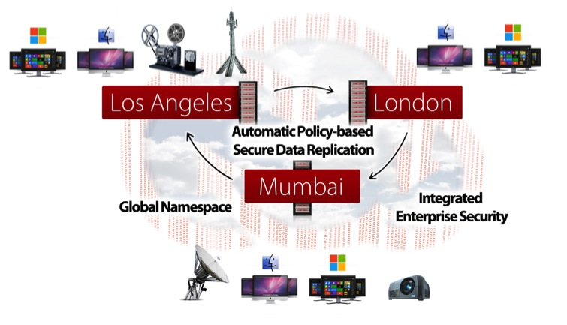
Geo-distribution

Slide 11
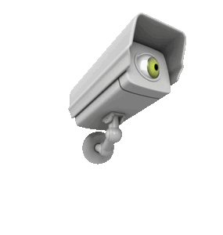
Security
Encryption
Governance, Regulation and Compliance
E-discovery
Data Citizenship
Location (files and customers) and law
Legal concerns
Right to privacy (ex. 4th Amendment in US)
Copying rules

Slide 12
Breadth of Access Protocols
If object storage is so great, why haven’t more people implemented it yet?
CIFS, NFS…
One should not forget legacy application
Your cloud solution should start with legacy options and allow your applications to evolve
Richness of access is key to success

Slide 13
Build, Buy or Rent
All possibly good solutions based on your needs
Build can be a daunting task. Make sure you understand what you are signing up for.
Buy and Rent - are both easier solutions and usually more cost effective
If you get successful and your volume increase Buy becomes more economical than Rent
VS
VS

Slide 14
Should your business be in the cloud?
“IFR flight depends upon flying by
reference to instruments only” - FAA
Should your business
be in the cloud?
We absolutely can operate in the cloud,
as long as we choose the right instruments.

Slide 15
The Future of Cloud Infrastructure?
Datacenter
Datacenter
Storage
&
Compute
Datacenter
Notes:
Increased compute power in mobile devices
Local device storage
Dealing with loss of connectivity
Cloud as referential storage
Recent example: Insurance

Slide 16
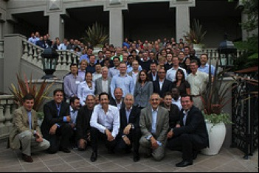
A Word from Our Sponsor

Slide 17
Thank You

Slide 18
The Future of Cloud Infrastructure
Another way to think of it

Slide 19
Why Not Run Your Business from the Public Cloud?
Geo-redundancy
Global Access
Scale
Cost
Resilience
Performance
Quality of Service
Legacy Access
Security
Latency

Slide 20
Performance, but How?
High performance, cost effective object storage is the foundation of cloud-scale architecture.
Features:
Geo-distribution
Replication
Erasure coding
Data locality
Single name space
Hundreds of billions of objects
Object storage features lend to increased performance and reduction of costs from other architecture components as well.
Linear scale-out
Object size agnostic
Self-healing
Complete drive utilization
Multiple access options
1 Seek/Operation
Notes:
Object storage features lend to increased performance and reduction of costs from other architecture components as well (networking, processing, management, total cost of ownership, etc…)

Slide 21
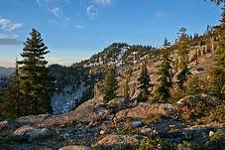
Global Access vs. Security
Access
London
Edge Cache
VS
Los
Angeles
Parent
Cache
Content Origin
Marble
Mountain
Sao Paulo
Edge Cache
Global Caching
Network
Security
Notes:
Speed of Access vs. Security
Last Mile Issues

