Slide 1
William Engelbrecht
Principal
National Service Offering Leader
Acquisition Diligence / M&A Strategy
Deloitte Consulting LLP

Slide 2
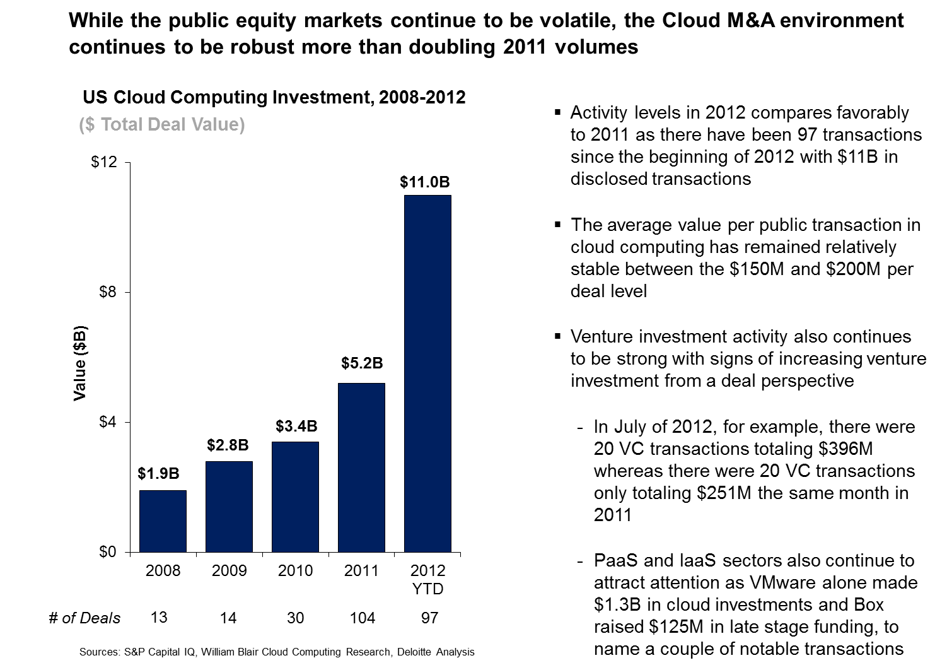

Slide 4
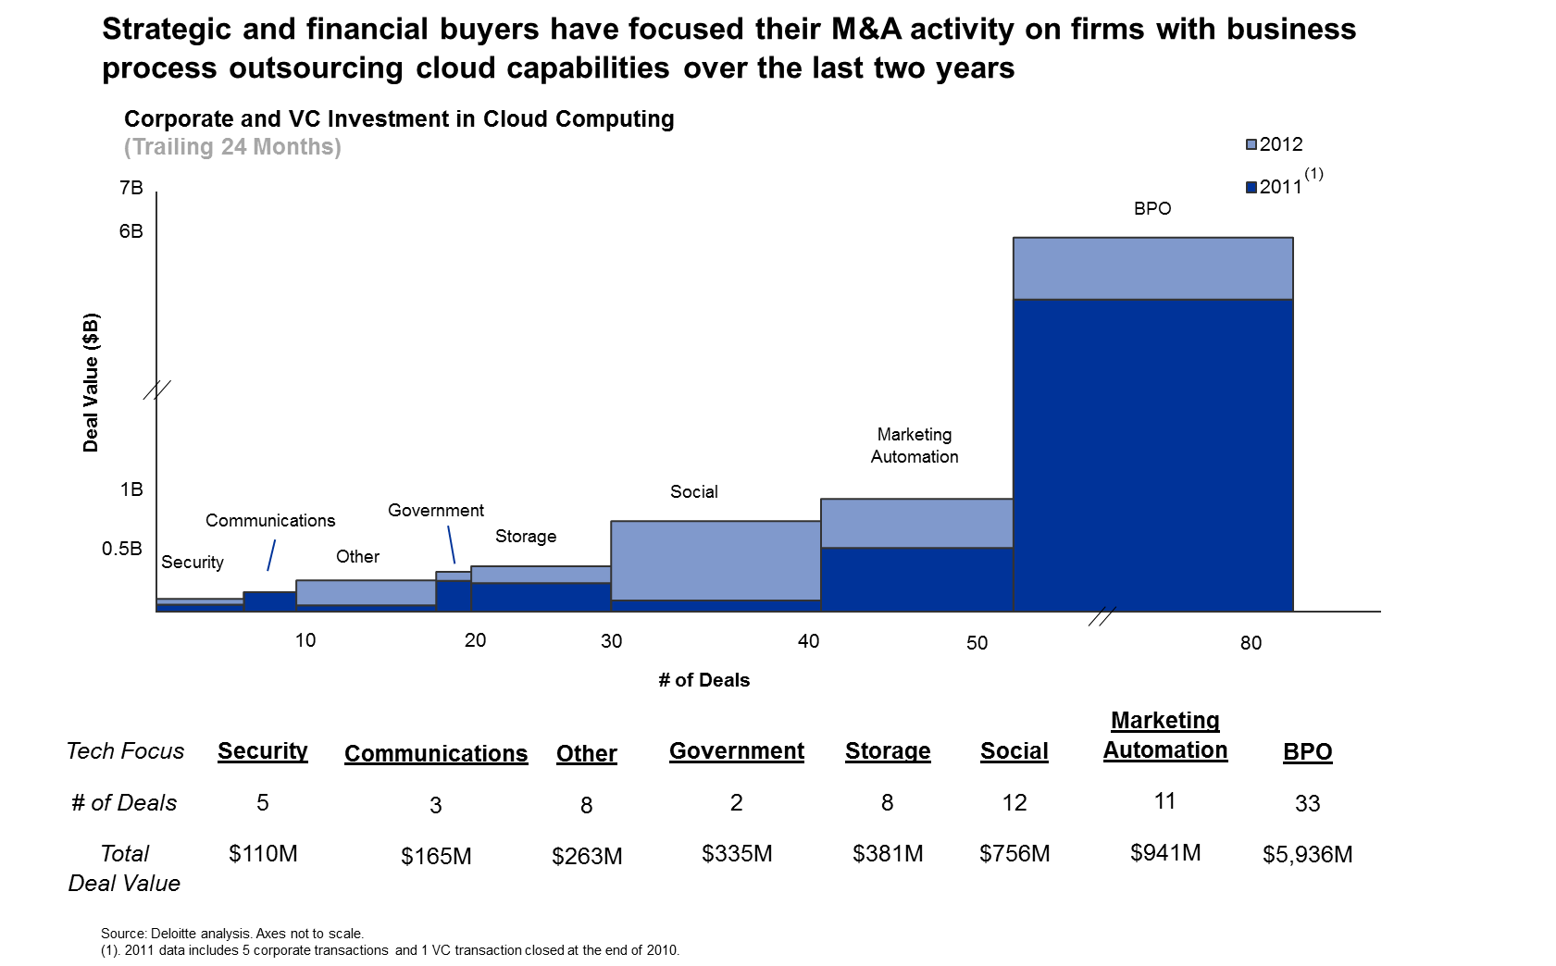

Slide 5
