Slide 1
Education Clouds: Field of Digital Dreams?
Dr. Gigi Johnson
Maremel Institute

Slide 2
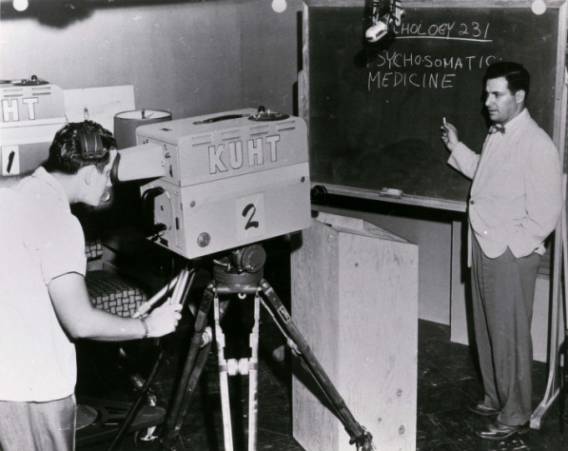
Distance Education: Long Paths
KUHT . "Dr. Richard I. Evans." June 8, 1953. University of Houston Digital Library. <http://digital.lib.uh.edu/u?/p15195coll38,195>

Slide 3
31% of US Higher Education Students Learning Online
More than 6 million students in the U.S. took at least one online course in 2010
Sources: Allen & Seaman, 2011; National Center for Education Statistics, 2010

Slide 4
Time- and Place-Shifted Education
Shifting Time: Capturing and Learning Remotely
Shifting Place: Video Learning at Home
Shifting Time and Place: Replaying on Demand via Internet
Shifting Time and Place: Portable Learning Everywhere
4

Slide 5
Impact of the Cloud on Education
Breaking time and space barriers
Local + Exclusive = Historical Barriers to Entry

Slide 6
Now: Two-Way and Ubiquitous
Cloud-Based Expansions
Ease of Entry
Commoditized Systems
BYOD as expected norm with browser based engagement or simple downloads
Limits: Program entry and cost, not time and place
2012: Explosion of MOOCs

Slide 7
All on YouTube? New Curators
Expansion by New Experts and Communities

Slide 8
Changing to Mass Economics
Student pays Tuition and Books with heavy investment in upfront costs and limited resources
Freemium or Affiliate Models – Big Data or Media Consumption Model

Slide 9
2012 – Blistering MOOC Pace
Udacity -- >1MM students
Coursera – 1.4MM students
EdX – >300,000 students
Stanford’s Venture Lab + Others
LMS Entry: Blackboard CouseSuites, Canvas Network
For pay: Udemy and many others

Slide 10
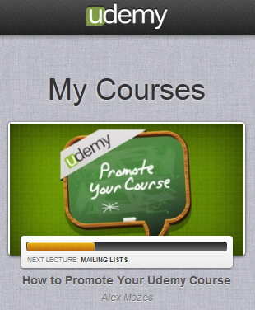
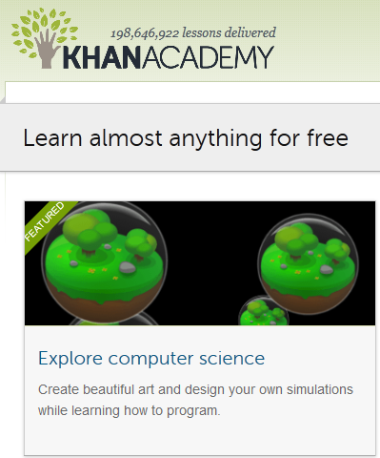
MOOC and Educational “Singles” as Freemium Cloud-based Media

Slide 11
Content Licensing – Fragmented
OER – big movement for Open Educational Resources – no marketplace for licensing
MOOCs -- Production costs w/o revenue model
BIG brand dumping
Blur of Publishing and Licensing
Books coming the other way – Publishers trying to lock schools into full packages of print and content delivery
Role of books and copyrighted materials in MOOCs – upside of the Freemium Model?

Slide 12
Maremel’s Areas of Excitement
Creative Industries Educational Exchange
Revenue sharing marketplace
Expanding options for direct licensing vs. open source
Co-learning Concepts
Peeragogy.org
Abundance of learning tools
Live/Local Groups in MOOCs

Slide 13
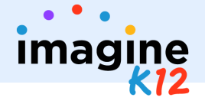
Investments in Educational Cloud
Only 1% of VC and private equity investments in education vs. 9% of GDP (Source: GSV)
Upswing in Private Investments
Incubator, Startup, and Conferences Growing

Slide 14
Education: Pushed Between
Infrastructure: K-12 Common Core Testing L&D Professional Development Higher Ed Complex System Delivery Student Support Resulting Mergers Private Equity Investment
Consumer: Everywhere Education Reduced Barriers to Entry to new Providers Reduced Cost of Course Production Cloud-Boosted Startups

Slide 15
Winners/Losers
Community Colleges – building friction while possible content benefits
MOOCs Banned in Minnesota
Local expensive colleges
Blackboard – challenged and benefiting?
Apple – device and publishing
???

Slide 16
Challenges: Album to Singles
Evidence
Identity
Mobile
Privacy
Control
Ownership/Curation/Quality
Power of institutions
Identity: Teacher/Student
Mobile
Privacy
Ownership/Curation/Quality of IP
Power of Incumbent Institutions
Fragmented Market(s)

Slide 17
Dr. Gigi Johnson
Maremel Institute
@maremel

