Slide 1
11/9/2012
Efficient Approaches to High-Scale Apache Hadoop Processing
Cloud Computing West - November 2012
Joey Jablonski
Practice Director, Analytic Services

Slide 2
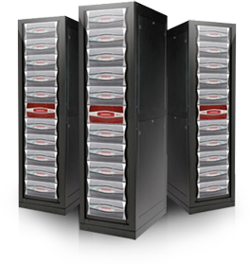
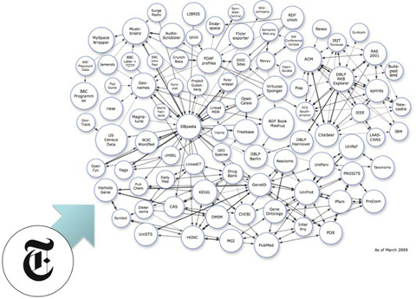
Analytics | Looking for Actionable Data
Billions of Data Points to Consider
Consumer purchasing trends
Product perception
Drug Discovery
Genomics
Surveillance
Financial Analysis
Actionable Results
2

Slide 3
What our users want
Delivering…
Content that is meaningful.
Content that is timely.
Content that evolves.

Slide 4
Customer Centric Decision Making
Improved Content, Directed at Consumers.
Value is Added
Decisions are Made
Data
Info
Insight
Results

Slide 5
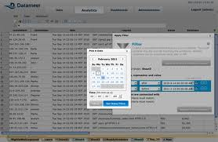
Enabling Adoption
Empowered
Users
Aware
Users
Enabled
Users
The Cloud

Slide 6
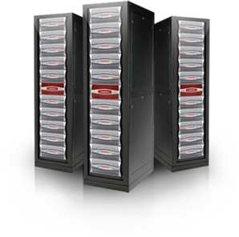
DDN | The Complete Big Data Platform
Process
Ingest
Distribute
Store
Unleashing Data Access to Accelerate Insight
Minimizing Infrastructure, Management and Data Center TCO

Slide 7
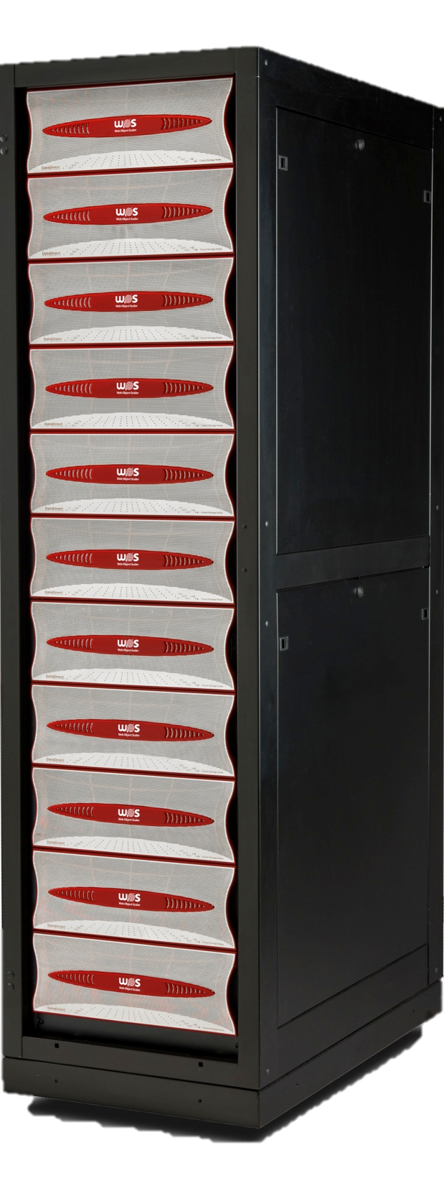
Operations Lifecycle
Deploy
Upgrade
Manage
Respond
Monitor
Software Platform
Hardware Platform

Slide 8
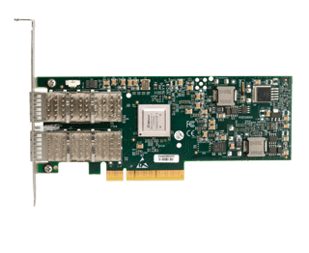
An Appliance-based approach to Apache Hadoop
Shared, Big-Data Storage with High Performance Networking Makes Hadoop Clusters More Efficient!
100% Storage Management Offload
End-End InfiniBand Networking with RDMA Acceleration
Real-Time Data Delivery to Provide MapReduce Process Consistency
Smaller Compute, Compact Storage to Minimize Data Center Impact
Reduce Compute Cluster Size by 40%
Reduce Disk Population by 60%
Reduce Data Center Footprint by 75%
Increase Responsiveness by 100%

Slide 9
Q & A

Slide 10
Who am I?
Practice Director, Analytic Services at DataDirect Networks, Inc.
3+ years with Hadoop, 12+ with HPC
Contact Details
@jrjablo
jjablonski@ddn.com/jrjablo@gmail.com
www.linkedin.com/in/joeyjablonski
10

