Slide 1
CLOUD MOBILITY: AT THE SPEED OF Hertz NeverLost®
November 9, 2012
Notes:
Introduce myself and the topic

Slide 2
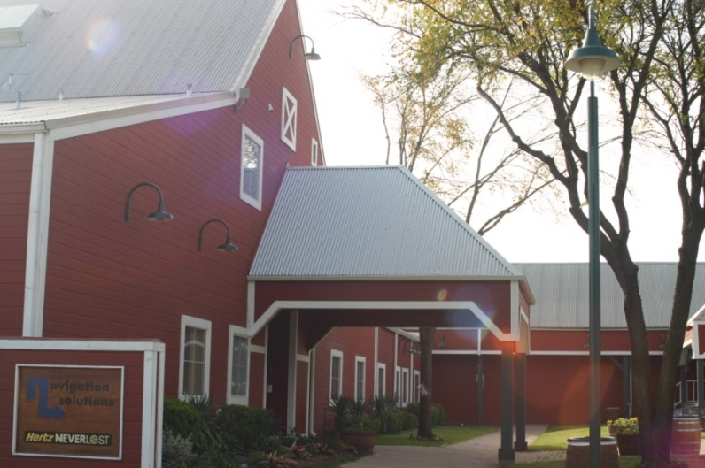
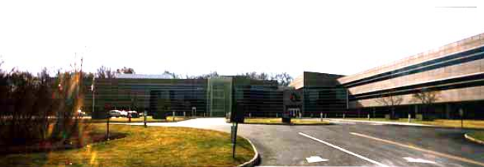
Navigation Solutions, LLC , a wholly owned subsidiary of Hertz, is the exclusive provider of NeverLost
NeverLost, the first car rental in-car navigation system, was introduced in 1997
The NeverLost portfolio has grown to include a diverse range of content and services to complement the travel experience
Navigation Solutions Headquarters
Hertz Corporate Headquarters
Notes:
In 1995 Google did not exist, consumer GPS and nav apps were not ubiqitious
technology driven effort – no customer demand
Rockwell dominated GPS with satellites and handheld devices used in telecommunications, defense and avionics
Sony was rumored to be getting into commercial gps so the CEO of Rockwell gave Roger Stevens an assignment to make it happen for Rockwell first
2. Roger pulled the intelligence together from various areas in the company such as the Rockwell Science Center and they wrote a spec to create a functioning receivedrboard. Their target was something sub $200 smaller than a pack of cigarettes. Components didn’t exist so they custom designed the chip, baseband and processor.
Their first customer was Lorenz fish finders.
3. The concept was pitched to Hertz and Avis and neither were interested in having a gps device in the car that could give directions based on where you were. At the time the necessary maps didn’t exist. -No map compression technology yet – had to use regional cartridges
Roger persisted and got Hertz to agree to a 7500 unit user trial. Hertz offered the NeverLost for $6.00 a day. The user trial lasted 2 years.
During the user trial Rockwell was sold to Orbital Sciences and Orbital was sold to Magellan.
In 1999 the CEO of Hertz met with the CEO of Orbital and brought copies of customer service feedback cards that referred to the GPS as magic and praised Hertz for offering this product.
By the end of that meeting an agreement was made to start a JV that would have a $50M capitalization from Orbital that would be used to manufacture 40,000 devices
Installation was done with a bendable floor seat mount and a wire that hooked into the speedometer cable to measure speed and help determine vehicle position.
No standarization until around 2004 with Mobile Electronics Certification Program

Slide 3
BUSINESS OBJECTIVES
Increase utilization
Maintain/increase penetration in some customer segments
Requires different approaches for customer segments to communicate the value proposition
Keep innovating with differentiators
Engage customers to keep them loyal and sticky
Integrate a mobile component
Increase un-aided brand awareness
Keeping it simple to use

Slide 4
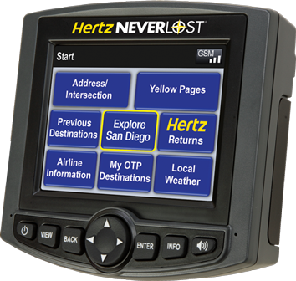
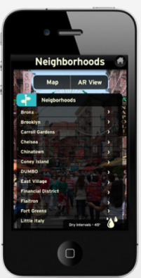
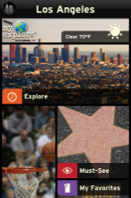
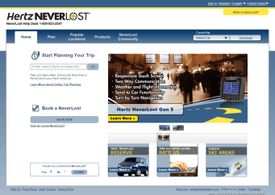
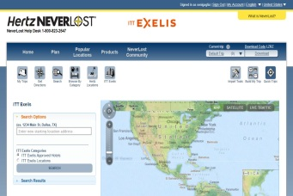
Navigation
Connected Services
Mobile Applications
Customized Content
Concierge Services
Neverlost.com
Notes:
NL5 – late 2009 launch of touch screen
Concierge - time savings of putting us to work for Hertz to help explain connected services
- Corporate use case and benefit – ROCK STARS
- Leisure travel use case and benefit – NO TIME LIMIT PER CALL
- Challenges of ramping up Concierge to take on more advanced services
NeverLost.com – Online Trip Planning
Briefly touch on our decision to build in house
Connected Services
2.5g modem in half of the fleet - - Wifi, Bluetooth
AT&T cellular coverage used
When/what types of content we use the connectivity for
Mobile
Briefly explain decision to expand to mobile
Fleet
Services we provide for the Hertz fleet
DBE tracks inbound assets
Hertz Asset Locator (high value cars)

Slide 5
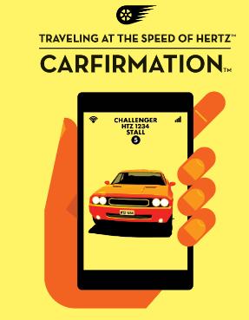
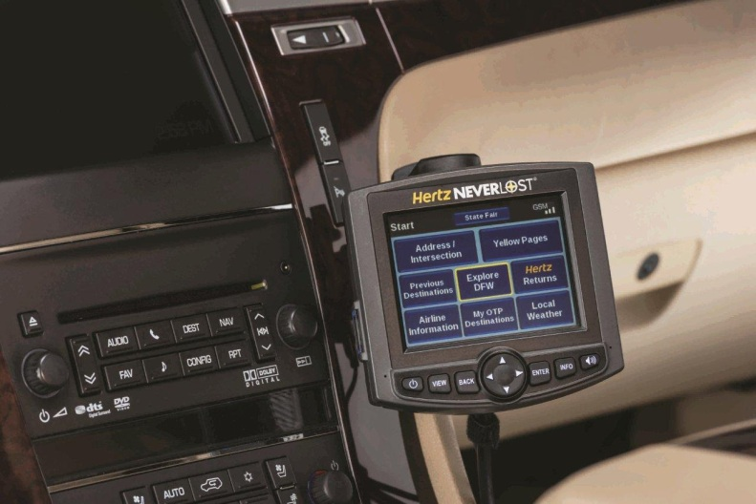
SOLUTION: UNIQUE DIFFERENTIATORS
Online Trip Planning
Customized Online Trip Planning
Download codes
Carfirmation
Explore
Special Events
Interoperability with mobile application
Notes:
We overcome weakness of updating product platforms by adding new services

Slide 6
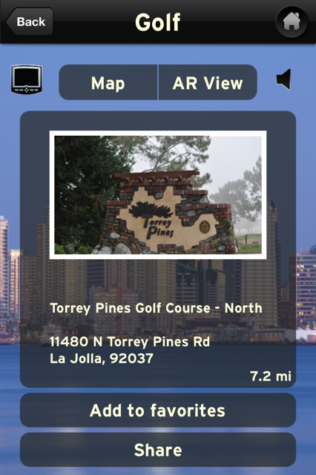
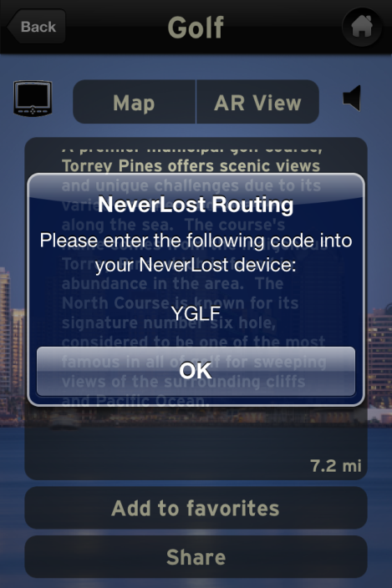
INTEROPERABILITY WITH MOBILE APPLICATION
Step 1: Press NeverLost icon
Step 2: Note Download Code
Notes:
Options we considered for send to car codes and what path we chose
App makes a service call to SOA, the Dynamic content servers generate code and broadcasts to app and DBE which communicates with NL5 (3 day life of code)
We took an iteration of our send to car code technology and used it
Different from our download codes which are permanent
Possibly Demonstrate a download code on the device – NeverLost will speak “enter wireless download code”, “A, I, T, P”, “download received”

Slide 7
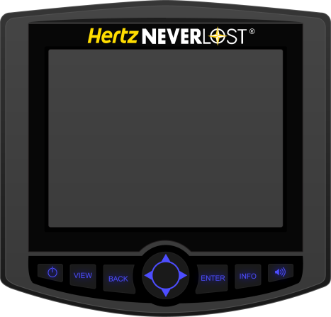
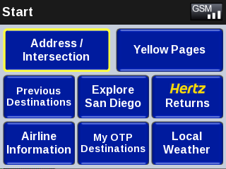
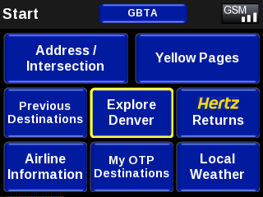
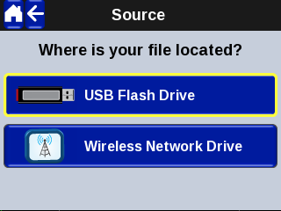
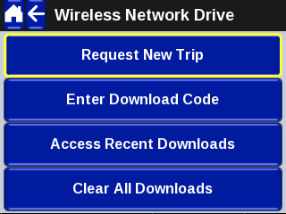
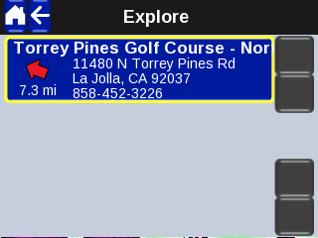
Step 3: My OTP Destinations
Step 4: Select Wireless Drive
CCW
Step 5: Enter code YGLF
Step 6: Route to Destination

Slide 8
Backup

Slide 9
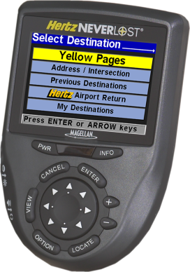
HERTZ NEVERLOST: FEATURES
Touch screen
Turn by turn directions
Speaks street names
Local search and Popular Chains
Route optimization
Real time weather
Flight information lookup
USB drive for pre-planned trips
“Always On” approach has created many loyal customers

Slide 10
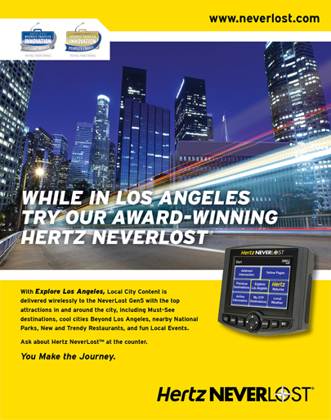
EXPLORE
Expanded to 40+ major metros
Five content categories
Beyond Los Angeles
Must See Los Angeles
Local Events
National Parks
New & Trendy Restaurants
Notes:
Explore Hawaii led to mainland concept
Decision points about how to collect data – build vs buy, quality vs. quantity
Bonnie & Clyde story
How we deliver the data OTA
Decision points around what metros to include in the project

