Slide 1
http://bit.ly/16q1Nia

Slide 2
WELCOME

Slide 3
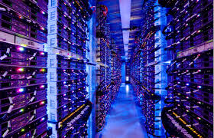

Slide 4
Mike King
DataDirect Networks

Slide 5
Michael Elliott
Dell

Slide 6
Jay Migliaccio
Aspera

Slide 7
Sean Barger
Equilibrium / EQ Net

Slide 8
Mike King, DataDirect Networks
Michael Elliott, Dell
Jay Migliaccio, Aspera
Daniel Kenyon, Equilibrium
Larry Freedman, EWP

Slide 9
THANK
YOU

