Slide 1
Phoenix Marketing International
Telecommunications Industry Benefits and Drawbacks of Cloud-Delivered Content:
New Opportunities vs. Infrastructure Challenges

Slide 2
What advantages do cloud-based solutions applied to popular entertainment properties bring to broadband network operators?
Broadband operators, as front man to consumer, are best positioned to increase in value chain/revenue stream, but also have the potential to face over the top cannibalization.
Away from per bit/speed model to service, value add, embedded
Increased network traffic for under utilized broadband pipes.
Catalyst for new industry standards/clearing house across competitive entertainment properties.
Operators who have both a fixed and mobile broadband platform have the opportunity to seamless own the everywhere, everything consumer.

Slide 3
How does the on-demand, always-accessible nature of cloud-based entertainment delivery challenge conventional distribution systems? Will older distribution methods disappear?
Consumer confusion – Which one? With whom? How?
Higher Service Level Expectations: More important than ever to be always on and no down time.
As cloud grows geometrically what happens to bandwidth demand and our ability to deliver across all geographies and platforms.
Security/privacy/migration /ownership (content developer and user)
Long term impact – multiple purchase life cycle gone?
Ultimately driven by consumer behavior and demand and industries willingness to meet these demands.

Slide 4
Devices They Can’t Live Without
Teens
Young Adults
Gen Y
Gen X
Mobile Phone
Mobile Phone
Mobile Phone
Mobile Phone
Laptop
Laptop
Laptop
Laptop
MP4 Player/iPod
Desktop
Desktop
Desktop
Desktop
HD TV
HD TV
HD TV
Gaming Console
Gaming Console
DVR
DVR
HD TV
MP4 Player/iPod
MP4 Player/iPod
Non-HD TV

Slide 5
How are they consuming content now?
Market
DVDs
Blu-rays
Stream
Download
Video Game
Movies
TV Shows
Video Games
Exercise/Fitness Media/Games

Slide 6
Media consumption time shift migration
Teens
Young Adults
Gen Y
Gen X
When Do You Watch Your Favorite Shows
Live as it airs
Live as it airs
Live as it airs
Live as it airs
74%
70%
57%
70%
22%
19%
13%
17%
Record
(Watch Another Night)
Record
(Watch Another Night)
Stream it later
Stream it later
Record
(Watch Same Night)
Record
(Watch Same Night)
Record
(Watch Same Night)
Record
(Watch Another Night)
17%
Record
(Watch Another Night)
Record
(Watch Same Night)
Stream it later
4%
Stream it Later

Slide 7
Which devices will drive future demand?
Teens
Young Adults
Gen Y
Gen X
Mobile Phones
12%
5%
Desktops
3%
Laptops
19%
8%
Netbooks
36%
33%
Tablets
43%
41%
38%
eReaders
39%
37%
Gaming Systems
HD TVs

Slide 8
What are they demanding: Mobile Phone
Teens
Young Adults
Gen Y
Gen X
Texting
Talking on your phone
Taking photos or videos
Changing backgrounds/wallpaper
Changing ringtones
Playing games
Searching the Internet
Accessing social networking sites
Emailing
Using apps you downloaded to your phone
Watching short videos
Using GPS Navigation
Backing up your phone to a computer or laptop
Watching movies
Watching TV shows
Creating or editing documents in MS Word Excel or PowerPoint
Texting
Talking on your phone
Taking photos or videos
Changing backgrounds/wallpaper
Playing games
Searching the Internet
Emailing
Changing ringtones
Accessing social networking sites
Using apps you downloaded to your phone
Using GPS Navigation
Watching short videos
Backing up your phone to a computer or laptop
Watching movies
Watching TV shows
Creating or editing documents in MS Word Excel or PowerPoint
Talking on your phone
Texting
Taking photos or videos
Searching the Internet
Emailing
Using apps you downloaded to your phone
Playing games
Accessing social networking sites
Using GPS Navigation
Changing backgrounds/wallpaper
Changing ringtones
Watching short videos
Backing up your phone to a computer or laptop
Watching movies
Watching TV shows
Creating or editing documents in MS Word Excel or PowerPoint
Talking on your phone
Texting
Taking photos or videos
Searching the Internet
Emailing
Changing ringtones
Using GPS Navigation
Playing games
Using apps you downloaded to your phone
Changing backgrounds/wallpaper
Accessing social networking sites
Watching short videos
Backing up your phone to a computer or laptop
Creating or editing documents in MS Word Excel or PowerPoint
Watching movies
Watching TV shows
14%
15%
Incidence

Slide 9
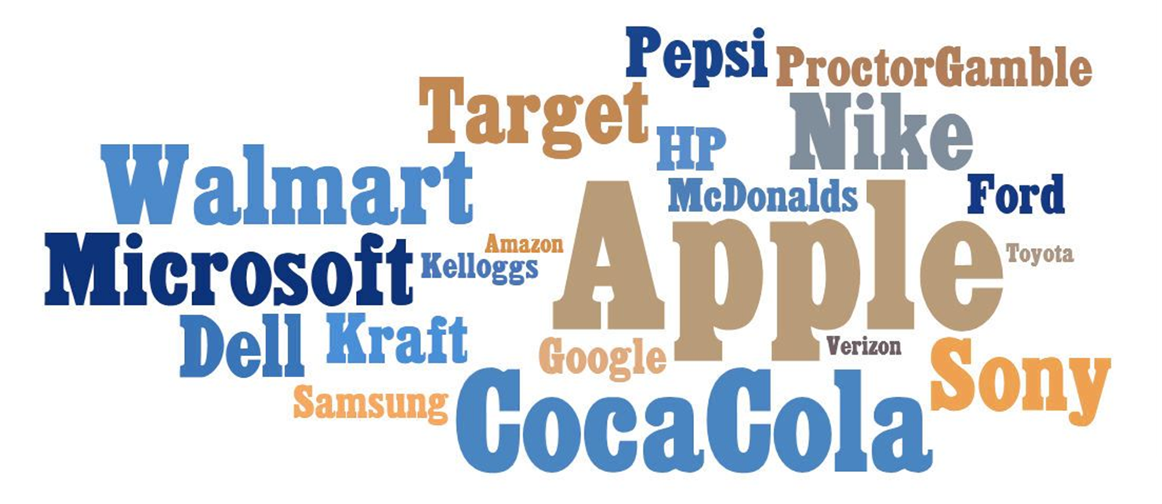
Top Recognized Brands – Who is best positioned?

Slide 10
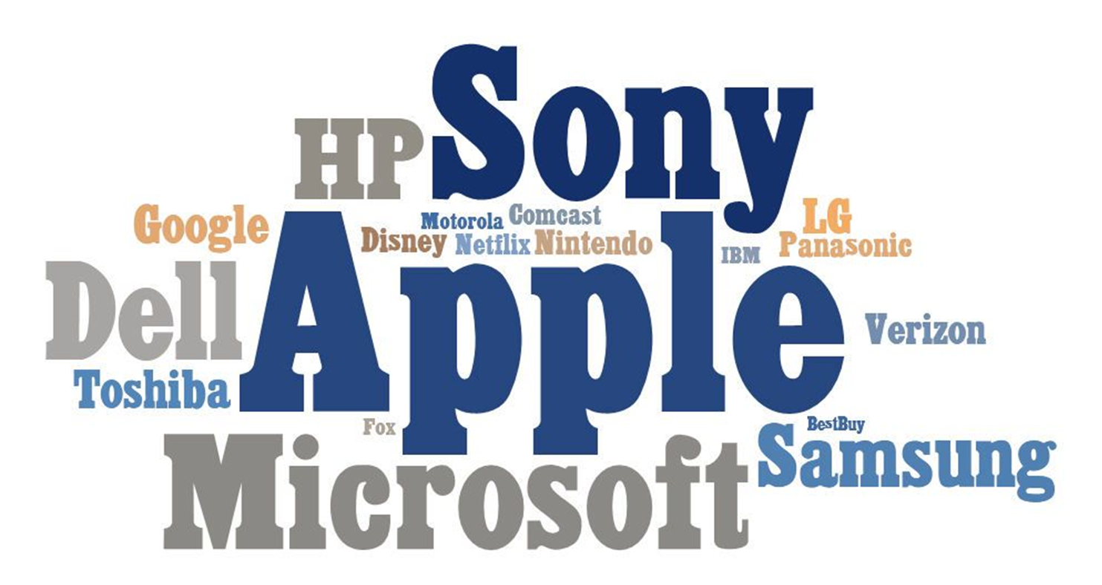
Top Recognized Tech and Media Brands: Who can make the cloud rain?

Slide 11
Please email: convtechmedia@phoenixmi.com or call 215-395-6655
THANK YOU FOR YOUR TIME
For Additional Information please contact:

