Slide 1
Benefits & Drawbacks of Cloud-Delivered Content – A Consumer Electronics User Experience Perspective
Lucia Gradinariu, Chief Market Strategist
Carrier Software & Core Networks
Lucia.Gradinariu@huawei.com

Slide 2
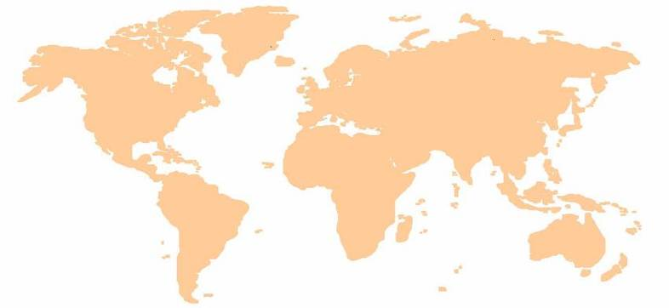
Introducing Huawei Technologies Co., LTD
Group Functions (efficient and low-cost operational platform for BGs)
Carrier
Business Group
Enterprise
Business Group
Device
Business Group
Emerging Areas
Business Group
Regional Organizations (“Local Global” operations to maximize value to customer)
Holland
Germany
■
Hungary
◆
■
Romania
▲
Bahrain
◆
UAE
India
Mexico
◆
▲
China
■
■
■
■
◆
Huawei Headquarters
▲
Malaysia
▲
Accounting share center
■
Brazil
◆
Biding center (Planning)
▲
■
Supply center & Hub
▲
Argentina
Mauritius
R&D center
Training center
Technical support center
120,000+ employees with 150+ nationalities worldwide
15 Regional Headquarters, operations in 140+ countries
20 R&D centers, 43,600+ R&D employees
Global 2nd largest patent applicant under WIPO

Slide 3







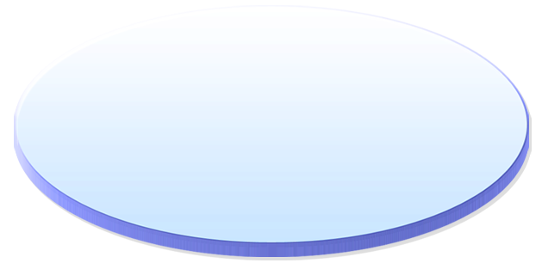
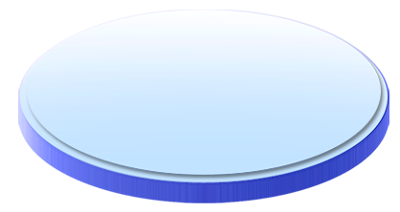

















Business Strategy: ICT Solutions to enable Value Creation in the “Digital Economy”
Lead
in Networks
Extend
in Enterprise Supply Market
Persona
Content
FTTx,LTE
(FBB/MBB)
Cloud, CDN, Data Centers
(All IP)
Platforms, Apps& Services
(Digital Experience)
Voice
Establish
in e2e
ICT Solutions
Excel
in Telecom Supply Market
Expand
in Devices
Brand
of Consumer Market
Cellular & Broadband
Enterprise
Individual
Home
Industry
Notes:
Mobile devices, not TVs => in the digital experience on/off is not an option

Slide 4
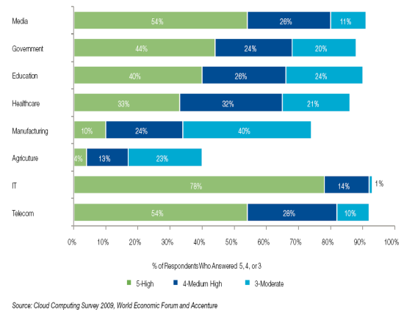
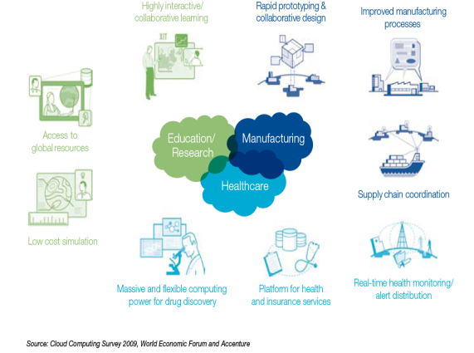

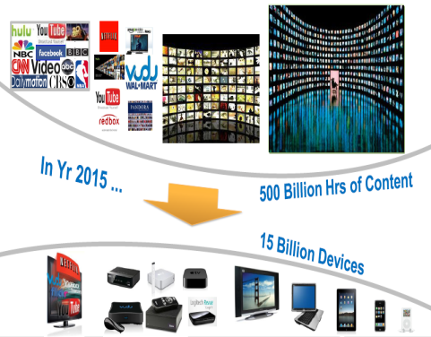









Digital Media & Communications: a perfect case for Cloud Technologies … or is it?
“The internet disrupted the music business; Google disrupted the media; cloud-based companies could become disrupters in other inefficient industries.”
The Economist (2008)
Innovation Optimization
Cloud computing is a model for enabling convenient, on-demand network access to a shared pool of configurable computing resources (e.g., networks, servers, storage, applications, and services) that can be rapidly provisioned and released with minimal management effort or service provider interaction
(NIST - definition of Cloud Computing)
Production =>
Storage, CPU,
Services, Apps
Technology Already
Transformed the Business
Distribution =>
Caching, Bandwidth,
QoS
Exhibition =>
Devices, Adaptation

Slide 5
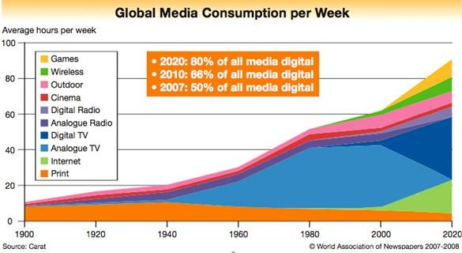
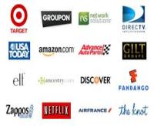
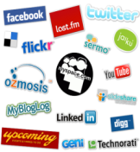
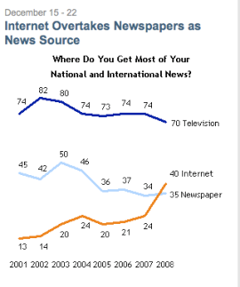
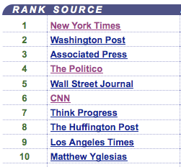


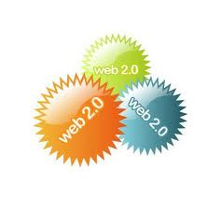







What value is created by each player? What is the basis of its claim?
“People had been counting on digital exposure ... even as it grew, it was not necessarily the big growth engine for legacy media companies that were trading those analog dollars for digital dimes. We're now up to dimes.” Jeff Zucker, NBC, 2009
“The digital world has changed the revenue dynamics for publishers; in the print world, a publisher’s shipment of physical media was the basis for generating revenue. In the digital world, consumption of media is the basis for revenue. ... In other words, engagement is the unit of monetization.” Digital Equilibrium, 2011

Slide 6
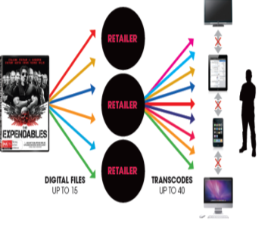

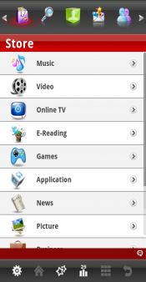
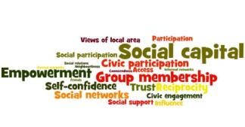

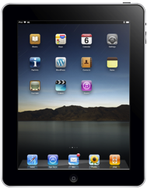
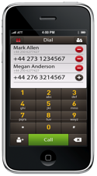
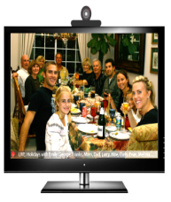


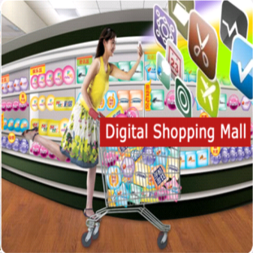
Value is in the eye of the beholder !
Coffee
Preferences
Taste
Expertise
Common
Interests
Rational
Addiction
Interactive
Interdependent
Purely Internal
Satisfaction
My Content
“Experience”

Slide 7
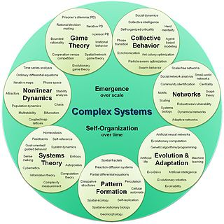





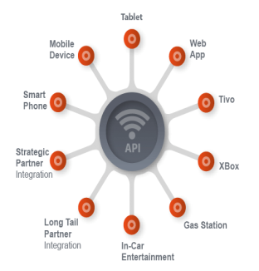




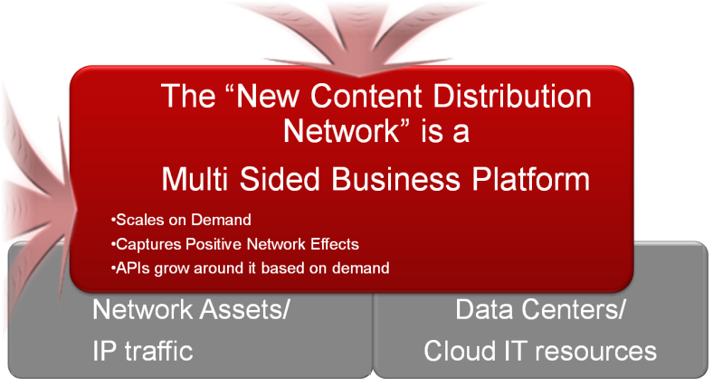









“The Demand for Experience Goods is Strongly Influenced by Interactions of Preferences and Consumption”
Source: Prof. William Greene, E&M Economics, Stern School of Business, NYU
Device
Pipe
Cloud
Interact/Transact
Search
Browse
Upload/download/stream
Ask/Answer/Vote
Sample, Consume, Share, Create
Music, video, e-books
Ads
Apps
Games
Vote
Buy/Redeem
Play/Rew/Rec
Play/Rec
Buy/Redeem

Slide 8


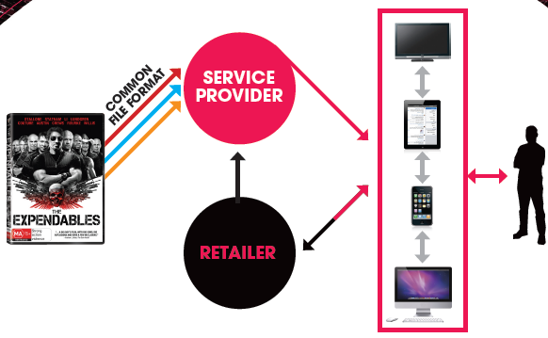

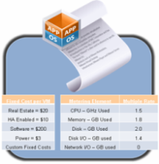
Was he right? (Does it
make economic sense?)
“Traditional media may disappear within 10 years, replaced by online content. “
STEVE BALLMER (June, 2009):
$
$
$
$
$
Content Recommendation
Targeted, Interactive Ads
Content & User Correlation
Analytics & Search Ability
Device & User Awareness
$
Social Media Aggregation
Differentiated Charging
Cloud Enabled Platform
The Marginal Cost of reproduction and distribution has always protected copyrights.
In the Digital Economy “Zero cost” distribution is the issue, not reproducibility.
In Platform Based Business, each distribution may create additional value at “Zero Cost”
( my “capital stock” and “social capital”)

Slide 9
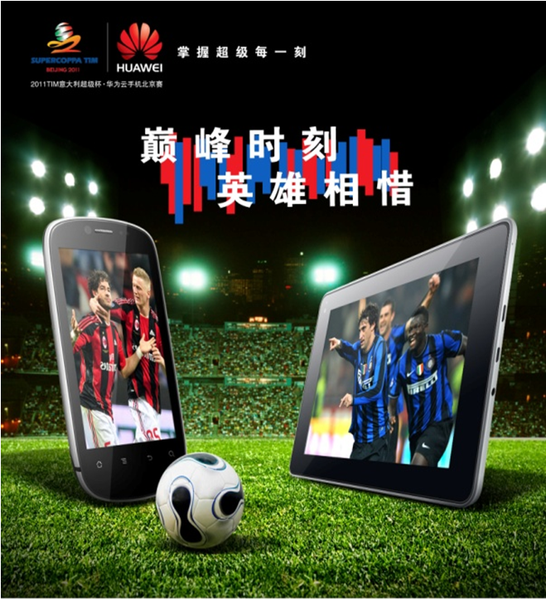

主画面 （小脚篇）
尝试大型活动
提升品牌
Beginning large-scale campaign
to Enhance our brand

Slide 11



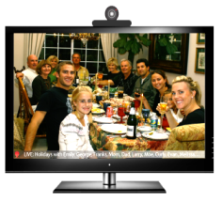





Market Trend: Convergence (Utility & Entertainment)
ICT
Comms/Operator
Web/Consumer
IT/Enterprise
Blurring the distinctions between Business and Personal, Communication, Content and Internet Service Providers
Telecom
Service Cloud
Enterprise
App. Cloud
Lifecycle
Mgmt.
Data
Mining
Virtual Desktop
Virtual Data Center
IPTV
App store
……
OA/ERP/CRM
E-health
E-traffic
E-government
……
OSS/BSS
in Cloud
Enterprise Experience
Home
Experience
Mobile
Experience
Cloud Platform Services
Enterprises are using consumer and OTT technology for business.
Home users are embracing conferencing and collaboration tools
Operator services are being delivered by consumer companies
Media APIs Framework
Service APIs Framework
Ingestion
Storage
Streaming
Creation
Execution
Deployment
Basic Cloud Services
Distributed Database
Parallel Computing
Automatic management
Distributed File system
Dynamic Resource dispatcher/pooling
OS & Virtualization
Cloud-Oriented Hardware
Server
Network
Storage
Security
Power & cooling

