Slide 1


Content In The Cloud Conference
2012 International CES
Entertainment Industry Benefits and Drawbacks of Cloud-Delivered Content:
Innovation and Flexibility vs. Disruption and Accountability Issues

Slide 2



Octoshape
Global Video Distribution Solutions
Octoshape is high performance cloud-based media distribution technology:
- TV Quality
- TV Scale
- TV Uptime

Slide 3
Cloud Infrastructure
What are we talking about really?
In order to facilitate media distribution on the Internet large amounts of computing, storage, and networking resources are required.
Just some of the tasks include:
Encoding
Transcoding
Metadata Processing
Delivery
Ad Insertion
Security
“Cloud” refers to generic server and network infrastructure deployed by a provider as a service.
These are often shared resources, and can scaled and deployed flexibly depending on the specific needs of the customer.

Slide 4
Cloud Distribution
The Good / The Bad
Pro’s / Advantages
Con’s / Dis - Advantages
Low Barrier To Entry - Innovation
Fast Deployment – Procurement
Economies of Scale – Cost
Low Total Cost of Ownership
Performance Varies between providers
Ingest Challenges
Egress Challenges
More Security Considerations
Overall this movement is excellent for the consumer as it escalates the availability of new content offerings outside of traditional content channels.

Slide 5



Quality is key to Cloud content business models
Higher quality video suitable for big screen living room viewing requires higher bit rates
Higher bit rates with traditional technologies bring more buffering
To get around buffering traditional technologies lower the quality
When the quality is lowered or buffering occurs, people tune elsewhere

Slide 6
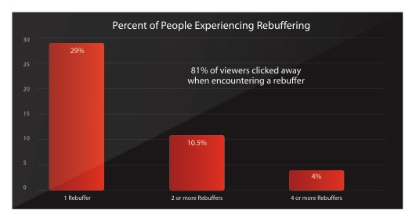
Low quality is a significant impact
81% of people clicked away when they encountered a buffering event
Study by TubeMogul (12/09) combined with research data from IDC (1/10)
Octoshape proprietary and confidential

Slide 7
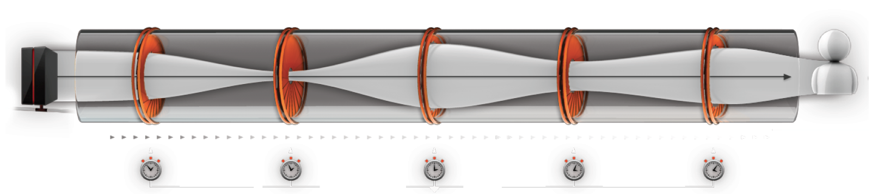

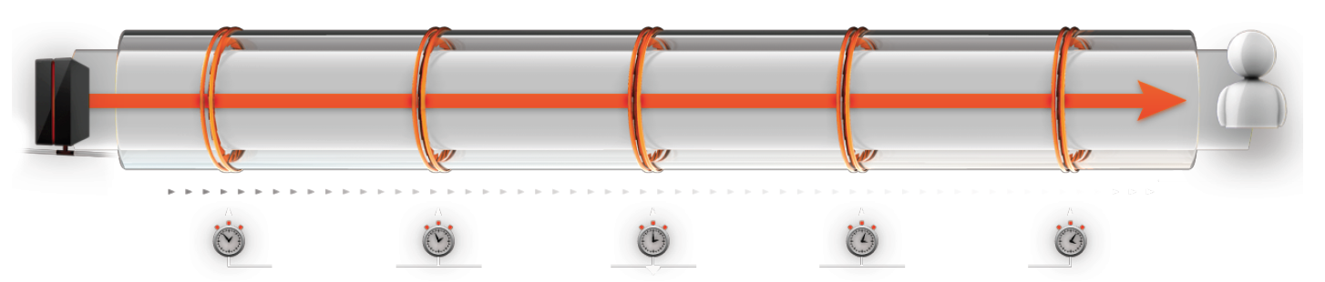

Octoshape removes these problems
Traditional OTT Video Delivery
Octoshape accelerates the video distribution, avoiding congested pathways through the cloud to the consumer.
This throughput variation causes people to click away
- Lowering viewer satisfaction for subscription services
- Lowering ad revenues
Octoshape Accelerated Video Delivery
Octoshape offers sustained TV quality experiences
- Extending viewer engagement time for ad revenues
- Building consumer affinity for subscription services

Slide 8


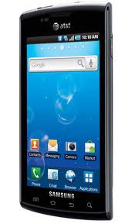
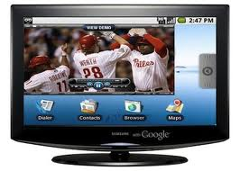
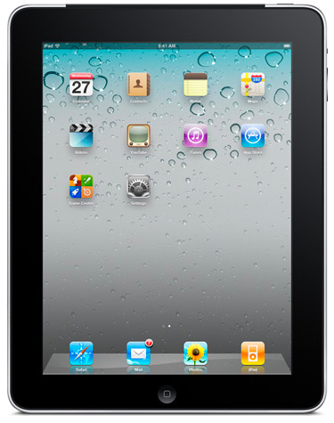
Octoshape
CloudMass
Octoshape Cloudmass transparently aggregates multiple clouds together to create a massive global distribution infrastructure

Slide 9
Content in the Cloud
Summary
Clouds are good: They foster innovation, escalate product roadmaps, reduce total cost of ownership
Clouds have some challenges: They require more planning around security, performance, quality and workflow
Octoshape optimizes the cloud: By accelerating video into and out of the cloud

Slide 10
Thank you!
Contact:
Email: sales@octoshape.com
White Papers:
They don’t make a CDN this big
http://bit.ly/octosolution
http://bit.ly/cloudmass

