Slide 1
Consumer Benefits of Cloud Delivered Content DCIA Content in the Cloud Conference @ CES

Slide 2
Cloud Promises
Redundancy → my content is safe
Synchronization → shared documents are synchronized
Access → content anytime and anywhere I want it
Cost → I’ll save money
Control → content providers will make more content available

Slide 3
Cloud Realities
Good > Bad
Marketing > Technical Innovation
Not all clouds get along

Slide 4
Cloud Realities
Redundancy → my content is safe
Redundancy → my content is safe
Synchronization → shared documents are synchronized
Synchronization → shared documents are synchronized
Access → content anytime and anywhere I want it
Access → content anytime and anywhere I want it
Cost → I’ll save money
Cost → I’ll save money
Control → content providers will make more content available
Control → content providers will make more content available

Slide 5
BitTorrent’s Cloud Tenets
The Cloud must be efficient
The Cloud should be distributed
You should control the Cloud – it should not control you

Slide 6
BitTorrent’s Approach: Help Everyone Publish
Famous TED Talks series promoted on BitTorrent and distributed millions of times to BT users
Award winning film promoted on BitTorrent and later picked up by HBO
2,000,000 downloads by BT users
Episodic TV series promoted on BitTorrent and raised $60,000
1,000,000 downloads by BT users
Local Hip Hop Artist promoted on BitTorrent and grew social media 10x
500,000 downloads by BT users
Khan Academy educational videos (championed by Bill Gates) providing free education to anyone, anywhere

Slide 7
BitTorrent’s Approach: Help Everyone Publish
"BitTorrent is a great platform to help us fulfill our mission of providing world-class education to anyone, anywhere…it offers a unique opportunity to video creators and publishers. The technology allows users to download large video files quickly, plus it requires no costly hosting or infrastructure on our end.”
“The idea of BitTorrent as a viable means of distributing content is really starting to break through…between Pioneer One, Zenith and other projects adopting the same model, it's going to become too big to dismiss."
“My goal is to use BitTorrent to build as large an audience as I can, and I want to be where people my age go to hear new music.”
"You can't fight against the technology people are using. People are using BitTorrent to discover music and we want them to hear our music."
“To see movies such as ours welcomed into the BitTorrent ecosystem marks a significant step in the adoption of the technology as a legitimate film distribution platform.”

Slide 8
BitTorrent’s Approach: Include Personal Media
High Quality
Low Quality

Slide 9
BitTorrent’s Approach: Include Personal Media
High Quality
High Quality

Slide 10
BitTorrent’s Approach: Include Personal Media
Quality
Unlimited size and number of files
Social
Real-time commenting + social network integration
Fast
Peer-computing accelerated delivery
Private
Controlled delivery to known parties
Personal TV
Viewable on any BitTorrent Certified device

Slide 11
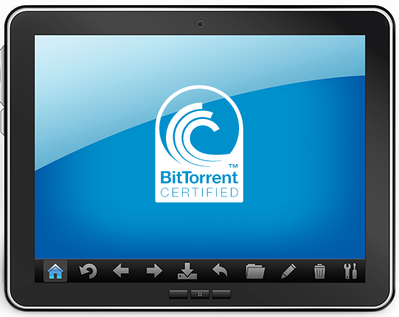
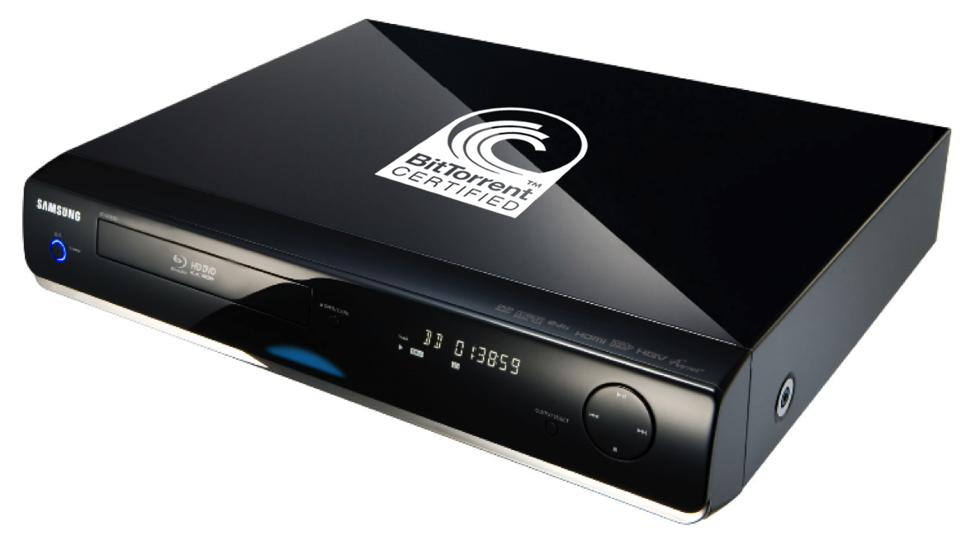
BitTorrent’s Approach: Put Content Everywhere
High Quality
High Quality

Slide 12
BitTorrent’s Advantage
Centralized Clouds are less efficient and more expensive as usage increases
Consumers must choose between Cheap & Bad or Expensive & Good
=============================
BitTorrent is more efficient and less expensive as usage increases
Consumers get high-quality at little to no cost

Slide 13
Summary
The cloud is real and good, but hype > reality
Early winners are redundancy and sync
Real innovation requires a different approach
A distributed, efficient cloud wins in the long-run

Slide 14
Thank You
sha@bittorrent.com

