Slide 1
Content in the Cloud CES 2011
Claude Tolbert
Vice President, Business Development
claude@bittorrent.com
Notes:
BitTorrent is first and foremost a technology company. Innovation is core to our company, and as technologist we seek out market driven solutions that can change the Internet in a very fundamental while also improving our users’ experiences.
This path has led us to a two year investment and the creation of new transport protocol that we believe can yield significant benefits to both ISPs and consumers. Today I will discuss the market drivers that led to micro transport protocol, explain some of the benefits that we see in it for users and ISPs as well as some of our standards work.

Slide 2
Company Overview
Highlights:
100M+ active users around the globe
Over 400k new downloads per day
Explosive growth in emerging markets
4+ hours avg. monthly viewing/user
Profitable and growing business
Iconic brand – one of the Internet’s archetypal open platforms
Investors:
Accel
DCM
Management Team:
Eric Klinker, Chief Executive Officer
Bran Cohen, Chief Scientist
Shahi Ghanem, Chief Strategist
Ilan Shamir, VP Engineering
Simon Morris, VP Product Management
Claude Tolbert, VP Business Development
Headquarters:
San Francisco, Calif.
Employees:
40

Slide 3
Notes:
…are used by over 100m users every month, and are downloaded and installed over 400k times every day

Slide 4
BitTorrent for Beginners: BitTorrent is finding its way into your wireless routers, NAS drives, media streamers, and more.
Bram Cohen on the
Evolving Business of BitTorrent
Where Does BitTorrent Inc.
Go From Here?
Apps give uTorrent a feature boost
BitTorrent downloads lessons…
4 Ways Bands Can Cash in Online
Without a Label
BitTorrent Expands App Studio, Distributes Movie via P2P
BitTorrent Debuts Film,
Upgrades uTorrent
uTorrent 2.2 App Studio
Finds and Fixes Up BitTorrent Content
BitTorrent Expands Apps Availability

Slide 5
Driven by the
Principles of Innovation
Notes:
The BitTorrent open source protocol, managed by the company, powers as much as 50% of global Internet traffic, according to independent analysts
It was initially developed as a P2P protocol to dramatically increase the speed and availability of large popular files distributed over the internet like Linux software distributions
Today, aside from many independent software clients, the BitTorrent protocol has been embraced by some of technology’s most recognized brands for a variety of purposes – from internal network efficiency (Facebook and Twitter) to consumer software updates (Blizzard), and distribution of large files to users (Wikimedia and Revision 3)

Slide 6
The Center of
Your
Experience

Slide 7
The Digital Content Explosion
Notes:
The next phase of BitTorrent will deliver a true 3 screen experience. No matter how big your file is, you will be able to find it, get it, watch it and share it – anytime and anywhere.

Slide 8
“The power of imagination makes us infinite”
-John Muir
Software
Devices
Content
Notes:
To achieve this vision, we’re designing an integrated technology ecosystem to bring simplicity to the digital media consumption lifestyle.
This technology ecosystem will include:
Major updates to our client software already in the market, although still based on the same underlying transmission protocols
Digital Content which will have privileged access to our huge ecosystem of consumers
Consumer electronic devices such as Digital TVs, DVD/BluRay Players, Mobile and tablet or Pad platforms, and various other connected devices.

Slide 9
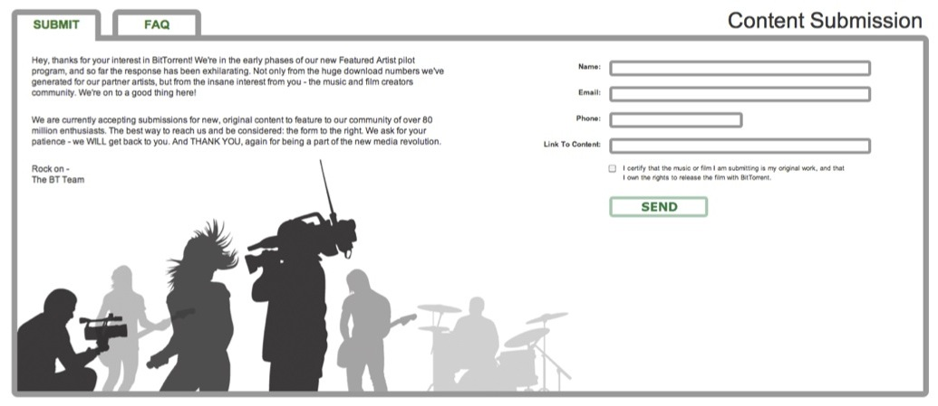
Artist Spotlights
Notes:
BitTorrent’s content efforts bring content partners closer than ever to millions of consumers with frictionless distribution channels allowing the richest media to be delivered within the rich interactive experiences which users have grown used to on the web.

Slide 10
Special Releases
Notes:
And efforts are already yielding real success, showcased here in these artist spotlights:
The independent movie Yes Men? has been downloaded more than two million times, which is (create stat to compare to opening screens or traditional media reach – possible HBO stat?)
Episodic content series Pioneer One, which is employing a new model for fan-funded content, was download over 1 million times and has already raised funding for its next production which will go live on BItTorrent in December
And then there’s LA-based Hip Hop artist, PAZ, whose debut mix tape dropped on BitTorrent has been already been downloaded over half a million times. He’s now celebrating ‘going gold’ while also reinforcing his venue attendance, merchandise sales, and social media presence (FB or MS stat)
And to date, we’ve found big success in artist spotlights. Yes Men? Downloaded more than XX times. Pioneer One created episodes, hooking fans and setting donation thresholds before releasing the next. The result? Over $33k raised with just one episode. The next episode will hit BitTorrent in December. And PAZ? Over 500,000 downloads. These artists are partnering with BitTorrent because they know the importance of building engaging relationships and leveraging the vast viral nature of the Internet.

Slide 11
Thank You
Claude Tolbert
Vice President, Business Development
claude@bittorrent.com

