Slide 1
Launch at Content in the Cloud Conference NAB 2011, Las Vegas
April 11, 2011
Notes:
LADIES AND GENTLEMEN
I am deeply honored to be here today at such an important event and in front of such an important audience – here in the heart of Silicon Valley.
We were planning to launch our new company at NAB in Las Vegas in April, but after receiving the honors of being listed in the AlwaysOn OnDemand Top 100 top private companies in the cloud, and being invited to be the first CEO to address this exclusive audience, it was an opportunity to good to miss. Thank you for inviting me here!
I can promise that you will never forget TODAY! This time in history, when you first time heard about Creaza.
Creaza is about to trigger a revolution, which will change the video industry and how video is being produced forever
We will make the old paradigm;, single user focused video editing suites obsolete, by bringing video editing to the cloud in a big way
Many people have said YouTube and Facebook have started the social video revolution, but just wait until to see what Creaza will do!

Slide 2
Combining the most important trends on the net today
Creaza
Social Networking
Online Video
Cloud computing
Mobile
Notes:
What happens if you bring together the three most important trends on the web today?

Slide 3
Opportunity Knocks
From PrimeTime to MyTime, From Broadcast to Narrowcast
Web 2.0/3.0 is all about user-generated content
Fiber and 4G broadband is emerging
HD-video recording everywhere (Video cameras, cell-phones, flip, tablets)
& revolutionized video DISTRIBUTION
Creaza is revolutionizing video PRODUCTION
Creaza is the platform for the personal and user generated “TV of the future”
Notes:
What are the forces in the market today?
We are now moving from Prime Time to My Time. People are themselves deciding what they want to see, and when they want to see it
The broadcast model is under threat, and the big broadcaster are stryggling.
The future of TV is moving from broadcast to narrowcast, where each user is choosing what he wants to watch around his own interests. And anyone can now themselves become a broadcaster online. It is no longer limited to the big studios with the deep pockets.
Web 2.0 and 3.0 is all about user generated content; with an explosion in use of online video and social networks in particular
Just like Youtube and Facebook have revolutionised DISTRIBUTION of online video, Creaza will revolutionise the CREATION AND PRODUCTION of video.
Creaza is the ideal platform for the personal TV and user generated TV of the future!

Slide 4
Creaza at a glance
media with your mobile phone or any SHOOT camera enabled device and sync to private or share media libraries in the cloud
your movie by editing your media clips with SHAPE professional-looking titles, transitions, effects, animation, music and narration
media with friends, family and colleagues SHARE in an online workspace and publish movies to social networks and video scrapbooks

Slide 5
DEMO

Slide 6
Problems Solved!
Media acquisition and synchronization
Acquiring and gathering media from multiple devices
Secure long-term storage
Today’s highly fragmented storage of media, lead to a high risk of losing valuable memories forever
Media sharing and team-editing
Sharing media from same event between participants
Team-editing of media from shared, private or content libraries
Easy and secure access to your media
Facebook and YouTube are having limited functionality to keep your media private so you can control the distribution
Sharing of advertising revenue with the online video industry
Be an outlet for and share revenue with content owners
Create a marketplace
Become an eBay for online video, where millions of users can generate revenue from selling content and services

Slide 7
Key Features
Multi-User Team Collaboration
Multiple Picture in Picture
No Rendering Time !
HD Video Cloud Based Storage
HD Import/Export
Multi-Media Market Place
Video Scrapbooking
Creaza

Slide 8
Creaza today
Selected for AlwaysOn OnDemand Top 100, nominated for Global Top 250
Major partnerships to be announced soon!
United Nations
Major Telecom
Targeting millions of users worldwide!
Creaza Education: 9 languages, 150 000 users, Already profitable
Notes:
8

Slide 9
Media Broadcast • Web based
Multi-User Support
HD Import/ Export
Create highly content rich media, incorporating videos from multiple sources, perspectives, view points and geographical locations.
Enable news/media editing 24/7.
Your customers and viewers expect broadcast quality footage.
Upload, edit and publish your content all in a HD workspace.
Secure Access
Don’t risk a story being leaked to other media channels.
Restrict access to your highly encrypted workspace.
Video Scrapbooks
Cloud Based Processing
Create content rich pieces linking all your multi-media, scrapbook style.
Ideal for Web based articles, or more in-depth coverage for broadcasted pieces..
Every minute counts when you are getting that hot story out.
no time lags through cloud based distributed processing.

Slide 10
Professional Photo/Videographers Commercial • Portrait/Wedding • Sports/Nature • Photo/Video Journalism
Multi-User Support
Allow wedding guests to upload video clips or photos to create “candid” footage/slideshows of the event.
Rapidly create documentaries with contributions from journalists and the general public.
HD Import/ Export
Exceed your client’s expectations through vibrant HD, broadcast quality, products.
Export your HD videos for offline viewing/showing.
Secure Access
Protect and respect your client’s confidentiality.
Video Scrapbooks
Cloud Based Processing
Conveniently package your videos, portraits, and even music into a friendly and attractive scrapbook format.
Time is money. So, why let rendering slow you down when you can edit with zero rendering time in the cloud !

Slide 11
Universities Clicks and Mortar • Online Only
Multi-User Support
HD Import/ Export
Enable student assignment collaboration with a cloud based video editing workspaces.
Create at the individual, assignment, or class level…without boarders.
Import HD videos from previous assignments, or newly created content.
Export HD videos for offline use.
Video Scrapbooks
Secure Access
Quickly and conveniently combine video and other multi-media content into subject, topic or even assignment level study aids.
Restrict access and protect privacy.
Access to authorized faculty and student members.

Slide 12
Corporations(In-house Marcom) Private Companies (low budget) • Public Companies (“Big Splash”)
Multi-User Support
HD Import/ Export
Create professional looking videos, at a fraction of the cost.
You have offices throughout the world, enable 24/7 video capture and editing, leverage your global workforce.
Your product is state-of-the-art, your brand is strong, so import, edit and export high definition videos that are of a quality that matches your own.
Secure Access
Why risk leaking a new product, edit your product videos in a secure environment.
Video Scrapbooks
Cloud Based Processing
Package your videos and other multi-media content into a custom, professional, navigation scheme, across multiple devices.
Time is money, so edit in real-time through distributed processing in the cloud.

Slide 13
Special Interests/Hobbies Extreme Sports • Gaming • Major League • Gardening • Travel • Pro-sumer video/photo
Multi-User Support
HD Import/ Export
High content rich videos using contributions at different viewing angles, positions & perspectives.
Allow video editing from members for a truly social experience.
Take full advantage tablet, phone and camera technology to upload HD video clips.
Create video packages for off line viewing and sharing.
Secure Access
Keep the content for your “elite” members & friends.
Keep things social, then viral when ready.
Video Scrapbooks
Cloud Based Processing
Create a easy to navigate “scrapbook style” layout for your videos, contributed photos and music !
You’re busy, your members are busy too.
Share the processing to instantly render in the cloud !

Slide 14
Families & Friends Pre-School thru 5th Grade • Tween • “at college” • 50+/Grandparents
Multi-User Support
HD Import/ Export
Share and edit videos with family & friends.
Relive your finest moments.
Encourage your tweens and teens to stay social with family.
Don’t settle for low bandwidth, work in “feature film” quality !
Take your memories with you on tablet, pad, smartphone or laptop
Secure Access
Video Scrapbooks
Bringing your scrapbooking traditions into the 21st century !
Share multiple videos, feature film style, show your photos and play music
Share your fondest memories in confidence, without going viral !

Slide 15
Join the revolution today!
Register on www.creaza.com to participate in our closed beta from 11th April 2011
SPECIAL CODE NAB2011
Notes:
Register on www.creaza.com to be kept up to date, and to participate in our closed beta from 11th _{April 2011}
Enter ‘OnDemand Top100’ for priority access
Oh – and one more thing; Creaza expect to announce a strategic partnership with an international telecom and mobile operator 4 times the size of Verizon very soon!

Slide 16
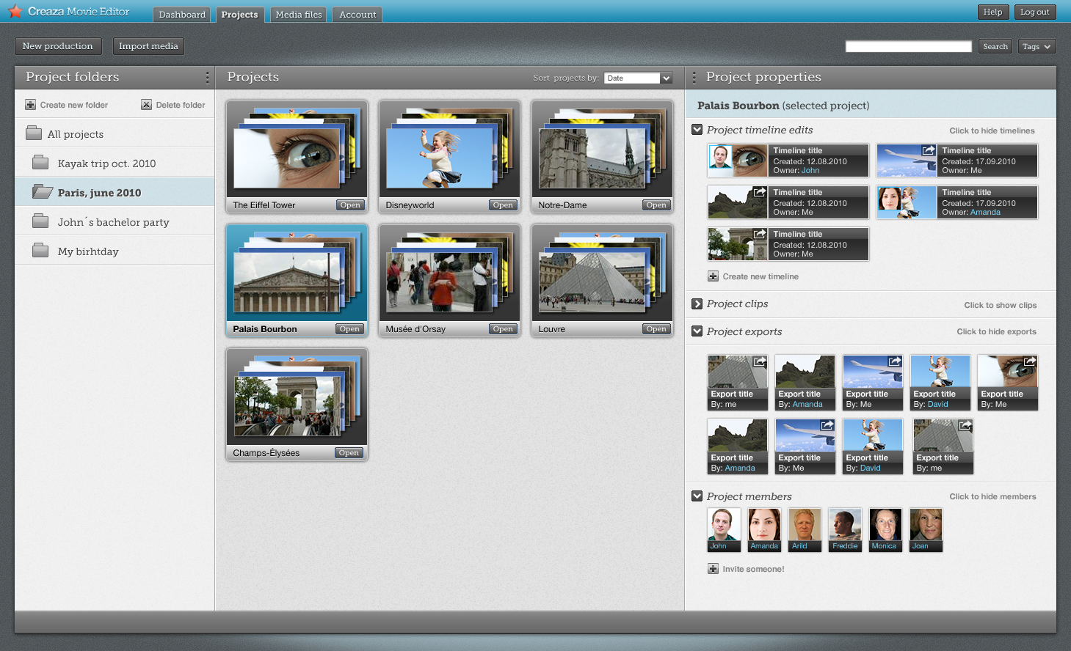
Media Management
Notes:
One of the key new features in the new version if the ability to create project rooms, where you can invite friends and colleagues (actually anyone) to collaborate in creation of new videos
For each project you can decide who to invite.
For example – you have made a trip to Paris and you are storing all of your videos and images for this into a project room. Then you send out an email everyone else who came with you to Paris to upload their videos and images, and also help to create timelines (new videos) and publish videos as they would like.
There is also a simple and direct link to publish videos to your favorite social networks or video sites, like Youtube and Facebook (already setup in each users profile)

Slide 17
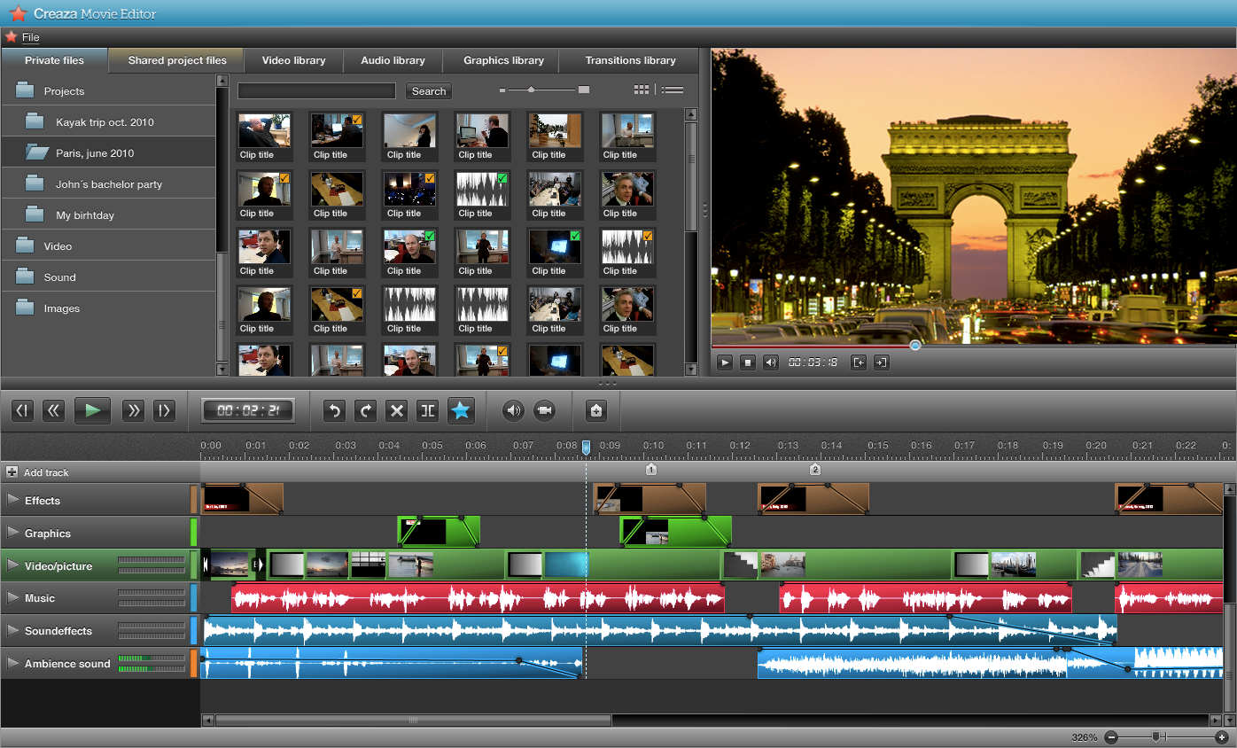
Timeline Editing
Notes:
17
There are also a number of improvements to the video editor
As you can see the UI has received a facelift, and is even easier to use then before
The projects are easily accessible from the left menu
And you can see the addition of video library, audio library, graphics and transition library which can give the user access to thousands, later maybe millions of user generated and professional video clips from users and commercial libraries from around the world.
It is extremely simple to use a clip for any of these libraries. It is a simple drag and drop into the timeline, with no downloads, conversions or media manegement needed
Creaza is building a marketplace which will take care of commercial and usage rights, and bills the users for clips he wants to use in exported projects.

Slide 18
Video Scrapbook
Notes:
Are we going to show this now? or save it for the next lunch?
What about competition trying to copy us on this feature? beat us to it?

