Slide 1



Slide 2
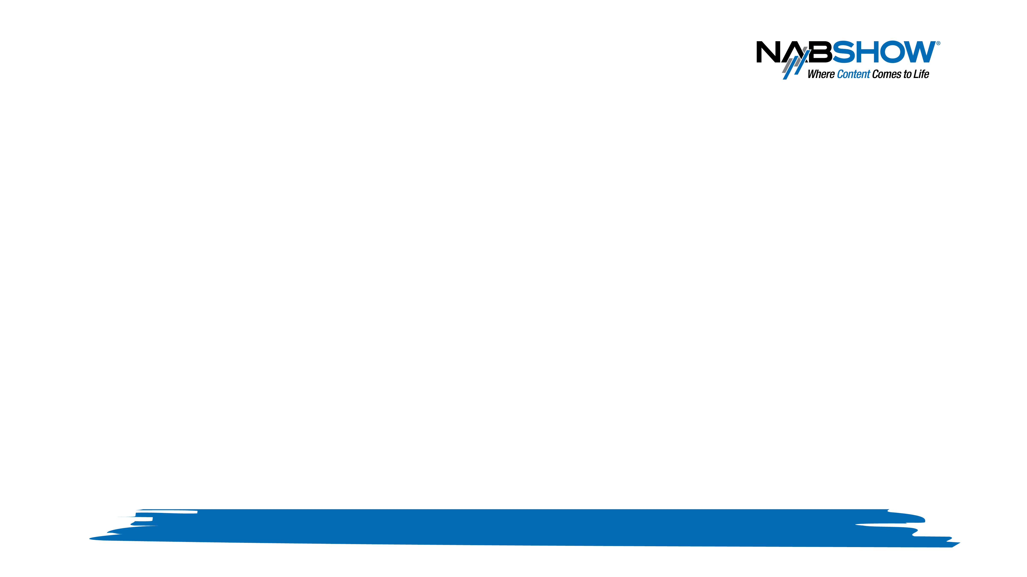
“Benefits of Cloud-delivered Content to Broadcasters: Efficiency, Control, Flexibility Improvements “
John Griffin
Dolby Laboratories

Slide 3
Agenda
Media consumption & delivery trends
Impact on Encoding/Transcoding
New Challenges
Benefits of Cloud-based Solutions
Product examples

Slide 4
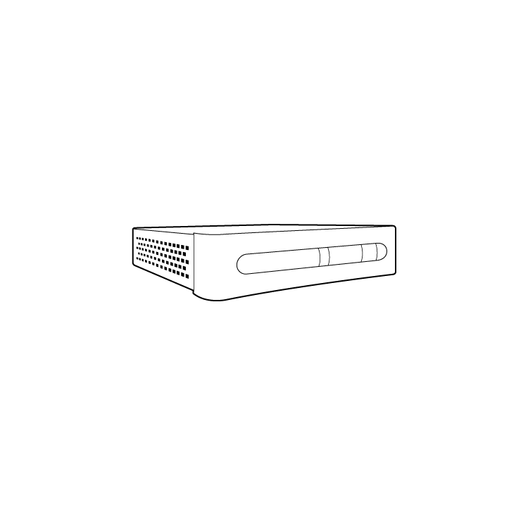
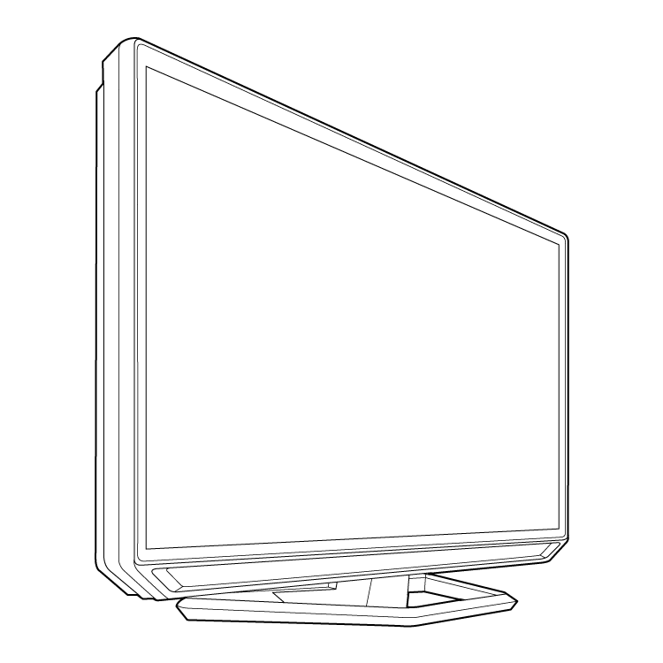

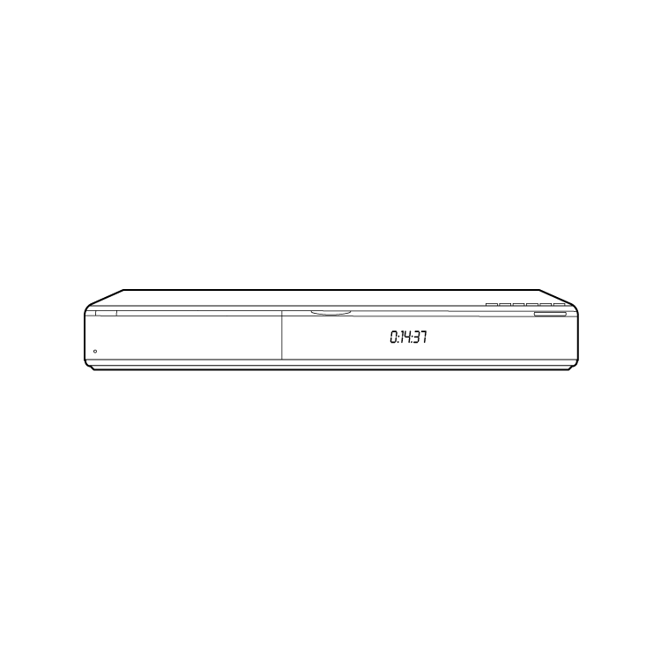
The Past
Limited delivery channels with defined standards and target playback devices

Slide 5


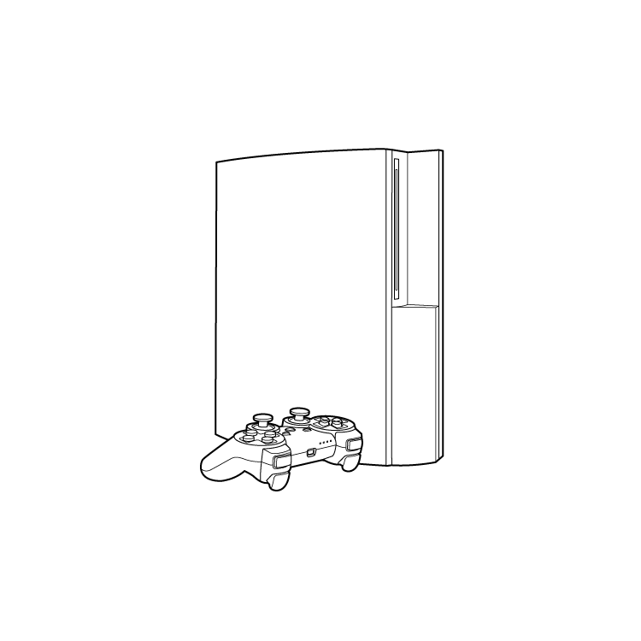
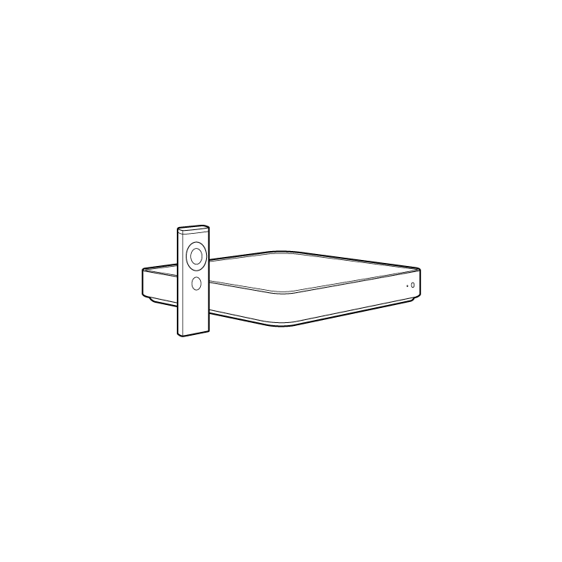
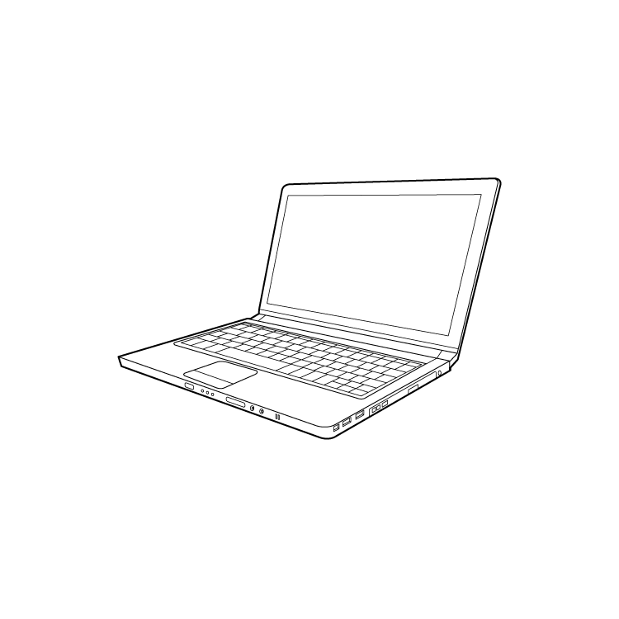
The Connected Landscape
A growing range of connected devices…

Slide 6
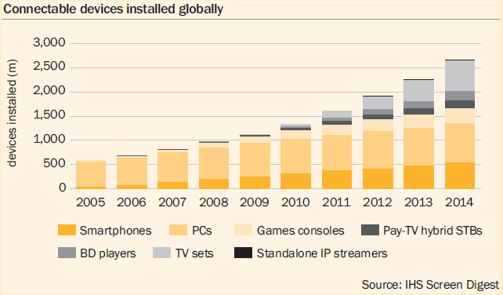
Steadily Rising Tide
Screen Digest 2011

Slide 7
The Connected Landscape
A growing range of delivery options…
Broadcast
DVD/Blu-ray
Mobile
Online

Slide 8
The Connected Landscape
A growing range of usage models…
“Our goals for the [Xfinity TV] app are to bring enhanced features and more content to more platforms…Over the last several weeks we have increased the amount of content viewable through the iPad version of Xfinity TV by nearly 1,000 hours.“ – Comcast Interactive Media blog, 3/2011
“According to our latest research, subscribers that use Blu-Ray players to stream Netflix video are already watching 4.5 hours a week. This means they're probably watching more Internet video on the players than DVD and Blu-ray movies! “ – TDG Research, 2011

Slide 9
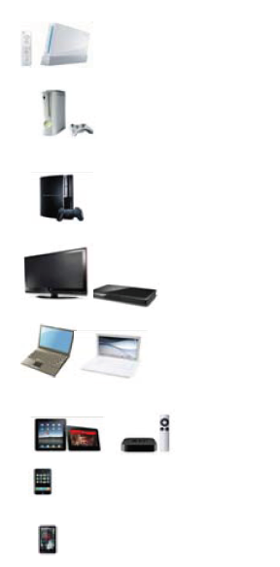

Impact on Encoding
Multiple delivery channels
Multiple output profiles
Multiple formats
Ingest & Encode
Content file

Slide 10
Impact on Encoding
1080p HD
Delivering the best possible quality can lead to:
Multiple quality options
Multiple bitrates per option for adaptive streaming
720p HD
SD

Slide 11
In Summary…
“This is a very complicated case…a lotta ins, lotta outs, lotta what-have yous.”
- Jeffrey ‘The Dude’ Lebowski

Slide 12
Variable Requirements
Difficult to predict & plan for encoding needs in advance
???
Encode/
Transcode
workload
time

Slide 13
Traditional Infrastructure Challenges
Traditional ‘on premise’ encoding workflows may not be the most efficient
  Difficult to predict needs in advance
    Required infrastructure & capacity, formats, etc.
  Difficult to quickly & efficiently scale
  Costly to maintain large infrastructure during encoding ‘down times’
Cloud-based solutions address needs of connected entertainment landscape
  Massively and quickly scalable
  Flexible & efficient
  Feature rich

Slide 14
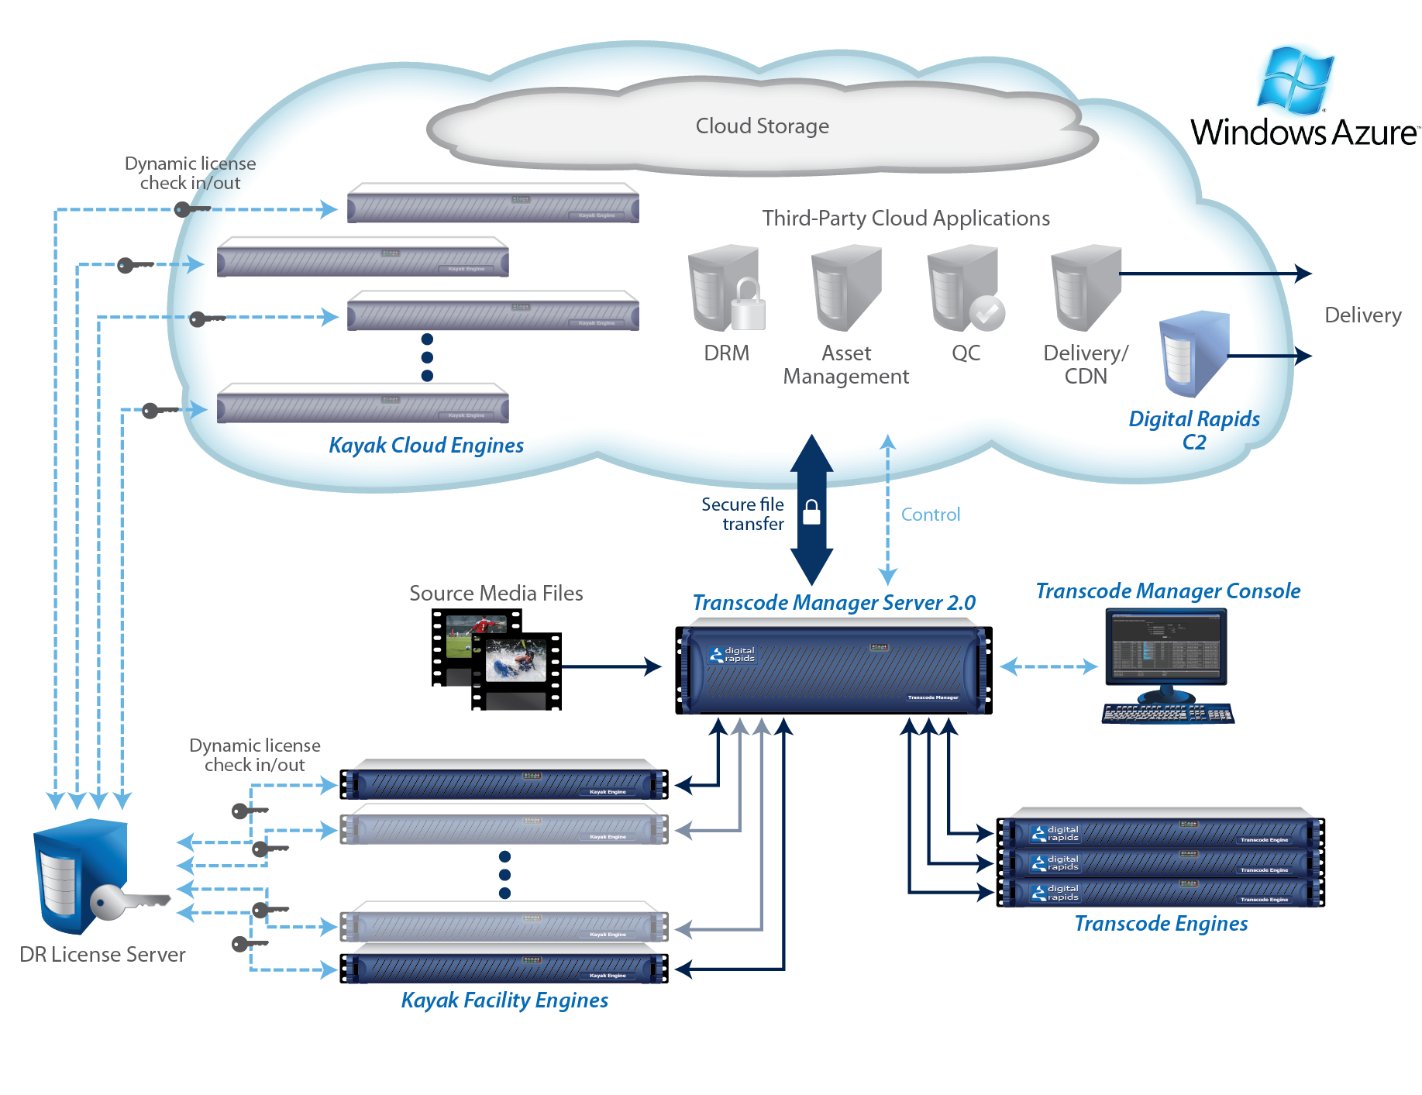
Solution Example
Digital Rapids Transcode Manager 2.0
  High-volume, enterprise-class media transcoding software
  Expands multi-screen opportunities with output for devices from mobile phones and tablets to
  game consoles and connected TVs
  New cloud transcoding capabilities running
  on the Windows Azure platform
  Extends on-premises media processing into the
  cloud for on-demand, elastic scalability
  Cloud-optimized, modular architecture with
  lightweight, self-deploying engines

Slide 15
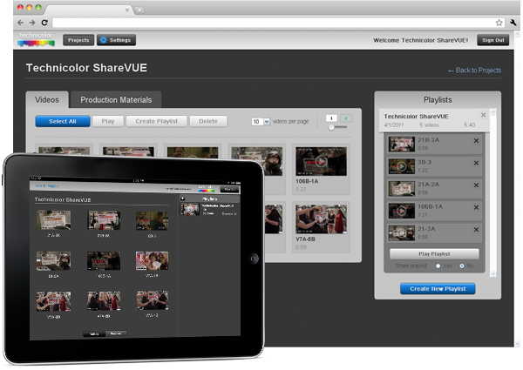
Solution Example
Sorenson Media Squeeze Solution Pack & Technicolor’s ‘ShareVUE’ service
  Sorenson’s Squeeze encoding engine deployed in
  the cloud
  Used to power Technicolor’s recently
  announced cloud-based ‘ShareVUE’ Dailies Service
  ‘ShareVUE’ enables secure sharing of dailies
  online to iPads, iPhones, PCs, etc.
  Good example of how cloud-based encoding &
  delivery is streamlining post-production

Slide 16
Summary
The cloud triggered new challenges
  Online delivery to more devices
  New consumer content consumption use cases
  More formats
  More complexity
The cloud is the answer however to the challenges it triggered
  Cloud-based encoding addresses scalability & flexibility issues
  Cloud solutions can also make post-production more efficient

