Slide 1
Drawbacks of Cloud-Delivered Content for Consumers
Privacy, Reliability, Security Issues
Jim Burger
Dow Lohnes PLLC

Slide 2
Introduction
Contractual Issues: Privacy, Reliability, Security
Cloud-Based Services and the Fourth Amendment
Copyright Issues in Cloud Computing – Uncertainty in the Law

Slide 3
Contractual Issues: State Law
Where is data physically stored/processed?
What state law controls? E.g., CA law provides more privacy protection
Where are your customers? E.g., EU e-Privacy Directive (US-EU Safe Harbor Framework)

Slide 4
Contractual Issues: Privacy/Reliability Terms
Privacy
What are the cloud provider’s obligations to ensure privacy of customer data?
What terms apply to third party access (e.g., notice)?
Reliability (SLA)
What are acceptable service levels?
Will the cloud provider have alternative services during scheduled downtime?

Slide 5
Contractual Issues: Security/Exit Terms
Security/Risk
What obligations to ensure security of customer data?
How is security maintained?
How is risk of breach allocated?
Does the cloud provider have cyber insurance?
Exit
What is the exit scenario?
What obligations does the provider have to find/transition to an alternate provider?

Slide 6
Cloud-Based Services and the Fourth Amendment
Consumer expectation of privacy in the cloud?
Physical world – Constitution says: people should be secure from unreasonable search
Therefore need a judge to issue a warrant for your home PC; judges confused in the digital world
But ECPA allows mere subpoena to cloud provider to access confidential information

Slide 7
United States v. Warshak
6th Circuit Federal Court of Appeals declared warrantless search of email servers unconstitutional
Must have a search warrant
“…subscriber enjoys a reasonable expectation of privacy in the contents of emails that are stored with, or sent or received through, a commercial ISP”
Subscriber agreement doesn’t defeat that expectation

Slide 8
Copyright Issues in Cloud Computing – Uncertainty in the Law
Cartoon Network, et al. v. CSC Holdings, Inc. (Cablevision)
Music in the Cloud
EMI v. MP3Tunes
Amazon (Google? Apple?)
What are the cloud provider/service provider risk in storing consumer’s entertainment content?

Slide 9
Copyright Issues in the Cloud: Cablevision
Remote Storage DVR (RS-DVR)
Second Circuit held:
Consumer making copy “in the cloud”
Playback not a public performance
Supreme Court denied cert after SG’s Do Not Grant Brief
But inefficient, “de-duplication” …

Slide 10
EMI Music v. MP3tunes – Part 1
Copyright challenges to MP3tunes’ cloud-based digital music storage services and free music download search service – Sideload.com
Interplay between contributory/vicarious infringement and DMCA safe harbors under Sections 512(c) and 512(d)
Case raises a more uncertain copyright question for cloud-based content delivery : Has MP3tunes infringed copyright holders’ exclusive right of public performance by using an efficient storage system?
Is User copying, streaming to/from the cloud an infringement or a fair use?

Slide 11
EMI Music v. MP3tunes – Part 2
Infringement of the public performance right may hinge on whether MP3tunes uses “de-duplication” to reduce server capacity demand by storing only one unique copy of same music file uploaded/sideloaded by users into cloud “lockers”
User copying raised in complaint but not in Summary Judgment filing
Court’s decision could have significant consequences for cloud-based services

Slide 12
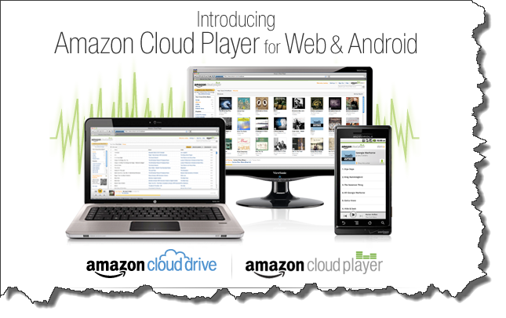
Amazon Cloud – Fair Use
Is User uploading, streaming, copying for personal use a fair use?

Slide 13
Conclusion
Hopefully sunrise for providing consumers cloud computing services
But many legal pitfalls
At least in the consumer entertainment space – open copyright questions

