Slide 1
Content In the Cloud Summit 2011 NAB
Drawbacks of Cloud–Delivered Content to Broadcasters:
Interoperability, Data Security, Quality of Service (QoS)

Slide 2
The Cloud represents flexibility, virtualization,
global access, and low barrier to entry

Slide 3
… but it isn’t all pretty

Slide 4
The cloud is a pool of unreliable resources
APIs: Web interfaces and APIs across multiple providers exist at different maturity levels
Host Interconnectivity: Often host-to-host, data center-to-data center, or cloud-to-cloud performance is not provisioned
Performance: Non-deterministic performance across hosts, time slice, data centers, clouds
Security: Physical, regulatory, data segregation and provider disaster recovery
Provisioning Restrictions: Time to provision, # host caps, geographic constraints
SLA: Are not necessarily robust and are also divergent across providers
Apps / Protocols: Some providers restrict specific applications and protocols

Slide 5
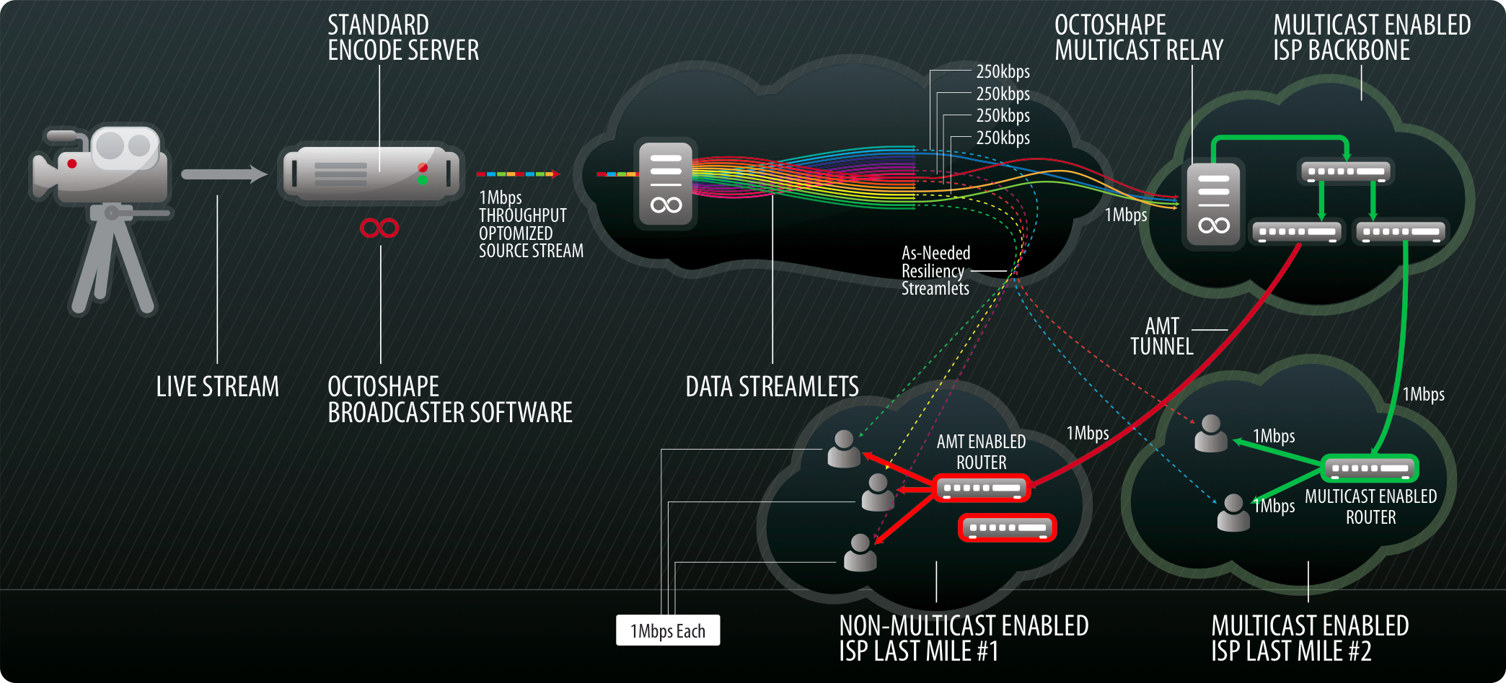
Designed to provide reliable TV quality OTT delivery over a pool of unreliable resources
Core Transport:
Octoshape splits inbound streams or files up into many video accelerated streamlets that are spread across the hosting infrastructure.
Every streamlet is unique and encrypted in such a way that a client can tune into multiple streamlets at once to recreate the stream.
As a client tunes into a stream, it learns of a pool of resources in the cloud to begin building a resilient mesh of streamlet information providing a multi source, multi path reliable channel.
This relieves constraints around:
Cloud bandwidth Performance / availability
Region Fiber cuts
Power outages

Slide 6
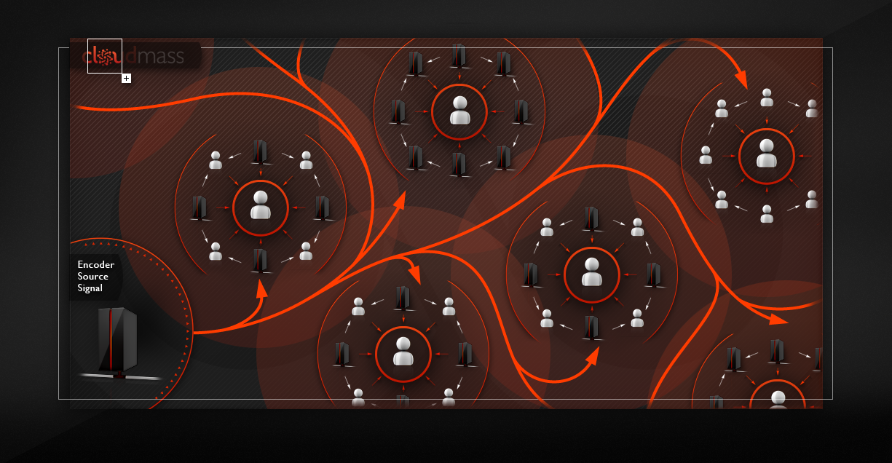
One of the top 10 cloud providers has as much server and network capacity deployed as the largest CDNs
Dynamic Cloud Aggregation:
This flexibility allows Octoshape to leverage multiple clouds globally and simultaneously.
Resources can be throttled dynamically during the event without audience disruption.
Aggregating clouds dynamically creates scale, without the normal CapEx and OpEx required.

Slide 7
What does it all mean for media companies?
A new evolution for the content delivery ecosystem:
Rapid innovation due to lower barrier to entry for innovating media companies
Massive scale due to incredible rate of cloud investment globally
Flexible OpEx models for companies to rapidly scale in changing markets
Lower cost of goods sold (CoGS)
Escalated convergence rate for OTT media delivery

Slide 8
Q&A
scott.brown@octoshape.com

