Slide 1
D
Notes:
Thank you and welcome. I’d like to introduce you to a dynamic P2P experience today through Music Mogul….now known as Mogul World or just MOGUL.

Slide 2
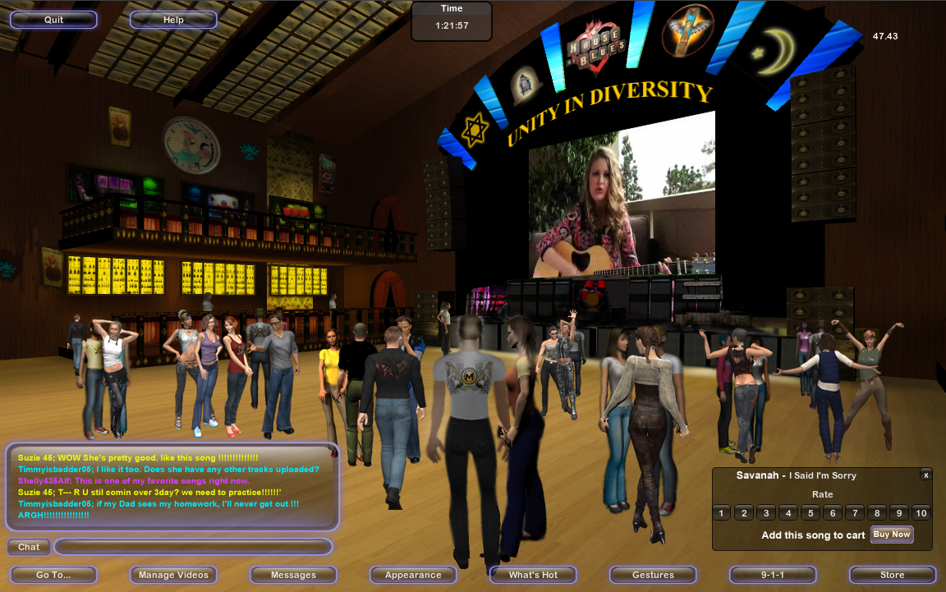
D
MOGUL WORLD IS…
MOGUL WORLD IS THE PREMIER 3D SOCIAL NETWORK ENABLING
MUSIC DISCOVERY TO THIS GENERATION OF GLOBAL ‘MILLENIUMS’, WHERE
FUTURE ARTISTS WILL BE DISCOVERED WITH A CHANCE FOR A RECORD
DEAL EVERY 90 DAYS, AND WHERE THEIR CONTENT IS MONETIZED AND
DISTRIBUTED IN THE WORLD’S ONLY VIRTUAL MUSIC STORE.
MOGUL IS THE MANNER IN WHICH FACEBOOK™ AND MYSPACE™ USERS
WILL INTERACT IN THE FUTURE – IN 3D AND IN REAL TIME.
Notes:
Mogul World is a 3D Entertainment Network.
An immersive online experience which is centered around empowering artists, fans, celebrities, content owners and brand marketers alike.
A living, breathing world of discovery….and what we like to refer to, as a purpose driven virtual life with real world rewards.

Slide 3
D
MOGUL WORLD IS AT THE APEX OF SEVERAL POWERFUL TRENDS:
COMMUNITY
(2) HUGE VIRTUAL WORLD GROWTH
(3) USER EMPOWERMENT
(4) COLLABORATION
(5) P2P MARKETING, SALES AND DISTRIBUTION
(6) GLOBALIZATION
(7) PURPOSE
Notes:
What we’re witnessing today is 6 powerful trends….and Mogul World is at the Apex of that.
Social networking – we all know….is driving internet activity – break this down further and you find that 1 in 3 internet users are driven by their music.
Next - Virtual worlds and online games are exploding as the fastest entertainment sector worldwide. Projected to reach 1b users by 2012 and several billion dollars.
Third. People want to be empowered…empowered to select the next superstar the music they want to hear. The empowerment extends beyond music.
Of great importance is Collaboration among individuals - whether a quest in a multiplayer game, the missions I undertake with friends in my social network, or in the case of Mogul World – the support I throw behind a band.
We’re seeing the growth of P2P marketing and distribution…nothing is more powerful than word of mouth and the recommendation of a friend.
The world is truly a smaller places and now, through virtual worlds, people can visit worldwide cities, virtually, and experience local artists and content….directly.
Then the ultimate question – what am I spending my time doing….a purpose driven experience is key. Otherwise…it’s just a game.

Slide 4
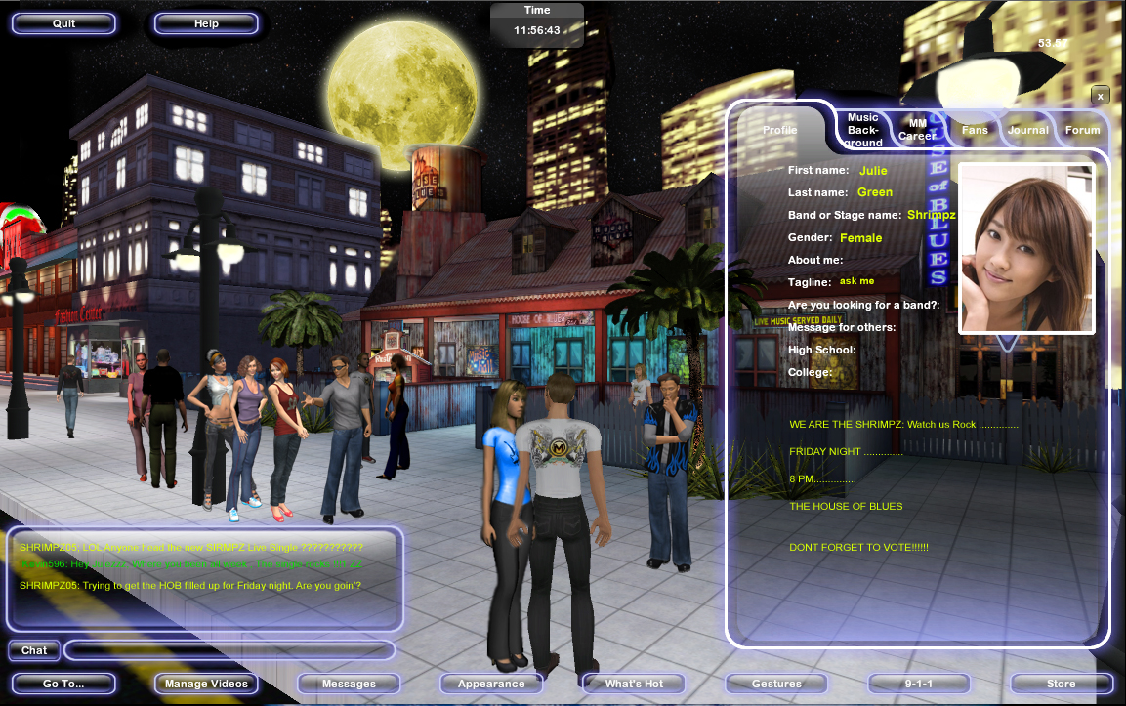
D
I. MOST COMPREHENSIVE NETWORKING EXPERIENCE
An immersive social network, beyond today’s 2D formats.
Notes:
What we’ve created in Mogul World brings together the best of all worlds….real and virtual.
As far as social networking is concerned, a 3D world provides is the most immersive form of socializing in real time, with anyone, anywhere in the world.

Slide 5
D
II. REAL LIFE REWARDS – PURPOSE DRIVEN
Real life rewards - empowering new artists and audiences, alike.
Suzie O – Mogul’s first demo-deal winner
Notes:
Going back to the purpose driven virtual life – Mogul rewards new artists and their fans….every 90 days someone wins a demo deal with top producers.
And it’s the Audience that selects each quarter’s winners. It takes us back to Empowerment.

Slide 6
D
III. MONETIZATION OF USER GENERATED CONTENT
Monetization system for millions of artists – offering P2P distribution and monetization of music, short films, video content, events and services.
Notes:
Taking that further, today, an artist’s tools are limited to showcasing and emailing….now Mogul World provides the platform and the tools where people can meeting, collaborate, market, sell, they can distribute their content….and most important – the ability to monetize that content.

Slide 7
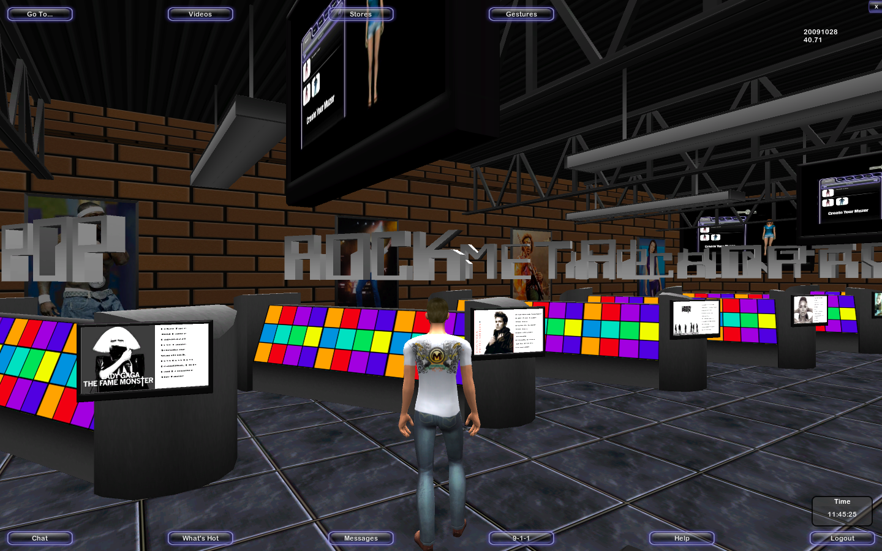
D
IV. WORLD’S FIRST 3D MUSIC STORE
Music discovery and platform for music sales – this is the next
generation of music discovery and purchase in a completely
3D social format.
Notes:
Speaking of Content Monetization….now Imagine a complete interactive and immersive music shopping experience, where you’re discovering music…not alone, but with others. Virtual music store of 6 million songs - in 3D - with friends – no matter where they live.

Slide 8
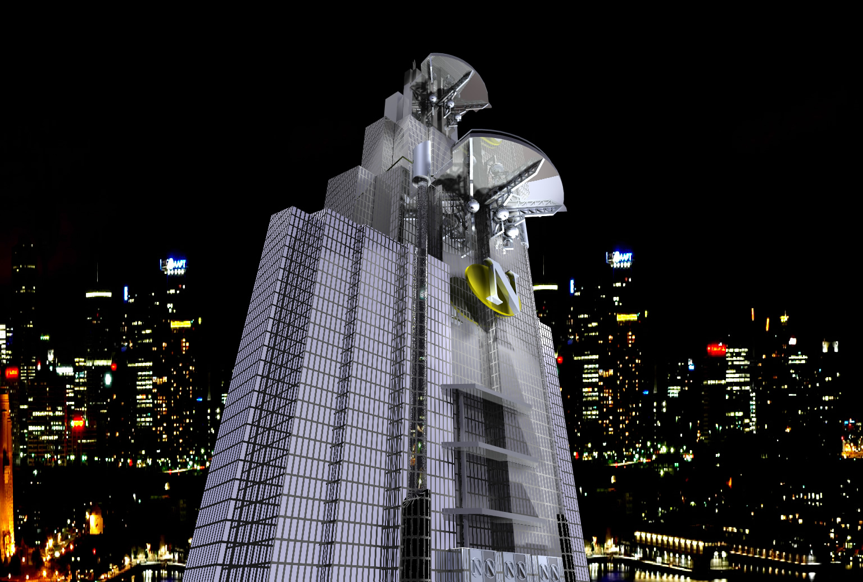
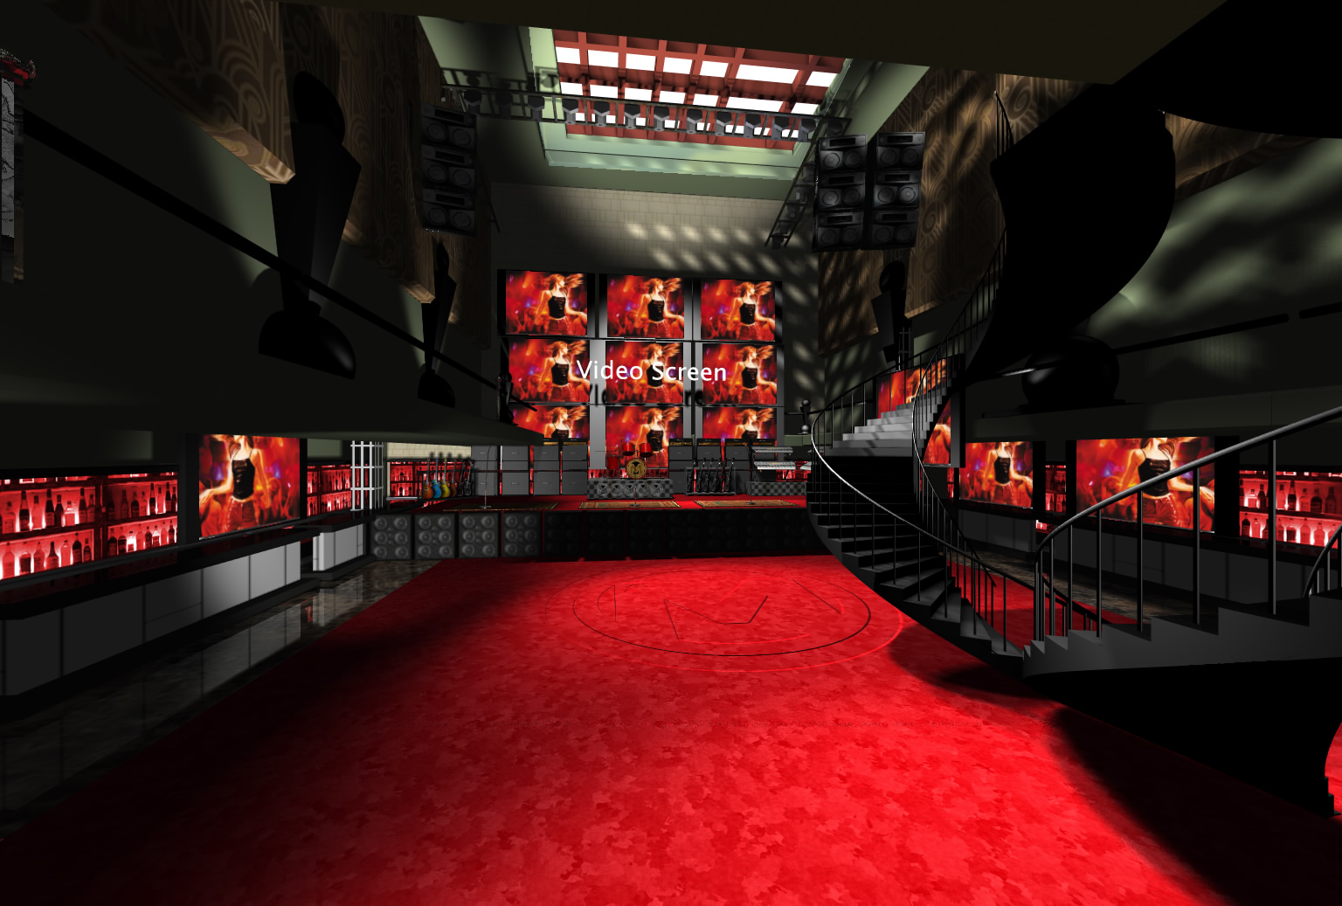
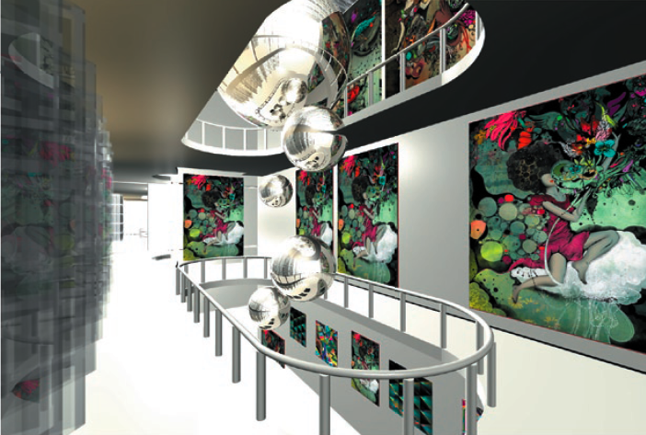
D
V. NEW REVENUE STREAMS
For celebrities, a brand new revenue stream and direct to
consumer communication tool – it monetizes.
ARTIST PROMOTING AUDITIONS
ARTIST LOUNGES
ARTIST PROMOTING THE ARTS
ARTISTS ENTERTAINING WITH ILLUSION
MAGIC AND ILLUSION
Notes:
For established celebrities – Mogul offers a brand new revenue stream – a direct to consumer tool which can be monetized.
Celebrities can talk direct to their legions of fans in two way communication, entertain them, and sell direct.
Imagine, as well, a world where you can communicate directly to established producers, like Rodney Jerkins….submit your demo….receive feedback….watch him in the studio at work….learn….and never have to leave your home. Now imagine doing that beyond just music.

Slide 9
D
VI. LABEL MARKETING TOOL
For Music Labels, it’s a direct way to launch new acts and new
music…monetizing concerts, listening events, and real
merchandise – direct to consumer.
Notes:
For Music Labels it’s a platform for launching new acts, new music – going beyond airplay – it’s a direct distribution, marketing and retail platform as well.

Slide 10
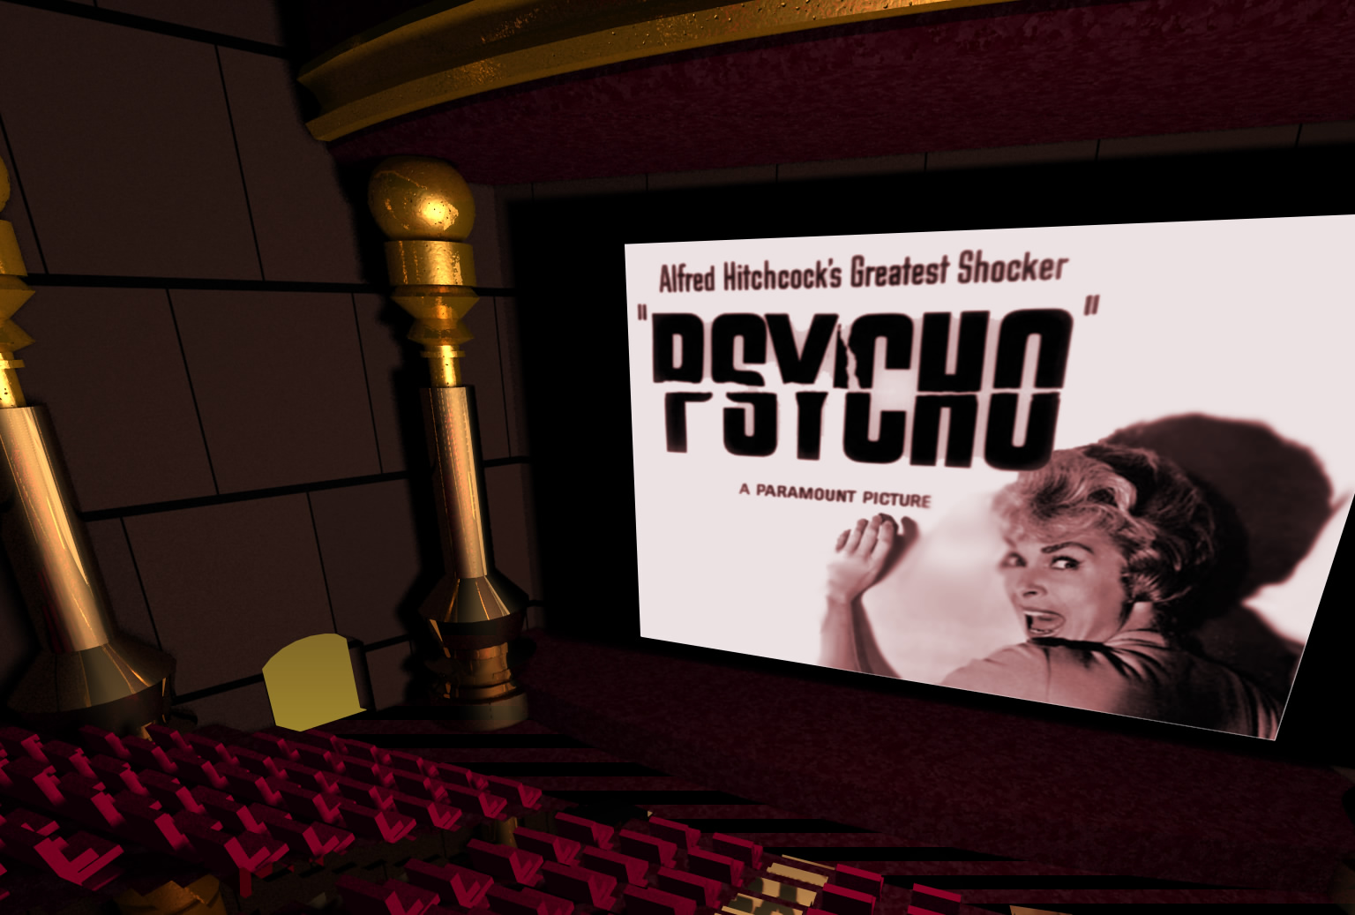
D
VII. DRIVE CATALOG REVENUES
For Movie studios – a place to monetize catalog and showcase
new releases.
Example only
Notes:
This is a world of entertainment beyond just music…..where you’ll be watching movies with friends, attending magic shows, concerts, listening events, learning….it’s a complete entertainment experience –again in real time, with anyone and everyone, anywhere in the world.

Slide 11
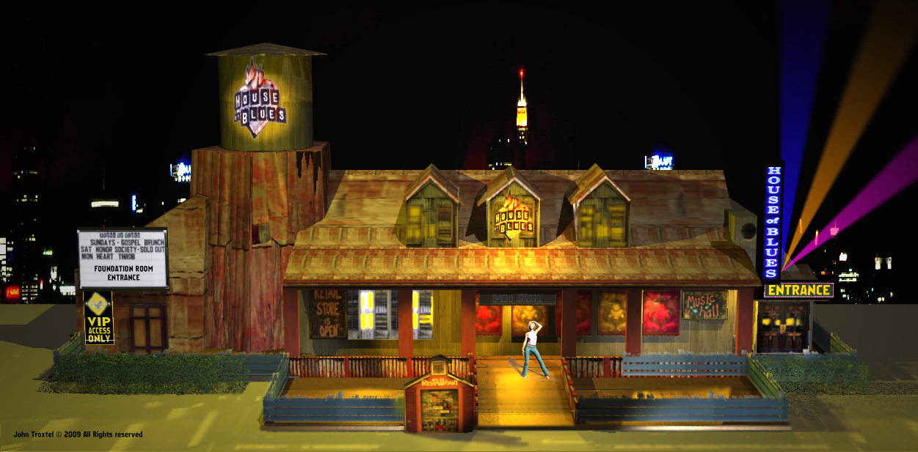
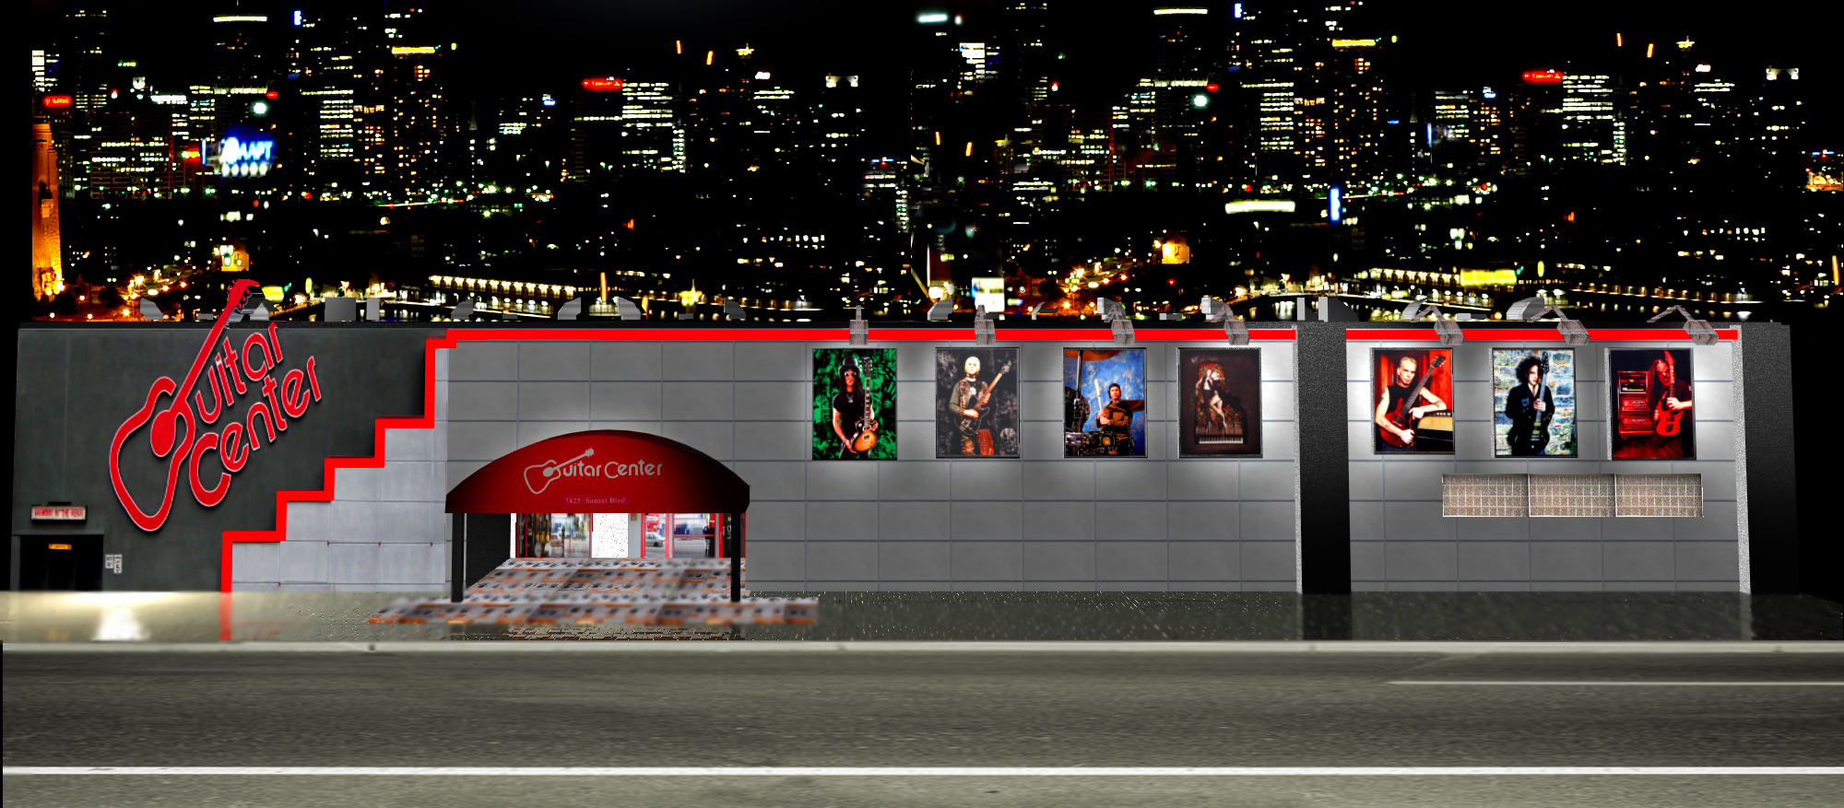
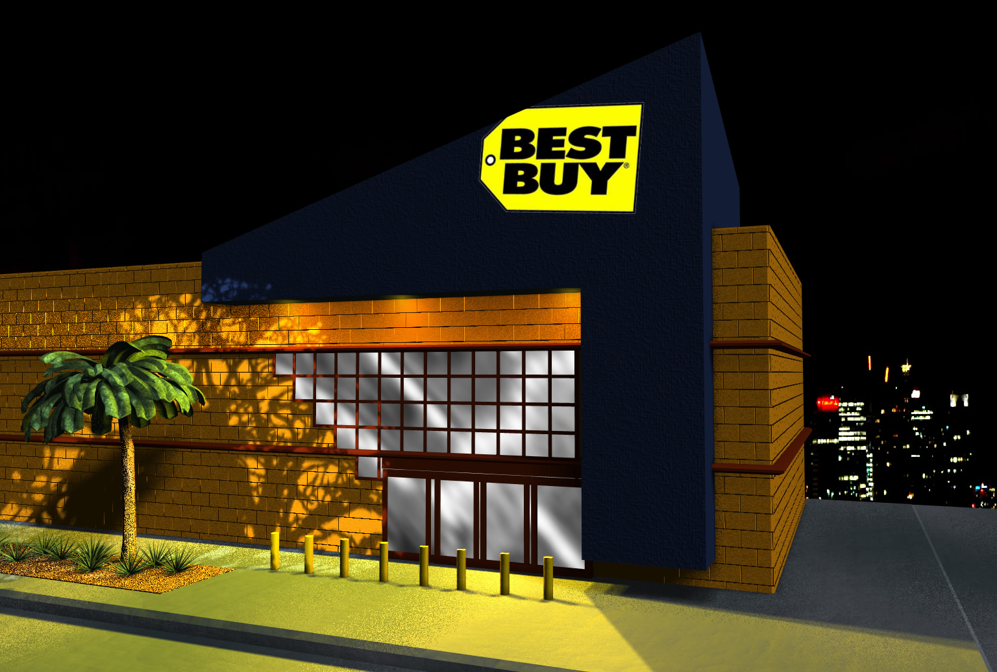
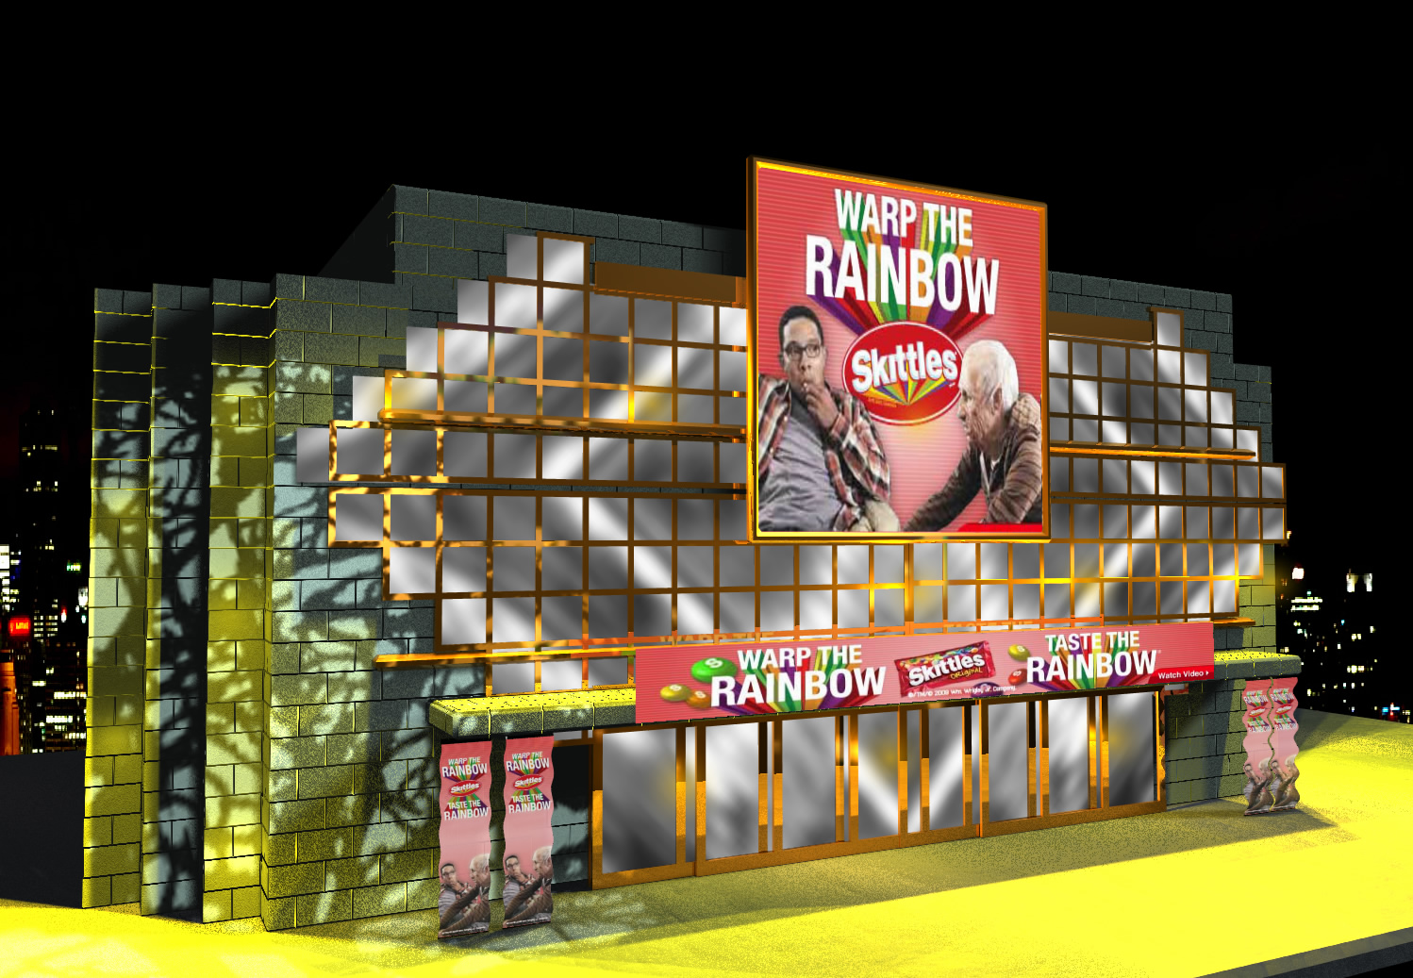
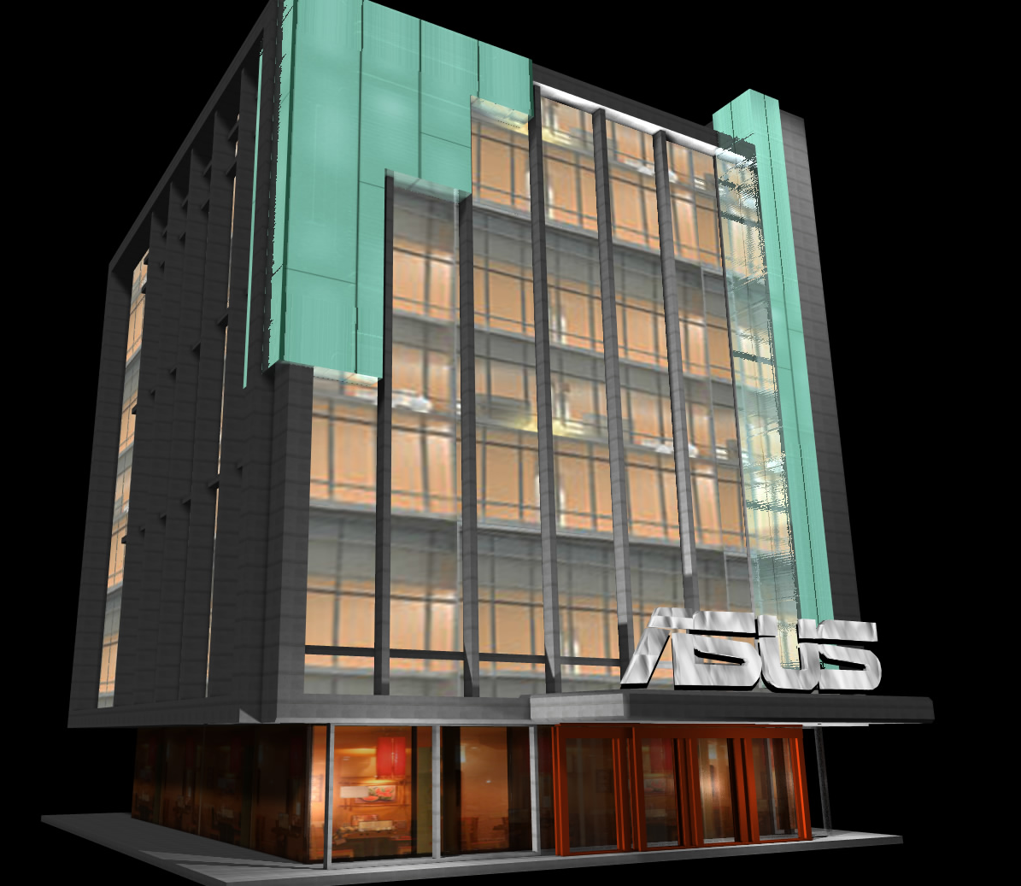
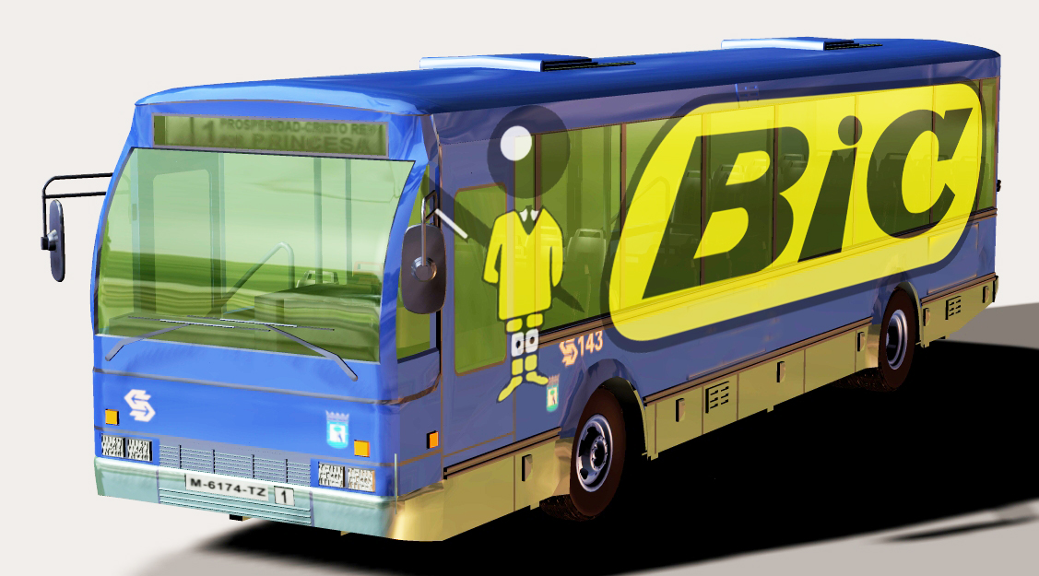
D
VIII. INTERACTIVE MARKETING TOOL
For Marketers, brands are contextually integrated – connecting with audiences – touching their lifestyle, beyond any traditional ‘eyeball’ driven programs.
Notes:
And finally for marketers – a medium where brand integration is contextual and touches consumer lifestyles directly. Not only are marketers able to create awareness and affinity for their product…but they’re able to generate revenues from virtual good sales...and what a great test bed this becomes for new product ideas.
Put it in the virtual world….let it grow…launch in the real world.

Slide 12
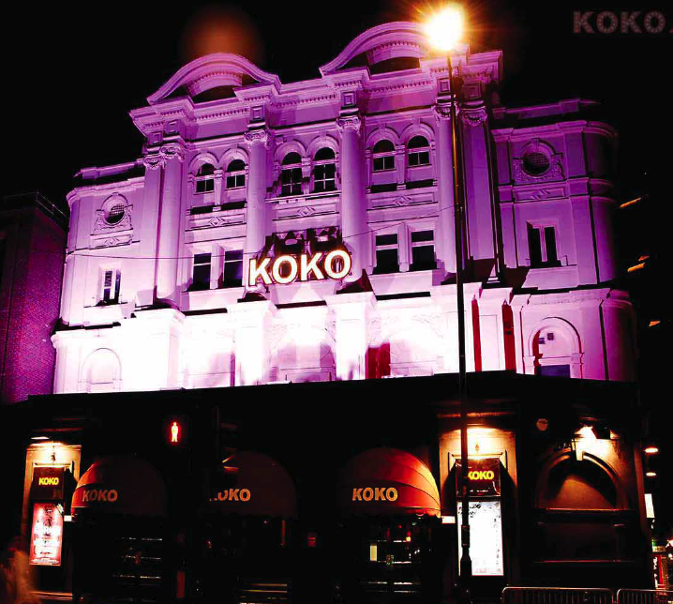
D
IX. TRULY GLOBAL EXPERIENCE
Users enjoy a truly global experience…traveling to European, Asian, and South American cities to discover local content and meet local communities.
Notes:
And finally for marketers – a medium where brand integration is contextual and touches consumer lifestyles directly. Not only are marketers able to create awareness and affinity for their product…but they’re able to generate revenues from virtual good sales...and what a great test bed this becomes for new product ideas.
Put it in the virtual world….let it grow…launch in the real world.

Slide 13
D
MOGUL WORLD VIDEO
Notes:
If a picture is worth a thousand words….then this must be priceless…..

Slide 14
D
Notes:
Thank you and welcome. I’d like to introduce you to a dynamic P2P experience in Mogul World….also formerly known as Music Mogul.

