Slide 1
Computing in the Cloud: Fear vs. Reality
P2P and Cloud Market Conference

Slide 2
About Harris Interactive
We are a full service research agency specializing in media, technology, telecom, entertainment and the modern consumer.
We offer a full range of services for both quantitative and qualitative research.
Our range of services:
Concept testing
Product/service launching, including pack testing
Product/service configuration
Communications testing and tracking
Brand equity / extension / tracking
Satisfaction and loyalty
Segmentation
Market sizing / opportunities
Youth and kids research
Employee research
Global omnibus research
State-of-the-art qualitative techniques
2

Slide 3
Our discussion today
Current use of cloud computing
Future intentions
Concerns about cloud computing
The mobile cloud
The dark cloud - Content piracy
Piracy in the US vs. Great Britain
Latest trends from the UK
Percentage figures in this report may
not add precisely due to rounding.
3

Slide 4
Data from Multiple Studies
Cloud Computing and Device Purchase Intent
US Online Survey fielded 3/1 – 3/5
N=1,831 UNWEIGHTED
File Sharing and Mobile Device Usage
US Online Survey fielded 11/23/09 – 11/30/09
N=2,344, Weighted to US national demos*
UK FastForward Syndicated Report
UK Online Survey fielded Quarterly
N≈2,000 per quarter, Weighted to UK national demos*
* Either general population or online population depending on activity/device
Percentage figures in this report may
not add precisely due to rounding.
4

Slide 5
Cloud Computing is nothing new...
Base: March 2010 fieldwork 18+ population (1,831) - unweighted
 | Echo Boomers (18-33) | Gen X (34-45) | Baby Boomers (46-64) | Matures (65+)
Email | 93% | 92% | 95% | 95%
Banking | 54% | 58% | 61% | 64%
Video | 65% | 50% | 37% | 26%
Office | 26% | 17% | 21% | 24%
Photos | 22% | 19% | 16% | 11%
Q: Which of the following Web-based services do you currently use?
© Harris Interactive 2009
5

Slide 6
...but not everyone realizes it
When it comes to storing personal files people typically store them on their computer.
As a result these files need to be transferred to another machine/device if they want to access them from another location.
There is new technology, sometimes called "cloud computing" that allows files to be stored, edited or played online from any location at any point in time.
How interested are you in using this type of service for the following types of files?
© Harris Interactive 2009
6

Slide 7
People don’t think about their emails and banking info in the cloud
Base: March 2010 fieldwork 18+ population (1,831) - unweighted
Percentage Point difference between %Use, and % Interested in using Cloud Computing
 | Echo Boomers | Gen X | Baby Boomers | Matures
Email | 39 | 42 | 51 | 66
Banking | 25 | 31 | 37 | 43
Video | 20 | 13 | 12 | 15
Office | 19 | 19 | 5 | 6
Photos | 29 | 27 | 18 | 15
Q1: Which of the following Web-based services do you currently use?
Q2: How interested are you in using this type of service for the following types of files?
© Harris Interactive 2009
7

Slide 8
Cloud computing is a tradeoff between accessibility and security
Base: March 2010 fieldwork 18+ population (1,831) - unweighted
Over Half of Respondents Agree:
- Access to files makes life much easier
- Would worry about losing connectivity
- Concerned about security
- Would still keep offline backups
50%
Less than Half of Respondents Agree:
- Sounds too complicated
- Need access to all my files at all times
- I would trust files are safe
- Would trust with personal information
© Harris Interactive 2009
Q: Do you agree or disagree with the following statements?
5 point scale, Strongly Agree – Strongly Disagree
8

Slide 9
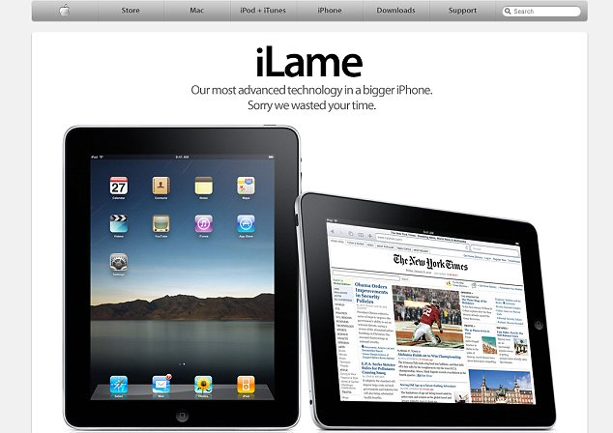
Interest in Cloud Computing Devices
(% Definitely or Might get in next 6 mos)
Base: March 2010 fieldwork 18+ population (1,831) - unweighted
© Harris Interactive 2010
9

Slide 10
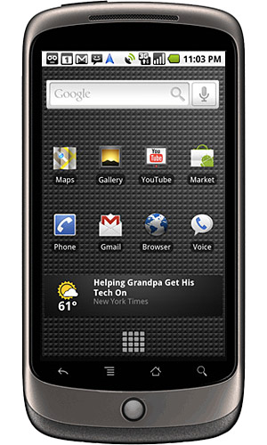
Mobile is where the cloud, and the device, mesh
Base: November 2009 f18+ mobile owning population (2,071) – nationally representative
The analysts say…
Follow the PaaS…
© Harris Interactive 2010
© Harris Interactive 2009
Q. Please tell us if you do any of the following on your mobile phone. Please select all that apply
10

Slide 11
Mobile activities
– highlights among younger mobile consumers
Base: November 2009 f18+ mobile owning population (2,071) – nationally representative
48%
of 18-24 year olds send and receive photos on their mobile phones
22%
of 18-24 year olds listen to music stored on their mobile
16%
of 18-24 year olds use their mobile for major social networks like Facebook et al
© Harris Interactive 2010
11

Slide 12
Content piracy – the dark cloud

Slide 13
Tracking current filesharing & piracy
Base: 18+ population (2,344) – nationally representative
"The bottom line is that the operators of the Pirate Bay and others like them are criminals who profit handsomely by facilitating the distribution of millions of copyrighted creative works and files protected under the law."
-- John Malcolm, Executive Vice President and Director of Worldwide Anti-Piracy Operations for the MPAA
© Harris Interactive 2010
© Harris Interactive 2009
Q. Please look at these activities and tell us whether you do any of them.
Weekly or more often/every 2 weeks/monthly/less often/never/used to but not now
13

Slide 14
Overview of activity (% do at least monthly)
Base: November 2009 fieldwork GB 18+ population (1,959), USA 18+ population (2,344) – nationally representative samples
Stream programs from sites like BBC iPlayer
Stream programs from sites like Hulu.com
Remarkable levels of consistency between GB and US entertainment activities with DVD rental and TV streaming the only strong differences
© Harris Interactive 2010
© Harris Interactive 2009
14

Slide 15
Ownership of devices
Base: November 2009 fieldwork GB 18+ population (1,959), USA 18+ population (2,344) – nationally representative samples
Device ownership is equally consistent, with the only major difference being a higher incidence of 3G phone ownership in GB.
© Harris Interactive 2010
© Harris Interactive 2009
15

Slide 16
Mobile activities
Base: November 2009 fieldwork GB 18+ mobile owning population (1,887), USA 18+ mobile owning population (2,071)
– nationally representative samples
GB mobile owners are more likely to use their device as a music player, but otherwise there is a fairly consistent pattern of mobile media usage between the two countries.
© Harris Interactive 2010
© Harris Interactive 2009
16

Slide 17
Current filesharing & piracy
Base: November 2009 fieldwork GB 18+ population (1,959), USA 18+ population (2,344) – nationally representative samples
While legal entertainment behaviors and device ownership levels are fairly consistent between the two countries, this analysis shows GB consumers to be somewhat more active than their US counterparts in illegal file sharing activities.
© Harris Interactive 2010
© Harris Interactive 2009
17

Slide 18
Tracking current filesharing & piracy
Base: wave 1 (1,980), wave 2 (2,012), wave 3 (2,007), wave 4 (2,180), wave 5 (1,965), wave 6 (2,037)
Overall levels of piracy are steady over past 15 months
© Harris Interactive 2010
© Harris Interactive 2009

Slide 19
What’s Next
Continued focus on content portability
Internet enabled TVs
Smartphones, Tablets, eReaders
Unthrottling Mobility – 4G
Google vs. the telecoms
Mike Saxon
SVP, Harris Interactive
msaxon@harrisinteractive.com
201-564-0617
19

