Slide 1
Monetization Strategies at LimeWire
Zeeshan Zaidi, COO
March 9, 2010

Slide 2
LimeWire Monetization Principles
Put the consumer experience first
Diversify revenue streams and models
Be nimble and quick to market
Be innovative and experimental
Invest in organization's future

Slide 3
LimeWire overview
No. 1 P2P application in the world
Downloaded over 8 million times each month
Installed on 18% of PCs in the world
Each month >50 million users, perform billions of searches
2010 is LimeWire’s 10th anniversary

Slide 4
LimeWire Monetization Strategy
 |  | LimeWire Software |  | LimeWire Store
Product/E-Commerce |  | Freemium model: LimeWire Basic/Pro |  | Launched in 2007
Subscription |  | Starting now |  | 3 tiers
Display Advertising |  | Pilot phase in Client |  | N/A
Search Advertising |  | LimeWire Toolbar |  | LimeLinks

Slide 5
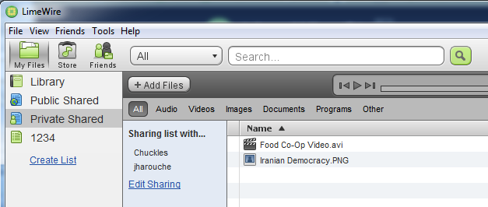
LimeWire Basic
Recent innovations:
BitTorrent functionality
Video player

Slide 6
LimeWire Pro
Recent innovations:
Antivirus Partnership with AVG
In Client Activation

Slide 7
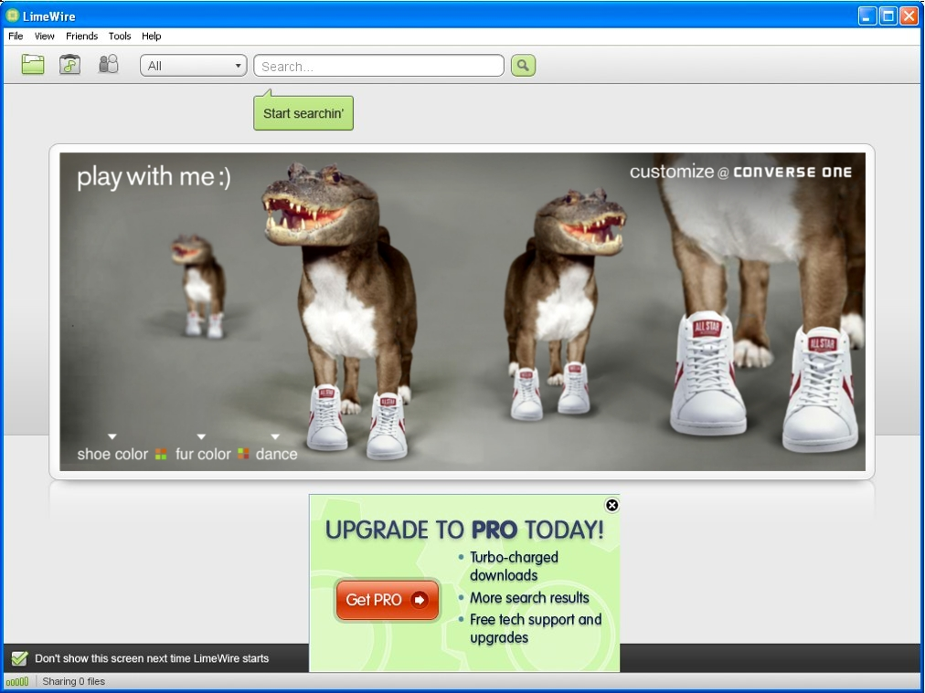
Display Advertising in the Client
the program over delivered by 48%
it generated a CTR over 7x the industry average
it drove almost 1.5MM people to converse.com during the hectic holiday season

Slide 8
LimeWire Toolbar
Partnership with Ask.com
Bundled with LimeWire Basic software
Proprietary features: “Magnetize” and Media player

Slide 9
LimeWire Monetization Strategy
 |  | LimeWire Software |  | LimeWire Store
Product/E-Commerce |  | Freemium model: LimeWire Basic and |  | Launched in 2007
Subscription |  | Starting now |  | 3 tiers
Display Advertising |  | Pilot phase in Client |  | N/A
Search Advertising |  | LimeWire Toolbar |  | LimeLinks

Slide 10
LimeWire Store
Launched in 2008
Over 5 million tracks
Fully licensed from record labels

Slide 11
LimeWire Store Subscription offering

Slide 12
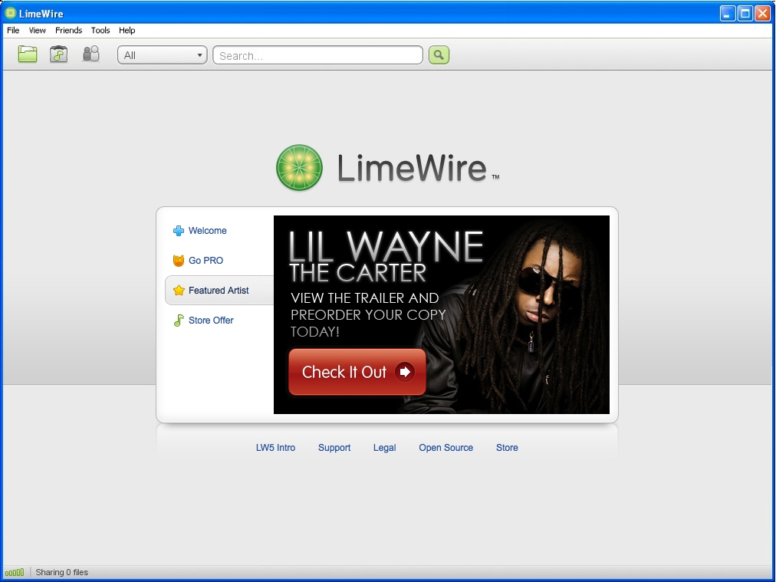
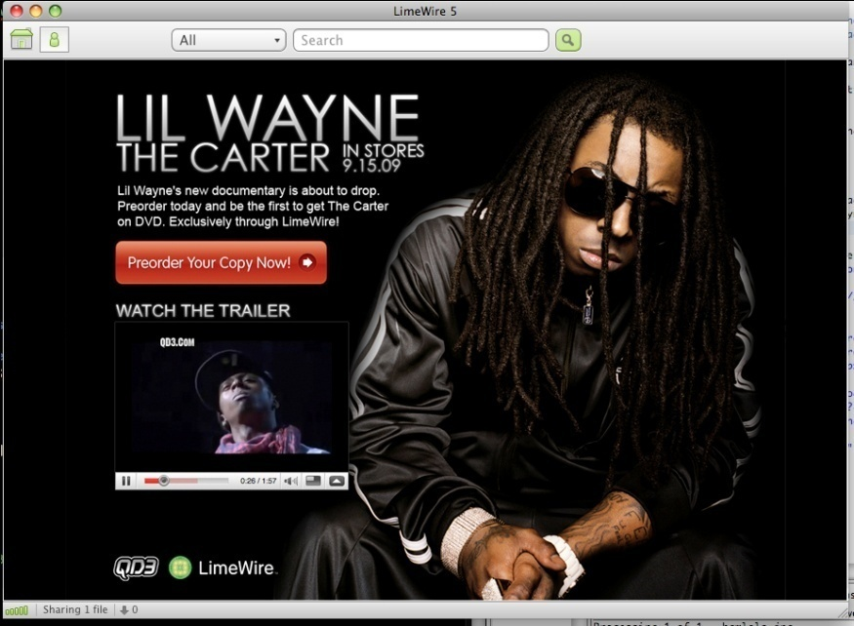
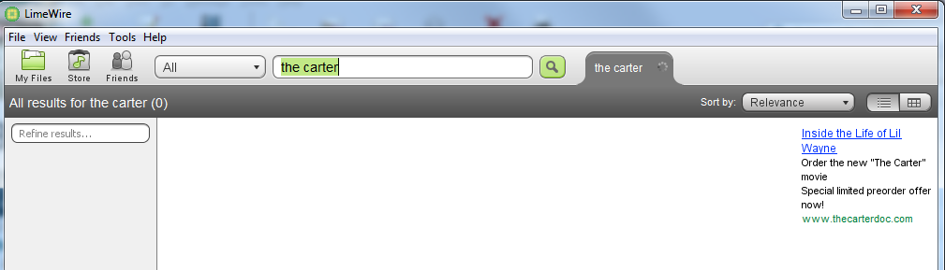
Cross Promotion: Lil Wayne Featured artist
Limelinks in search results
Notes:
QD3/The Carter
Goals:
- Promote pre-release of The Carter documentary (Sundance)
- Try some modifications of a more traditional ad experience
How it worked
- ….
What we learned
- Still analyzing data, pleased so far
- Great to work with partners like QD3/Quincy
Worked with Quincy Jones III and his company QD3 to promote their documentary, “The Carter” about Lil Wayne
Quincy thinks outside the box and really sees the opportunity inherent in P2P, so it was a pleasure to work with them.
Used a combination of search responsive ads and low-impact display units.
Differs from Converse in that rather than pushing the content in front of the user, the user comes to the content.

Slide 13
LimeWire Monetization Strategy
 |  | LimeWire Software |  | LimeWire Store
Product/E-Commerce |  | Freemium model: LimeWire Basic and |  | Launched in 2007
Subscription |  | Starting now |  | 3 tiers
Display Advertising |  | Pilot phase in Client |  | N/A
Search Advertising |  | LimeWire Toolbar |  | LimeLinks

Slide 14
Monetization Strategies at LimeWire
Zeeshan Zaidi, COO
March 9, 2010

