Slide 1
The Glass Half Full The Untapped Promise of File Sharing Networks

Slide 2
A decade of video on the Internet
2001 2002 2003 2004 2005 2006 2007 2008 2009 2010

Slide 3
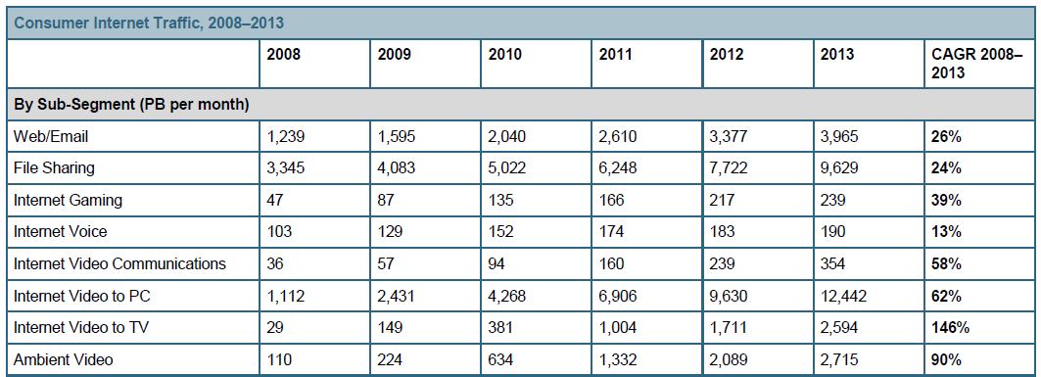
Explosive growth in internet video is predicted…
Source: Cisco Visual Networking Index, 2009

Slide 4
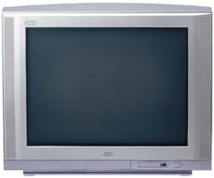
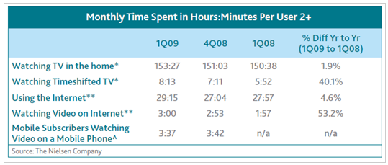
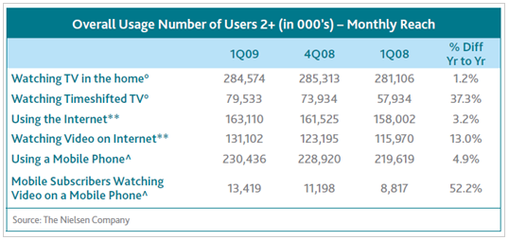
Yet people still watch comparatively little Internet video…
~99% of video watched in the US is still TV

Slide 5
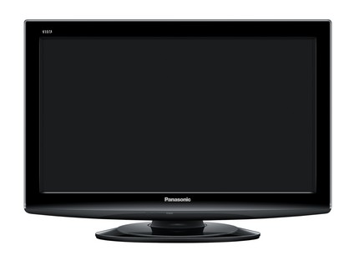
…but this will change as more content becomes available and as the viewing device changes:

Slide 6
BitTorrent
BitTorrent is:
A vast network of consumers using software “clients” and websites to get content and rely on each other for bandwidth
BitTorrent, Inc is:
mainline
“the world’s original BitTorrent client”
“the world’s favorite BitTorrent client”

Slide 7
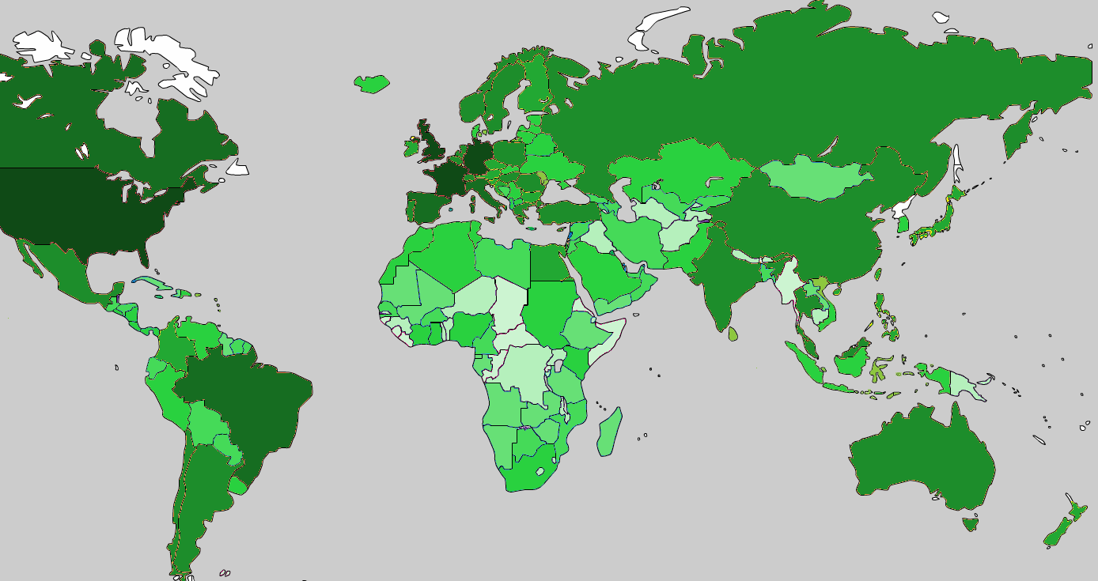
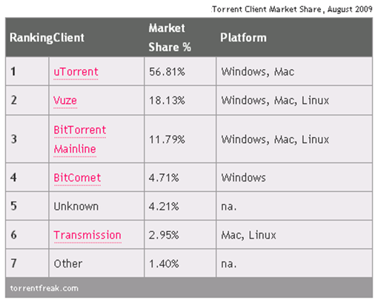
The BitTorrent Ecosystem
A global phenomenon
Dozens of alternative software clients
Thousands of websites
Well over 100m active users
Market Saturation
Low
High
100
10k
1M
>10M
* Share assumes dedicated BitTorrent software, not BitTorrent-capable software like Opera web browsers and P2P clients from Limewire, Xunlei, and others.
Probably well over 200m active BitTorrent-capable clients

Slide 8
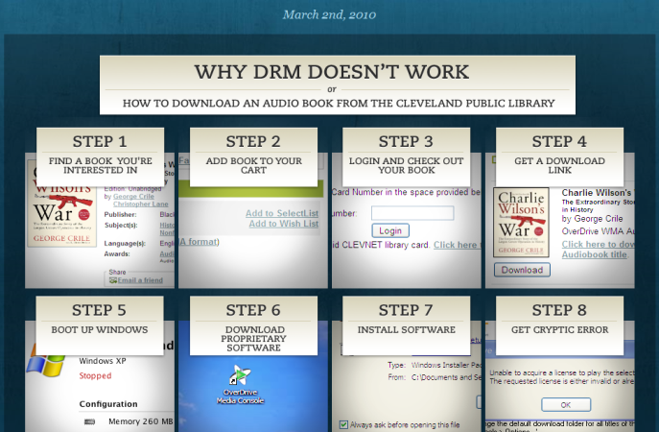
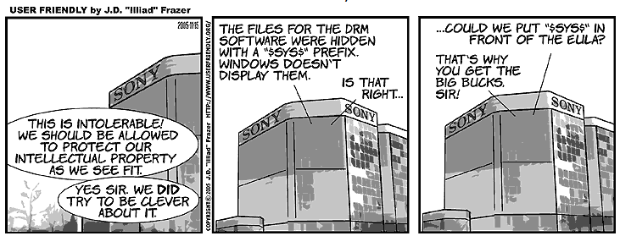
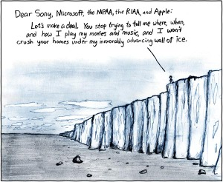
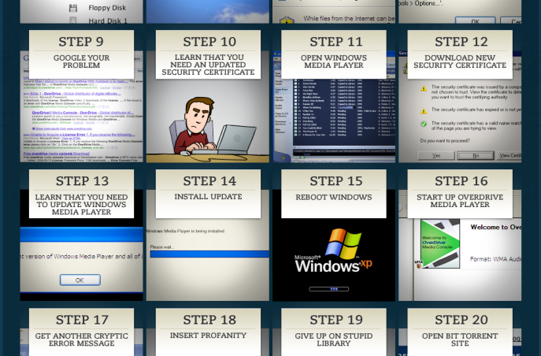
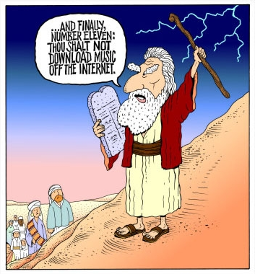
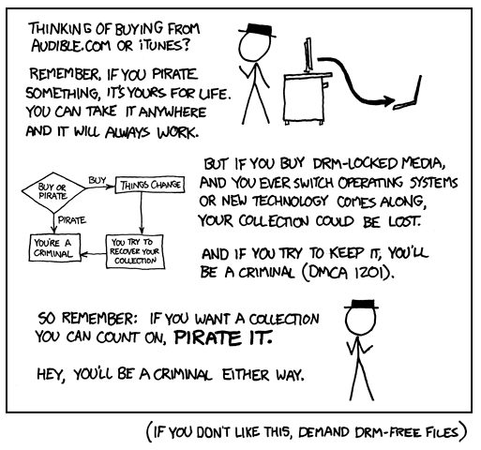
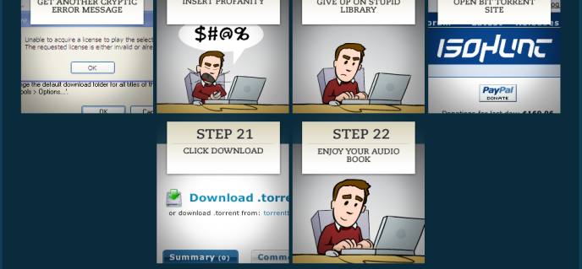
Consumers are evidently frustrated with the slow pace of change in the media industries

Slide 9
Filesharing has been around for a long time…
…and is very likely here to stay

Slide 10
What’s the problem?
What will people pay for???
Actually, the fundamentals haven’t changed:
Value
Scarcity
But, the Internet has changed something very fundamental about media scarcity…

Slide 11
What’s the solution?
Every media industry is looking for how to deal with the “scarcity crisis” brought on by the Internet
BitTorrent, Inc. is no different
Most important is to extract a rent for something other than a static set of 1’s and 0’s

Slide 12
What we’re doing for consumers
Make BitTorrent much more accessible to consumers
Web-based interface
Secure access from any connected device
Streaming – point/click/watch, not point/click/wait

Slide 13
What we’re doing for publishers
Adapt BitTorrent ecosystem to Publishers
Presentation fully in control of publishers
Access directly to consumers (70+M)
Access to consumer affinity groups (BT exposes “affinity” networks, not social networks)
Better stats (for publisher-sanctioned distribution)
And of course, user-contributed bandwidth
Notes:
.

Slide 14
The opportunities and challenges presented by the future are exciting
Thankyou
And BitTorrent is looking to provide some pieces of the way forward

