Slide 1
DIGIMELD SOLUTIONS
DigiMeld, Inc.
http://www.digimeld.com
134 W37th St., 2nd Fl.
New York, NY 10018
Copyright © 2008 -2009 DigiMeld, Inc.

Slide 2
About DigiMeld
Company Background
Seasoned management team
Run by serial entrepreneur Alex Mashinsky
Launched in 2008
Operations
Headquartered in New York, NY
R&D center in Shenzhen, China (ex-QQ Live product managers)
10 full time employees
Technology
B2B and B2B+C content distribution network enabling companies to distribute broadcast quality video over IP
Patent pending technology for disruptive live and on-demand Internet video streaming
Copyright © 2008 -2009 DigiMeld, Inc.

Slide 3
What We Do
DigiMeld enables content owners and broadcasters to reliably and cost-effectively transmit their HD programming, over IP, to cable operators, end users and online portals around the globe.
Copyright © 2008 -2009 DigiMeld, Inc.

Slide 4
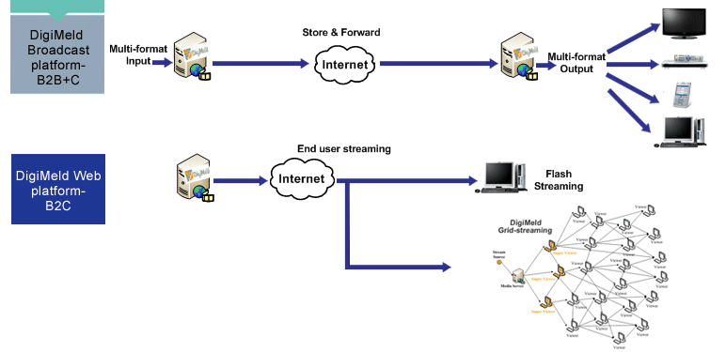
The DigiMeld Ecosystem
Copyright © 2008 -2009 DigiMeld, Inc.

Slide 5
DigiMeld Broadcast Platform
B2BBroadcast to Multiple Platforms over IP - B2B+C
Copyright © 2008 -2009 DigiMeld, Inc.

Slide 6
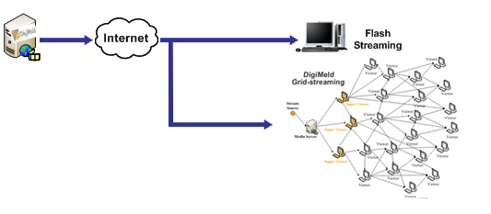
DigiMeld Web Platform
Solution Stack
- Live chat while watching - Community/Forum/Web 2.0 - Subscription and pay-per-view - Digital right management - Flexible ad placement - Geo-filtering/targeting - Real-time viewer statistics/reporting - SEO
Live Streaming | VOD + CDN Hybrid
Copyright © 2008 -2009 DigiMeld, Inc.

Slide 7
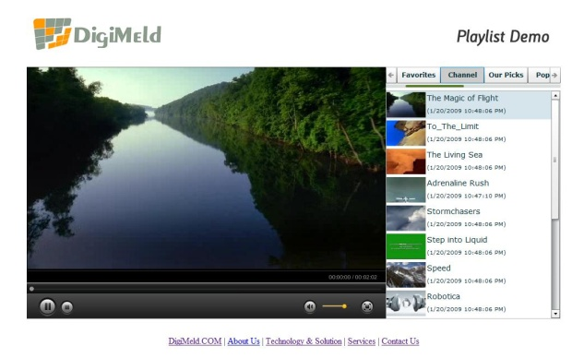
DigiMeld Web Platform (Flash Streaming)
Flash-streaming Platform - B2C
DigiMeld provides an HD or SD Flash streaming solution for customers with basic streaming requirements
Features adaptive bit-rate streaming capability
DigiMeld’s player can be fully customized and easily integrated onto your site
Enjoy full control over your video library with DigiMeld’s easy to use content management
Copyright © 2008 -2009 DigiMeld, Inc.

Slide 8
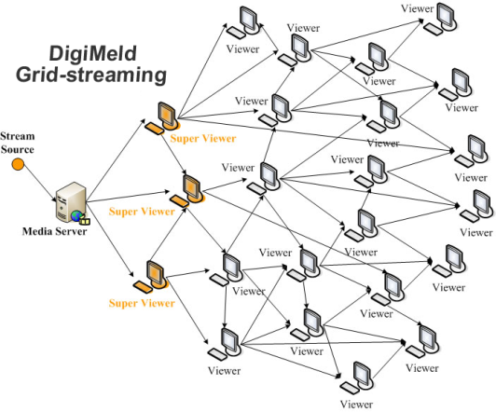
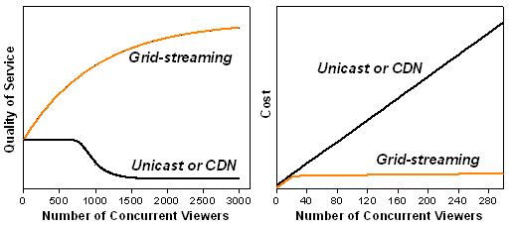
DigiMeld Web Platform (Grid Streaming)
Grid-streaming Platform - B2C
DigiMeld enables millions of concurrent viewers with both live and VOD capabilities
DigiMeld platform and solution provides 50-80% bandwidth reduction and cost savings
More viewers = Lower cost and better quality
High cost advantage over traditional CDN-based streaming of HD content while supporting up to 10 million concurrent viewers
Copyright © 2008 -2009 DigiMeld, Inc.

Slide 9
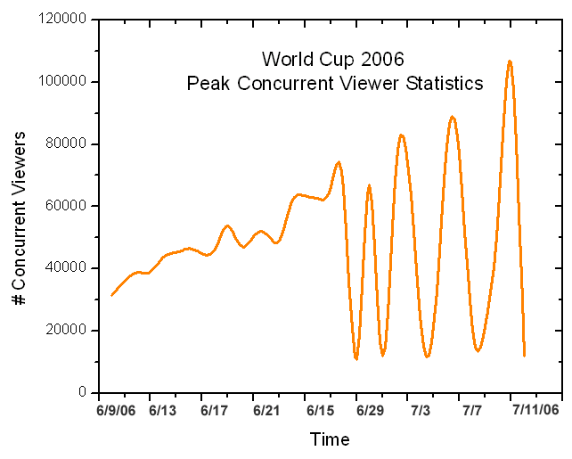
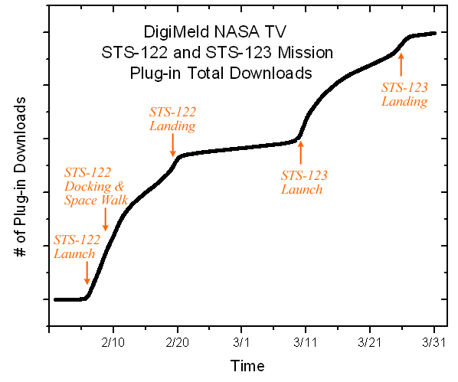
Proven Grid Technology
World Cup 2006
She chart to the right demonstrates the successful test of DigiMeld’s technology in China during rebroadcasts of the World Cup games in 2006. This extended test provided a unique opportunity to stress test the DigiMeld platform and optimized with concurrent viewers exceeding 1,000,000.
NASA Live Public Channel Broadcasting
Plug-in Downloads around 100,000 with minimum promotion. Positive viewer comments from around the world.
VOD – Sina TV and Samsung Set-top-box
The VOD solution has been adopted by Sina.com (China’s #1 Internet portal) and Samsung for their new Set-top-box.
Copyright © 2008 -2009 DigiMeld, Inc.

Slide 10
Thank you!
Contact:
Alex Mashinsky
CEO
(646) 552-4499
alex@mashinsky.com
Copyright © 2008 -2009 DigiMeld, Inc.

