Slide 1
UltraBand
Content Delivery Platform

Slide 2
Agenda
Content Delivery Platform
Internet Content Caching
CDN: Premium Services
UB5000 Product

Slide 3
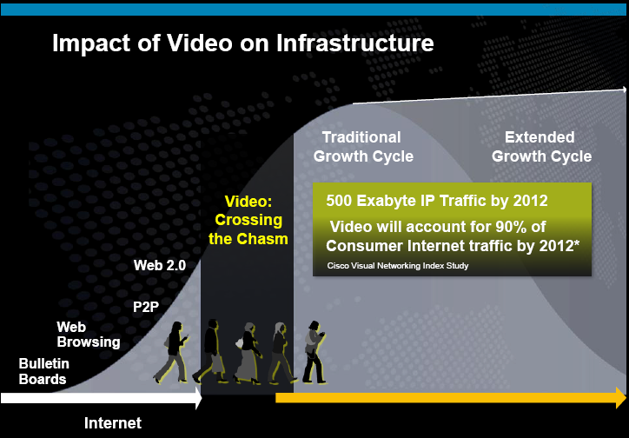
Broadband Model Disruption
“Crossing the Video Chasm”
Margin Erosion
ARPUs are stagnant, the OPEX and CAPEX network costs are rising, payback of network investment is uncertain
Bit Pipe
Operators to get into the Internet video value chain, to fend off threats from competition and over-the-top providers, to increase their subscribers stickiness
Supply & Demand Gap
Operators invest into next-gen broadband, yet depend on Internet services to make use of the capacity and drive adoption of top-tier packages
Source: Cisco Systems 2009
ARPU
Margins
Cost

Slide 4






UltraBand: Content Delivery Platform
Premium Services
Internet TV, Premium OTT, CDN
Network Optimization
Core & backhaul savings through edge delivery
Improvements of aggregation network utilization
Access network convergence
Content Acceleration
Improved content delivery times
Elimination of video buffering
Quality improvement for dynamic bitrate
Reporting
& Telco BI
Internet applications SLA and classification
Content, device and subscriber profiling
Service Delivery
Tiered policies by subscriber, time-of-day, Internet service
Content filtering & control
CDN content management
Best Effort Services
YouTube, filesharing, software updates

Slide 5
UltraBand CDP
Solution Overview
Web 2.0 File sharing
Internet
Common platform for delivery of best effort OTT services and SLA services
“Open Garden” support
  Distribution of OTT services
  IP CDN
  TV Everywhere
Clustered software solution based on COTS hardware
Flexible network integration options
  1G to 40G scale
  Router/DPI integration
  Seamless scalability
WebTV
IP Core
Best effort
WebTV
SLA services
Aggregation Network
UltraBand
5
Notes:
5

Slide 6








“Open Garden”
Single Policy Framework
Mrs. Smith
$
Ms. Johnson
$$
Mr. Williams
$$$
Jones Family
$$$$
Premium
Delivery
Best Effort
Delivery
Blocked

Slide 7
Company Profile
Customers growing by 15%/quarter; 90% annual revenue growth
The leader in carrier-grade content delivery, Internet/OTT video caching and traffic management
Planned:
Content Delivery Solution
>100 Customers
Profitability
2010
2009
UltraBand 20Gbps Launched
75 Customers
EU Patent in Video Caching
and P2P Acceleration Granted
30 Customers
2008
US Patent in Video Caching
and P2P Acceleration Granted
20 Customers
P2P W e b 2 . 0
2007
2006
UltraBand with HTTP Video
10 Customers
2005
UltraBand Launched (P2P)
2004
PeerApp USA Established
Boston HQ

Slide 8


PeerApp: Global Reach
London
Boston
Tokyo
Miami
Hong Kong
Bogota
Singapore
Sao Paolo
PeerApp HQ
PeerApp Offices
PeerApp Customers
Over 100 Customers and Growing Rapidly
200 Systems installed around the world
16M Users serviced
16 PB/M content delivered from cache

Slide 9
Content Delivery Platform
Overview
Cost Containment
Reduce network costs by up to 30% through saving of network opex and capex costs
Reduce churn by improving broadband service levels
ARPU Growth and Differentiation
Increase competitiveness and stickiness by combining broadband with premium content
Launch new Internet-based services
ARPU
Margins
Cost

Slide 10
Agenda
Content Delivery Platform
Internet Content Caching
CDN: Premium Services
UB5000 Product

Slide 11
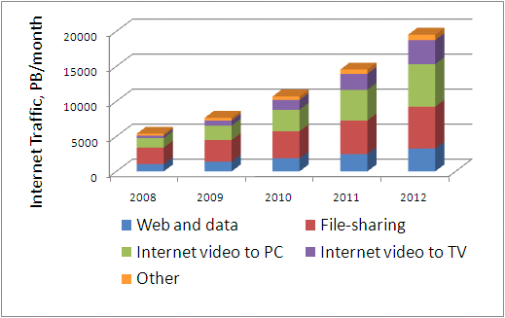
Internet Content Caching
Recovery of Backhaul Bandwidth
Operators face growth of bandwidth consumption at the rate of 50-100% year-over-year, driven by video and other large Internet content
Operators are required to continue investing into network equipment and capacity, while ARPU is static
UltraBand offers consistent rates of backhaul capacity recovery, holding down the growth
Reduces backhaul provisioning by meeting “flashcrowd” demand
Maintains service level in time of backhaul capacity degradation
Flashcrowd Peak
Cache
Backhaul
Transit Link Failure
11
Notes:
11

Slide 12
Caching 2.0
History and Relevance of Internet Caching
Caching 1.0 became irrelevant as bandwidth consumption of interactive Web became stagnant and networks caught up
Caching 2.0 focuses on video and media applications, that drive up consumption through quality increases and show no signs of abatement
PeerApp is only Caching 2.0 vendor to offer transparent caching of all Caching 2.0 services and protocols in one engine
12
Notes:
12

Slide 13
Internet Content Caching
Internet Quality of Experience
ISP subscribers look at throughput based KPIs as a main measure of ISP service level
Touting of “blazing speeds” is the main branding mechanism for ISPs to upsell subscribers to top-tier broadband packages
Cache
Backhaul
Caching of popular content within access network allows network operators to accelerate and control subscribers QoE
Caching SLAs depend on last mile and aggregation network capacity only
Last mile upgrade
13
Notes:
13

Slide 14
Internet Content Caching
Application SLA impact
Application Type | Acceleration Impact
Progressive download | Near-100% reliability for SD content, no freezes and buffering Enablement of HD content
Dynamic playback streaming (HTTP/FMS/WMS) | Improved video quality
File sharing (P2P/HTTP) | Faster completion of downloads Enablement of larger content objects
App downloads | Faster completion of downloads “Instantaneous delivery”
Web browsing | Faster web page load times (<10 sec.)
Automatic software updates | None
14
Notes:
14

Slide 15
Legal Compliance
DMCA “Safe Harbor”
US DMCA (1998) act has put forward legislation protecting network operators from liability for routing, caching and hosting 3rd party Internet content
The detailed procedural requirements of DMCA has been adopted globally including EU E-commerce directive (2000)
The transparent caching architecture of UltraBand 5000, is fully compliant with the procedural DMCA “safe harbor” requirements
US DMCA 512b Section Terms | UltraBand 5000
The ISP is not the one who originally made the material available | 100% Compliance
Caching is automatic, intermediate and temporary storage of content in local servers | 100% Compliance
ISP did not modify the content | 100% Compliance
ISP complies with industry standards regarding the updating of the content | 100% Compliance
ISP does not interfere with content’s access manners (such as passwords, etc.) | 100% Compliance
Provider must remove infringing files upon gaining actual knowledge of infringement | 100% Compliance

Slide 16
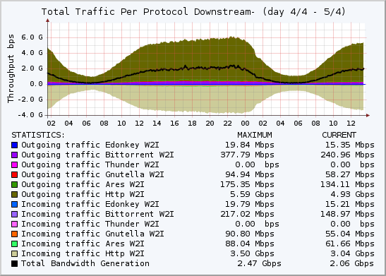
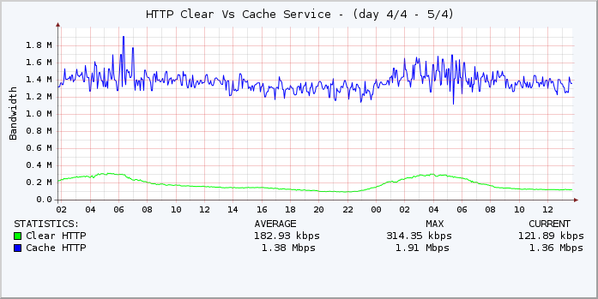
Case Study #1
Tier2 cable operator in Central America
International transit 50$/Mbps per mo.
250,000 subscribers
Total 6Gbps to subscribers, 2.5Gbps from cache
40% byte hit ratio
Network integration: PBR
System: UB5000-100 (recently upgraded from UB5000-25)
Average session throughput 1.4Mbps, peak of 2.0Mbps
2x improvement after recent introduction of top-tier 6Mbps broadband package
16
Notes:
16

Slide 17
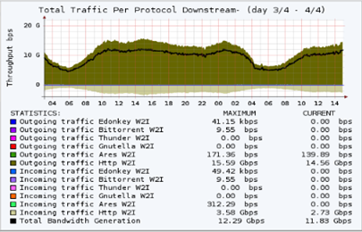
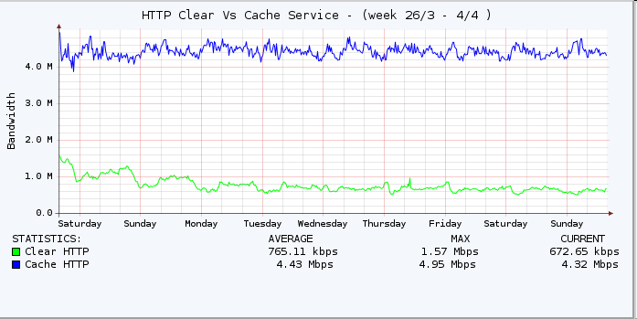
Case Study #2
Tier1 multi-play operator in Asia Pacific Rim
International transit 40$/Mbps per mo.
3,500,000 subscribers
Total 16Gbps to subscribers, 12.25Gbps from cache
75% byte hit ratio
Network integration: PBR, selective video redirection
System: custom UB5000-100
Average session throughput 4.5Mbps, peak of 5Mbps
5x acceleration compared to sessions delivered over transit
17
Notes:
17

Slide 18
Internet Content Caching: Fixed Networks
Network Costs
Last mile & aggregation
Upgrading last-mile and aggregation networks (e.g. telco migration away from ATM to Ethernet), is responsible for up to 70% of network expense
IP core
The operators owning their own IP core infrastructure are facing expensive upgrade to 40G/100G
Operators serving remote markets are forced to lease expensive circuits running into these areas
IP transit
In many geographies away from terrestrial Internet hubs, the IP transit costs remain high and peering is unavailable
UltraBand
UltraBand
18
Notes:
18

Slide 19
Internet Content Caching: Mobile
Network Costs
Downstream radio
Unlike Web browsing, the video is not chatty and doesn’t lend itself well to multiplexing, leading to suboptimal RF utilization
Mobile backhaul
Aggregation of from geographically dispersed cell to mobile core requires equipment and circuit investments
3.5G/4G mobile drives up capacity demands
UltraBand
Mobile packet core
For many operators, the high-capacity packet core either not built out or requires upgrade
SGSN/GGSN became expensive network choke points and require ongoing upgrades
IP transit
In high-cost transit geographies, IP transit is a significant network cost component
19
Notes:
19

Slide 20
Content Delivery Platform
Internet Content Caching
CDN: Premium Services
UB5000 Product

Slide 21
Telco CDN
Taxonomy of use cases 2009
Use cases | Consumer market | Service model | Client form factor
 |  |  | STB | PC | Mobile
A | B2C B2B2C | Live television
B | B2C | Operator’s own “walled garden” VoD / Catch-up TV
C | B2C | Partners’ “walled garden” VoD / Catch-up TV
D | B2B2C | Partners’ OTT Web services
E | - | Over-the-top “best effort” traffic
F | B2C | Mobile “walled garden”
What’s New
Convergence of use cases
CDN is not a business model but access network capability
New use cases involving over-the-top services
Use of Internet delivery technologies
21
Notes:
21

Slide 22
Telco CDN
Delivery Models
Internet Content Caching
Edge content element sits in path between subscribers and OTT content sources
OTT CDN intermediation
Edge content element intermediates delivery between OTT CDN or origin server
  Live streaming
  Edge caching
IP CDN cloud
Content is ingested by “on-net” CDN
CDN offers load balancing of users and content within “on-net” cloud
CDN may pre-position content at content element or employ caching
22
Notes:
22

Slide 23
UltraBand CDP
Network Architecture
Three delivery models are optional
“On-net” CDN cloud requires centralized component
  Ingestion point and content vault
  Load balancing
Unified reporting and management for all three modules
  Internet content caching
  CDN intermediation
  CDN cloud
23
Notes:
23

Slide 24
Telco CDN
Ecosystem
Horizontal integration is required to enable solution flexibility and to support multiple use cases and business models
  Online video player (MoveNetworks, BrightCove, thePlatform)
  DRM
  Billing
  Ad insertion and ad campaign management
OVP
DRM
Billing
Ad insertion
CDP
24
Notes:
24

Slide 25
Content Delivery Platform
Internet Content Caching
CDN: Premium Services
UB5000 Product

Slide 26
UltraBand
Clustered System Architecture
Deploys in conjunction with network element: router/DPI/application switch
Based on standard x86/iSCSI hardware
Scales cache engines and storage arrays as needed
Common namespace of up to 72TB of unique SAN based content shared by all cache engines
N+x cache engine redundancy through cache engine interchangeability
Dedicated out-of-band management server
26

Slide 27
UltraBand
Transparent Media Caching
ISP subscriber requests a file
Internet content source
1
Network Element
ISP Subscriber
3
2
Cache serves request locally
in same transaction
The content source agrees to the transaction
ISP
Internet
UltraBand
Network element redirects a session to UltraBand based on L4 or L7 inspection
UltraBand propagates the content request to the content source at all times, and inspects the response to verify cached content freshness and availability
UltraBand maintains IP and application transparency for both subscriber and server side
In case of “cache hit”, UltraBand delivers the requested content object within the session established between the subscriber and Internet content source
In all other cases, UltraBand forwards packets between two session endpoints “as is”
27

Slide 28
UltraBand
Connection Management
Non-cacheable
Cacheable: Other
Cacheable: Cache Miss
Cacheable: Cache Hit
Traditional cache proxy architecture uses application-level proxying to forward traffic between ISP subscribers and Internet
As a result, cache TCP stack becomes the bottleneck, limiting both bandwidth throughput and number of flows that single cache engine can support
Cache proxy products achieve up to 700 Mbps and 20-40,000 flows per engine
Cache proxy architecture cannot support peer-to-peer applications that establish up to 500 connections per download session
UltraBand implements selective TCP termination on “cache hit” flows only, allowing it to scale to 2.5Gbps throughput and 500,000 flows per engine
All other flows are forwarded as is, using TCP stack of endpoints
28

Slide 29
UltraBand
Fault Tolerance
Redundant upstream connectivity
8x GigE redundant data ports per cache engine
Optional data switch redundancy
Redundant power supplies
N+x cache engine redundancy
Redundant iSCSI connections
Dual storage controllers
29

Slide 30
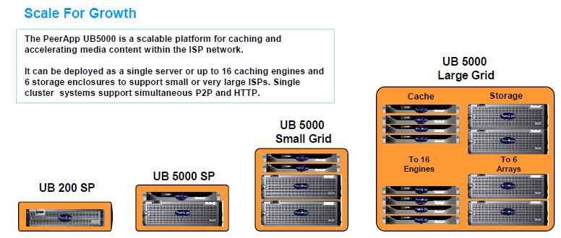
UltraBand
Product Family Overview
Models | UB200-SP | UB5000-SP | UB5000-05 | UB5000-10 | UB5000-25 | UB5000-50 | UB5000-100
Platform Description | Standalone platform | Standalone platform | Clustered platform with SAN storage | Clustered platform with SAN storage | Clustered platform with SAN storage | Clustered platform with SAN storage | Clustered platform with SAN storage
System Capabilities
System Throughput | 0.9 Gbps | 1.8 Gbps | 2.5 Gbps | 5 Gbps | 10 Gbps | 18 Gbps | 32 Gbps
Cache Engines | 1 | 1 | 1 | 2 | 4 | 8 | 16
SAN Storage Arrays | 0 | 0 | 1 | 2 | 3 | 4 | 6
Storage Capacity | 6TB SATA | 12TB SATA | 9 TB SAS | 18TB SAS | 27TB SAS | 36TB SAS | 42TB SAS
30

Slide 31
UltraBand
Protocol Support Matrix
 | Internet Content Caching | Content Delivery
HTTP | Progressive download Adaptive playback Microsoft Silverlight Adobe Zeri Apple Pantos Web filesharing & network storage Automatic software update services Mobile apps download Web 2.0 services | Progressive download Adaptive playback Microsoft Silverlight Adobe Zeri Apple Pantos
P2P | Bittorrent eDonkey Gnutella / Gnutella2 Ares Pando | -
Streaming | - | Flash Media Streaming 3GPP

Slide 32
UltraBand
Caching Engine Features
Single content engine for all protocols
  Assures best platform utilization across changes in traffic mix
  Enables deployments with constrained footprint requirements
Automatic self-configuration for all services, no performance tuning required
Support for very large content store (72TB / 8 million objects)
Advanced caching algorithms applied at content ingestion and expulsion to maximize storage performance
Granular bandwidth and acceleration control policies
Support for DMCA content takedown
Content filtering and cache control framework

Slide 33
UltraBand
Content Control Framework
Content class groups together multiple objects that share same control action
Reporting at granularity of content class
Content identified using
  Subscriber and/or server IP
  URL strings and regular expressions
  3rd party category (McAfee SmartFilter)
Transactions in each content class can be redirected to custom Web page, for captive portal and content control
Intuitive XML configuration for all content control policies
Content Class
URL group
IP addresses
Content Category (SmartFilter)
Content Directive
Redirect | Block
Bypass | Allow

Slide 34
UltraBand
Management and Monitoring
Dedicated out-of-band management server
  Monitoring of system KPIs and status
  Content and subscriber statistics
  XML configuration
  System management
Management interfaces
  SSH-based CLI
  UBView Web dashboard
  SNMP v2c agent
  Lights-out management
Reporting
  Web-based statistics archive
  Exportable transaction log (CDR)
Alerting
  SNMP traps
  Syslog
  Event log

Slide 35
UltraBand Everywhere
Network Deployment Options
Fixed
BRAS node
DSL aggregation
IP/MPLS service island
Transit gateway
Wireless
GGSN
Distributed Internet breakout
35

Slide 36
Network Element Integration
Policy-based routing (PBR)
PBR functionality supported in hardware in most ISP routers, with zero impact on router CPU
Minimum redirection cost
ISP in control of traffic redirection: what networks, what types of traffic
All known and delay-sensitive traffic classes are not affected at all (known TCP ports, UDP-based VoIP)
Supports network failover - router stops redirection when cache fails
Redirection of P2P and HTTP using L4 configuration
  HTTP tcp/80
  P2P tcp/1025-tcp/65536
Sessions of non-cacheable protocols are bridged in fast path with minimum latency

Slide 37
Network Element Integration
PBR with Grid System
UltraBand grid configurations (UB5000-10/25/50/100) utilize Etherchannel to load balance traffic across multiple cache engines
Cisco EtherChannel implementation supports session affinity to link, providing low-cost load balancing
Cisco Catalyst routing switches support 1G and 10G upstream connectivity
Each UltraBand engine is equipped with fail-to-wire card, that is activated in case of cache engine failure
37

Slide 38
Network Element Integration
DPI Redirection
Redirection of traffic based on signature-driven granular L7 classification of flows
DPI redirects flow from the packet that triggers the classification of flows as cacheable
The combined solution operates at Layer2, transparently to ISP routers and applications
DPI provides load balancing between multiple cache engines
Supported DPI vendors
  Allot NE2540 & Service Gateway
  Arbor Ellacoya e100 with ISM
  Sandvine PTS 8210/14000/24000
38

Slide 39
UltraBand: CDN support
Virtualization and Multi-Tenancy
Resources | Algorithms | Policies
Bandwidth limit | Explicit content management | Bandwidth SLA per subscriber class
Storage quota | Pre-population | Access control by IP, time-of-day and subscriber
 | Scheduled content removal | Subscriber-aware content redirection
Notes:
39

Slide 40
Thank You

