Slide 1
Locality aware P2P delivery: the way to scale Internet Video
Jin Li
Microsoft Research

Slide 2
Outline
The Upcoming Video Tidal Wave
Internet Infrastructure: Data Center/CDN/P2P
P2P in Microsoft
Locality aware P2P
Conclusions

Slide 3
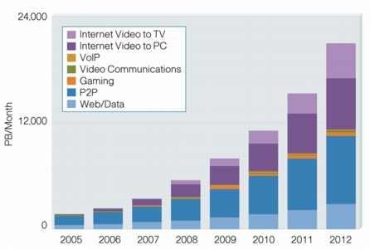
Video Will Become the Dominant Traffic On Internet
Source: Cisco

Slide 4
Internet Infrastructure: Data Center
DC
Massive data center
Good for: computation intensive application, e.g., Search.
Not good for: massive content delivery (too much stress on the network)

Slide 5
Internet Infrastructure: CDN
CDN
DC
Content delivery network
Sites strategically placed all over the world
Hundreds plus servers per site
Good for:
Form a high speed network core of the Internet
latency sensitive/throughput hungry application
Serve tail content

Slide 6
Internet Infrastructure: P2P
P2P
CDN
DC
P2P
Peer contributes resource (network bw, CPU, memory, hard drive)
Good for:
Throughput intensive app: improve server scalability, use locality to improve throughput to the end peers
Good for distributing popular content

Slide 7
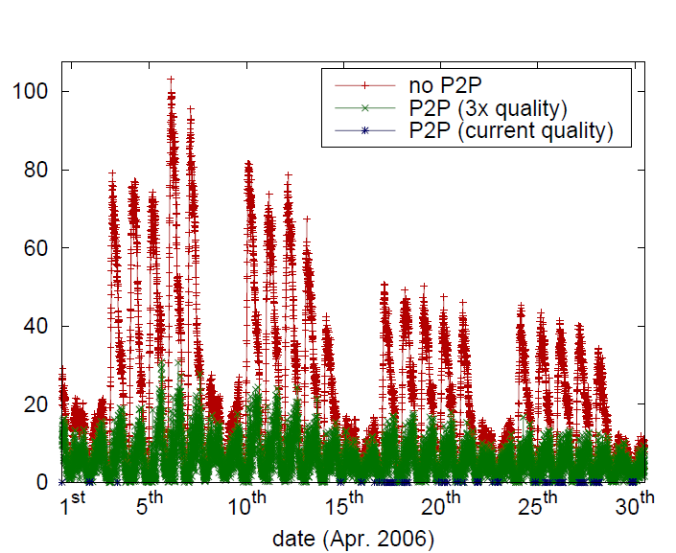
P2P vs. CDN: Peak & Trough

Slide 8
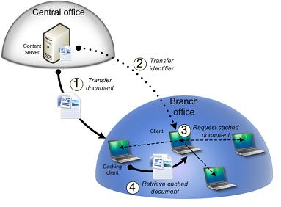
Branch Cache: An Infrastructure Less P2P Solution

Slide 9
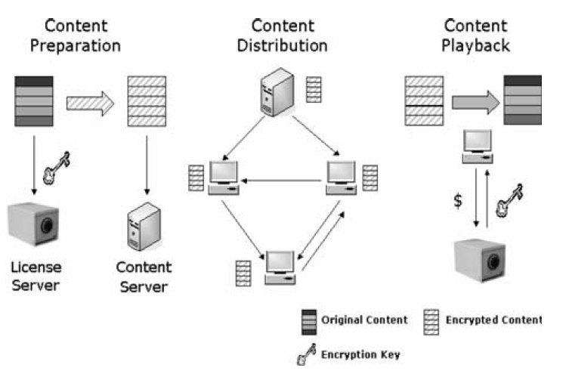
P2P & DRM : Seperating Content Delivery & Authentication

Slide 10
P2P & ISP
P2P is the main driving force for broadband adoption
P2P affects QoS levels for ALL subscribers
P2P represents 60% of Internet traffic and still growing
92% of P2P traffic crosses transit/peering links
80% of upstream capacity is consumed by P2P
As content provider uses P2P to deliver content, their costs are being passed onto service providers

Slide 11
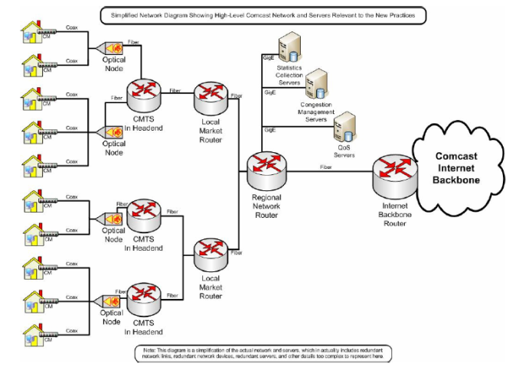
Internet Architecture
Internet
Backbone
Local Access
Network

Slide 12
P4P Architecture

Slide 13
Conclusion
Peer assisted delivery is the way to go for mass content delivery over the world
Peer assistance can significantly reduce server bandwidth requirement
Demonstrated in real world for file sharing & broadcast
Locality aware P2P delivery is the way to scale

